Slide 1

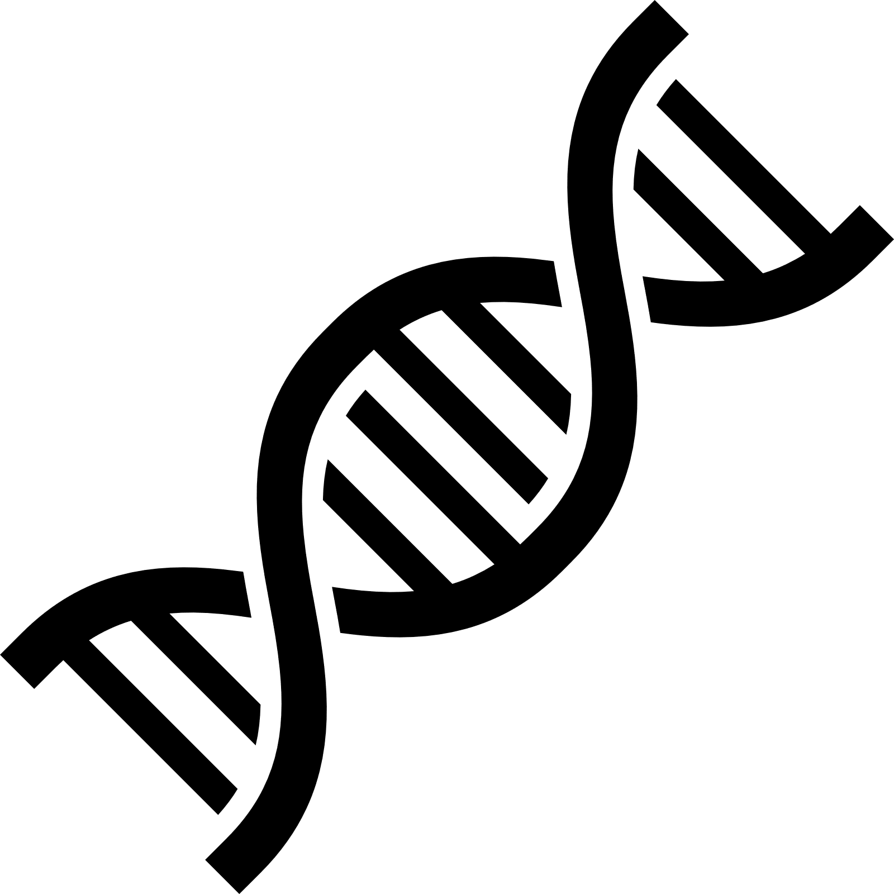

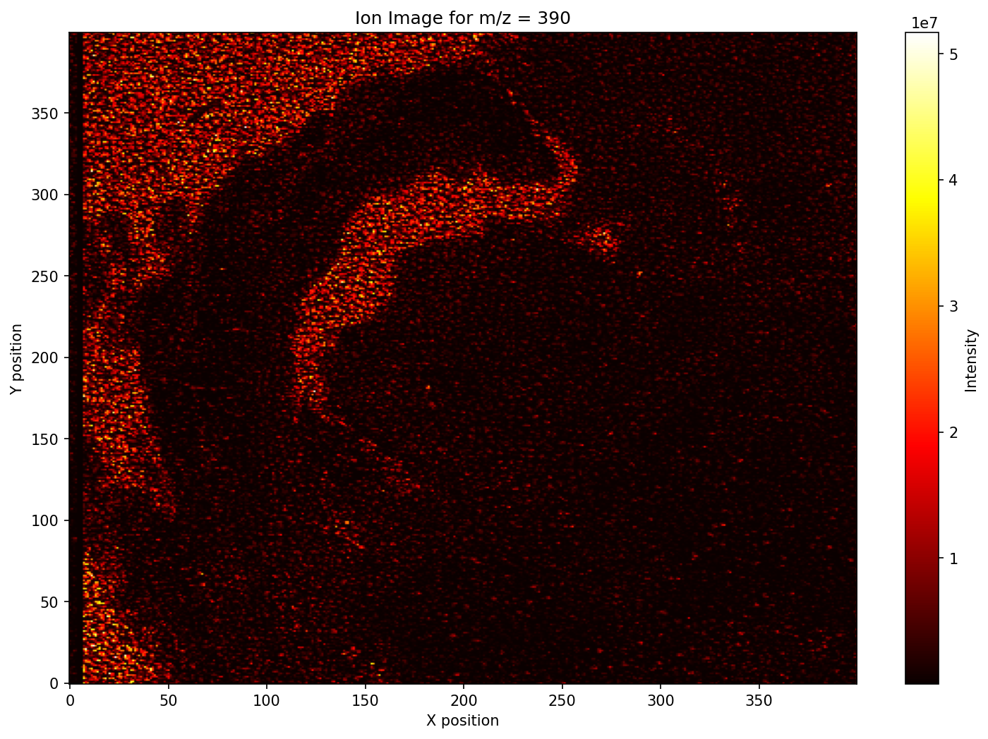
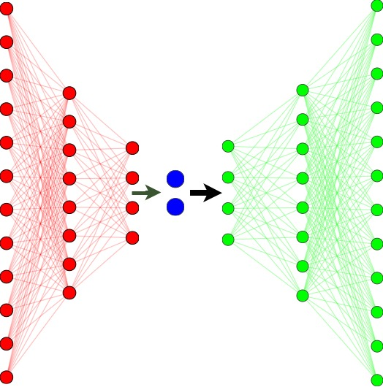
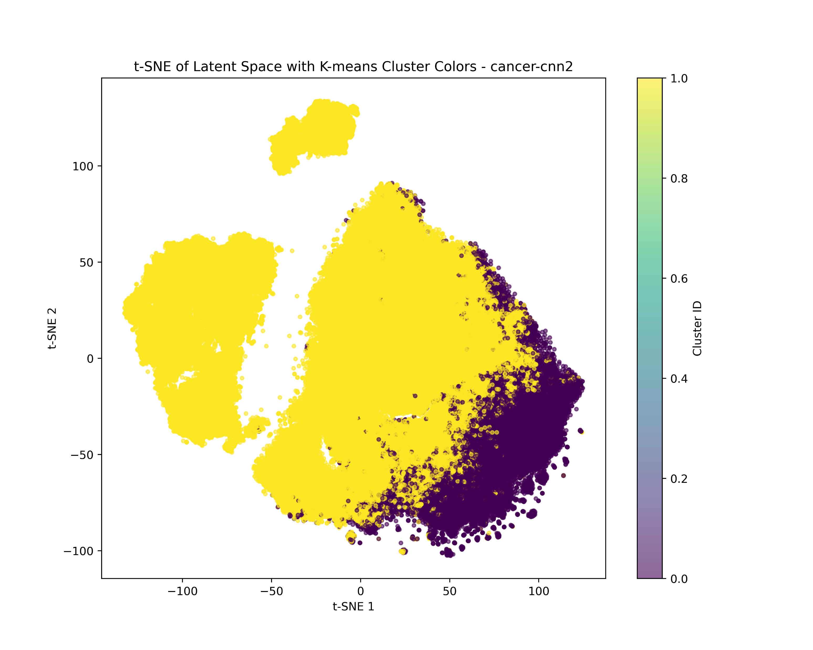
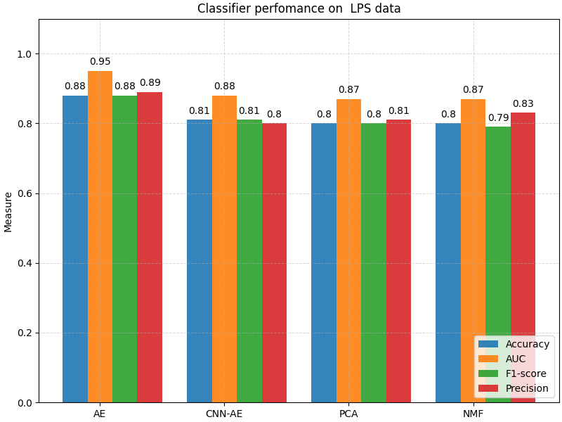

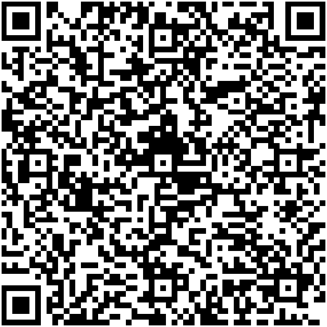

Presenter
Tapiwa Mazarura
Supervisors:
Dr Devon Jarvis
Dr Hairong Bau
Can neural networks extract biological information from mass spectrometry data?
Background
The Promise: Mass Spectrometry Imaging (MSI) is revolutionizing medicine. It allows us to map the spatial distribution of molecules in tissue, aiding in disease detection (like cancer), drug monitoring, and compound annotation.
The Data Structure: Imagine a digital image, but instead of just Red, Green, and Blue, every single pixel contains a spectrum of thousands of chemical values. This creates a massive 3D Data Cube (X, Y, m/z) that is sparse, noisy, and incredibly complex.
The Bottleneck: Traditional methods struggle to handle this complexity. We need a way to compress this massive "cube" into essential features without losing the biology
Methods
Preprocessing: We cleaned the raw spectra using binning, Total Ion Current (TIC) normalization, and feature scaling to remove noise and technical artifacts.
The Contenders: We pitted deep learning against traditional math:
  Baselines: PCA (Linear) & NMF (Matrix Factorization).
  Challengers: Deep Autoencoder (AE) & 1D Convolutional Autoencoder (CNN-AE).
The Strategy: We trained the Neural Networks to compress the spectra into a tiny "latent space" (200 features) and then reconstruct them. We used a special Weighted MSE Loss to force the AI to focus on chemical peaks, not just empty space.
Raw cancer tissue section at m/z ratio 390 Da.
Autoencoder architecture (Encoder -> Latent Space -> Decoder)
The t-SNE plot of the CNN-AE (the one with distinct islands). The CNN-AE separates biochemical profiles into distinct, clean clusters.
Results
Generalization to Unseen Data: The Fully-Connected AE achieves the highest predictive performance (AUC 0.87), proving it captures robust, transferable features.

