Slide 1
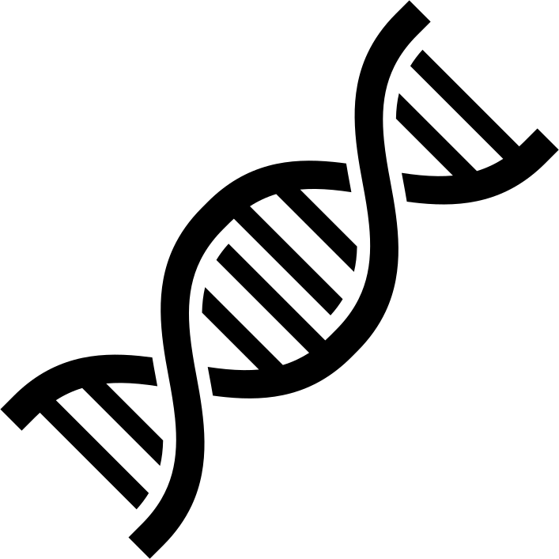
Can Neutral Networks learn biological patterns
from Mass Spectrometry data?

