Slide 1
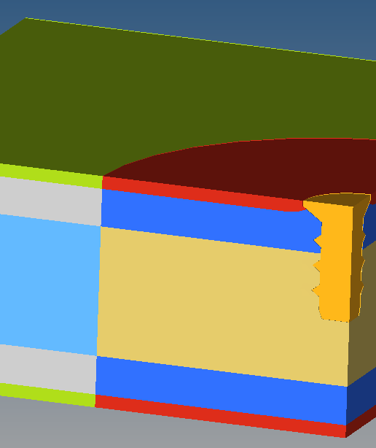
Predicting screw pull-out failure in particleboard
Nonlinear FEA material modelling and validation for furniture design
Tapiwanashe Phiri
Master's thesis with IKEA of Sweden
Notes:
[Sources]
- Source report, pp. 1 and 44; Figure 30 (finite element pull-out model). Co-authored thesis by Tapiwanashe Phiri and Niklas Björkman.

Slide 2
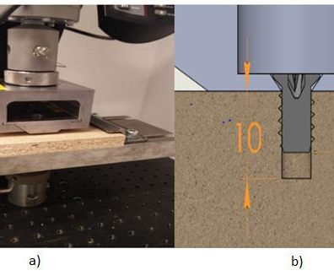
THE ENGINEERING PROBLEM
A small connector can determine whether furniture survives daily use
Screw withdrawal strength affects product safety, durability and assembly. Physical testing is reliable - but expensive to repeat for every design.
Goal
370 N
Build an LS-DYNA model that predicts failure before physical prototypes are made.
measured mean pull-out force
TAPIWANASHE PHIRI / ENGINEERING PORTFOLIO
02
Notes:
[Sources]
- Source report, pp. 9-12, 30-31 and 45; Figure 18 (experimental pull-out setup). Experimental data were supplied by IKEA; the thesis authors did not conduct the tests.

Slide 3
MY CONTRIBUTION
I co-developed a disciplined validation route before modelling the final failure
01
Defined particleboard behaviour
Translated layered, direction-dependent material behaviour into FEA inputs.
02
Built three candidate models
Evaluated LS-DYNA material formulations and damage approaches.
03
Validated in stages
Tested single elements, mesh sensitivity, tensile, shear and bending cases.
04
Modelled screw pull-out
Built contact, symmetry and local-damage definitions around a EURO screw.
05
Diagnosed limitations
Linked premature failure to shear data, mesh size and damage-zone assumptions.
TAPIWANASHE PHIRI / ENGINEERING PORTFOLIO
03
Notes:
[Sources]
- Source report, pp. 12, 32-50. Work was completed jointly by the two thesis authors.

Slide 4
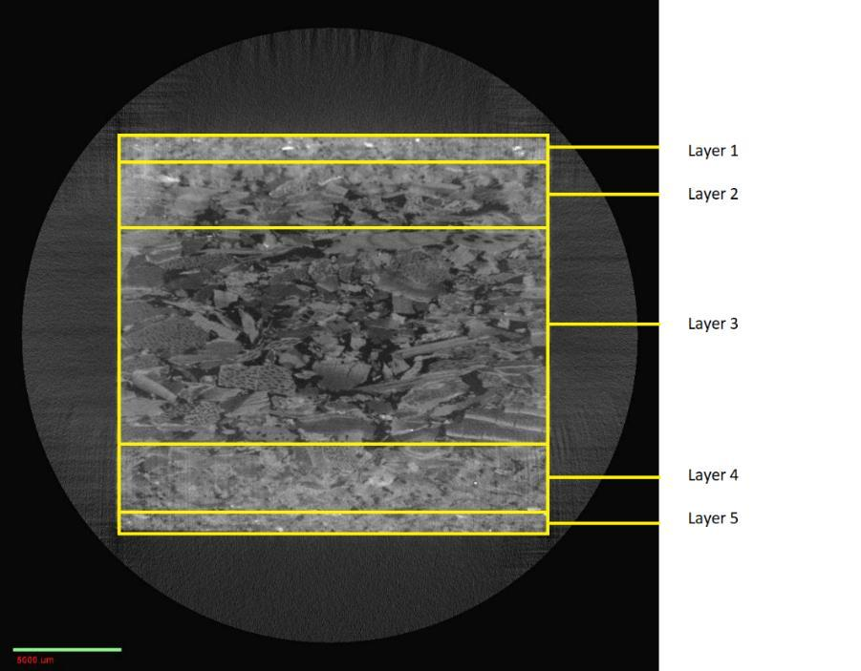
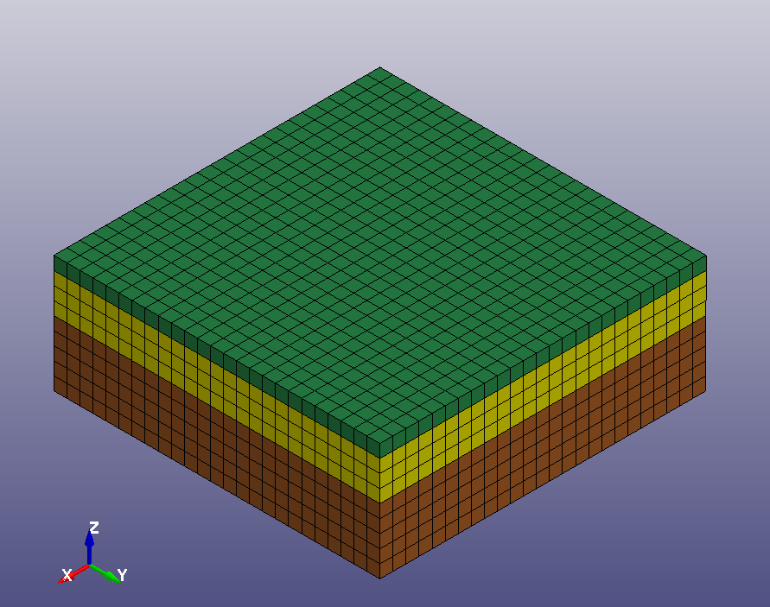
MODEL CONSTRUCTION
Layered models captured how particleboard behaves in different directions
Real material
Five layers with different densities
Simulation
Layer-specific properties and aligned material directions
TAPIWANASHE PHIRI / ENGINEERING PORTFOLIO
04
Notes:
[Sources]
- Source report, pp. 13-15 and 38; Figures 3 and 23. Recommended visuals: Figure 3 to explain particleboard's layered structure and Figure 23 to show how it was represented in FEA.

Slide 5
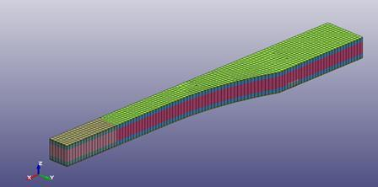
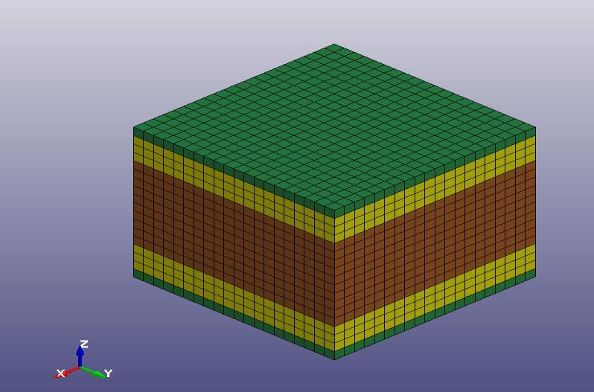
VALIDATION RESULTS
The new models reached 86 - 100% accuracy on core load cases
MODEL 2
MODEL 3
99%
99%
tensile
tensile
86%
98%
shear
shear
100%
86%
bending
bending
TAPIWANASHE PHIRI / ENGINEERING PORTFOLIO
05
Notes:
[Sources]
- Source report, pp. 39-41; Table 4 and Figures 24-25. Model 2: tensile 99%, shear 86%, bending 100%. Model 3: tensile 99%, shear 98%, bending 86%.

Slide 6
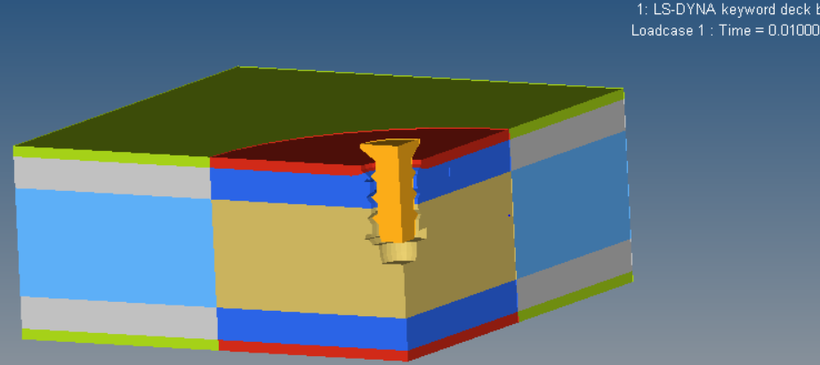
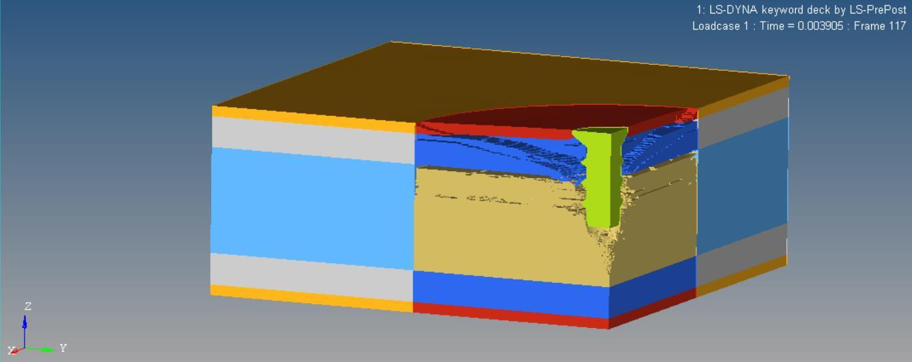
CRITICAL FINDING
Pull-out exposed the gap between a good fit and a robust model
Experimental
370 N
Model 2
Model 3
122 N
96 N
33% accuracy
26% accuracy
Why it mattered
Premature shear failure and mesh-dependent crack growth showed the model needed better shear data—not cosmetic tuning.
TAPIWANASHE PHIRI / ENGINEERING PORTFOLIO
06
Notes:
[Sources]
- Source report, pp. 45-49; Table 5 and Figures 32-33. Recommended visuals: Figures 32 and 33 side-by-side to show how mesh density changed crack propagation.

Slide 7
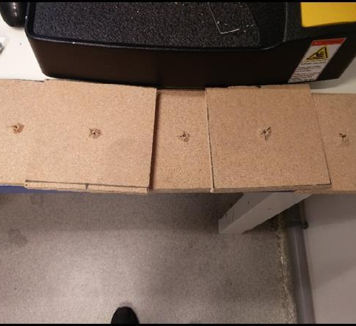
ENGINEERING JUDGEMENT
I showed where simulation could be trusted—and where it could not.
The current IKEA model matched pull-out force at 99% for one damage area, but was sensitive to modelling assumptions and inaccurate in pure shear. The new models generalised better across standard loads but under-predicted pull-out.
What this demonstrates
Nonlinear FEA • Material modelling • Validation strategy • Root-cause analysis
Portfolio case study by Tapiwanashe Phiri
Notes:
[Sources]
- Source report, pp. 44 and 47-50; Figure 29. Recommended visual: Figure 29 to connect simulated damage with the physical pull-out crater. Model 4 achieved 99% for the 18 mm damage area but showed damage-area dependency and poor pure-shear performance.

