Slide 1
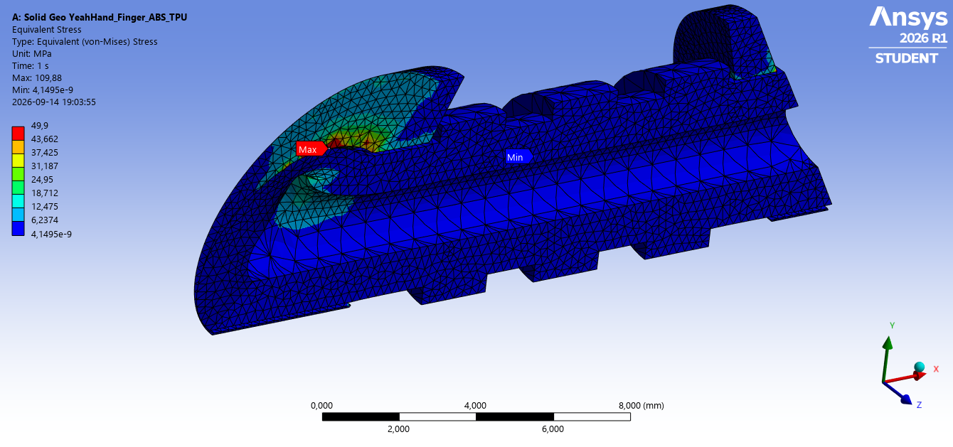
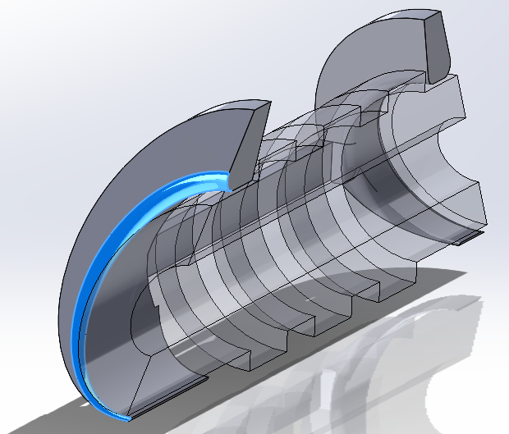
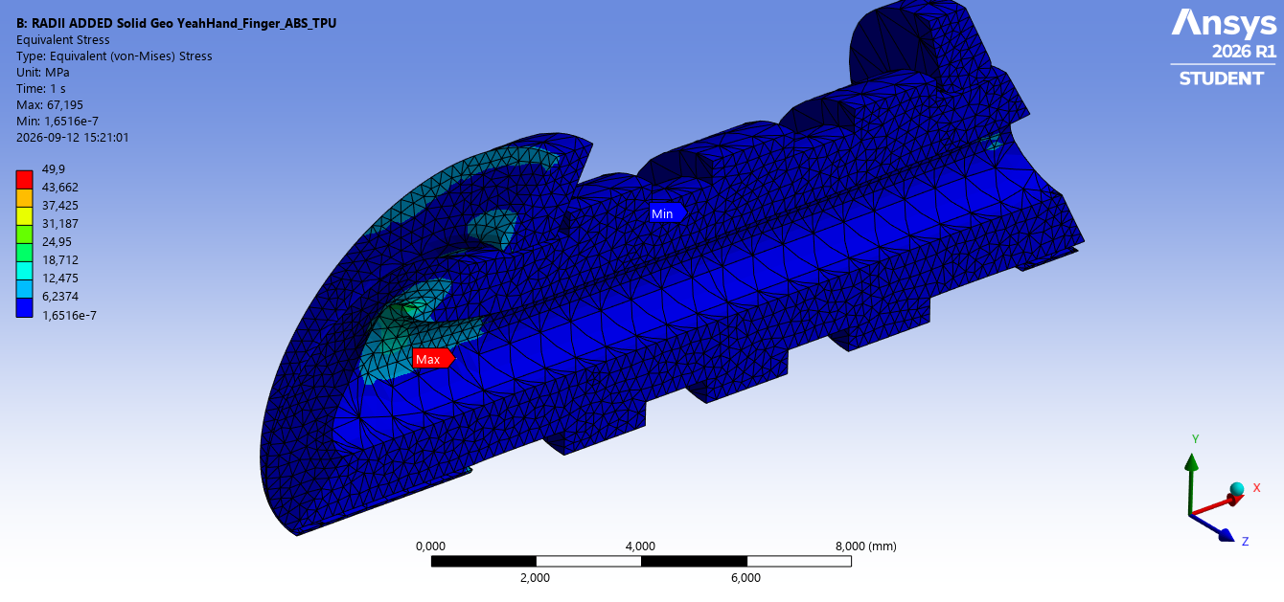
Tendon-Driven Robotic Hand - FEA Failure Investigation
ABS/TPU finger structure | Structural simulation, failure localization and geometry redesign
Engineering objective
Identify why the 3D-printed ABS finger was cracking around the TPU tendon-channel exit, reproduce the failure region in FEA, and redesign the local load path without adding unnecessary mass.
My contribution
Outcome
• Prepared/simplified CAD for structural analysis.
• Defined ABS-TPU contact, supports, symmetry and tendon loading.
• Refined the critical region and interpreted von Mises stress.
• Implemented and evaluated a radius-based redesign.
• Baseline breakage zone stress: 38-49 MPa.
• Critical breakage-zone stress after 0.3 mm radius: 18-24 MPa.
• Critical breakage-zone stress reduced from 38-49 MPa to 18-24 MPa.
• The 0.3 mm radius moved the critical zone below the stated injection-molded ABS yield range and into/near the expected FDM ABS range.
Redesign result shown in ANSYS Mechanical; display contour capped at 49.9 MPa for visibility.

Slide 2
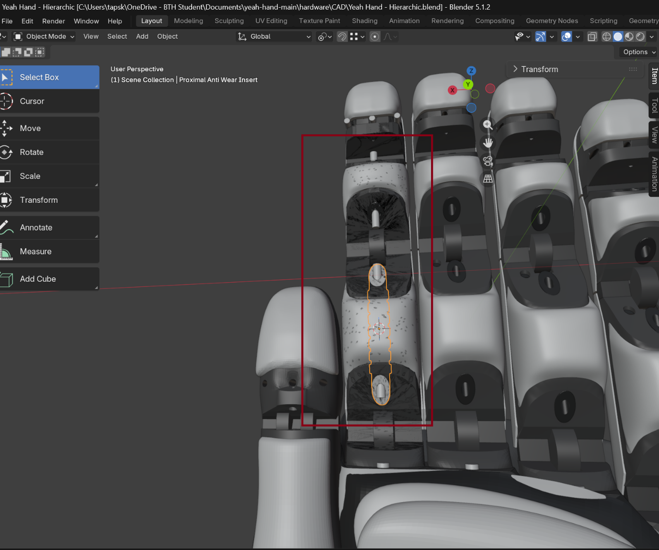
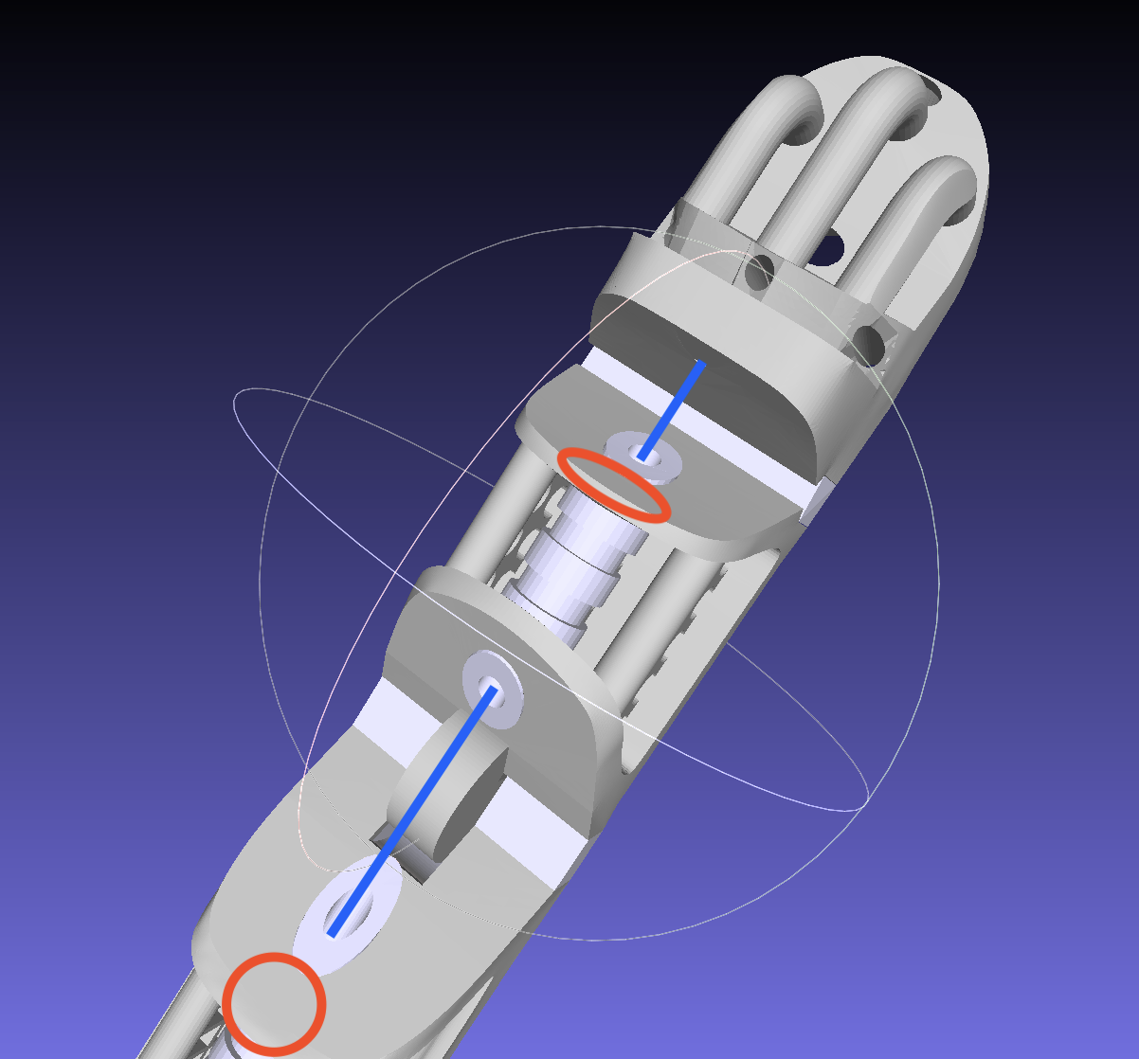
1 | Problem Definition & Component Function
The finger combines a rigid load-bearing polymer structure with a compliant tendon-routing feature.
ABS structure
TPU tendon canal
• Provides the rigid finger geometry and primary structural load path.
• Transfers tendon reaction forces into the finger body.
• Observed physical failure occurred near the tendon-channel exit.
• Provides a compliant routing surface for the actuating tendon.
• Interfaces directly with the rigid ABS structure.
• TPU remained intact while the surrounding ABS was the critical region.
Design question
Failure hypothesis
• Can the local geometry be modified so the tendon reaction spreads into a larger volume of ABS, reducing the stress concentration while preserving the tendon path and finger function?
• Abrupt geometry/material transition concentrates load locally.
• Tendon reaction is transferred from compliant TPU into rigid ABS.
• Local yielding can initiate deformation and subsequent cracking.

Slide 3
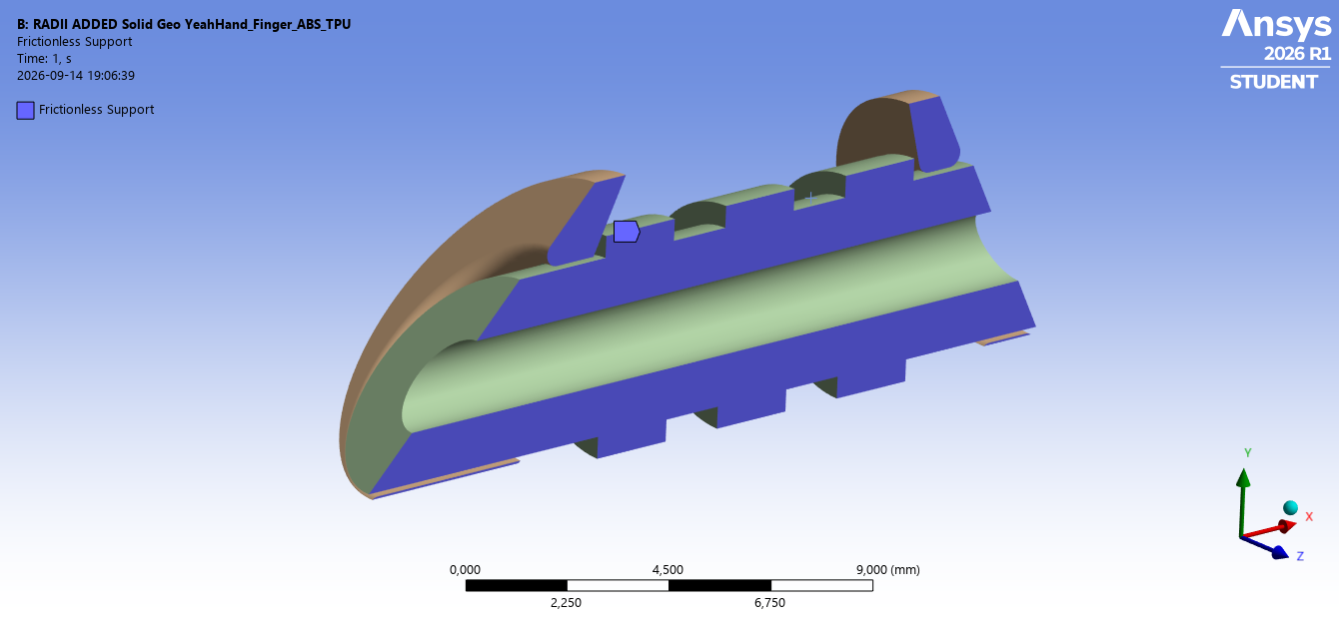
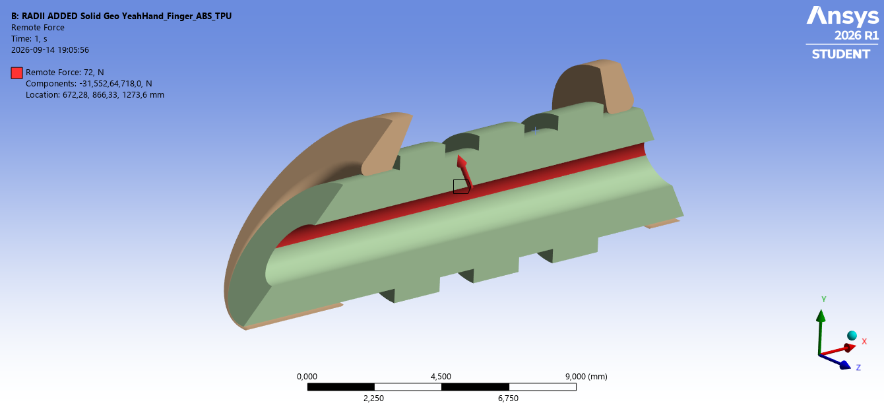
2 | FEA Model & Boundary Conditions
Static structural model established as a repeatable comparison baseline.
Model setup
Loading
Load-model caveat
• ANSYS Mechanical static structural analysis.
• Separate ABS and TPU bodies with bonded interface.
• Symmetry represented with a frictionless support on the cut plane.
• Bottom ABS mounting interface fixed in all directions.
• Local mesh refinement used around the tendon exit and material transition.
• Remote force applied to the TPU tendon-load face.
• Baseline force: 72 N.
• Force direction aligned with the tendon pulling direction in the model.
• 72 N retained across design iterations so geometry changes can be compared directly.
• Servo specification provided: 25 kg·cm ≈ 2.45 N·m torque.
• Tendon radius: 0.8 mm.
• Actual tendon tension also requires the effective servo horn/spool radius.
• Therefore 72 N is a controlled baseline, not yet the final validated service load.

Slide 4
3 | Baseline Finding - Local Stress Concentration
The simulation reproduced a mechanically plausible failure zone at the tendon-channel exit.
Baseline result
Material interpretation
Engineering decision
• Critical physical breakage-zone stress: approximately 38-49 MPa in the baseline model.
• High-stress region localized around the ABS adjacent to the tendon-channel exit.
• The rest of the structure remained comparatively low stressed.
• This points to a local load-path problem rather than a need to thicken the entire finger.
• Injection-molded ABS tensile yield strength: approximately 29.6-48 MPa.
• Injection-molded ABS tensile break/ultimate strength: approximately 29.8-43 MPa.
• FDM ABS is typically lower and process-dependent; a practical comparison range is about 20-35 MPa.
• Baseline breakage-zone stress of 38-49 MPa is therefore consistent with a high risk of local yielding/cracking, especially for FDM material.
• Target the geometric discontinuity at the tendon exit.
• Add a 0.3 mm local transition radius to reduce the stress concentration.
• Keep the same boundary conditions and load for an apples-to-apples redesign comparison.

Slide 5
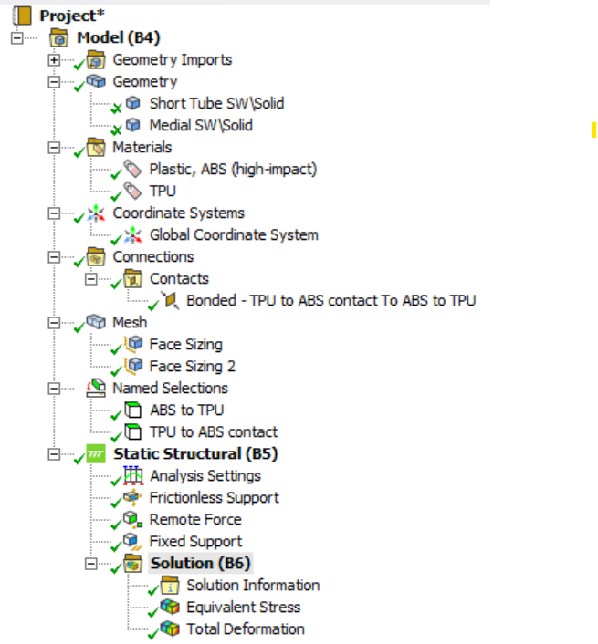
4 | Redesign Iteration - Added Transition Radius
A 0.3 mm local transition radius substantially reduced stress in the physical breakage zone.
38-49 MPa
Baseline breakage zone
18-24 MPa
0.3 mm radius
37-63% reduction
Important: evaluation is focused on the known physical breakage zone, not the model’s absolute global maximum. The displayed contour limit is a visualization setting.
Interpretation
• The 0.3 mm radius smooths the local load path and reduces the breakage-zone stress from 38-49 MPa to 18-24 MPa.
• The redesign removes the original 38-49 MPa hotspot from the physical failure zone; final acceptance still requires the actual printed ABS material/process allowable.

Slide 6
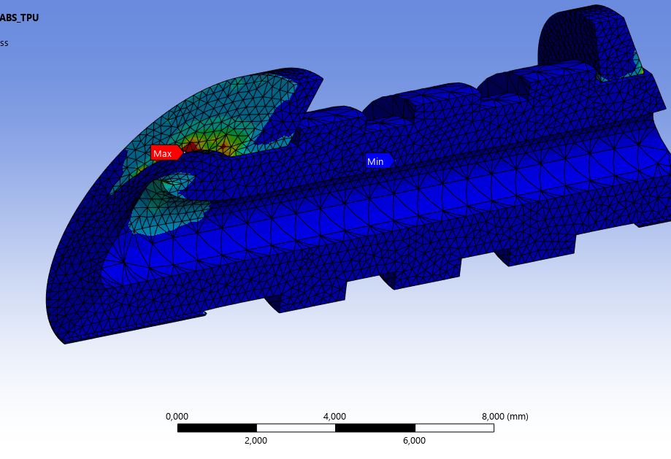
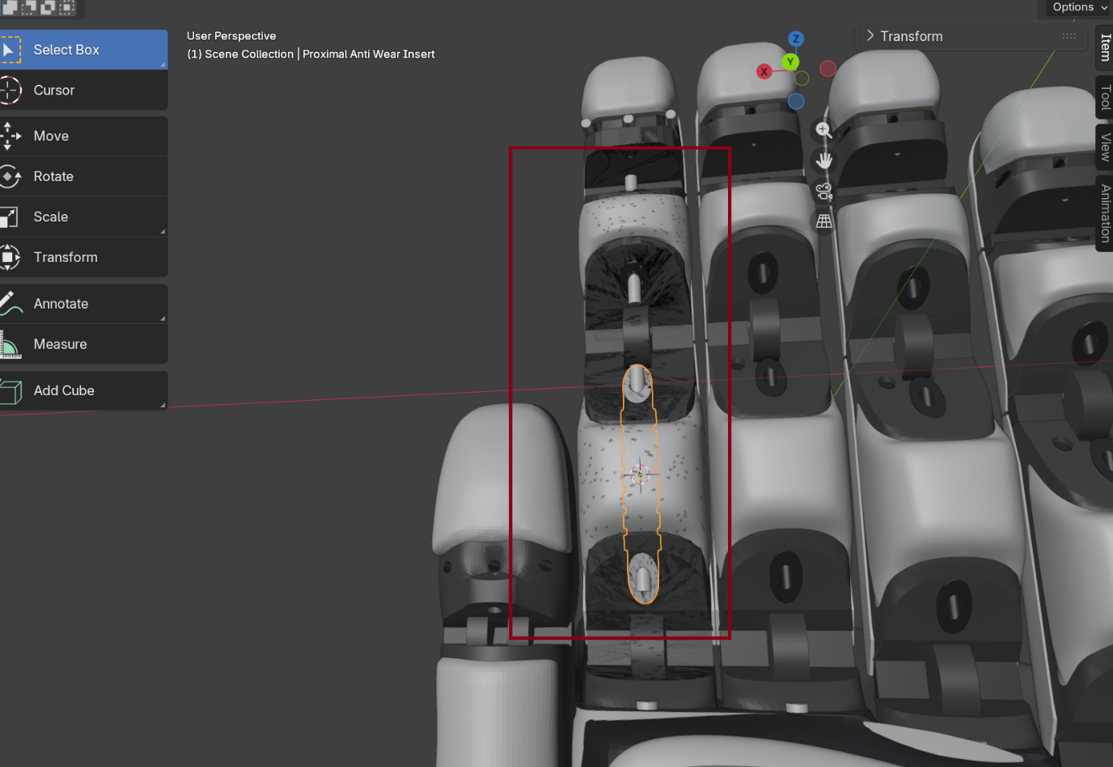
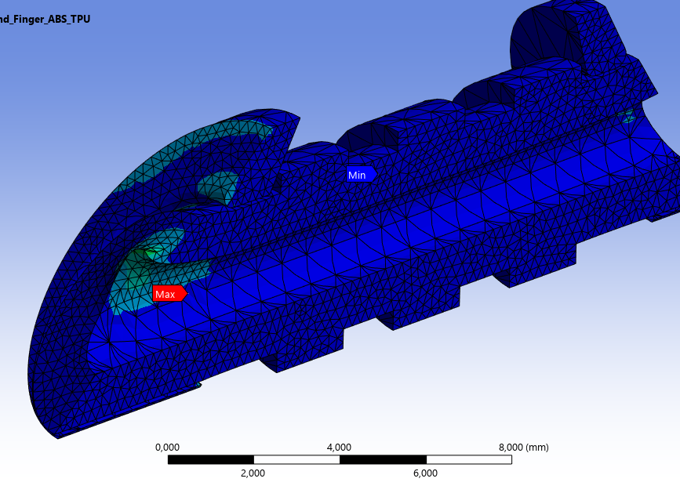
5 | Engineering Conclusion & Design Recommendation
Case closed: a 0.3 mm radius at the ABS tendon-canal transition is the recommended design solution.
A. Root cause confirmed
B. Corrective action — 0.3 mm radius
C. Result — solution validated
• Physical failure occurs at the ABS transition beside the TPU tendon canal.
• Baseline FEA shows 38-49 MPa in the known breakage zone.
• Added a 0.3 mm fillet at the critical ABS transition.
• Smooths the load path without changing tendon routing or overall finger architecture.
• Critical-zone stress reduced to 18-24 MPa.
• ≈37-63% reduction versus baseline.
• Removes the original failure-producing stress state.
Baseline breakage zone: 38-49 MPa
Local geometry change: R = 0.3 mm
Redesigned breakage zone: 18-24 MPa
RECOMMENDATION ✓ Implement the 0.3 mm radius at the ABS tendon-canal exit for the next physical build.
Engineering outcome: observed failure → FEA root-cause correlation → targeted 0.3 mm fillet → critical-zone stress reduced to 18-24 MPa → design recommendation.

