Slide 1
The magic behind the offside detection in football
Presented by: Daniel-Cristian-Marian Țăpuși

Slide 2
What is the offside?
A player is offside if they are nearer to the opponent's goal than the second-last defender and the ball
Human referees and VAR are prone to errors and delays
Goal: Present the mathematical approach behind the offside detection using computer vision

Slide 3
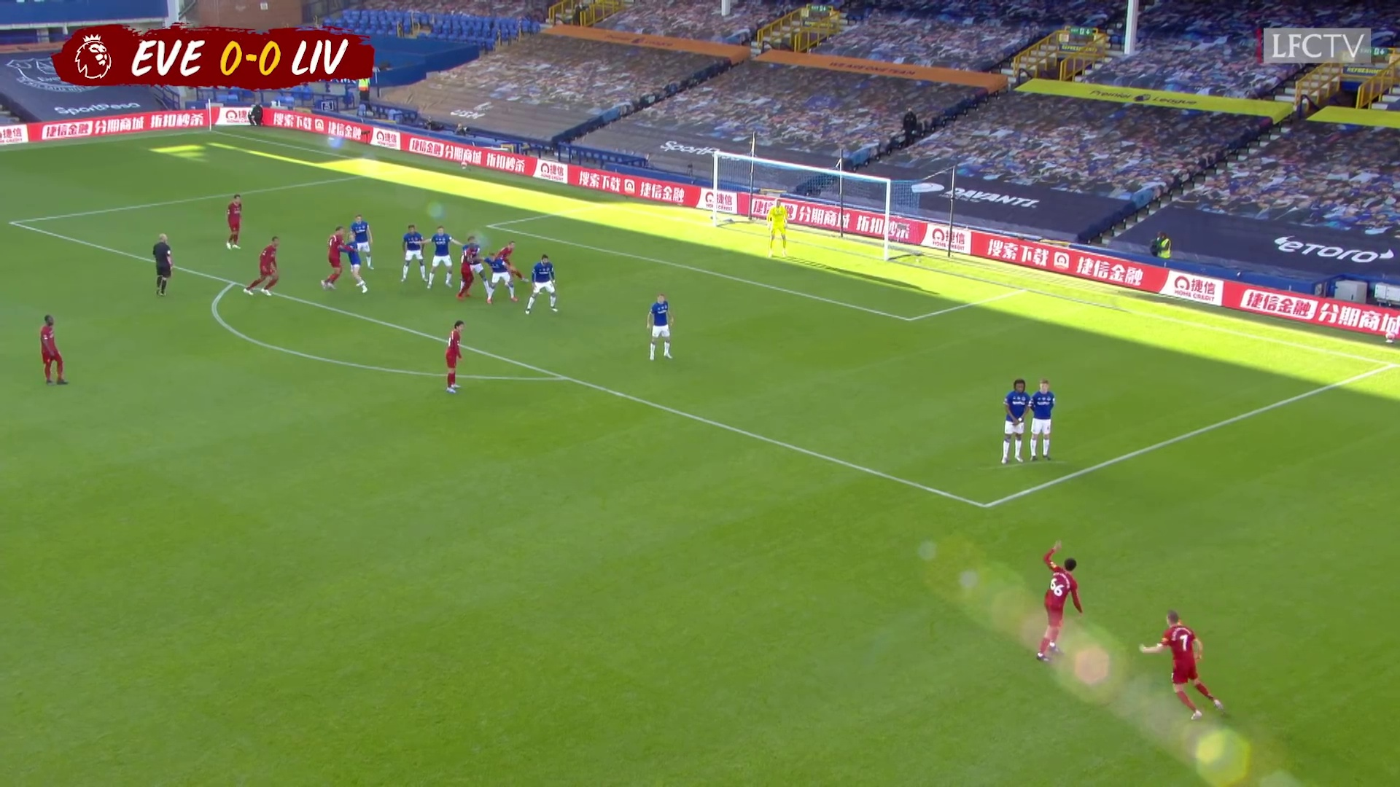
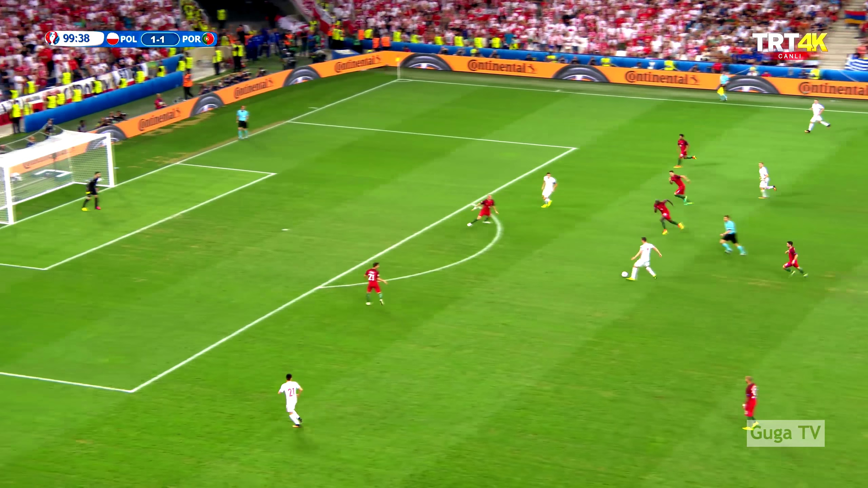
Challenges
Dynamic camera angles
Occlusions and overlapping players
Varying lighting conditions

Slide 4
Pipeline overview
1. Player detection
2. Team classification
3. Field line detection
4. Vanishing point estimation
5. Offside line determination
6. Visualization

Slide 5
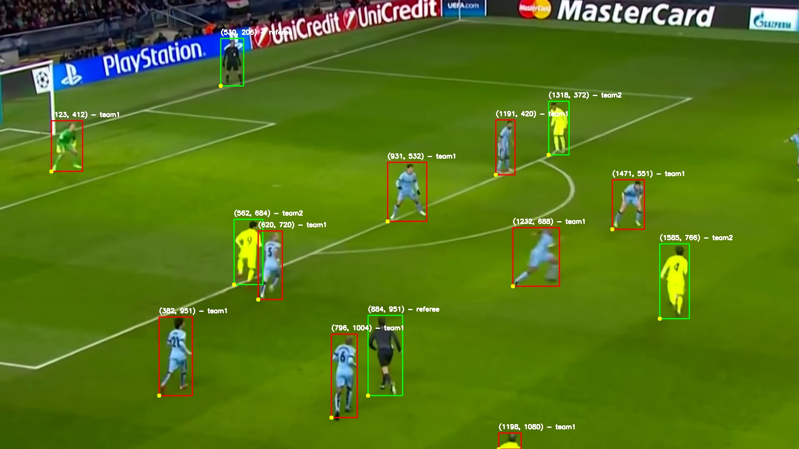
Player detection
Uses YOLOv8 for detecting players, referees and the ball
Outputs bounding boxes for each detected human

Slide 6
Team classification
The players are classified into teams based on their jersey colors
K-means clustering it is used to extract the dominant colors

Slide 7
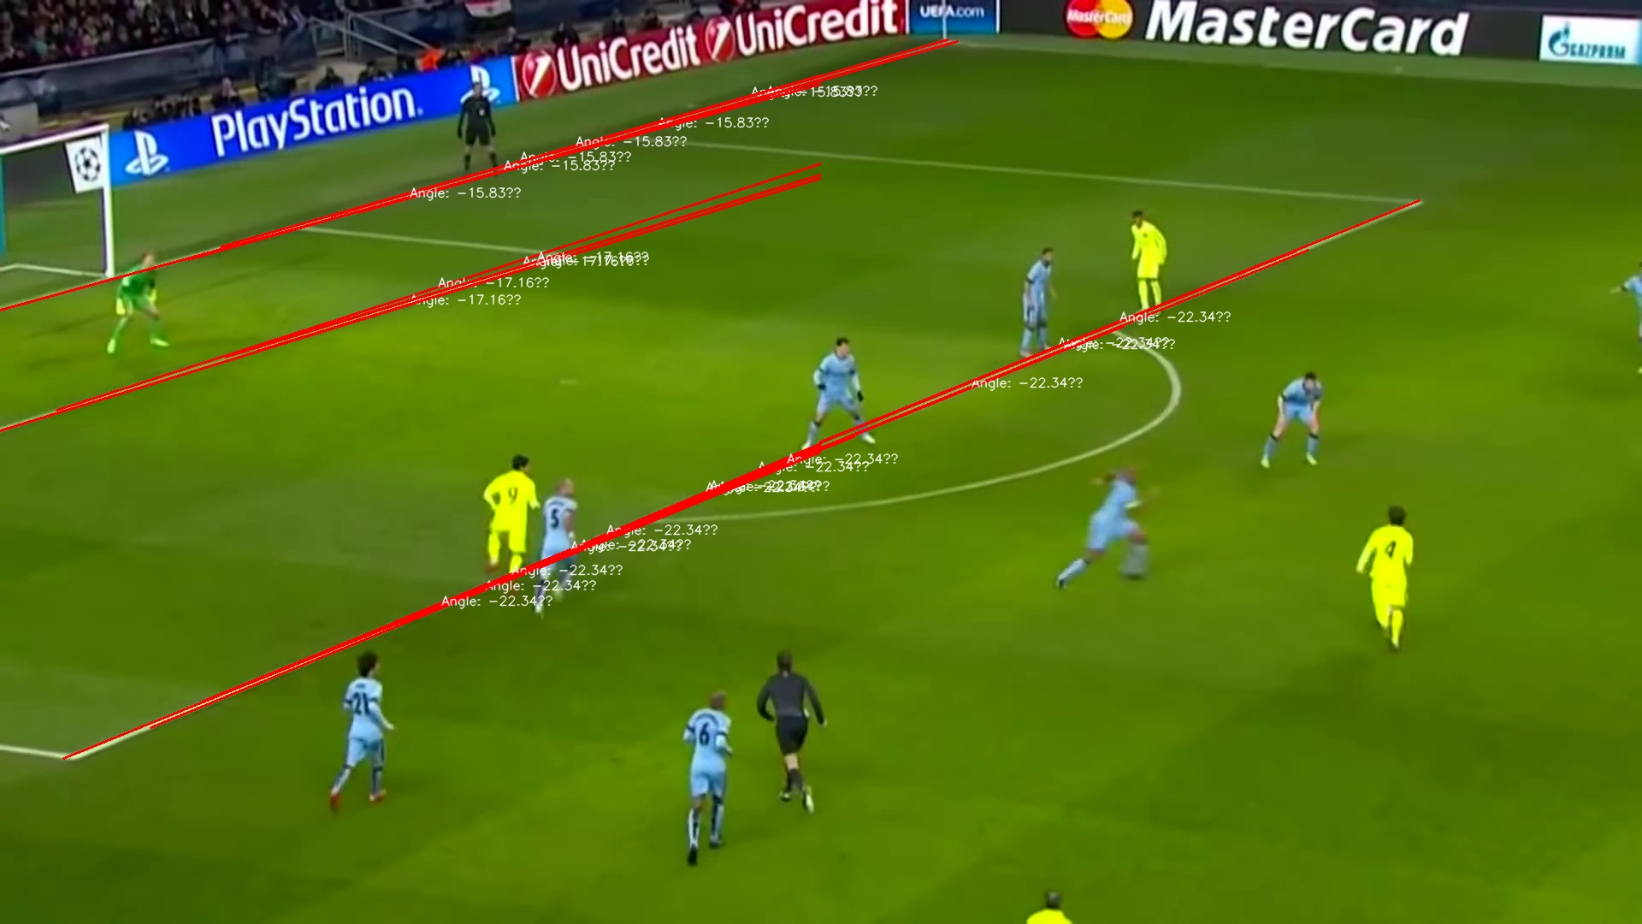
Field line detection
Hough transform for field lines detection
Lines are filtered based on angles and grouped into clusters

Slide 8
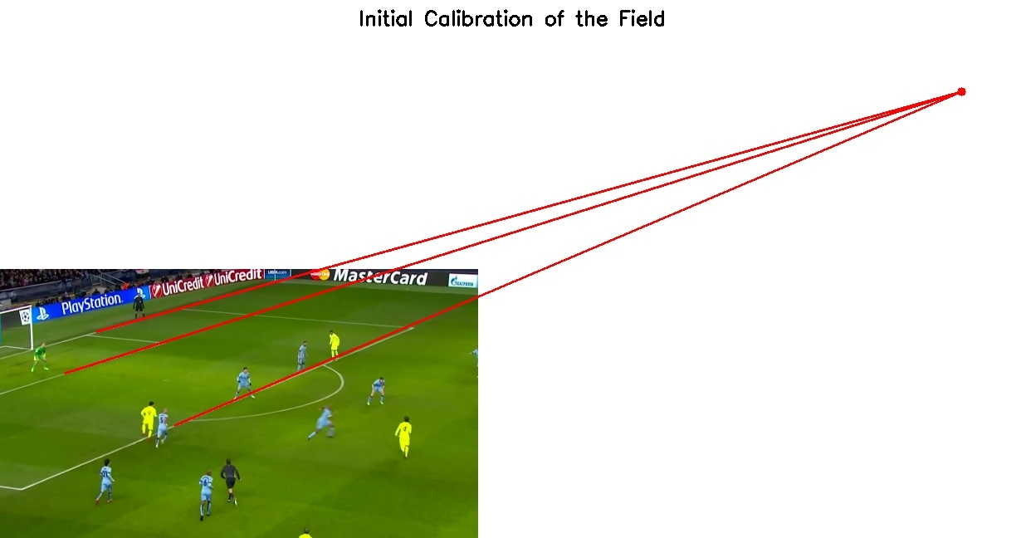
Vanishing point estimation
The point where parallel lines in the 3D world appear to converge in a 2D image
Used to correct perspective distortions in player positions

Slide 9
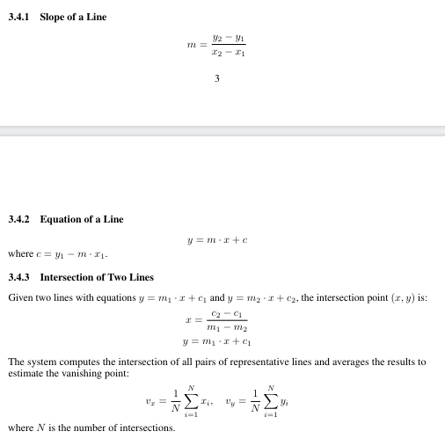
The formulas behind the vanishing point estimation

Slide 10
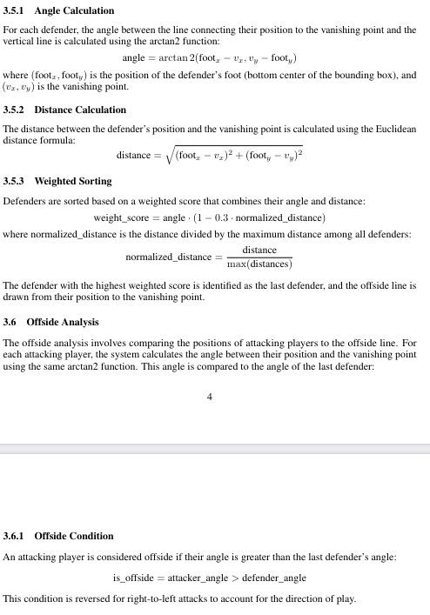
Offside analysis
Identifies the last defender using angle and distance metrics
Draws the offside line from the last defender to the vanishing point
Compares attacking players' positions to the offside line

Slide 11
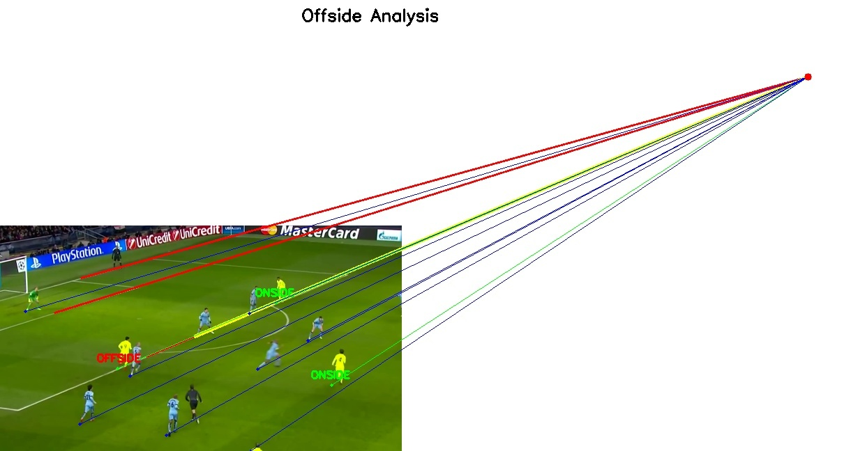
Final result

Slide 12
Future work
Incorporate deep learning models for player tracking
Extend the system to handle video inputs for real-time detection
Improve robustness in dynamic scenarios

Slide 13
Thank you!

