Slide 1

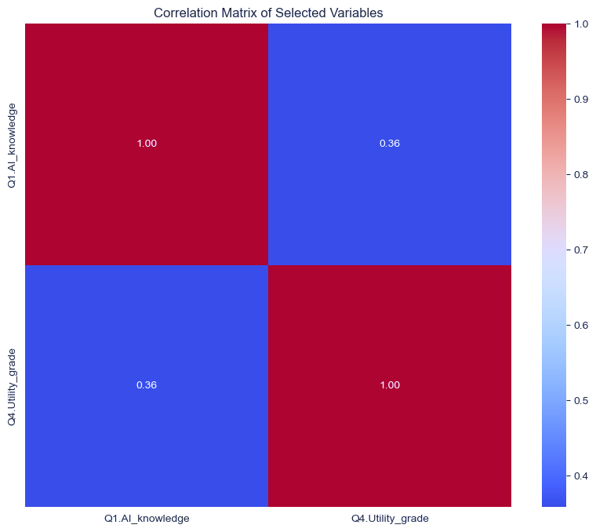
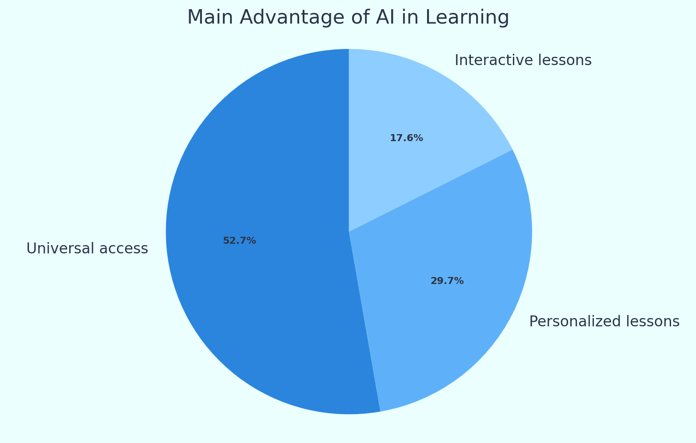
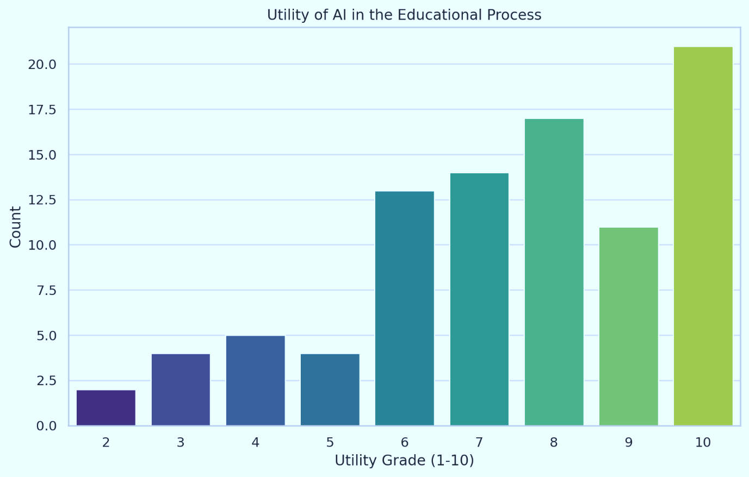
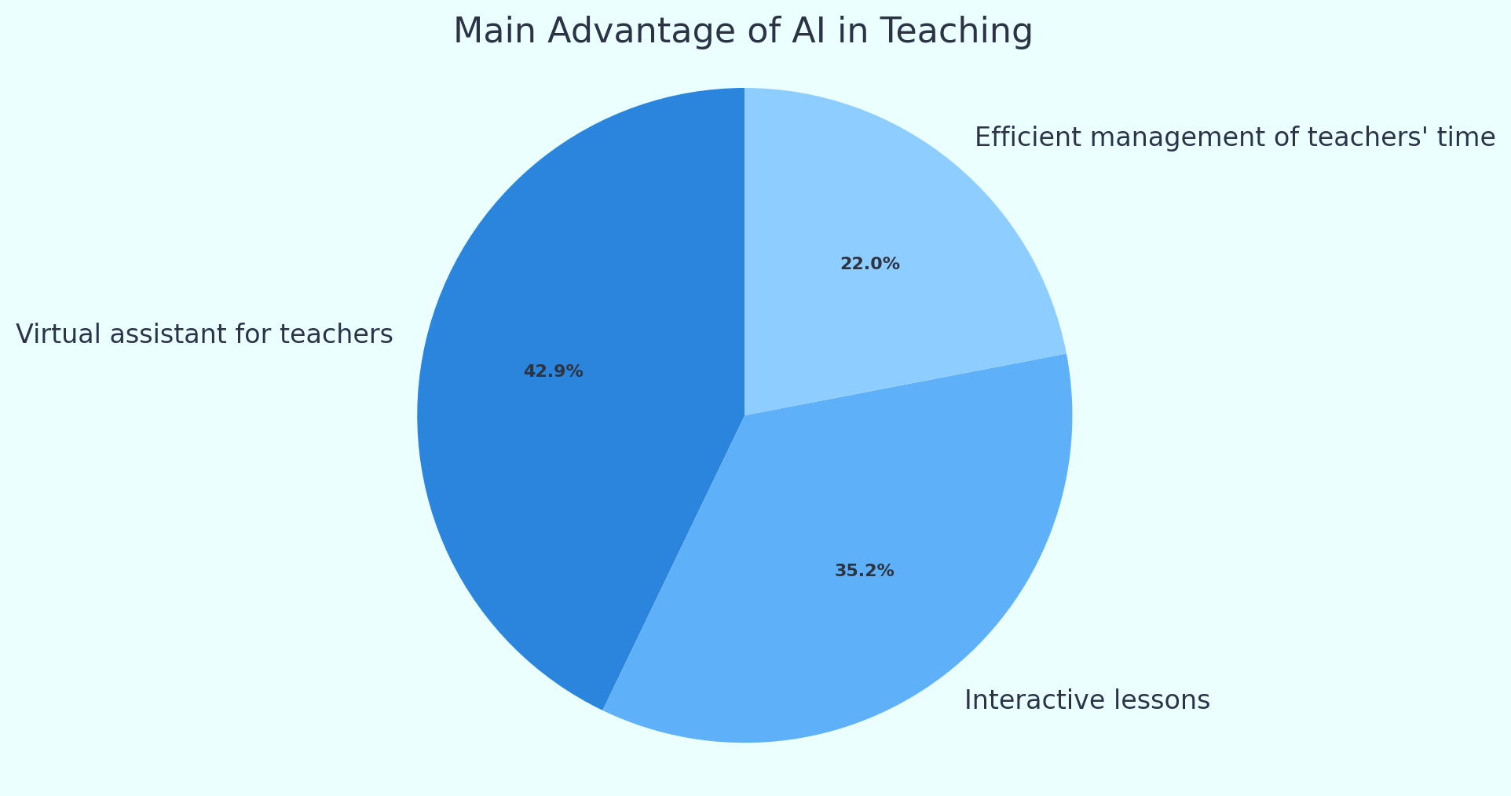

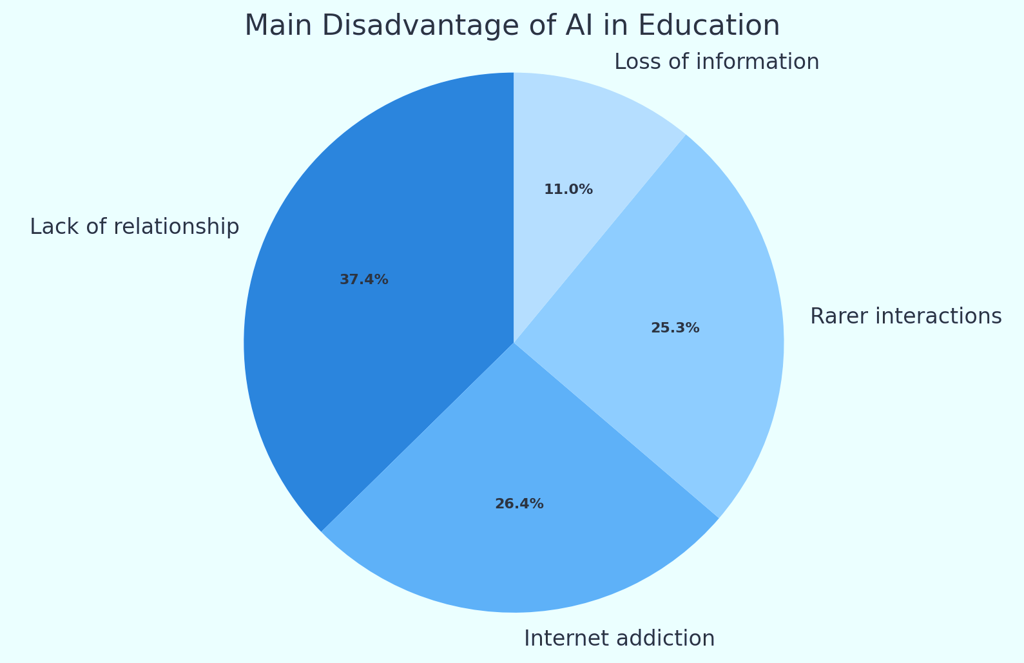
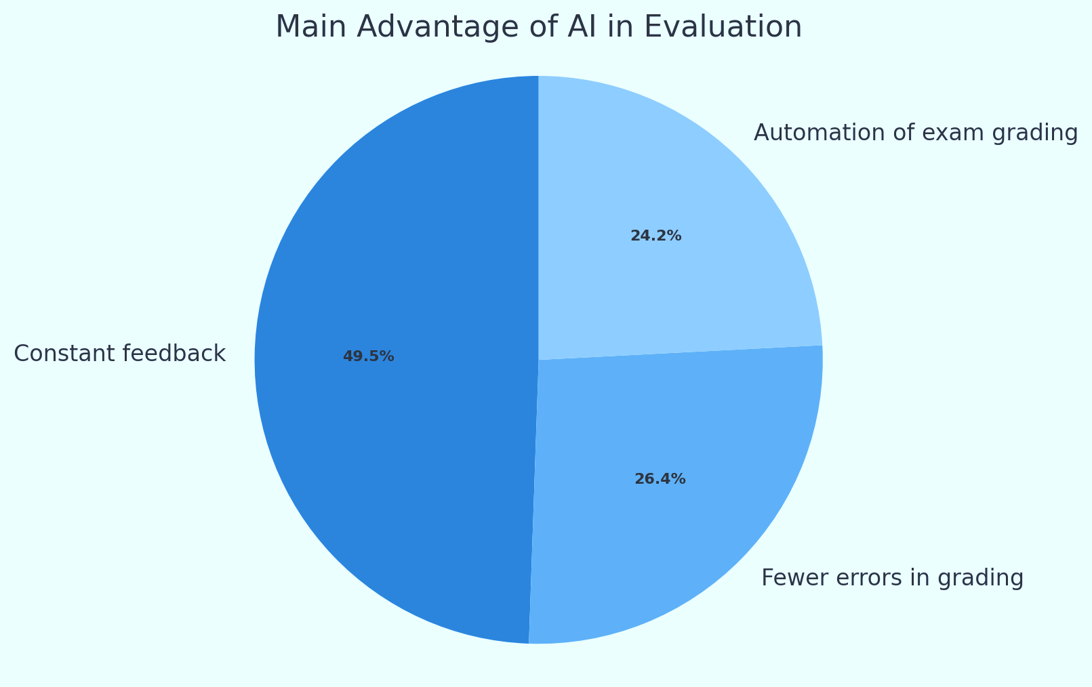

Impact of AI in Education Processes
Kusum Bhattarai Sharma, Saksham Adhikari
College of Science and Engineering, McCoy College of Business
Problem Statement
Discuss the importance of understanding students' perceptions of AI in education, highlighting the potential of AI to transform educational processes.
Research Questions
How useful do students find AI in the educational process
What do the students perceive as its main advantages and disadvantages in teaching, learning, and evaluation?
Methodology
CSV data file was derived from Kaggle.
The data file was imported to Excel and Jupyter Notebook.
Basic statistical measures were done using Excel’s functions.
The dataset was cleaned, and unnecessary variable columns were dropped.
Pre-processing of data was done using Python and its libraries such as Pandas, NumPy, etc.
Further analysis was done on the responses from the students.
The relevant data was visualized, and a correlation matrix was formed.
Countplots were used for visualization of data to draw comparisons and insights.
Matplotlib and Seaborn were used for the charts.
Findings
Following insights were made based on the students’ responses and various analyses:
The average self-rated knowledge about AI was 5.9 which means the students were moderately informed about AI.
The average feeling towards AI is closer to 1 (curiosity), with a mean score of 1.58, indicating that curiosity is the predominant feeling among the students.
Students find AI relatively useful in the educational process, with an average rating of 7.44 out of 10.
Advantages of AI in learning, teaching, and evaluation were shown.
The corresponding disadvantages only had a mean score of 2.1.
There was a linear regression between the knowledge of AI and the GPA of students.
There was a positive correlation of 0.36 between the AI knowledge and the Utility Grade.
There was a positive correlation of 0.28 between Utility Grade and GPA of students.
Results
The results from the findings indicated as follows:
Most of the students know about AI and have been informed through different sources.
Students are more curious about the potential of AI rather than being in fear or distrust.
Students view AI as beneficial in the educational process since majority of them view its usefulness positively.
Students have highlighted the universal access and personalized lessons as the most beneficial of AI in the Learning process.
AI in Teaching as perceived by students include majority responses for virtual assisting for teachers and interactive lessons.
The automation of grading, reduction in grading errors, and the provision of constant feedback are seen as the main benefits of AI in the evaluation process.
Students who are well informed and positive about the potential of AI in educational processes seem to be using it more to their advantage. We observed a positive correlation between the knowledge and usefulness of AI. Likewise, those who find AI useful in education seem to have higher GPA as compared to their peers.
Students perceive that AI can be used to improve the traditional educational process and make it more efficient.
Implications
AI in education has the potential to address some of the biggest challenges in the education field, innovate teaching and learning processes, and accelerate progress towards global education goals.
Student perceptions of AI in education are generally positive, and students that are well informed about it are leveraging it to improve their academic performance.
Correlation Matrix between all the available variables.
Correlation matrix between variable AI Knowledge (Q1) and Utility in Education (Q4) Correlation matrix between variable AI Knowledge (Q1) and Utility in Education (Q4)
Data Sources
An open dataset from Kaggle including survey responses from the undergraduate students at the Department of Cybernetics, Statistics and Economic Informatics, was used.
The survey was conducted online and distributed through social media groups.
Questions revolved around the perception of students regarding AI.
The data includes qualitative as well as quantitative responses.
Advantages of AI in Learning process
References
https://www.kaggle.com/datasets/gianinamariapetrascu/survey-on-students-perceptions-of-ai-in-education
How useful do students think AI is on the scale of 1-10?
Advantages of AI in teaching process
Disadvantages of AI in education as per the students’ responses
Advantages of AI in evaluation process

