Slide 1


Deep Learning for Influencer Marketing Analysis Using Global YouTube Trending Data
Tarun Betageri Tejeswara
811390248

Slide 2
Problem Statement
Virality is unpredictable
Influencer marketing budgets are rising
Brands need data-driven prediction tools

Slide 3
Dataset Overview
6.3M+ rows
Multiple countries
Text + Metadata
Engagement metrics
Viral label = top 10% views per date & country

Slide 4
Feature Engineering
Title/description/tag lengths
Likes-per-view & comments-per-view
Publish hour, day of week
Tokenized text sequences

Slide 5
Models
MLP (metadata only)
LSTM (Text only)
CNN (text only)
Fusion model (text + metadata)

Slide 6
Model Architecture
MLP: Dense Layer
LSTM: Sequence Layer
CNN: Pattern extraction
Fusion: Combined represtion

Slide 7
Result
index | Accuracy | AUC | Precision | Recall | F1 score
CNN | 0.9487136652188439 | 0.9736779406029691 | 0.7991860612997583 | 0.6686732336130367 | 0.7281274570660046
Fusion | 0.9826136374281423 | 0.9967420093356515 | 0.9289347273241029 | 0.899534841298796 | 0.9139984245401047
LSTM | 0.9486028146672454 | 0.973617934464853 | 0.7701032283516339 | 0.7121792533138757 | 0.7400094771758016
MLP | 0.9708369372773231 | 0.9903120197834933 | 0.9065752904417477 | 0.798324820625076 | 0.849013442402981

Slide 8
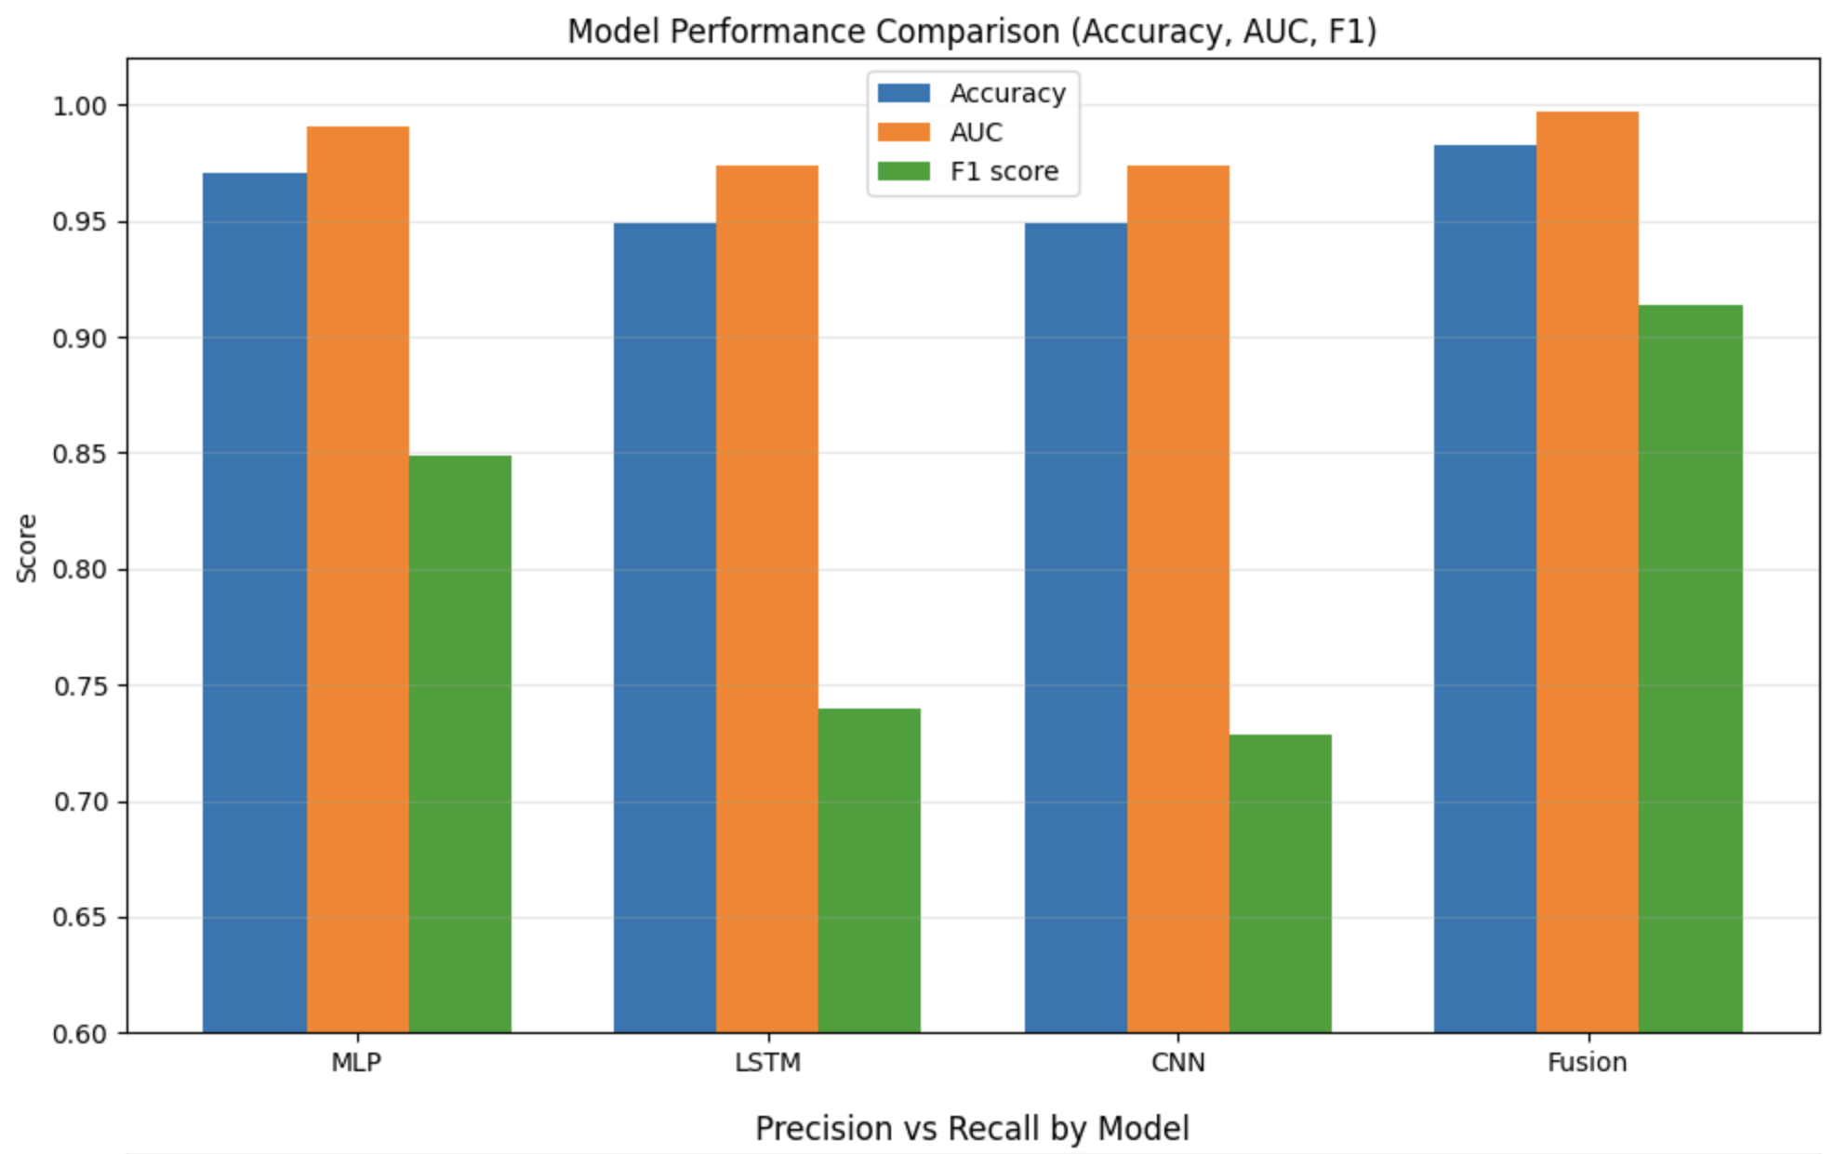
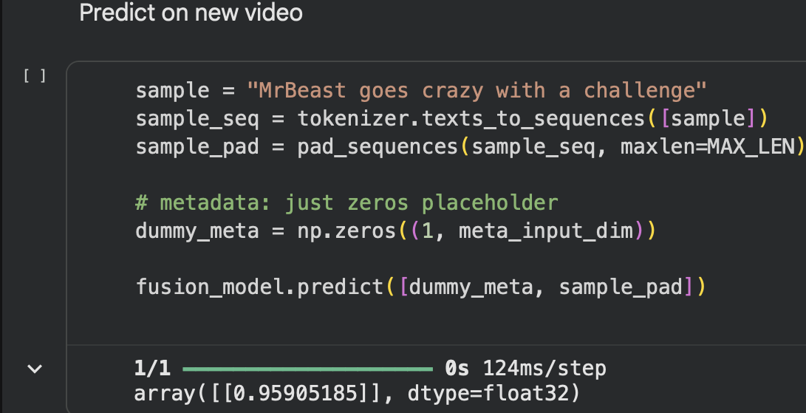
Performance Graphs

Slide 9
Business Implication
Budget optimization
Identifying high-potential influencers
Predicting campaign success
Platform recommendation improvements

Slide 10
Conclusion & Future Work
Fusion = best
Large dataset enabled robust learning
Next steps :
  BERT (Bidirectional Encoder Representations from Transformers)
  Temporal modeling (Transformers)

