Slide 1


INFO-H-410 : Techniques of AI Project : 2048
Presentation by :
Sébastien DE VOS
Tarik KALAI
David SILBERWASSER

Slide 2
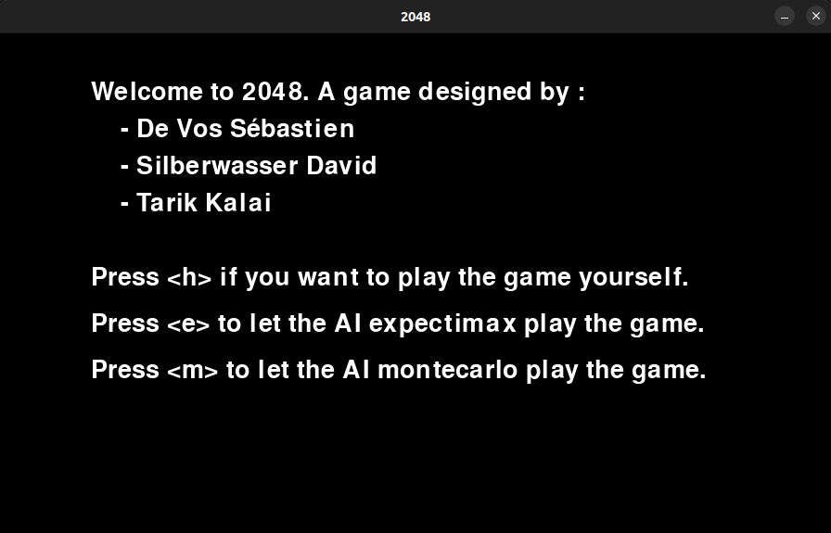
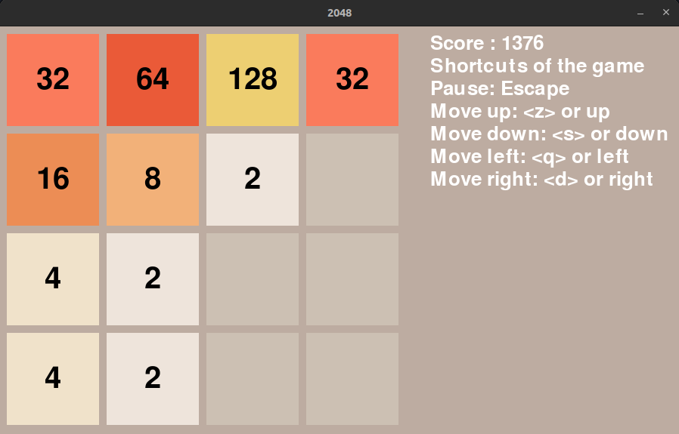
1. Interface of our game
Rule : Merge 2 tiles to sum their value and get the highest score
If the board is full without any possibility to merge → Game over

Slide 3
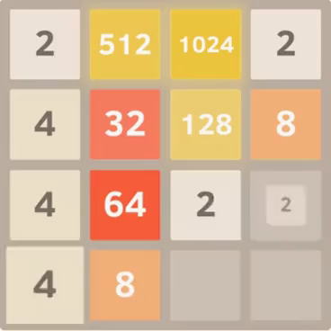
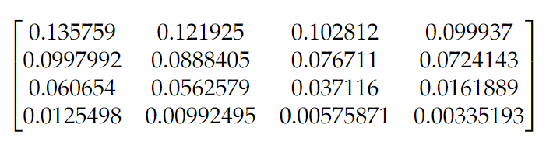
2. Expectimax + Results
Variant of MinMax algorithm
Does not strictly speaking have a pruning facility like Minimax as the value of a single unexplored utility can change the expectimax value drastically
requires the full search tree to be explored and it can be slow. This can intuitively limit the computational possibilities for the algorithm
Heuristic used → concerns the positions on the board
well-known trick to beat the 2048 game is to position the biggest tiles on the corners
weight matrix was used to make the AI understands where is the most important position.

Slide 4
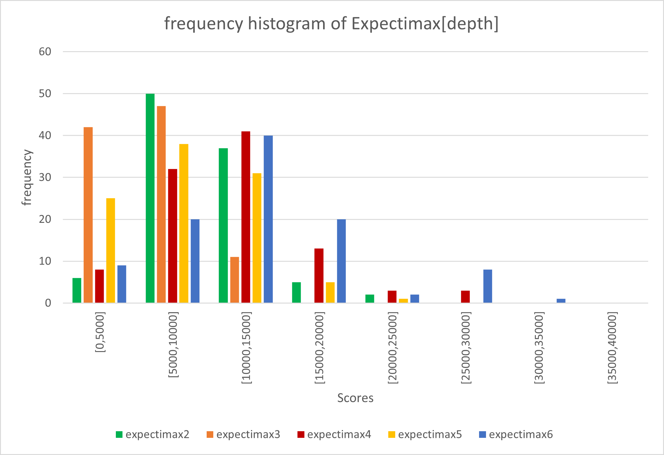
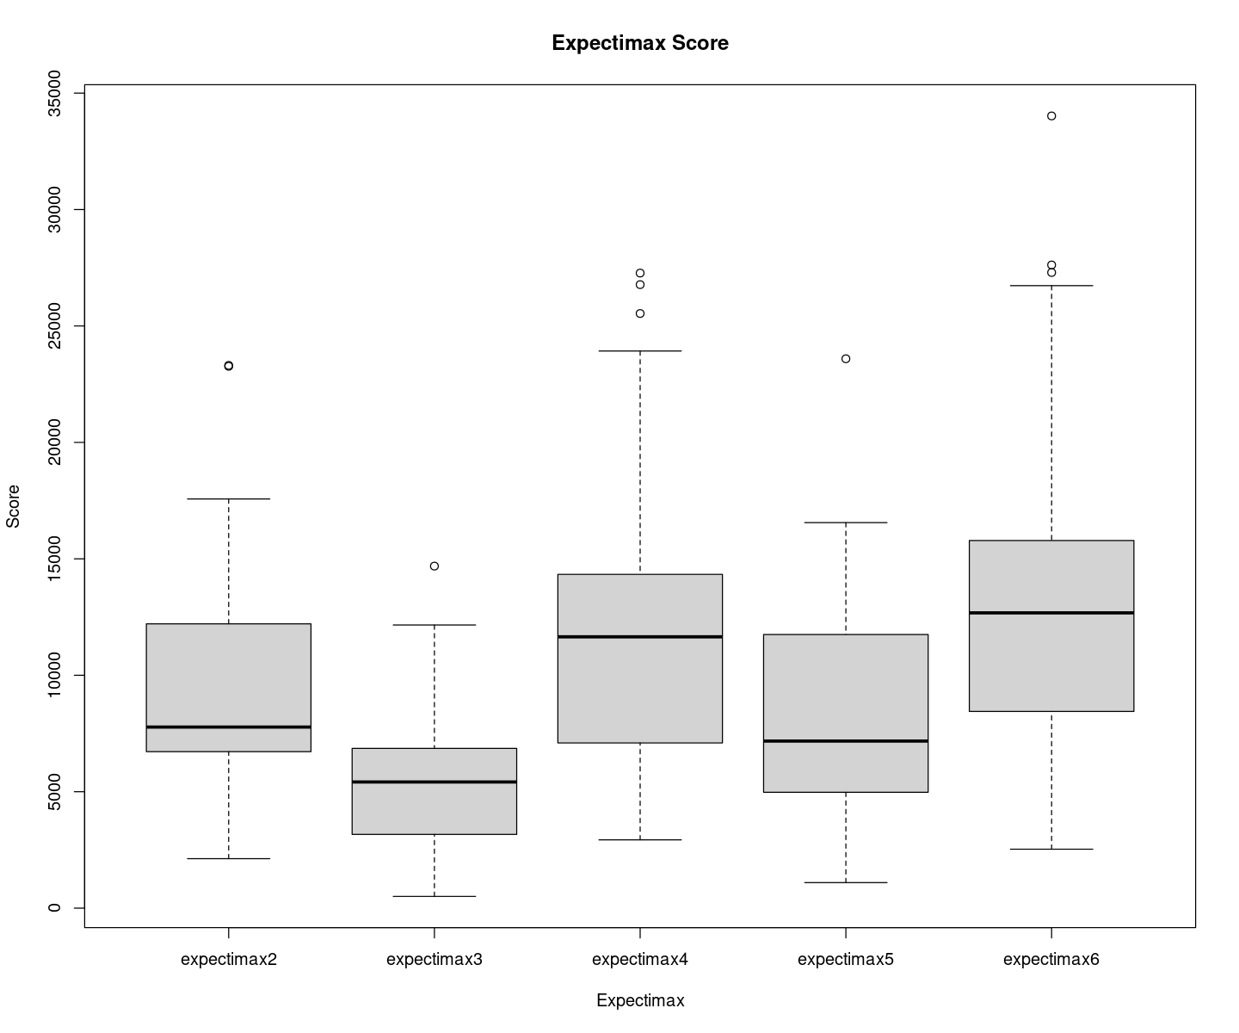
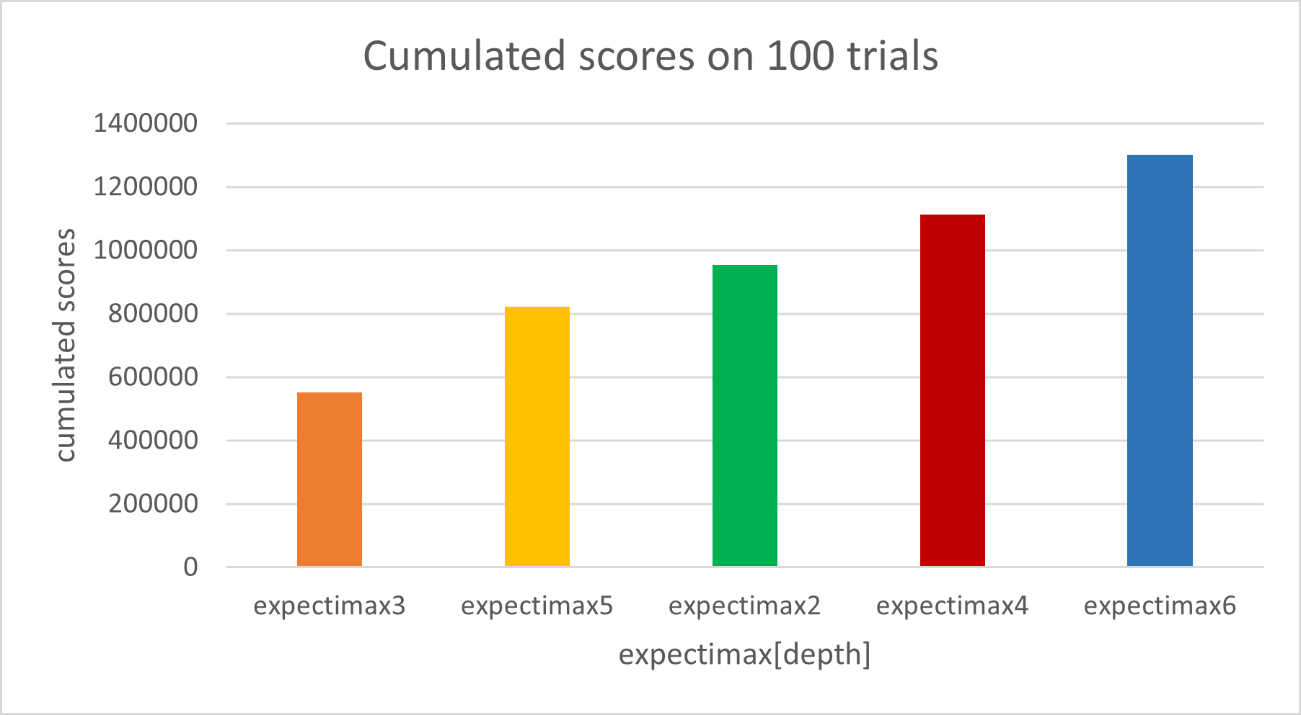
2. Results with Expectimax
The algorithm was executed for a 100 times in a row and for each iteration the score was remembered
An even value for the depth will typically perform better than its direct superior odd depth.
when the depth is odd the algorithm will not compute the results for the last random component of its current move → If depth even, the algorithm will compute the mean of the last random component → mitigates the randomness impact and greatly improve the performance of the AI

Slide 5
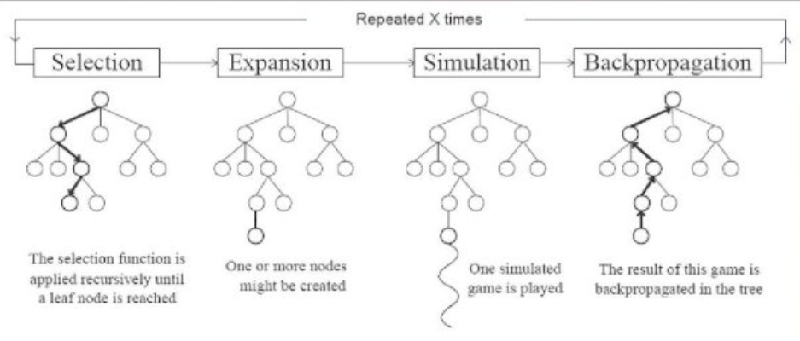
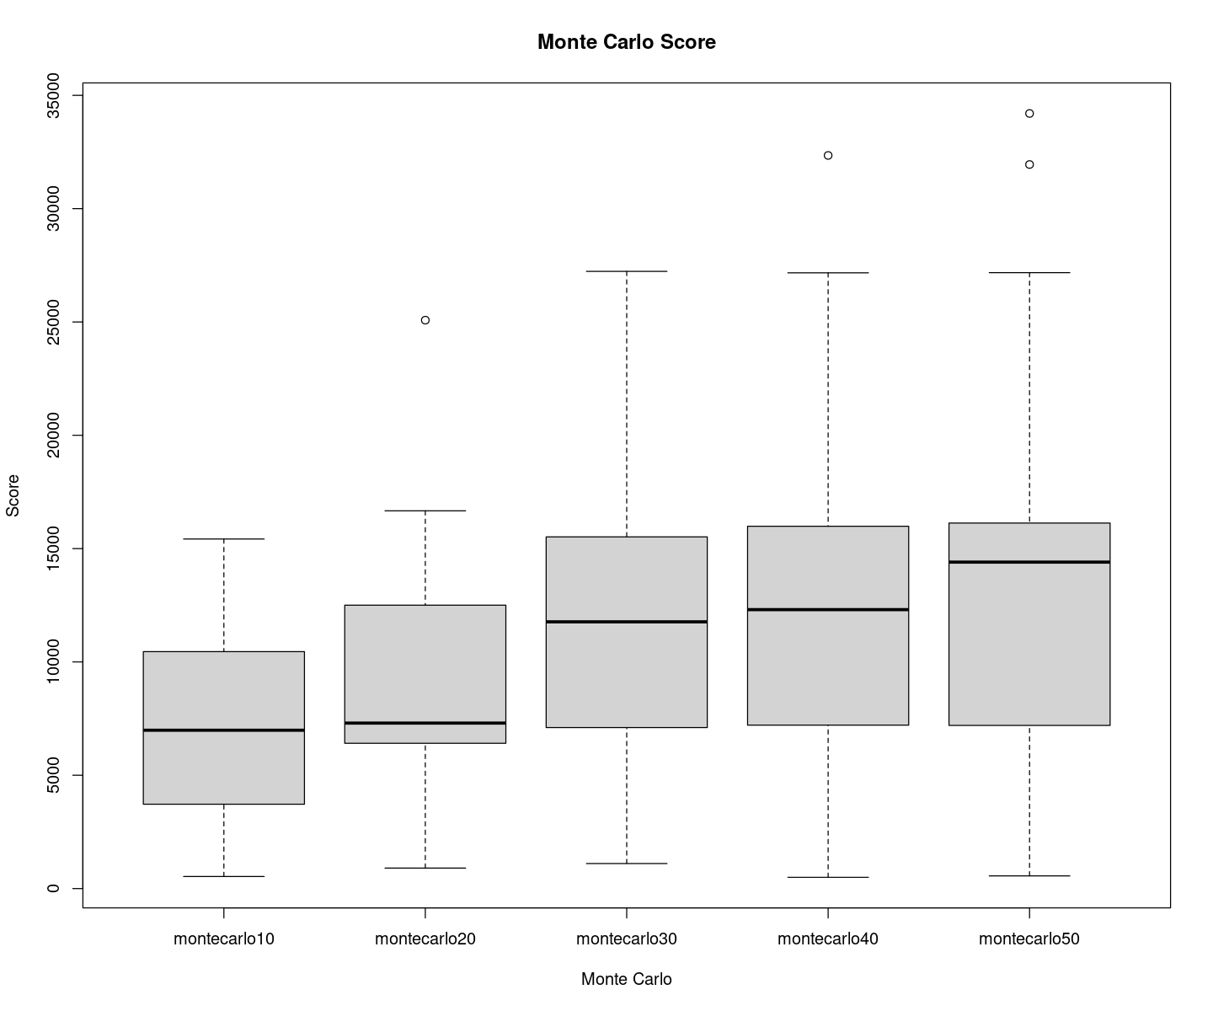
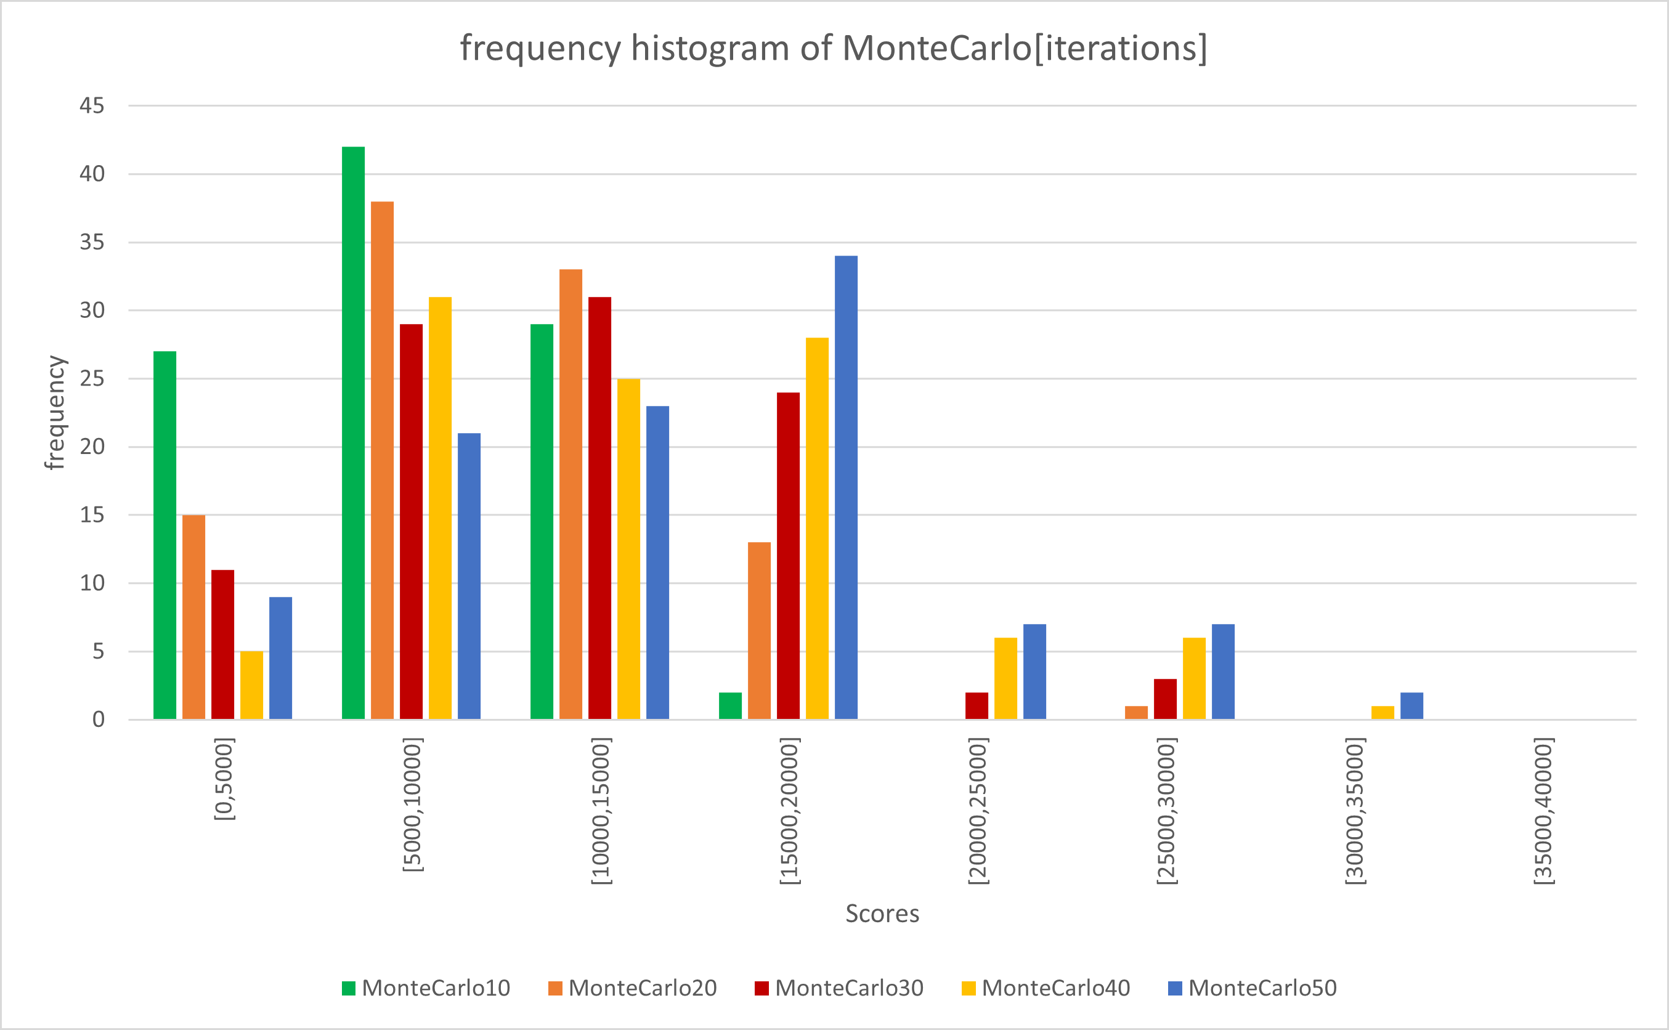
3. Monte Carlo tree search + Results
Tries all the possible moves and selects the best ones depending on the result of the total score of each simulation for each move
Focuses on analyzing the most promising movements, expanding the search tree based on random sampling of the search space

Slide 6
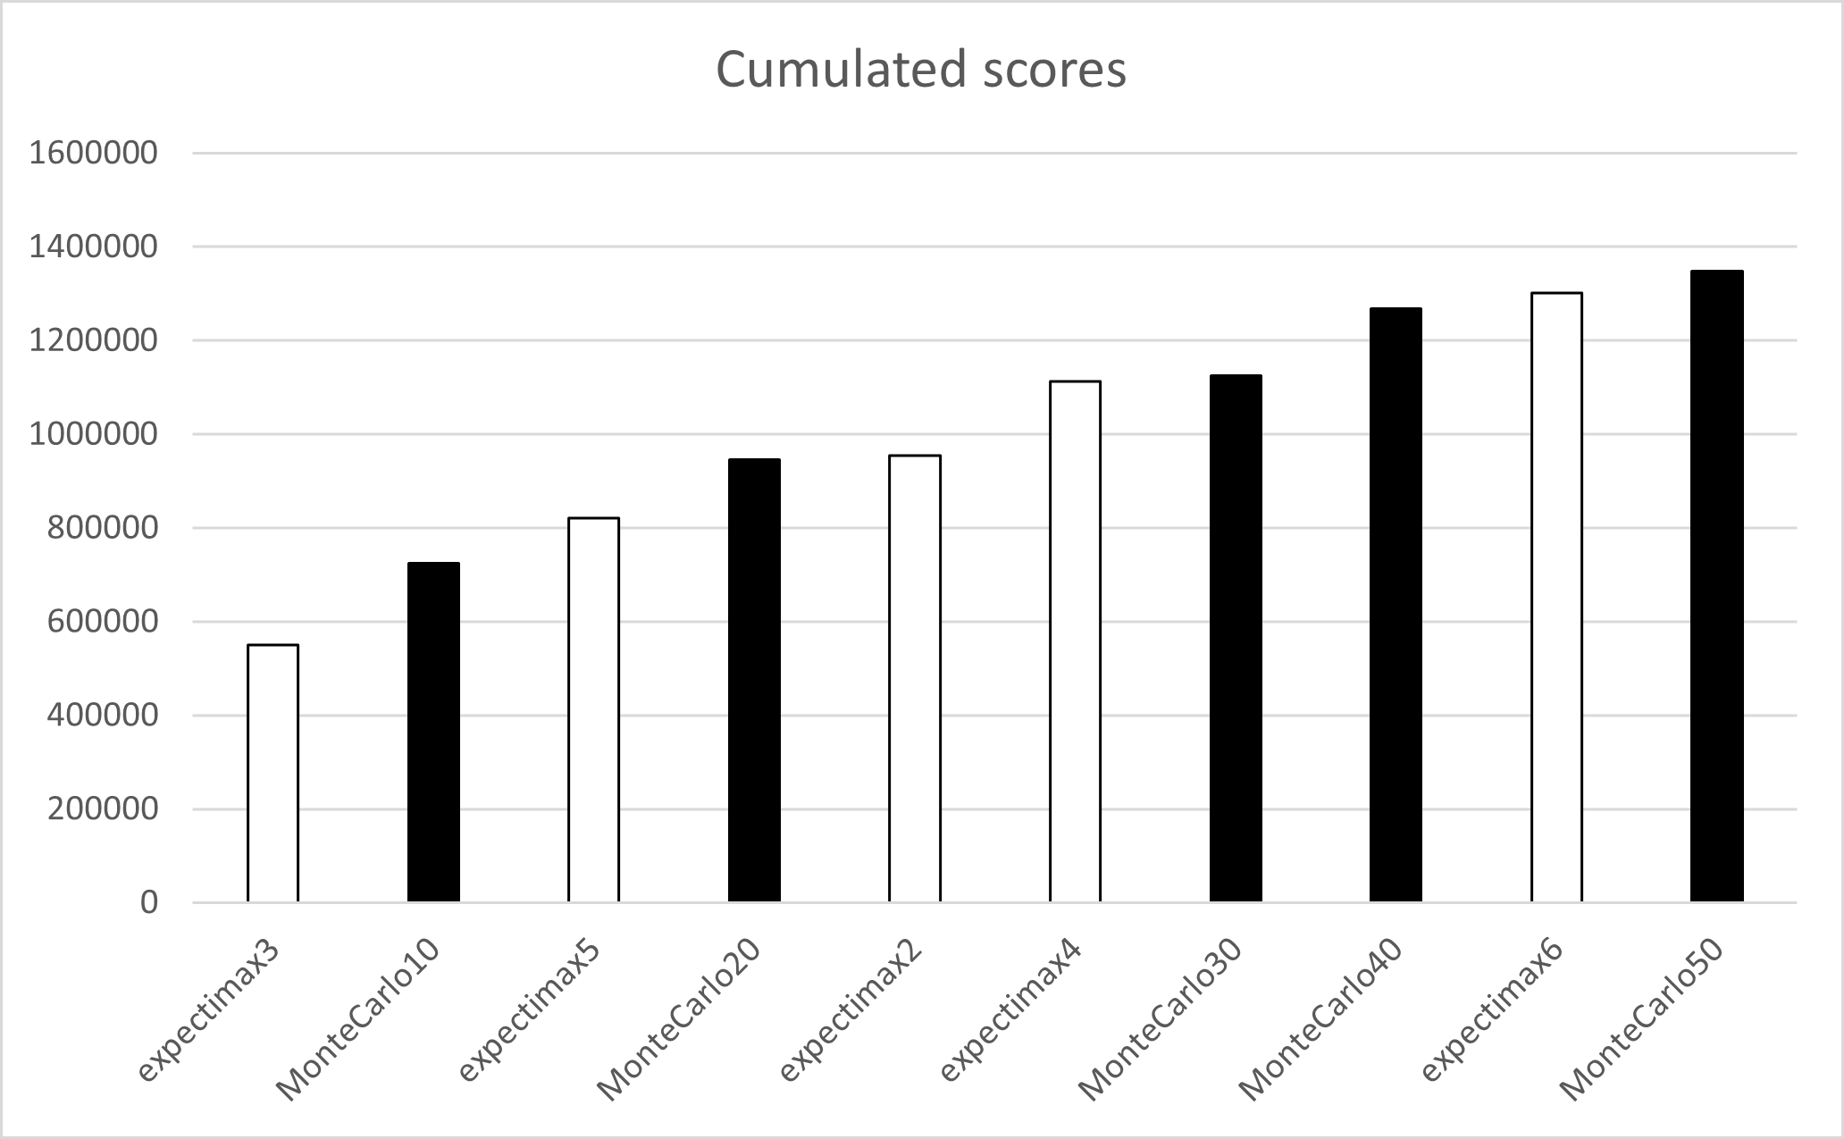
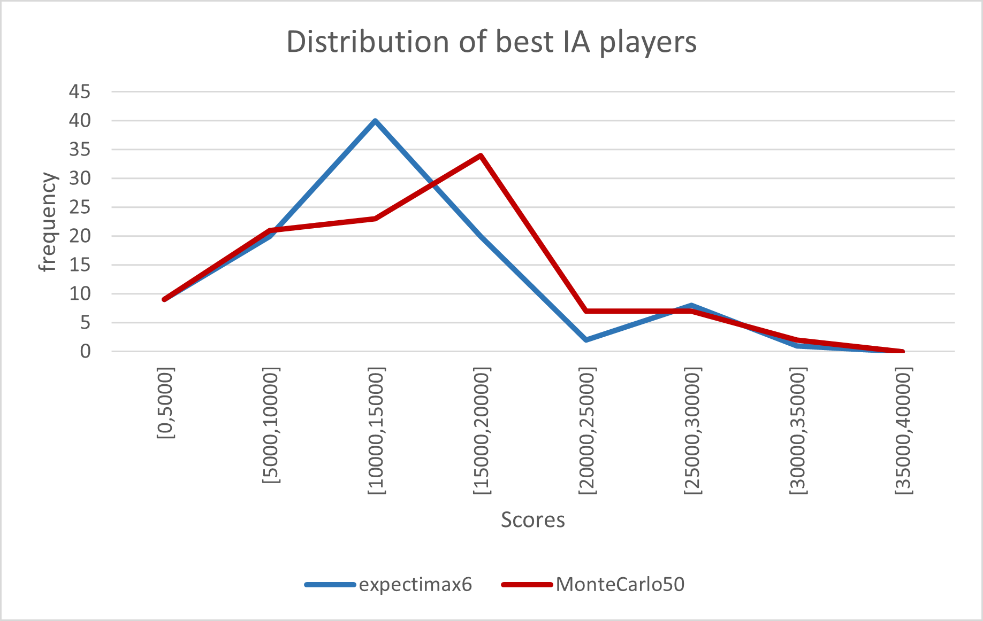
4. Expectimax VS Monte Carlo tree search
The Monte-Carlo tends to perform better and more linearly than Expectimax.

