Slide 1
DBSCAN
Presented by Ater Machar, Kyaw Toe Toe Han, Nyein Min Soe, & Tar Rein Thway

Slide 2
What is DBSCAN?
Density-Based Spatial Clustering of Applications with Noise
Groups data points based on density, not distance to a center
Forms clusters from high-density regions separated by low-density areas
Automatically identifies outliers (noise) that don’t belong to any cluster
A cluster = area where points are densely connected
Noise = points that don’t have enough neighbors nearby

Slide 3
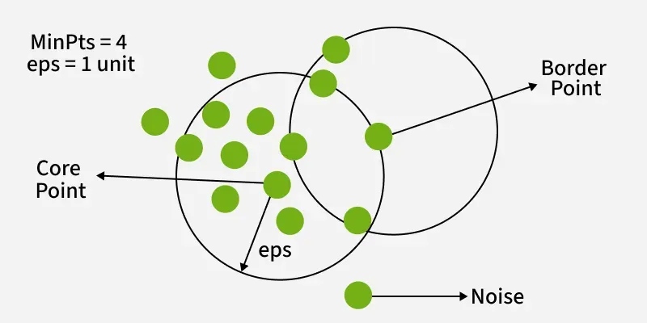

Slide 4
How the Math Works

Slide 5

The Advantages of DBSCAN
Why choose density-based clustering?
Can Cluster Non-Circle Data Points
No Pre-defined Cluster Count
Robust to Outliers
Minimal Domain Knowledge Needed

Slide 6

The Disadvantages of DBSCAN
Limitations and Challenges
High Computational Cost
Struggles with Varying Densities
Highly Sensitive to Parameters
The "Curse of Dimensionality"

Slide 7

Best Use Cases
When should we use DBSCAN?
Ideal Scenarios:
Spatial data analysis (e.g., geographic coordinates).
Datasets with lots of noise or anomalies (e.g., fraud detection).
When you suspect clusters have weird, non-circular shapes.
When to Avoid:
Massive datasets without computational resources or spatial indexing.
Datasets with extremely high dimensions (e.g., text data).
Data where cluster density fluctuates wildly.

Slide 8
Step 1: Calculating Euclidean distance
To use DBSCAN, we have to use the Euclidean distance formula to find the distance between two Points, (for the case of two points, if there is 4 columns for dataset like iris.
The formula will be like this -
In this formula, P and Q are two different rows in the dataset.
d(P, Q) is the resulting Euclidean distance between points P and Q.

Slide 9
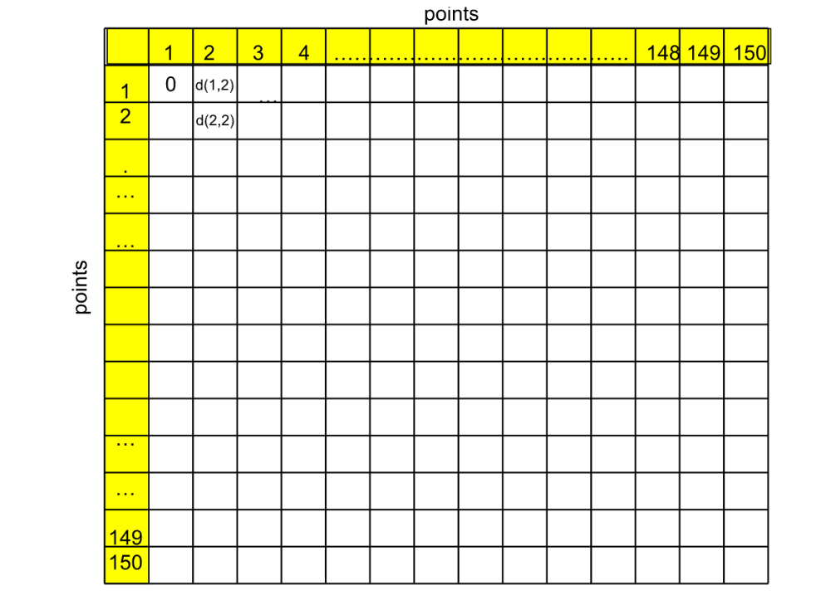

Step 1: Calculating Euclidean distance
If there are 150 rows, it will calculate the distance between each and every row.
This will result 150 * 150 values, if we include the calculation of distance between the points itself.

Slide 10
Step 2: Epison and max points
In the DBSCAN methods, the two parameters are very important, ϵ, and minimum points.
Epsilon (ϵ) defines the maximum distance to be considered as a neighbor.
If we define ϵ = 0.5 it means that we take the distances >= 0.5.
Minimum Point is the minimum points near a particular point (including itself to consider as a core point.
E.g., if we set the minimum point = 3, it means that -
we will try to consider that one is a core point if it has at least 3 neighbors (including itself).

Slide 11
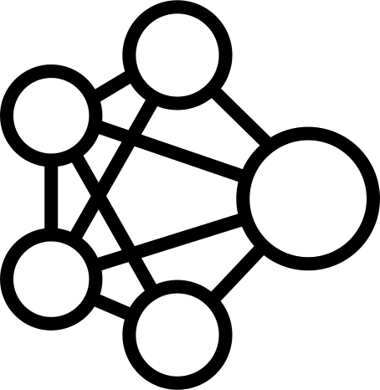
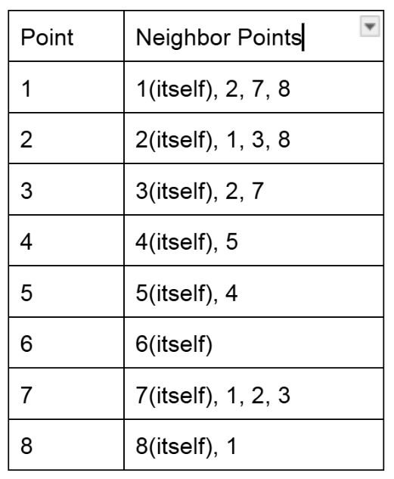
Step 3: How Clustering Works
Let say we set e = 0.5, and min-pts = 3. and get the following points.
In this case, core points are 1, 2, 3 and 7.
Point 8 is close to core point 1, but has < 3 neighbors.
8 is a neighbor point.
4 and 5 are very close to each other.
They aren’t neighbor points because they are not close to other core points.
6 is not close to any other point (noise).

Slide 12
Step 3: How Clustering Works
Let say we set e = 0.5, and min-pts = 3. and get the following points.
For the clustering part, we will start on point 1, and call it cluster A.
We will expand to its neighbors, 2,7 and 8.
We will not have 1, 2, 7 and 8 in cluster A.
And we will move to point 2.
Point 2 has its neighbors, 1, 3, 7.
As 1 and 7 are already in cluster A, we will add cluster 3 to cluster A.
The cluster A will now include 1, 2, 3, 7, and 8.

Slide 13
Step 3: How Clustering Works
Let say we set e = 0.5, and min-pts = 3. and get the following points.
And we will move to point 3, and it is already in cluster A.
And we will move to point 4, and it has one neighbor 5, but it the two cannot form cluster; similar for point 5.
Point 4, 5 (entire group) is noise.
And we will move to point 6, it is isolated and considered noise.

Slide 14
Step 3: How Clustering Works
Let say we set e = 0.5, and min-pts = 3. and get the following points.
And we move to point 7, it is already in A, and its neighbors 1, 2, 3 are already in A.
Lastly, we move to point 8, which is already in cluster A, and is a border point.
Therefore, we get
1, 2, 3, 7 and 8(border) in cluster A.
4, 5, 6 are noise.
Note :points that are within cluster of Core Point but are not Core Points themselves are specifically called Border Points.

Slide 15
References:
www.geeksforgeeks.org. (30/10/2025). DBSCAN Clustering in ML - Density based clustering - GeeksforGeeks
https://raghda-altaei.medium.com/understand-the-math-behind-dbscan-ae51672c0424

