Slide 1
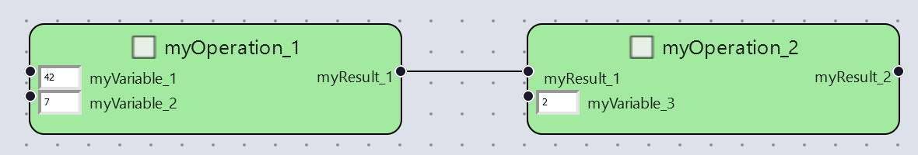
Node 1:
def Division(myVariable_1: Optional[int|float], myVariable_2: Optional[int|float]):
myResult_1 = myVariable_1/myVariable_2
return myResult_1
Node 2:
def Subtraction(myResult_1, myVariable_3: Optional[int|float]):
myResult_1 = myResult_1 - myVariable_2
return myResult_2
Workflow:
wf_maths = Workflow("myWorkflowExec")
wf_maths.myOperation_1 = Division(42.0, 7.0)
wf_maths.myOperation_2 = Subtraction(wf_maths.myOperation_1, 2.0)

Slide 2
PMDCO:Workflows
Subclass_of
PMDCO:Operands
PMDCO:Mathematics
executes
participant_of
Subclass_of
Subclass_of
Subclass_of
Subclass_of
Subclass_of
PMDCO:Operations
PMDCO:Dividend
PMDCO:Divisor
PMDCO:Minuend
PMDCO:Subtrahend
PMDCO:Numbers
Subclass_of
Subclass_of
Subclass_of
PMDCO:Division
PMDCO:Subtraction
output_of
PMDCO:Results
Subclass_of
Subclass_of
PMDCO:Quotient
PMDCO:Difference

Slide 3
NodeClass
PMDCO:Division
is_a
has_role
Division
is_input_port_of
is_output_port_of
InputPort
OutputPort
PMDCO:Quotient
is_input_port_of
PMDCO:Dividend
is_a
InputPort
PMDCO:Divisor
is_a
has_role
has_role
is_a
has_role
FirstVariablePort_1
SecondVariablePort_1
ResultPort_1

Slide 4
NodeClass
PMDCO:Subtraction
is_a
has_role
Subtraction
is_input_port_of
is_output_port_of
InputPort
OutputPort
PMDCO:Difference
is_input_port_of
PMDCO:Minuend
is_a
InputPort
PMDCO:Subtrahend
is_a
has_role
has_role
is_a
has_role
FirstVariablePort_2
SecondVariablePort_2
ResultPort_2

Slide 5
Workflow
PMDCO:Mathematics
Node
PMDCO:Division
is_a
has_role
has_role
myWorkflowExec
is_a
Division
Node
PMDCO:Subtraction
is_used_in
Is_instance_of
is_used_in
is_used_in
FirstVariablePort_1
is_input_port_of
is_output_port_of
is_a
has_role
myOperation_1
ResultPort_1
Subtraction
SecondVariablePort_1
connects
Is_instance_of
is_input_port_of
connects
myEdge_1
FirstVariablePort_2
is_a
is_input_port_of
is_output_port_of
Edge
myOperation_2
ResultPort_2
SecondVariablePort_2
is_input_port_of

Slide 6
Workflow
PMDCO:Mathematics
Node
PMDCO:Division
is_a
has_role
has_role
myWorkflowExec
is_a
Variable
is_used_in
PMDCO:Number
is_used_in
has_role
is_a
Division
myVariable_1
Node
PMDCO:Subtraction
is_input
Is_instance_of
is_used_in
is_used_in
is_used_in
rdf:value
FirstVariablePort_1
is_used_in
is_used_in
"42.0"^^xsd:float
is_input_port_of
is_output_port_of
is_a
has_role
myOperation_1
ResultPort_1
PMDCO:Number
Variable
is_output
SecondVariablePort_1
is_input_port_of
has_role
is_a
myResult_1
is_input
FirstVariablePort_2
myVariable_2
is_input
is_input_port_of
is_a
rdf:value
is_output_port_of
rdf:value
Result
“6.0"^^xsd:float
myOperation_2
ResultPort_2
“7.0"^^xsd:float
PMDCO:Number
Variable
is_output
SecondVariablePort_2
is_input_port_of
has_role
is_a
myResult_2
myVariable_3
is_input
is_a
rdf:value
rdf:value
Result
“4.0"^^xsd:float
“2.0"^^xsd:float

Slide 7
Workflow
PMDCO:Mathematics
Node
PMDCO:Division
is_a
has_role
has_role
myWorkflowExec
is_a
Division
Node
PMDCO:Subtraction
Is_instance_of
is_used_in
is_used_in
is_used_in
InputPort
is_a
FirstVariablePort_1
is_input_port_of
is_output_port_of
is_a
has_role
PMDCO:Dividend
has_role
myOperation_1
ResultPort_1
SecondVariablePort_1
connects
OutputPort
is_input_port_of
connects
is_a
myEdge_1
FirstVariablePort_2
is_a
has_role
is_a
is_a
is_input_port_of
is_output_port_of
PMDCO:Difference
InputPort
InputPort
has_role
myOperation_2
ResultPort_2
PMDCO:Divisor
Edge
PMDCO:Minuend
has_role
has_role
is_a
SecondVariablePort_2
is_input_port_of
PMDCO:Quotient
OutputPort
has_role
is_a
InputPort
PMDCO:Subtrahend

Slide 8
Workflow
PMDCO:Mathematics
Node
PMDCO:Division
is_a
has_role
has_role
myWorkflowExec
is_a
Variable
PMDCO:Number
is_used_in
is_used_in
is_a
has_role
Division
myVariable_1
Node
PMDCO:Subtraction
is_input
Is_instance_of
is_used_in
is_used_in
rdf:value
is_used_in
is_used_in
is_used_in
"42.0"^^xsd:float
InputPort
is_a
FirstVariablePort_1
is_input_port_of
is_output_port_of
is_a
has_role
PMDCO:Dividend
has_role
myOperation_1
ResultPort_1
Variable
is_output
SecondVariablePort_1
is_input_port_of
OutputPort
is_a
myResult_1
is_input
FirstVariablePort_2
is_a
myVariable_2
is_input
is_a
has_role
is_a
is_input_port_of
PMDCO:Difference
InputPort
is_a
rdf:value
has_role
is_output_port_of
rdf:value
has_role
Result
“6.0"^^xsd:float
InputPort
myOperation_2
ResultPort_2
has_role
“7.0"^^xsd:float
PMDCO:Number
PMDCO:Divisor
PMDCO:Minuend
Variable
is_output
has_role
is_a
SecondVariablePort_2
is_input_port_of
is_a
myResult_2
PMDCO:Quotient
myVariable_3
is_input
has_role
OutputPort
is_a
is_a
rdf:value
rdf:value
Result
“4.0"^^xsd:float
“2.0"^^xsd:float
InputPort
PMDCO:Subtrahend
has_role
PMDCO:Number

Slide 9
PMDCO:Workflows
Subclass_of
PMDCO:Operands
PMDCO:Mathematics
executes
participant_of
Subclass_of
Subclass_of
Subclass_of
Subclass_of
Subclass_of
PMDCO:Operations
PMDCO:Dividend
PMDCO:Divisor
PMDCO:Minuend
PMDCO:Subtrahend
PMDCO:Numbers
Subclass_of
Subclass_of
Subclass_of
PMDCO:Division
PMDCO:Subtraction
output_of
PMDCO:Results
Subclass_of
Subclass_of
PMDCO:Quotient
PMDCO:Difference

Slide 10
NodeClass
PMDCO:Division
is_a
has_role
Division
is_input_port_of
is_output_port_of
InputPort
OutputPort
PMDCO:Quotient
is_input_port_of
PMDCO:Number
PMDCO:Dividend
is_a
InputPort
PMDCO:Divisor
is_a
has_role
has_role
has_role
is_a
has_role
FirstRestriction_1
FirstVariablePort_1
SecondVariablePort_1
ResultPort_1
has_restriction
has_restriction
PMDCO:Number
has_role
SecondRestriction_1

Slide 11
NodeClass
PMDCO:Subtraction
is_a
has_role
Subtraction
is_input_port_of
is_output_port_of
InputPort
OutputPort
PMDCO:Difference
is_input_port_of
PMDCO:Number
PMDCO:Minuend
is_a
InputPort
PMDCO:Subtrahend
is_a
has_role
has_role
has_role
is_a
has_role
FirstRestriction_2
FirstVariablePort_2
ResultPort_2
FirstVariablePort_1
SecondVariablePort_2
has_restriction
has_restriction
PMDCO:Number
has_role
SecondRestriction_2

Slide 12
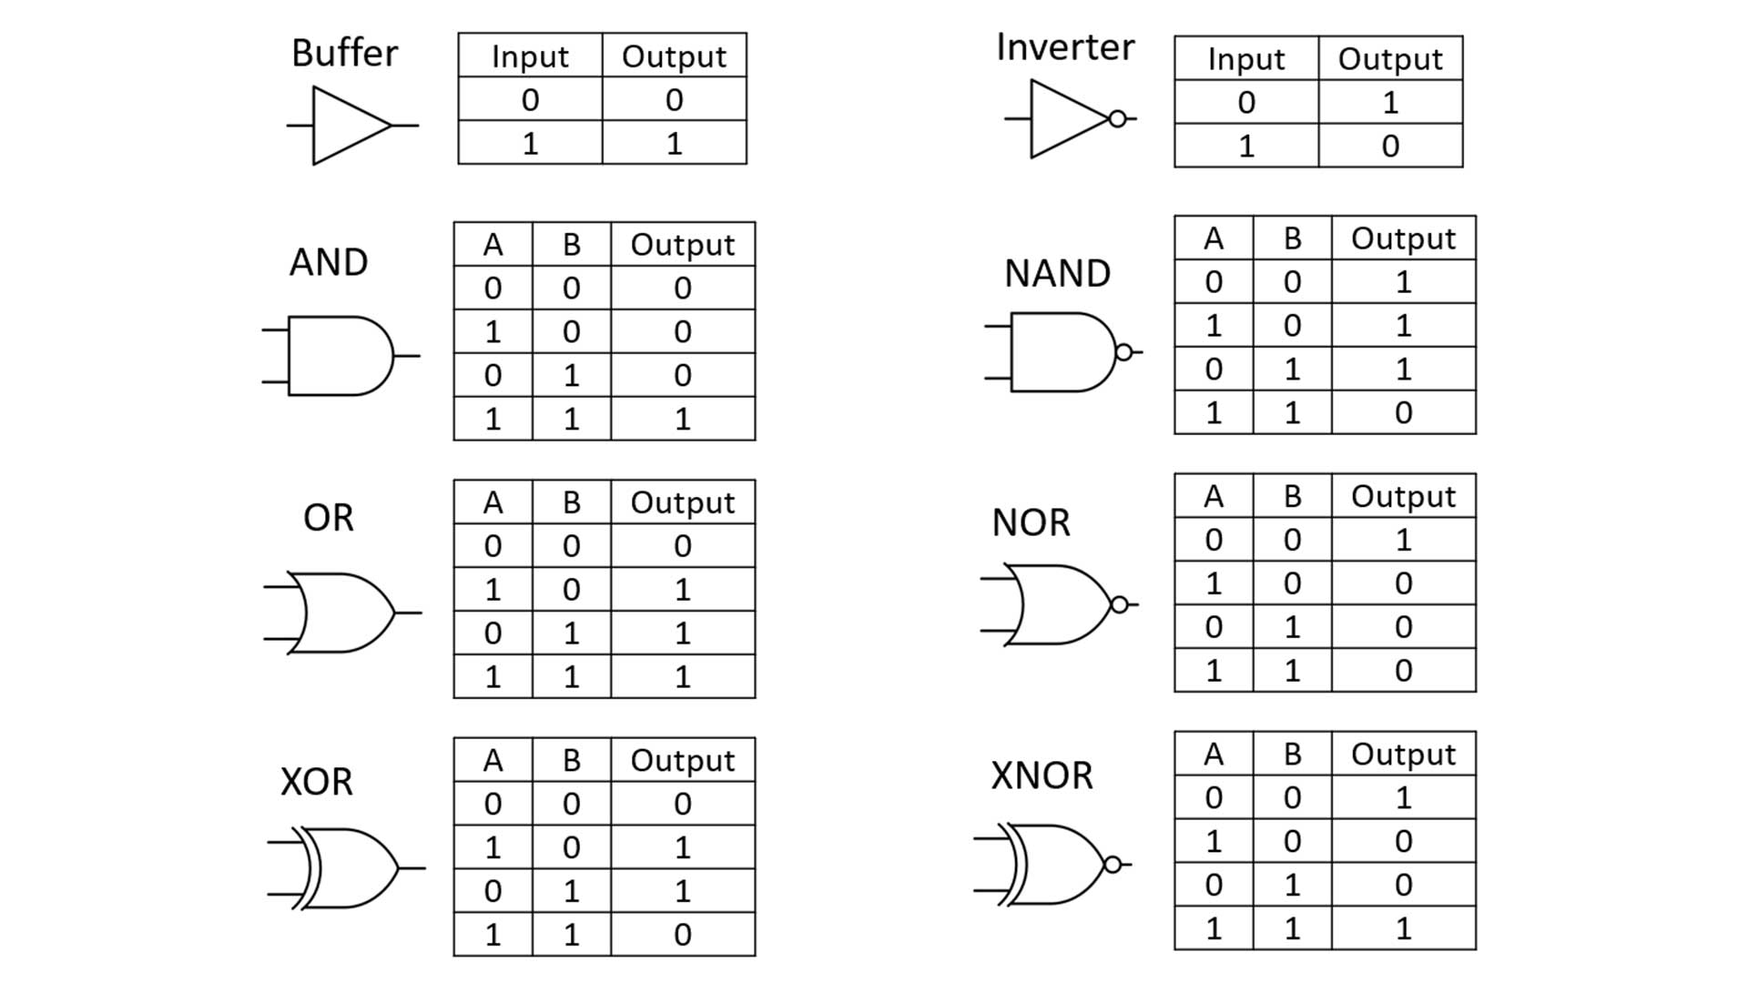
PMDCO:Workflows
Subclass_of
PMDCO:Operands
PMDCO:Mathematics
executes
participant_of
Subclass_of
Subclass_of
Subclass_of
Subclass_of
Subclass_of
PMDCO:Operations
PMDCO:Dividend
PMDCO:Divisor
PMDCO:Minuend
PMDCO:Subtrahend
PMDCO:Numbers
Subclass_of
Subclass_of
Subclass_of
PMDCO:Division
PMDCO:Subtraction
output_of
PMDCO:Results
Subclass_of
Subclass_of
PMDCO:Quotient
PMDCO:Difference

