Slide 1
A fine-grained station usage prediction for the Santander Bike-Sharing System in London
Tara Morovatdar

Slide 2
Overview
Introduction
Motivation
Problem Statement
Goal of the work
Approach
Data
Results
Conclusion

Slide 3
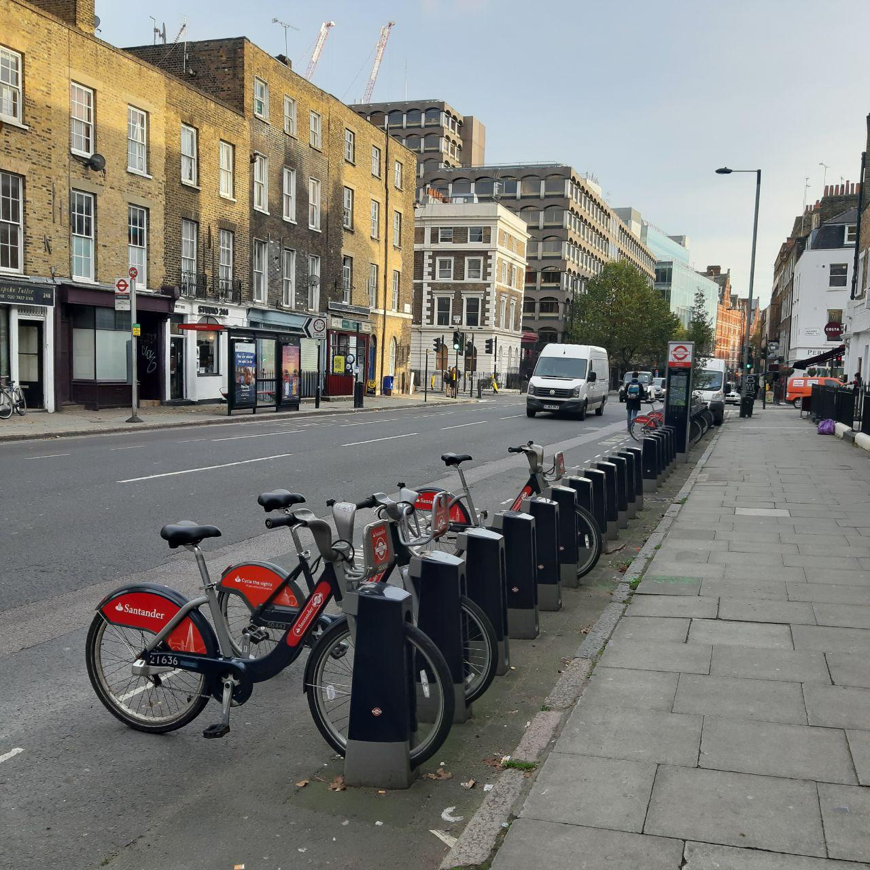
Introduction
Urban mobility
Shared mobility
Station-based shared mobility
Focus of this work: Station-based bike-sharing system
Fig 1: BSS bike station
Notes:
Urban mobility is a broad aspect meaning moving from one point in a city to another point
Because of fast growth of population living in the cities shared mobility is becoming
more and more popular . In shared mobility travelers share a vehicle either simultaneously as a group or over time as personal rental.
Station-based shared mobility refers to a network of strategically located stations that host transportation
mode vehicles like bikes, cars, or electric vehicles
In a station-based bike-sharing system there are stations in different parts of the city, and each station has some bikes available to
the users. A bike can be picked up at a station, be used for a journey, and returned to the same or any
other station.

Slide 4




Motivation
Advantages of BSS:
Less CO2 pollution and noise pollution
Increase of physical activities and public health improvement
Decrease bicycle ownership barriers
Travel cost saving
Providing missing link in public transport
Notes:
It is important to study Bike sharing systema because of its significant advantages for example:
-bss reduce single-passenger cars. When the traffic is eased down, there will be less CO2 and other air pollutants in the air.
-Public health will be improved, not only because of less air pollution but also as a result of increasing physical
Activity, reduced BMI , experiencing less stress, and lost weight because of using bicycles.
-Another advantage is decreasing bicycle ownership barriers, such as concern
about theft and parking place. When someone owns a bicycle, providing a parking place for it at home
and finding one at the destination, and concern about bicycle theft are the usual concerns
-BSS makes personal travel more affordable as it reduces the costs for road and parking.
It has been shown that the people from the poorer areas use the BSS more than the people from wealthier suburbs, which indicates that BSS make urban travel more affordable.
- BSS is filling the gaps in public transport travels, mainly the first mile from the origin to the first station of the public transit and the last mile from the last station to the destination.

Slide 5
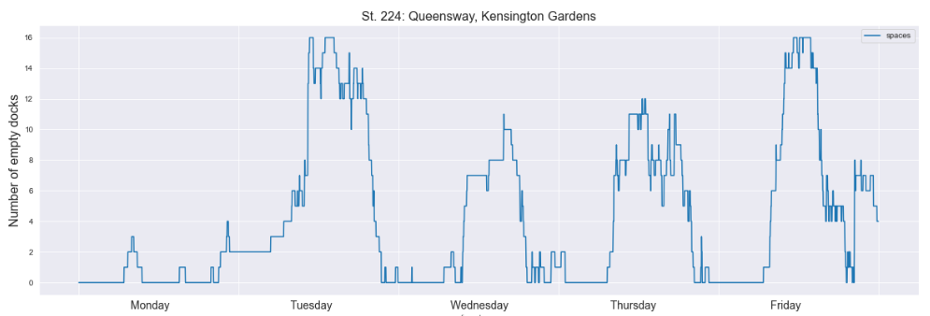
Motivation
Challenges of station-based BSS:
Theft and Vandalism
Sparse stations (non- optimal locations)
Unbalanced situation of a bike station
Fig 2. A station empty docks during the weekdays
Notes:
However, bike-sharing systems also bring various challenges with them.
- The bikes are often stolen or damaged while left unattended or unlocked. In addition, Bikes cannot
be found, as people take them “home” or to their yard
Using a station-based BSS, it might happen that stations are too sparse and too far away from each other.
This means that certain POIs are too far away from stations and people are less likely to use the
BSS
- Stations can be empty or full so there is no available bike to check-out or an empty dock to return the bike.
For example, in this plot which shows the number of empty docks for a station during a week, you can see that there are periods that there is zero empty dock in the station

Slide 6

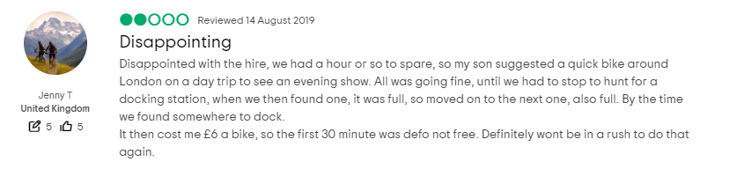
Problem statement
What is Unbalance situation?
Either no empty dock or available bike
One of the most critical issue in station-based BSS
Caused by asymmetric fluctuation of the system
Leads to low Quality of Service (QoS)
Fig4. Where's My Villo? A website that users made to put pressure on operators to redistribute the bikes better
Fig 3. A customer reviews London’s bike-share system on the Tripadvisor website
Notes:
At each station, the number of bike racks is limited, such
that it is not possible to return a bike to a full station or pick up a bike from an empty one. In bss, an unbalanced bike distribution in the stations is one of the most critical issues.
The bikes in a bike-sharing system need to be re-balanced frequently because, at different stations in
different periods, the bike check-in and check-out are unbalanced. In other words, the system usage
is asymmetric and fluctuates during the day.
If a user attempts to drop off a bike at a full station or tries to rent a bike from an empty station, the user would
be frustrated and have a feeling of bad quality of service when trying to use the system (Figure 2).

Slide 7
Goal of the Work
Examine existing solutions to mitigated the unbalanced situation:
Examine existing prediction models and compare their prediction accuracy of empty docks based on the same large-scale data
Examine to which extent surrounding stations have an impact on the prediction accuracy of the compared models
Investigating the usefulness of external features, such as weather, towards the prediction accuracy
Investigate whether the best performing prediction model can be applied in real-time, in order to be used in an app or other service for actual users.
Notes:
In order to prevent situations where a BSS user faces a station without any available bike or no empty slots to return the bike
, we aim to examine existing solutions to mitigated the unbalanced situation:
We examine existing prediction models and compare their prediction accuracy of empty docks based on the same large-scale data
We examine to which extent surrounding stations have an impact on the prediction accuracy of the compared models because if station is full people use nearby stations and this is sth that hasn’t taken into account yet
We investigate the usefulness of external features, such as weather, towards the prediction accuracy
We also investigate whether the best performing prediction model can be applied in real-time, in order to be used in an app or other service for actual users.

Slide 8
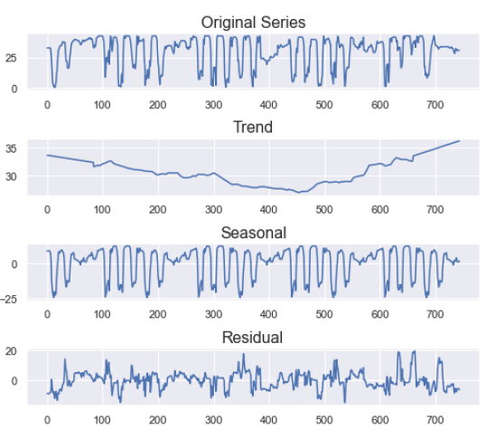
Approach
Usage patterns fluctuates during time
Time series decomposition:
Level, Trend, Seasonality, white noise
Stationarity condition:
No seasonality, no trend
Removing trend by differencing
Removing seasonality by Seasonal Adjustment
Notes:
Station usage patterns fluctuates during time and have repetitive pattern so simple regression will not work on this problem but Time series analysis can be useful to see how a numerical value changes over time.
A given time series consist of 4 components:
Level: The average value in the series.
Trend: The increasing or decreasing value in the series.
Seasonality: The repeating short-term cycle in the series.
Noise: The random variation in the series.
To be able to use any time series model our data must be stationary which means there shouldn’t be trend or seasonality.
To make sure that our data is stationary we removed trend by differencing and removed seasonality by Seasonal Adjustment
Then we applied the most promising models sarima, var and prophet.

Slide 9
SARIMA
A class of statistical models for analyzing and forecasting time series data
Based on the idea that the information in the past values of the time series can alone be used to predict the future values
A kind of regression
Uses observations from previous time steps called lags as input to a regression equation
We took the number of empty docks from previous time steps to predict the number of empty dock in future
The model can take independent variables (SARIMAX)
Notes:
SARIMA is a statistical analysis model that uses time series data to either better understand the data set or to predict future trends
It is based on the idea that the information in the past values of the time series can alone be used to predict the future values.
It is a kind of regression, that uses observations from previous time steps as input to a regression equation to predict the value at the next time step
We took the number of empty docks from previous time steps to predict the number of empty dock in future.
If we add independent variables to the model, it is called SARIMAX

Slide 10
VAR
A statistical model used to capture the relationship between multiple quantities as they change over time to show the correlation of multiple time series
Unlike SARIMA it can take the lagged values of other time series
Studying relationship between a station usage and its neighboring stations
2 different neighboring selection:
Fixed number of neighbors (n=5)
Stations within a fixes distance (d=300 m)
The model can take independent variables (VARX)
Notes:
VAR is another statistical model used to capture the relationship between multiple quantities as they change over time to show the correlation of multiple time series
So Unlike SARIMA that only take the past values of dependent variable it can take the lagged values of other time series
If a station is full or out of order users of a BSS will go to a nearby station so we used VAR to study relationship between a station usage and its neighboring stations
To understand the impact of neighboring stations we applied 2 different neighboring selection:
In the first set up we used the nearest five stations as the neighbors
And in the second scenario we selected stations that are in a 300 meters radius of the selected station
Similar to SARIMA the model can take independent variables

Slide 11

Fb-prophet
Facebook Prophet introduced by Facebook
Generalized Additive Model of decomposable time series model with traditional com-ponents; trend, seasonality, and holidays
Unlike VAR it can not take the lagged values of other time series
Advantages:
Can be intuitively adjusted by analysts
It is fast
Robust to missing values
The model also allows to incorporate independent variables as extra-regressors
Notes:
Facebook Prophet is a new model introduced by Facebook in 2017
unlike sarima and var that are based on regression , Facebook prophet uses Generalized Additive Model . It is based on the idea that time series are composed of trend, , seasonality, holidays plus some normally distributed error.
And Unlike VAR it can not take the lagged values of other time series
There are several significant advantages in this model that makes it stand out among the previous conventional methods: first The method allows one to apply the knowledge about the data into model without knowing statistical methods used within the model, secondly it fits very fast and one can interactively change the model parameters. And the method is robust to the missing values
The facebook prophet model also allows to incorporate extra-regressors as independent variables

Slide 12


Data
Bike sharing System from Santander in London and weather data, all in year 2018
Station observations including the number of available bike/docks in a 2-minute interval (CDRC)
796 stations in total → 68 stations that have high usage → 47 stations that are in central London
Trip data for each journey (publicly available)
Weather data with 60 mins frequency including: temperature, humidity, weather description, wind speed, pressure,..
Notes:
to test and evaluate the models we used the data from bike sharing system in London called Santander for the whole year of 2018.
The Station observations that we used for prediction includes the number of available bike and docks on each station in a 2-minute interval and was granted to us from consumer data research center or CDRC
In total there were 796 stations active during 2018. we selected 68 stations that have the highest change rate because we wanted to focus on the stations that have the most usage.
Then to make sure that this highly used stations are not just used by a certain group of people living in an area, we picked 47 stations that are in central London.
We also used the data about each trip occurred during 2018 for our explanatory analysis,
We also incorporated Weather data with 60 mins frequency that we got from openweather to investigate the weather impact on prediction accuracy

Slide 13
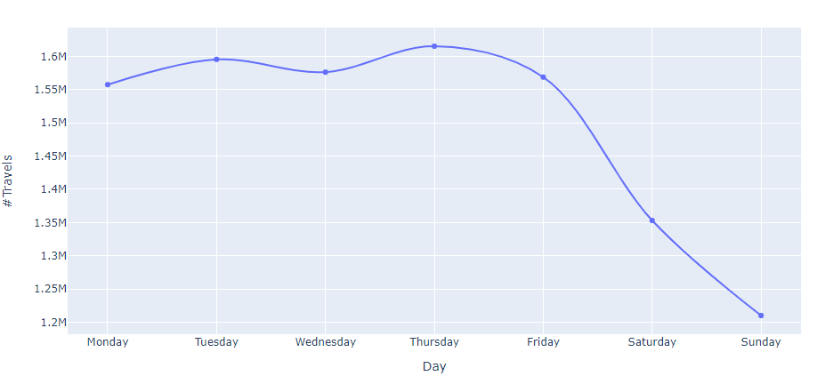
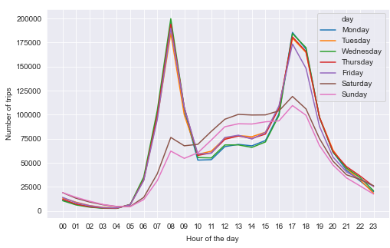
Data
Temporal dependencies
Fig 5. Frequency distribution of hire during the different days of the week
Fig 6. Frequency distribution of hire during the different hours
Notes:
different dependencies affect the imbalance in bike distribution. The first is a temporal one,
which means that the bike usage changes at different times of the day and week.
In the left figure we see a substantial distinction between weekday
and weekend number of travels.
looking at the hourly trend on weekdays versus
weekends. in the right figure we see that the patterns of weekdays and weekends bike usage are clearly different. On weekdays, the daily usage pattern is like each other
and weekend have a similar patter, but they are different from weekdays
We also observe that there are two peaks during the weekdays, which refers to the commuting.
behavior of the users. It also shows that working hour starts between 07:00 and 08:00 and people
finish the work between 17:00 to 18:00 in the city of London.

Slide 14
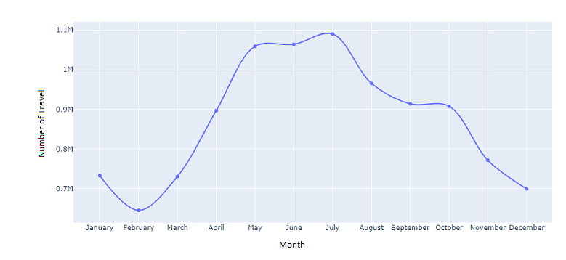
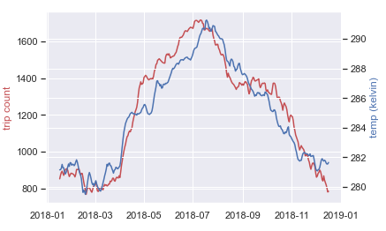
Data
Meteorological dependencies
Fig 7. Travel frequency during different month of a year
Fig 8. Average daily temperature versus number of trips
Notes:
The second dependency is the meteorological dependency, which
means that bike usage can change due to the different weather conditions.
In the left figure we se that a smaller number of trips occur during the winter time and there are high number of travels in June and July
Looking at the right figure it seems that bike usage and temperature correlate with each other.

Slide 15
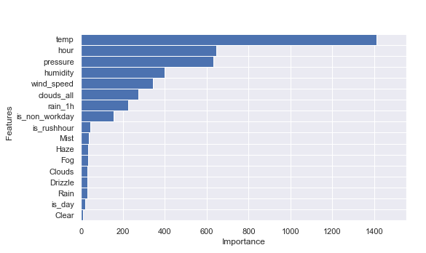
Data
Feature Engineering
17 variables were extracted
XGBoost regressor used for feature selection
7 features were selected
temperature, humidity, Rain
is_non_workday, hour, is_rushhour ,is_day
Fig 9. Feature importance ranked by XGBoost
Notes:
Based on temporal patterns in data we extracted 4 temporal variables like if it is rush hour or not, if it is a working day or not and so on.. we also added 13 features related to weather condition
then we applied XGBoost regressor to select the most important features

Slide 16
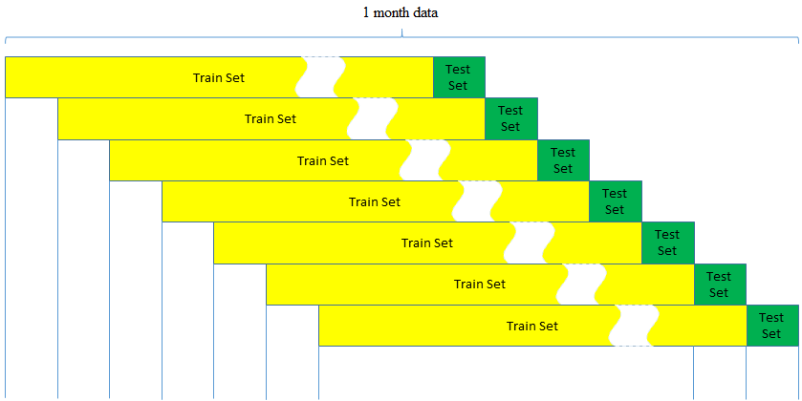
Evaluation
Training data and model Evaluation
3 weeks of train, 1 week of test
Used walking forward to improve accuracy
Sliding window of 4 hours
predict number of empty docks 10, 30,
60 and 120 minutes ahead
Fig 10. Walking forward validation with sliding window
Notes:
So , how do we evaluate the models?!
We divided one year of data into 12 sets of train and test
For each month we took 3 weeks as train and one week as test data
but instead of predicting the whole 1 week of data at once we used walking forward validation. meaning we retrain our model as new data becomes available
Since the predictions over time become less and less accurate, in time series, the walking forward approach has the best opportunity to make good forecasts and is used as a goal standard in time series
Each time the model is trained, we predict 4 hours in head and then the predictions are saved to calculate the overall error.
Four main time intervals for predictions are considered: $10$ minutes, $30$ minutes, one hour, and two hours. The first two time intervals for prediction are more suitable for frequently used stations. However, increasing the time interval to up to two hours can also be acceptable for less frequently used stations.

Slide 17
Evaluation
Base line approaches:
Last value(LV), Historical Average(HA)
Performance metrics:
Root Mean Square Error (RMSE), Mean absolute error (MAE)
Friedman T test
Wilcoxon signed rank test
Used Bonferroni adjustment to prevent Alpha inflation
Notes:
We have 2 baselines:
Lv assumes that the number of docks in the station at point t0+ ∆ will be the same as t0 for any time in the future.
And HA forecasts that all future values are equal to the average of the historical data
To compare the trained models’ prediction performance, we used Root Mean Square Error and Mean absolute error
Since the samples did not follow normal distribution, we used Friedman T test which is a none parametric test to see if at least one of the models is significantly different
And since we applied different models on the same data the samples are paired so we used Wilcoxon signed rank test to see if any of our model is performing significantly better
Also to prevent alpha inflation we used Bonferroni correction which mean we divided the p-value by number of null-hypothesis

Slide 18

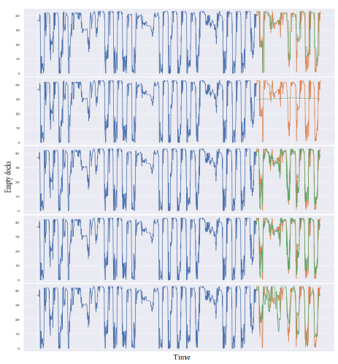
Overall Performance
LV
LV is a shift in data
HA has poor performance
SARIMA model and VAR model show very similar performance
SARIMA and VAR capture weekends and weekdays pattern
Fb-prophet struggles to fit the extremely low values
HA
SARIMA
VAR
Fb-prophet
Different model Predictions .The orange line is the real value, and the green line is the predicted value for each model.
Notes:
The HA model has the worst performance among all the models, but unlike the others, the performance does not differ for different time offsets.
the HA model fails to capture any seasonality or change in trend as the
average value of the number of empty docks in a station does not change
last value model can be interpreted as a shift in our actual data, so it is capable of considering
the
The SARIMA model and VAR model show very similar prediction patterns. It can
be seen that on weekends and weekdays, different behaviors are correctly captured, and the models
are stable during different days of the week.change points.

Slide 19
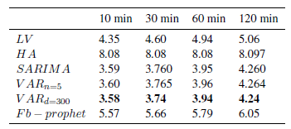
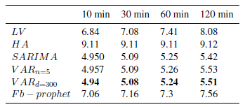
Overall Performance
Average performance over 47 stations with the highest change rate that are in central London During the year 2018.
The VAR_d=300 has the best performance
The average MAE error for all the sampled stations for all test days.
The average RMSE error for all the sampled stations for all test days.
Notes:
The VAR_d=300 has the best performance and HA has the worst.

Slide 20
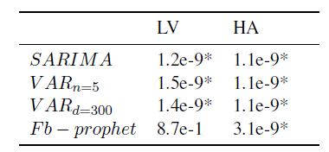
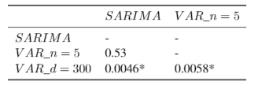
Overall Performance
All the models except Fb-prophet perform significantly better than both base lines (p-value=0.00625).
The VAR model using neighboring stations in 300 meters radius is performing significantly better than other models (p-value=0.016)
The p-value according to each Wilcoxon test testing our models versus the baseline. The alpha is equal to 0.00625
The p-value according to each Wilcoxon test testing our models versus the baseline. The alpha is equal to 0.016
Notes:
Now lets see if our models are significantly better the baselines or if any models is performing significantly better than all the other approaches

Slide 21
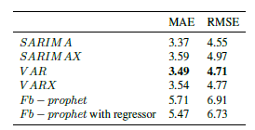
Exogenous variables impacts
Using independent variables in our models
Data is hourly averaged
The Exogenous variables are used as extra regressors
The performance only improved in Fb-prophet
Comparison of average model error using independent variables (SARIMAX and VARX are the ones including independent variables)
Notes:
After investigating different models' performance, we wanted investigate the impact of independent variables
As I mentioned before we selected 7 features using xgboost regressor then since our exogenous variables have 60 minutes frequency the frequency of our observation also has to be one 60 minutes so they can be passed to the models.

Slide 22
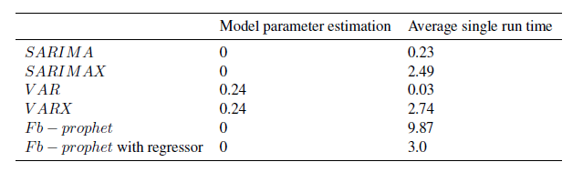
Computational time performance
Running the models on a Server with 500 GB of RAM and two CPUs (Intel(R) Xeon(R) CPU E5-2690 v2 @ 3.00GHz) that each CPU has 10 cores
The winner model VAR has an average run time of 0.27 second
The model can run on a real-time system
Computational time (in s) on average for each round of fitting the model.
Notes:
The tables shows that our winner model VAR has an average run time of 0,27 second. While the
Santander BSS has approximately 800 stations the time needed for predicting all the stations is 3,6
minutes. As we predict multiple-steps for four hours into future and we need few minutes for prediction
it proves the model is capable of running on a real-time system.

Slide 23
Discussion
The independent variables didn’t have positive effect on prediction accuracy;
weather condition has less effect on commuters
Model captures the temporal patterns
The weather change is coded in previous lags
The VAR_d=300 has the best performance;
Incase of a station shut down or no available empty dock users will go to a nearby station
300 meters is a walkable distance for users
Notes:
the meteorological features have an impact on bike usage in general, but it does not have the same impact during different times of the day. Usually bike share users in the rush hours are commuters, who use BSS to enhance their commute so that weather condition has less effect on commuters than tourists and casual users.
The other fact is that since we are using time series, the model itself captures the temporal patterns, though adding them as extra features will not have a significant impact. Similar to that, the weather impact already exists in the bike usage data, so using the weather data does not help much in predicting bike usage.

Slide 24
Conclusion
Neighboring stations have effect in predicting a frequent BSS station usage
VAR_d=300 (using stations in 300 meters radius) model is performing significantly better than our baselines and other methods.
Our analysis revealed that while the temporal and meteorological dependencies are captured by our SARIMA and VAR model it will cause over-fitting using them as independent variables.
The winner model (VAR_d=300) not only has a good performance but also has a low computational time that makes is fast and scalable for using in a real-time application

Slide 25

Questions
Thank you for your time. Any questions?

