Slide 1
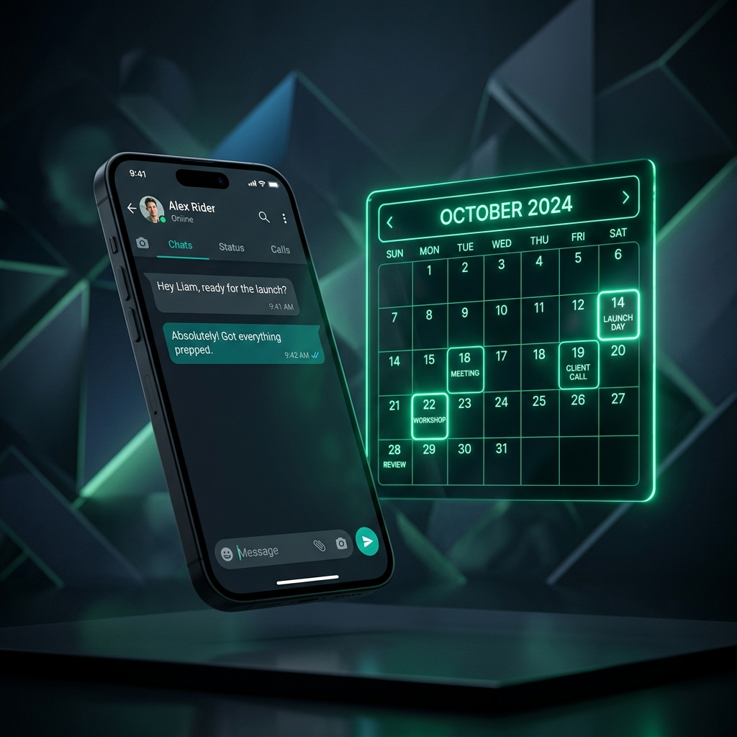
STARX FLOW
24/7 AI Receptionist
Setup Masterclass
A Step-by-Step Roster & Calendar Integration Playbook for Local Service Businesses.
OPERATIONAL BLUEPRINT

Slide 2
PHASE 1: PRE-REQUISITES & CALENDAR HOOK
Lay the Solid Foundation
01
02
03
04
Dedicated Line
Calendar Sync
Roster Definition
Double-Booking Safe
Secure a clean WhatsApp Business number. Back up chat logs if converting an existing active business line.
Integrate Google Calendar, Outlook, Square POS, or Clover natively in the StarX Flow Dashboard.
Add employees, custom hours, active days, service pricing, and appointment buffers.
Configure 2-way sync to lock slots instantly and prevent overlapping sessions.

Slide 3
PHASE 2: BUILDING THE AI KNOWLEDGE BASE
Teach the AI Your Front-Desk Rules
Identity & Voice
Core FAQ Mapping
Live Staff Triage
• Match business name/locations
• Cancellation & refund policies
• Define handover triggers
• Calibrate brand tone (warm/professional)
• Parking, building access guidelines
• Keywords: "emergency", "complaint"
• Adopt native localized greetings
• Service specifications & upgrades
• Live desktop sound alerts

Slide 4
PHASE 3: INTEGRATION TESTING & LAUNCH
Go Live and Put Bookings on Autopilot
🚀 Go-Live Playbook Checklist
✔ Dry-Run Testing: Send test texts on WhatsApp to book slots, ask for pricing, and request changes.
✔ Waiver Integrations: Confirm that WhatsApp waivers or Stripe deposits display cleanly inside the chat flow.
✔ Staff Escalation Hook: Ensure active front-desk staff can see active chats in the StarX Admin Hub.
✔ Autopilot Activation: Switch the AI Assistant toggle to Live, put up the WhatsApp business link, and watch bookings scale.

