Slide 1
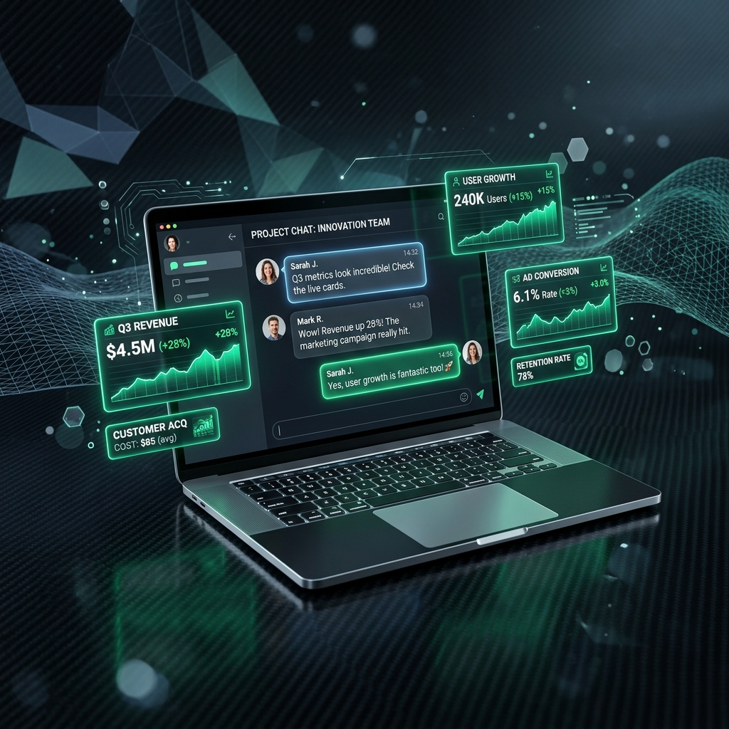
STARX FLOW
WhatsApp Booking
Templates Playbook
High-Converting, Copy-Pasteable Conversation Flows & Auto-Followups for Service Businesses.
CAMPAIGN ASSETS

Slide 2
TEMPLATE 1: SALON & SPA AUTO-BOOKING STREAM
High-Convert Flow (90%+ Retention)
Client
"Hey, do you have any openings for a massage tomorrow?"
AI Receptionist
"Hi! We do have a few openings tomorrow. Here are our available slots:
- 10:30 AM (with David)
- 2:00 PM (with Emily)
- 4:30 PM (with David)
Which slot matches your schedule?"
Client
"2:00 PM with Emily works great."
AI Receptionist
"Awesome! To secure your 60-Minute Therapeutic Massage with Emily at 2:00 PM tomorrow, please reply with your Full Name and Email Address."

Slide 3
TEMPLATE 2: DEPOSIT & CLINIC INTRO WAIVERS
Intake and Booking Secure Script
Client
"Can I book a Chiropractic Adjustment?"
AI Receptionist
"Hi! I can schedule that right now. We have open times this Tuesday at 9:00 AM and Wednesday at 3:00 PM. Which is better?"
Client
"Tuesday at 9:00 AM."
AI Receptionist
"Great! To finalize this slot, first-time patients are required to fill out a brief intake waiver and secure the session with a $20 deposit.
Here is your secure link: [Link]
Once done, your slot is locked!"

Slide 4
TEMPLATE 3: THE GOOGLE REVIEW BOOSTER CAMPAIGN
Post-Session Review Booster Auto-Pilot
📈 Google Review Automator Script
Trigger timing: 2 hours after checkout
"Hey [Client-Name]! Thank you for visiting us today at [Business-Name]. We hope you loved your session with [Staff-Name]!
If you have 10 seconds, it would mean the world to our local staff if you shared your experience on Google:
[Your-Google-Review-Link]
Have an amazing week!"

