Slide 1
Blue Wireframes

Slide 2
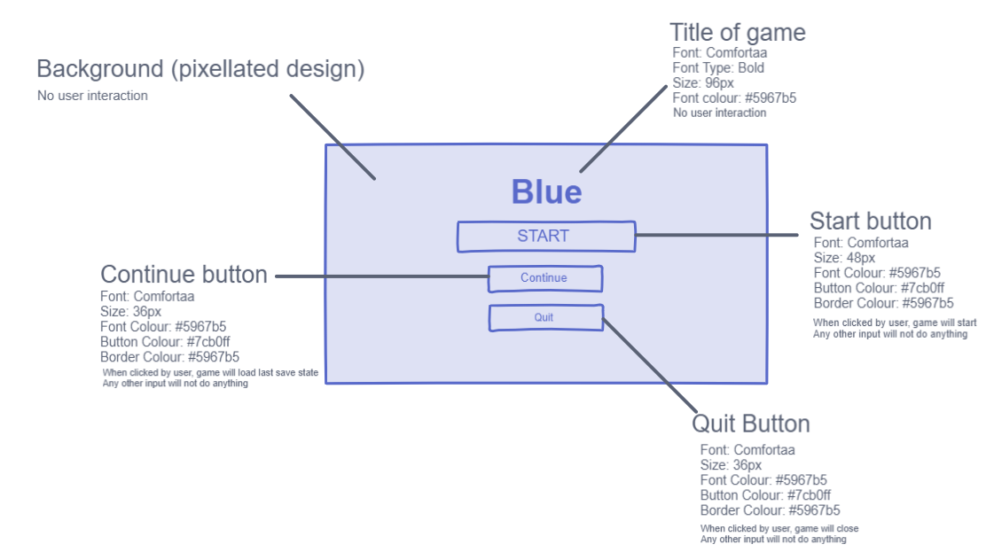
Main menu design

Slide 3
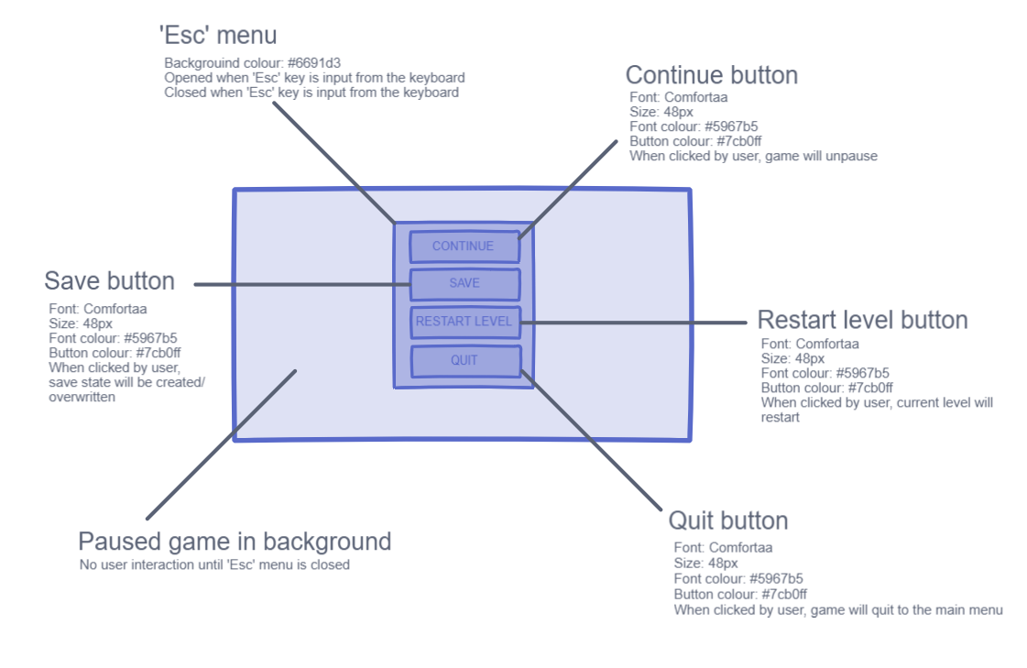
‘Esc’ menu design

Slide 4
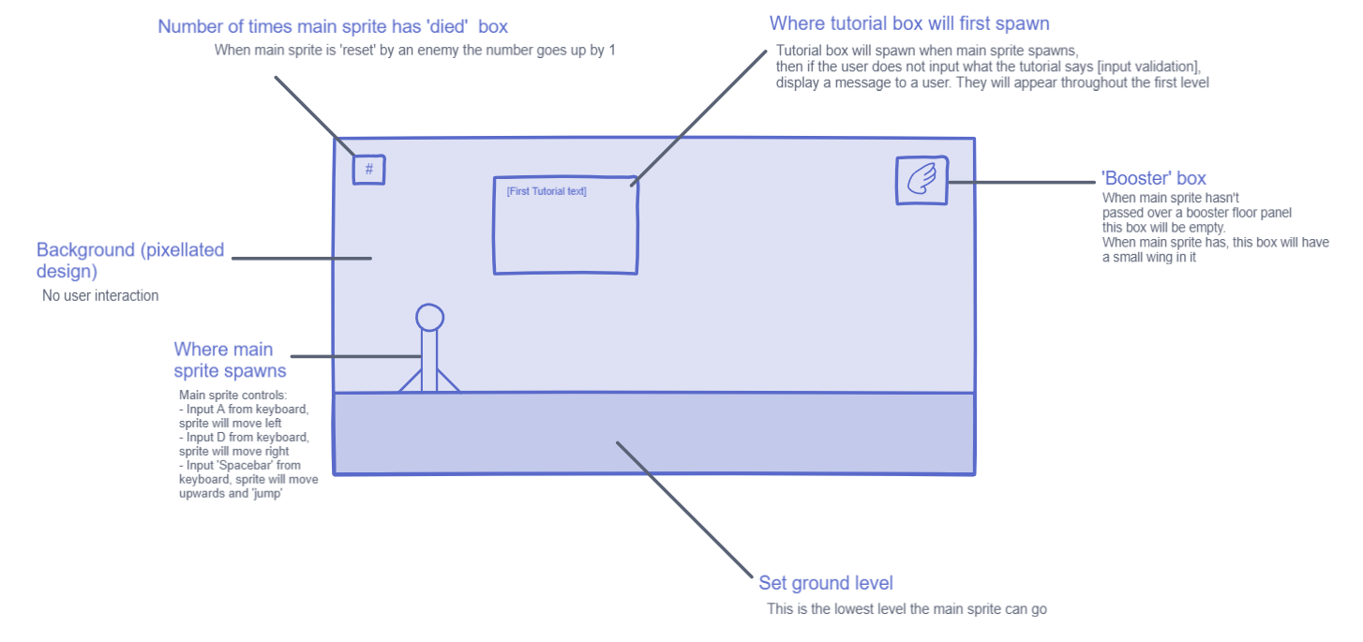
In-game design

Slide 5
Update for:
Candara instead of comfortaa
Screen resolution
Box width/height

