Slide 1



Wrangling Identity
& Access in AWS
Lecture 2: Fencin' the Frontier
Notes:
1

Slide 2

What You Just Broke
Attack | What You Did | Root Cause
CreatePolicyVersion | Modified a policy attached to yourself | No ceiling on max permissions
AssumeRole | Assumed an overly-trusted admin role | :root trust = trust everyone
PassRole + EC2 | Passed a privileged role to EC2 | Missing iam:PassedToService
UpdateFunctionCode | Hijacked a Lambda with admin role | Resource: * on write actions
PutGroupPolicy | Wrote admin policy on your group | Resource: * on group actions
Now we will learn some guardrails that could have prevented these privesc paths
Notes:
1

Slide 3
Condition Keys: Be Specific
BEFORE
AFTER
{
"Effect": "Allow",
"Action": "iam:PassRole",
"Resource": "*"
}
{
"Effect": "Allow",
"Action": "iam:PassRole",
"Resource": "arn:...iamws-ci-runner-role"
"Condition": {
"StringEquals": {
"iam:PassedToService":
"ec2.amazonaws.com"
}
}
}
Pass ANY role to ANY service
Pass ONE role to ONE service
Two fixes: Resource constraint (WHICH role) + Condition key (WHICH service)
Notes:
1

Slide 4
Permissions Boundaries: The Ceiling
Identity Policy
Allow *:* (attacker-modified)
{
"Sid": "DenyPrivilegeEscalation",
"Effect": "Deny",
"Action": [
"iam:CreatePolicyVersion",
"iam:SetDefaultPolicyVersion",
"iam:DeleteUserPermissionsBoundary",
"iam:DeleteRolePermissionsBoundary"
],
"Resource": "*"
}
× Boundary
Allow s3:*, ec2:Describe*
= Effective
s3:*, ec2:Describe* (capped)
Boundaries are attached to a principal (user or role). They limit what identity policies can grant.
Always deny DeletePermissionsBoundary in the boundary itself — otherwise the attacker removes it first.
Notes:
1

Slide 5
Condition Keys You Should Know
aws:SourceIp
aws:CurrentTime
Restrict to specific IP ranges or VPN CIDR blocks
Enforce business-hours-only access windows
aws:PrincipalOrgID
aws:RequestedRegion
Limit access to principals within your AWS Organization
Restrict which AWS regions can be used
aws:PrincipalTag
aws:MultiFactorAuthPresent
Attribute-based access control (ABAC) using tags
Require MFA for sensitive operations
Notes:
1

Slide 6
Hardening Trust Policies
BEFORE
BEFORE
AFTER
{
"Effect": "Allow",
"Principal": { "AWS": "...ACCT:root" }
"Action": "sts:AssumeRole"
}
{
"Effect": "Allow",
"Principal": {
"AWS": "...role/specific-role"
},
"Action": "sts:AssumeRole",
"Condition": {
"Bool": { "aws:MFA": "true" }
}
}
Trusts EVERYONE in the account
Trusts ONE role + requires MFA
Remember - trust policies are resource policies on the TARGET role, not the caller.
Notes:
1

Slide 7

Resource Constraints
BEFORE
AFTER
{
"Action": [
"lambda:UpdateFunctionCode",
"lambda:GetFunction",
"lambda:InvokeFunction"
],
"Resource": "*"
}
{
"Action": [
"lambda:UpdateFunctionCode",
"lambda:GetFunction",
"lambda:InvokeFunction"
],
"Resource": "arn:..function:my-function"
}
Can modify ANY Lambda
Can only modify function with name my-function
Wildcards are the enemy. Principle of least privilege is our friend.
Notes:
1

Slide 8
Service Control Policies
· Apply to entire AWS Organizations
Organization
· Permission LIMITS, not GRANTS
· Even account root user is subject to SCPs
Organizational Units
← SCP applies here
{
"Effect": "Deny",
"Action": [
"iam:CreateUser",
"iam:CreateAccessKey",
"organizations:LeaveOrganization"
],
"Resource": "*"
}
Account
Principal
In this workshop, we are working in one AWS account, but in reality understanding AWS Organizations is critical for enterprise defense.
Notes:
1

Slide 9
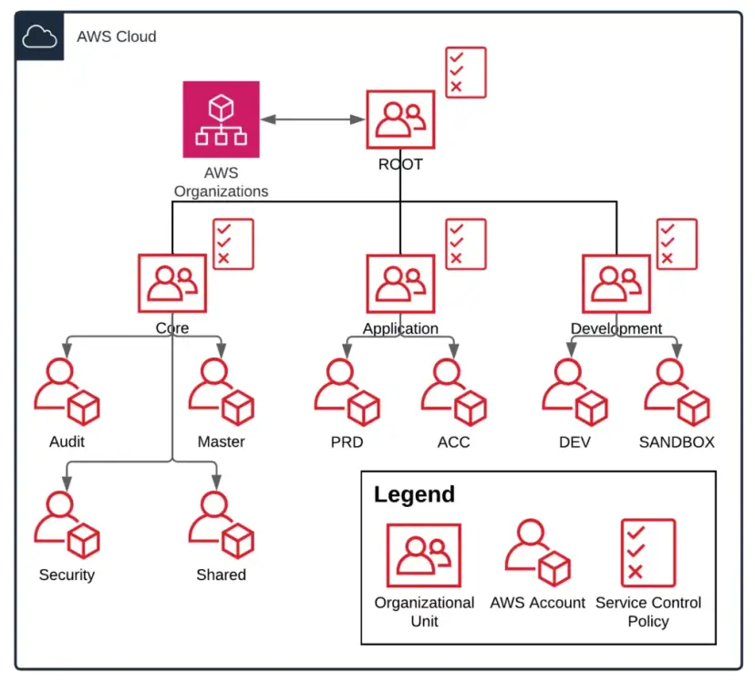
AWS Organizations: OU Structure
Source: towardsthecloud.com
SCPs are attached at the OU level and inherited by all accounts below.
Notes:
1

Slide 10
Guardrails recap
Guardrail | What It Does | Attached To
Permissions Boundary | Sets max permissions an identity policy can grant — acts as a ceiling | IAM user or role
Trust Policy | Controls which principals can assume a role | IAM role (target role)
Condition Keys | Adds context-based restrictions (IP, time, MFA, tags) | Any policy statement
Resource Constraints | Scopes Resource element to specific ARN patterns | Resource field in any policy
Service Control Policies | Sets max permissions for all principals in affected accounts | AWS Org root, OU, or account
Notes:
1

Slide 11
Use case 1: What strategy?
An ops team needs permission to restart production EC2 instances, but only during their on-call shift window and only when connected to the corporate VPN.
Condition Keys
Use aws:CurrentTime with DateGreaterThan / DateLessThan to enforce the time window, and aws:SourceIp to restrict to the VPN CIDR. Both conditions scope ec2:RebootInstances to the right context.
Notes:
1

Slide 12
Use case 2: What strategy?
Junior developers need to deploy Lambda functions and create IAM execution roles. But you need to guarantee they can never create a role with broader permissions than a pre-approved set — even if they write a policy granting *:*.
Permissions Boundary
Attach a boundary to each developer principal that defines the maximum permission set. Any role or policy the developer creates is intersected with this boundary. Even *:* is capped at the boundary ceiling.
Notes:
1

Slide 13
Use case 3: What strategy?
A shared analytics S3 bucket needs to be accessible by ETL pipeline roles in three different AWS accounts owned by different business units. No other principals — inside or outside the organization — should have access.
Resource Policy/Resource Constraints
Attach an S3 bucket policy that lists the three cross-account role ARNs as principals. Add aws:PrincipalOrgID as a condition to ensure only principals within your organization are accepted. Cross-account access requires the resource policy — identity policies alone aren't sufficient.
Notes:
1

Slide 14















Defense in Depth: Layered Security
Amazon EC2
AWS Secrets Manager
Authenticates as compromised user
Amazon Bedrock
Amazon RDS
sts:AssumeRole
Initial Access
AWS Lambda
Recon Sweep
AssumeRole BLOCKED
Possible Defenses:
properly configured resource policy on bucket
Don’t store AWS creds in buckets in plain text
Leaked IAM creds in
public S3 bucket
ReadOnlyAccess policy,
12+ services enumerated
Attempted to assume admin roles,
denied by trust policy
Possible Defenses:
SCP stopping account from accessing Bedrock and/or GPU resources
Possible Defenses:
Don’t leave old IAM Users laying around
better scope lambda role permissions
permissions boundary on IAM users
Possible Defenses:
Identity policy restricting ability to update function code
Condition key limiting context from which Lambda code can be updated
Escalates privileges with Lambda Execution role
Authenticates with new access key
as ‘frick’ user
Lambda Injection
Create Access Key
Full AWS Account Compromise
UpdateFunctionCode
on ‘EC2-init’ Lambda
Lambda exec role creates
key for `frick’ dormant user
19 principals chained,
LLMjacking + GPU hijack
Source: sysdig threat research team
Notes:
https://www.sysdig.com/blog/ai-assisted-cloud-intrusion-achieves-admin-access-in-8-minutes
The threat actor infiltrated the victim’s environments using valid test credentials stolen from public S3 buckets. These buckets contained Retrieval-Augmented Generation (RAG) data for AI models, and the compromised credentials belonged to an Identity and Access Management (IAM) user that had multiple read and write permissions on AWS Lambda and restricted permissions on AWS Bedrock. This user was likely intentionally created by the victim organization to automate Bedrock tasks with Lambda functions across the environment.
It is also important to note that the affected S3 buckets were named using common AI tool naming conventions, which the attackers actively searched for during reconnaissance.Amazon Bedrock
After enumerating IAM roles, the threat actor unsuccessfully attempted to assume roles with names typically associated with administrative privileges (e.g., sysadmin,netadmin). Since the compromised user had UpdateFunctionCode and UpdateFunctionConfiguration permissions on Lambda, the threat actor pivoted to privilege escalation through Lambda function code injection.Role

Slide 15

Policy validation
The never ending quest for well scoped policies
Notes:
1

Slide 16
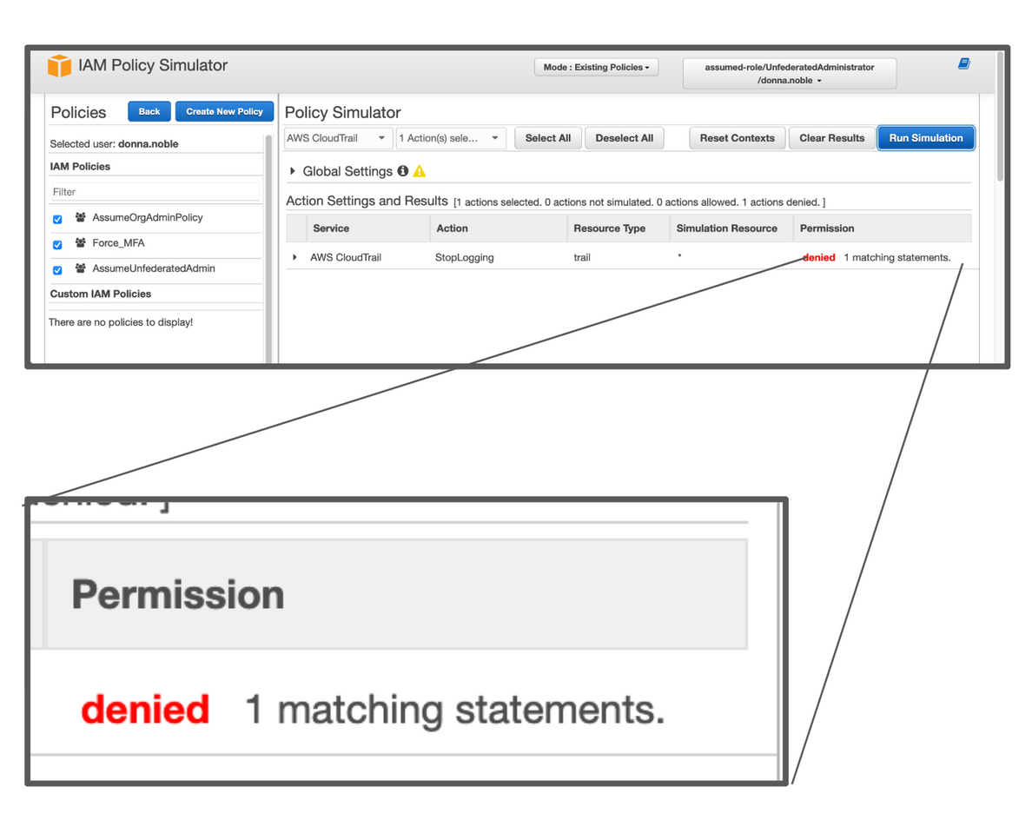
IAM Policy Simulator
Test before you deploy — simulate API calls against any principal's policies without making real requests.
Test identity policies
Pick a principal, pick an action + resource, see ALLOWED or DENIED with the exact statement that made the decision
Test boundaries + SCPs
Simulator evaluates permissions boundaries and organization SCPs in the same flow AWS uses at runtime
Test resource policies
Validate S3 bucket policies, trust policies, and other resource policies against specific callers
policysim.aws.amazon.com
Notes:
1

Slide 17
IAM Access Analyzer
Continuous analysis of your IAM environment — find what you missed.
External access findings
Unused access detection
Identifies resources (S3, IAM roles, KMS, SQS) shared with principals outside your account or organization
Finds unused roles, access keys, passwords, and for active principals: unused services and actions
Policy validation
Custom policy checks
100+ automated checks against AWS best practices and policy grammar as you write policies
Validate policies against your own standards before deployment using automated reasoning
Free for external access findings. Unused access detection requires organization-level scope.
Notes:
1

Slide 18


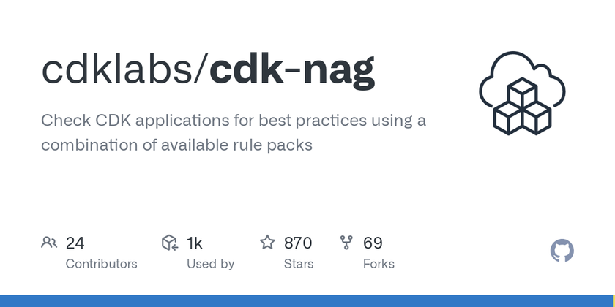
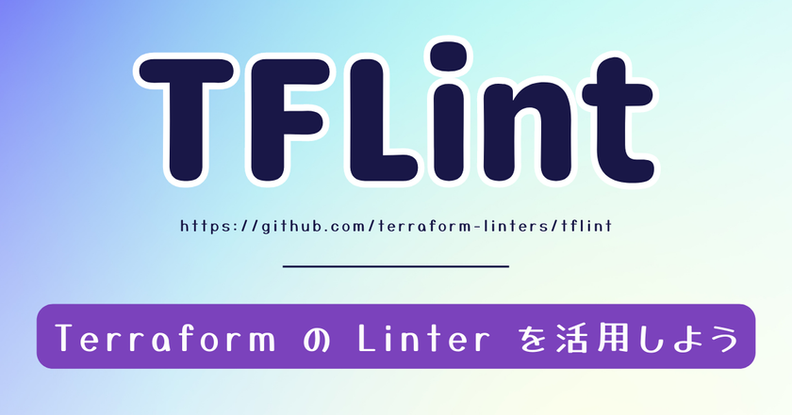


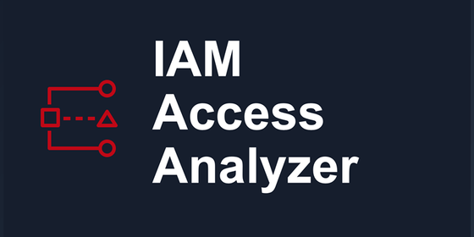
Shift Left: Lint Your Policies in CI/CD
Catch IAM misconfigurations before they reach AWS.
Notes:
1

Slide 19
Lab 2: Your Mission
# | Exercise | You Will... | Guardrail Type
1 | Permissions Boundary | Create DeveloperBoundary, apply to policy-developer | Perm. Boundary
2 | Trust Policy | Harden privileged-admin-role trust policy | Resource Policy
3 | Condition Key | Add iam:PassedToService + resource constraint | Condition Key
4 | Resource Constraint | Scope lambda-developer to dev-* functions | Identity Policy
Exploit → Remediate → Verify. 45 minutes.
Notes:
1

Slide 20

Thank you
Notes:
1

