Slide 1

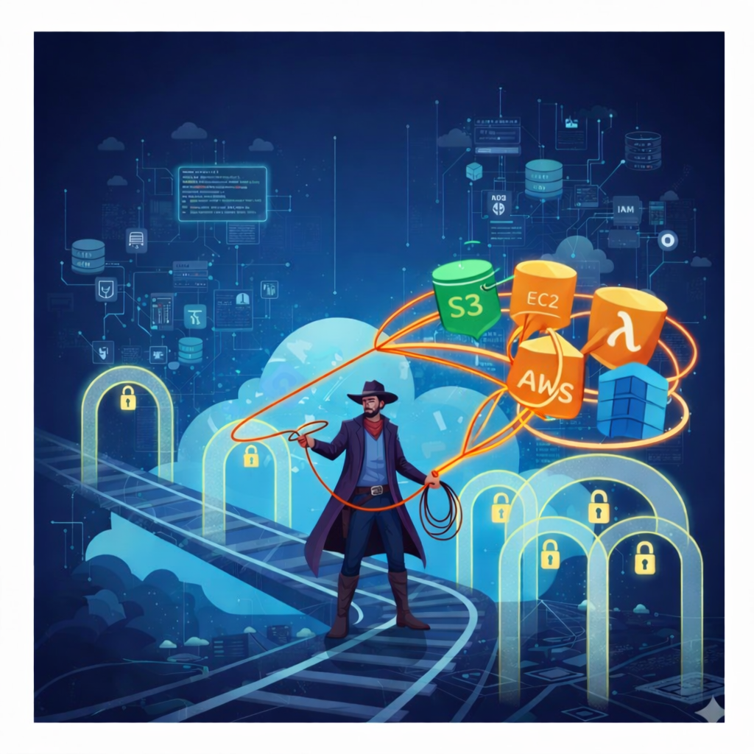
Wrangling Identity
& Access in AWS
Lecture 2: Lab Introduction
Notes:
1

Slide 2
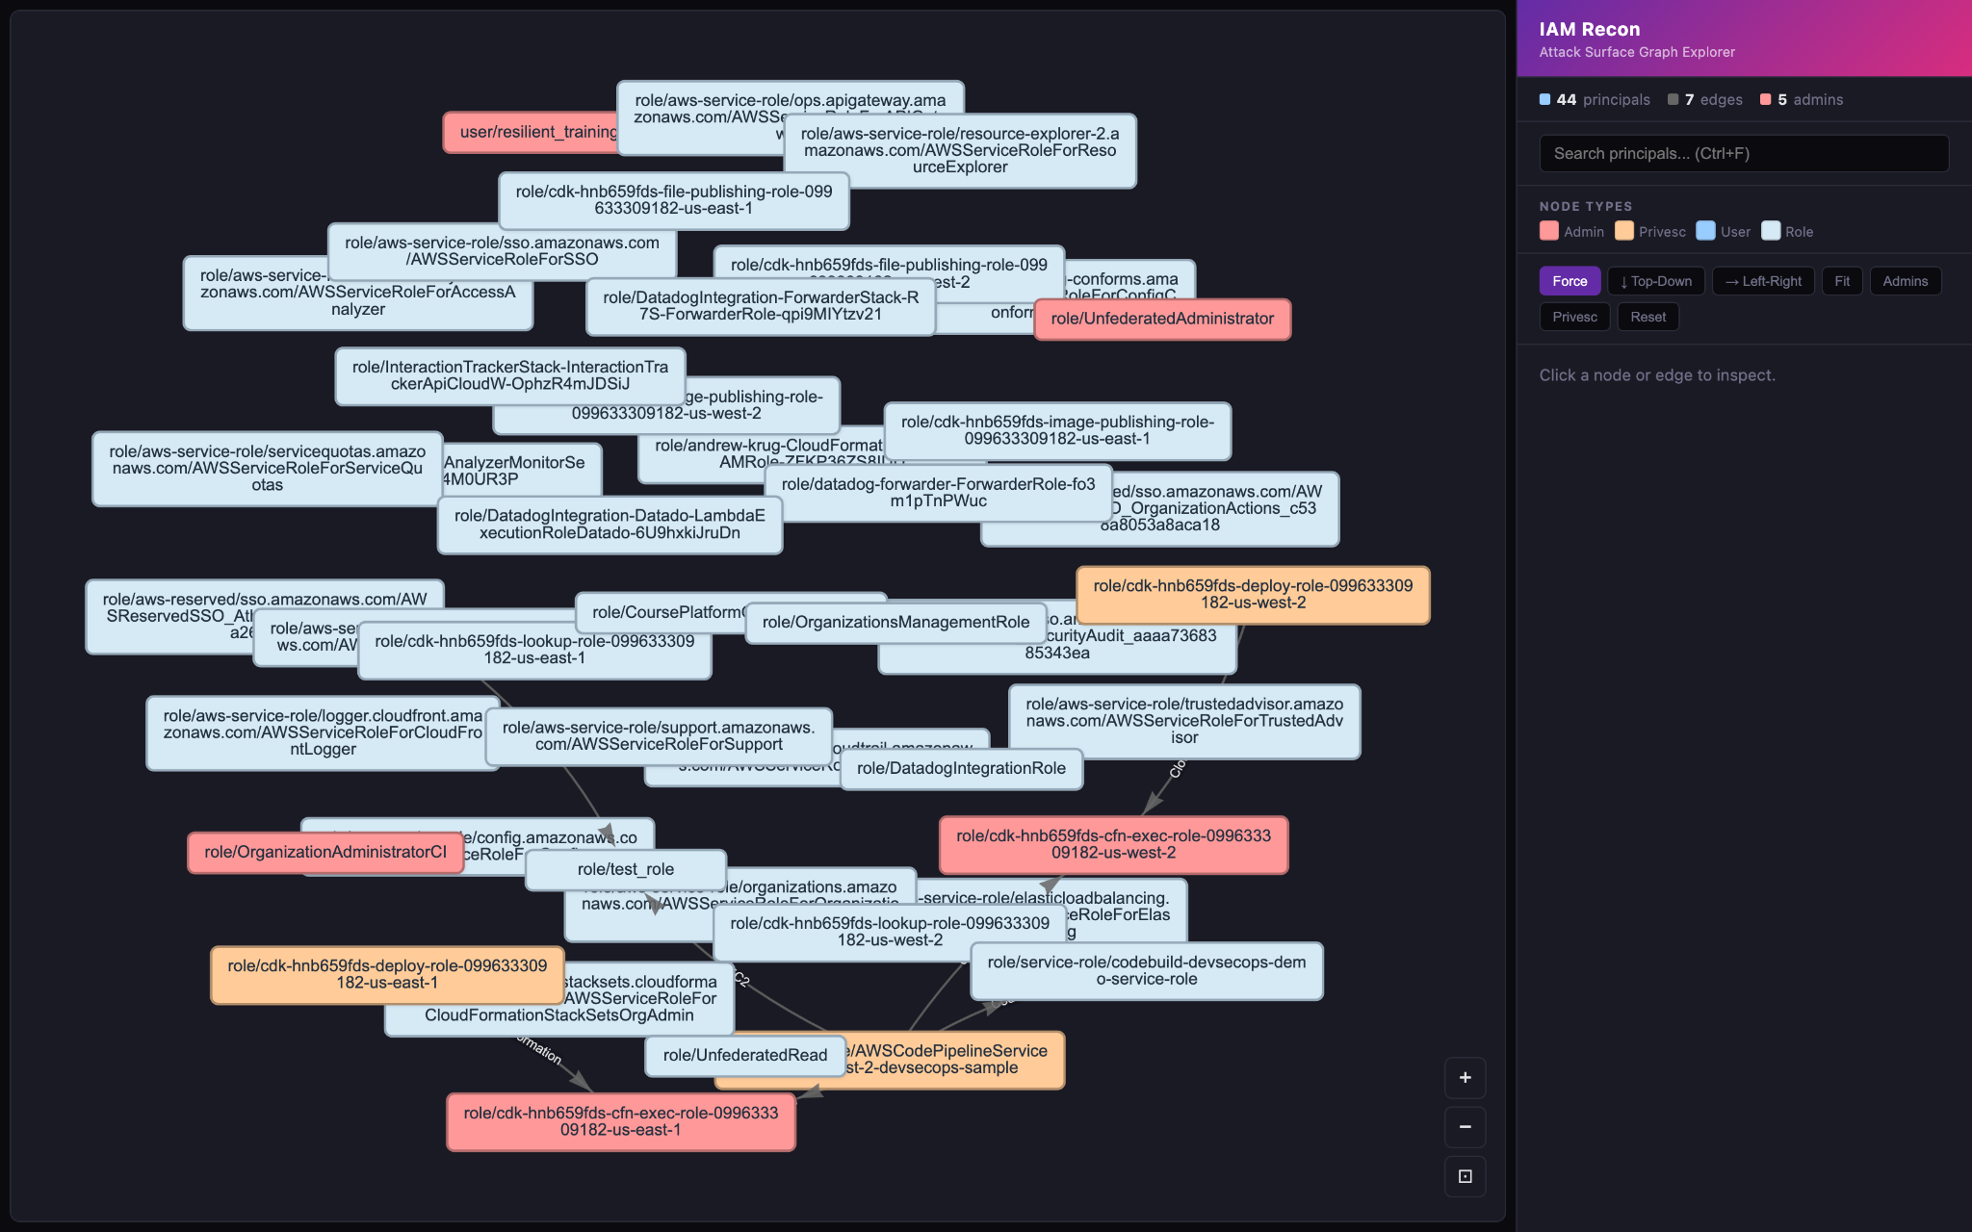
IAM recon
AWS IAM privilege escalation and attack path mapper.
https://github.com/andrewkrug/iam-recon
Inspired by PMapper, awspx, pathfinding.cloud

Slide 3
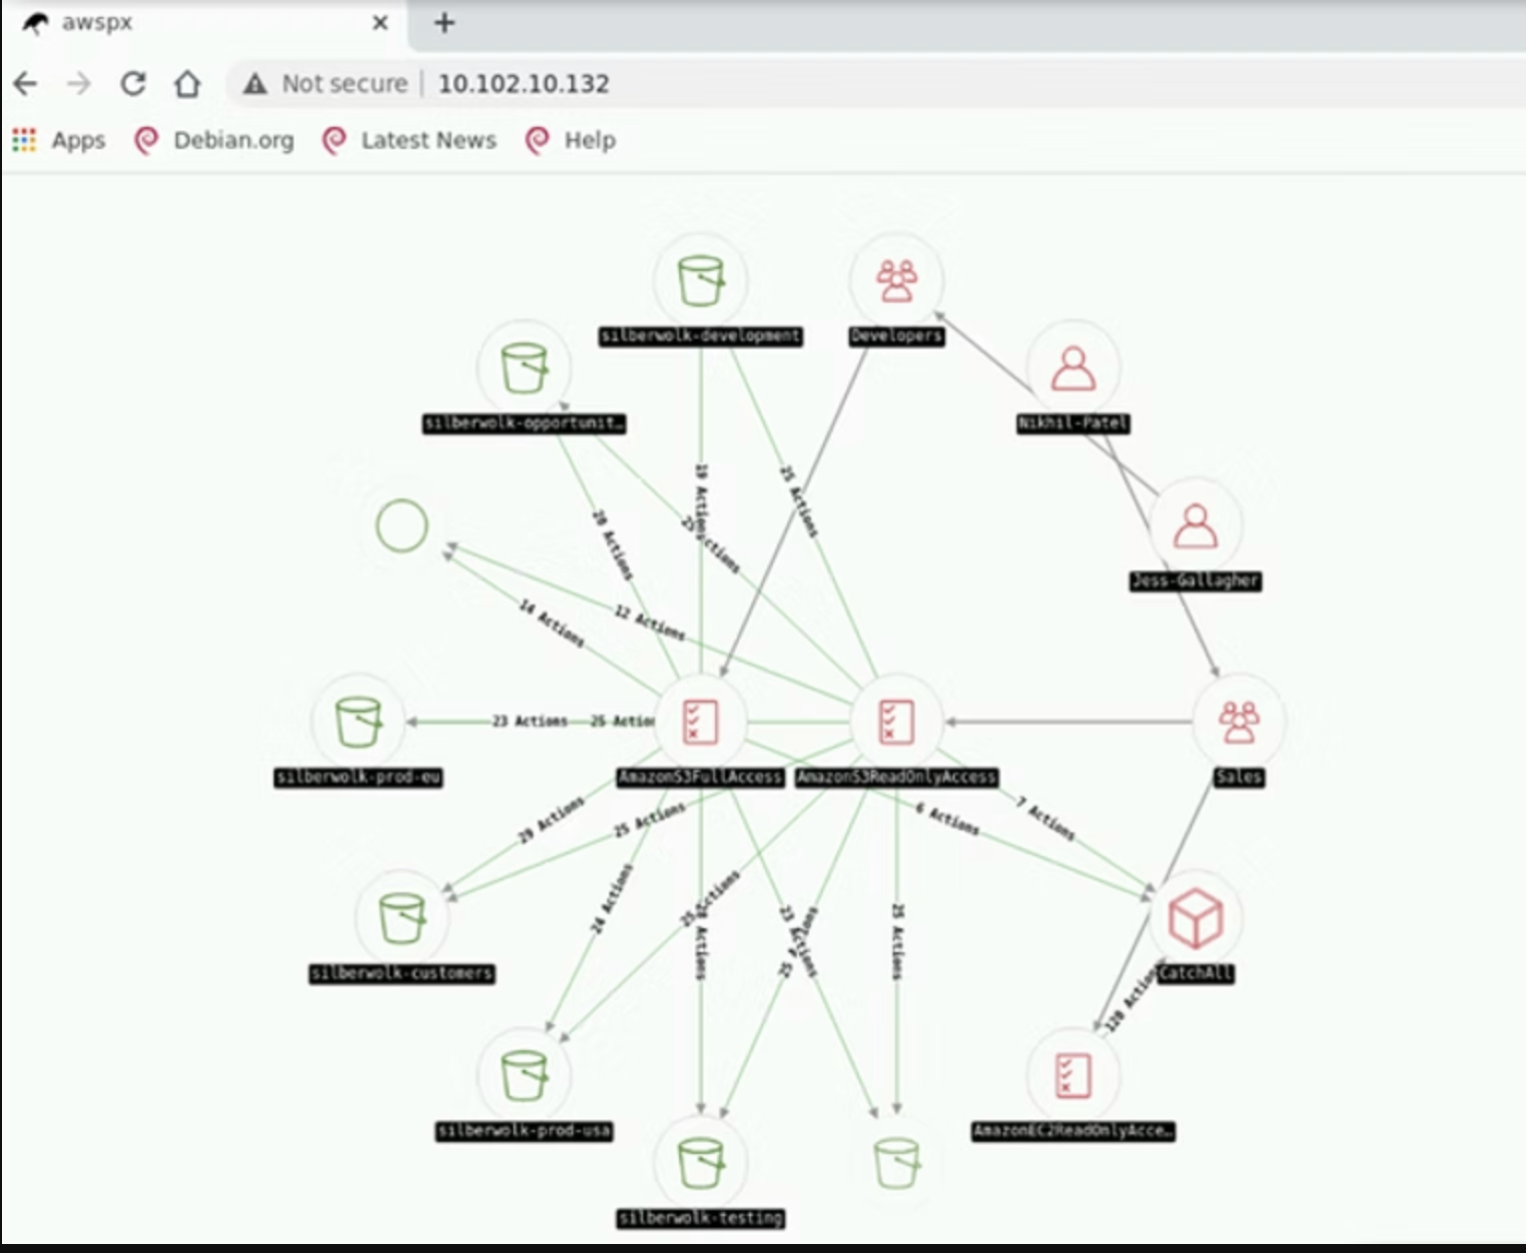
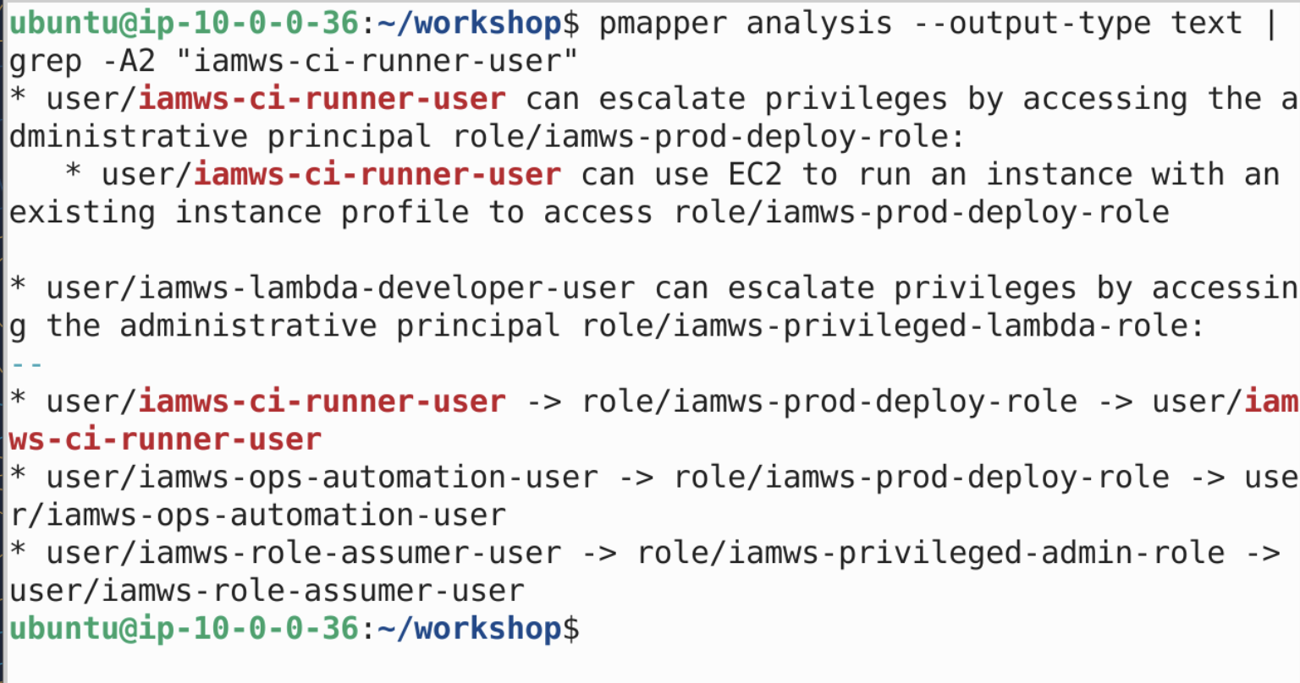
Traditional IAM pentesting tools
Inspirations for IAM recon
pmapper
awspx
Automated IAM privesc path discovery
Visual IAM graph with attack edges
https://github.com/nccgroup/PMapper
https://github.com/ReversecLabs/awspx
Notes:
Call out to traditional pentesting tools (that of course attackers can use too)

Slide 4
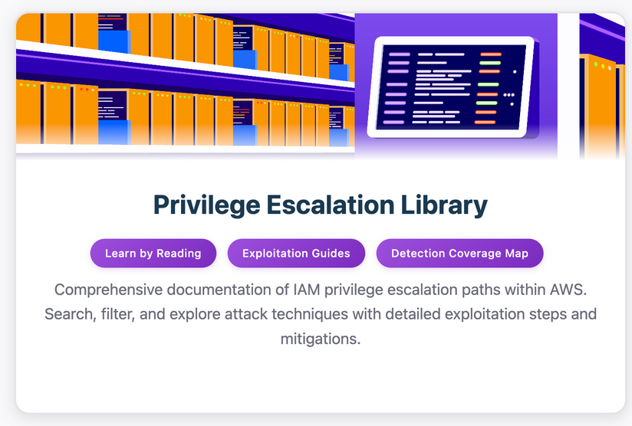
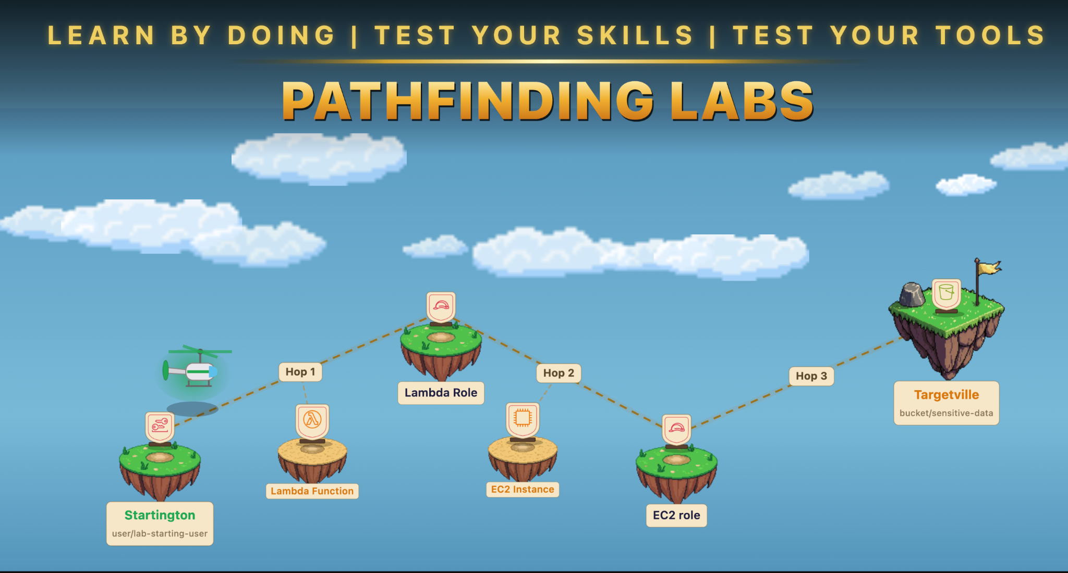
pathfinding.cloud
Privilege escalation playgrounds
pathfinding.cloud
pathfinding.cloud labs
Privesc knowledge base — categories, paths, detections
Hands-on privilege escalation scenarios similar to the ones you will do today
https://pathfinding.cloud
*official release coming soon
Notes:
22

Slide 5

Do this first - start lab resources
Start here - access the workshop environment
1
Navigate to workshop modules and enroll with code
https://learn.resilientsecurity.cloud/course/course-002
Notes:
Do this first and everything will be ready for you when we start the lab in a few minutes

Slide 6
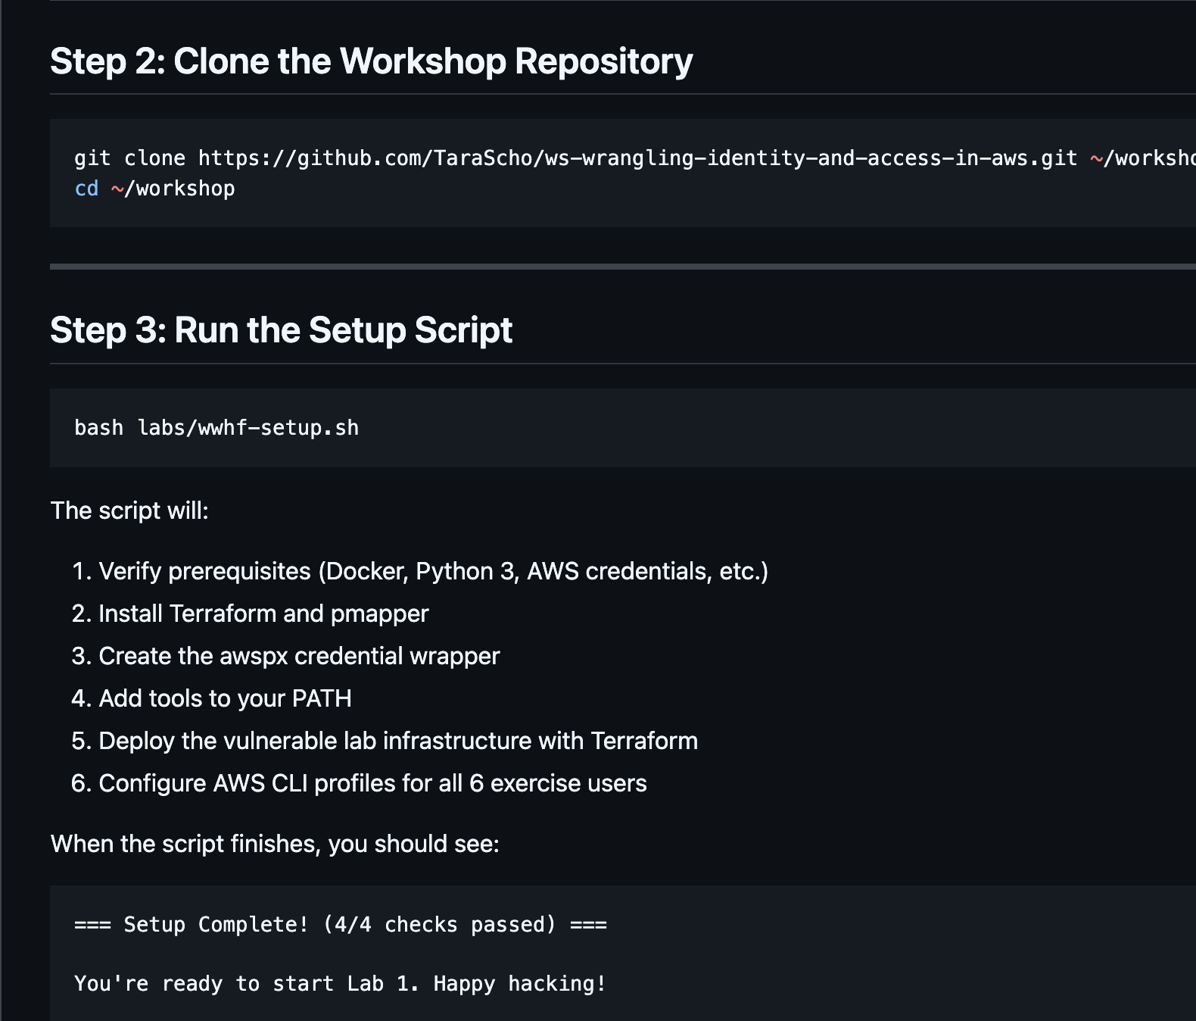
Find lab instructions here

Slide 7
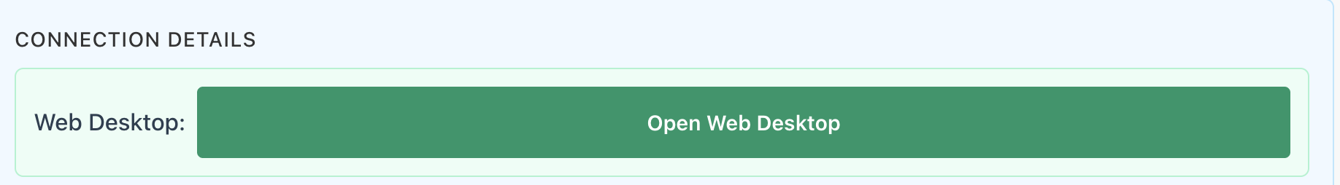
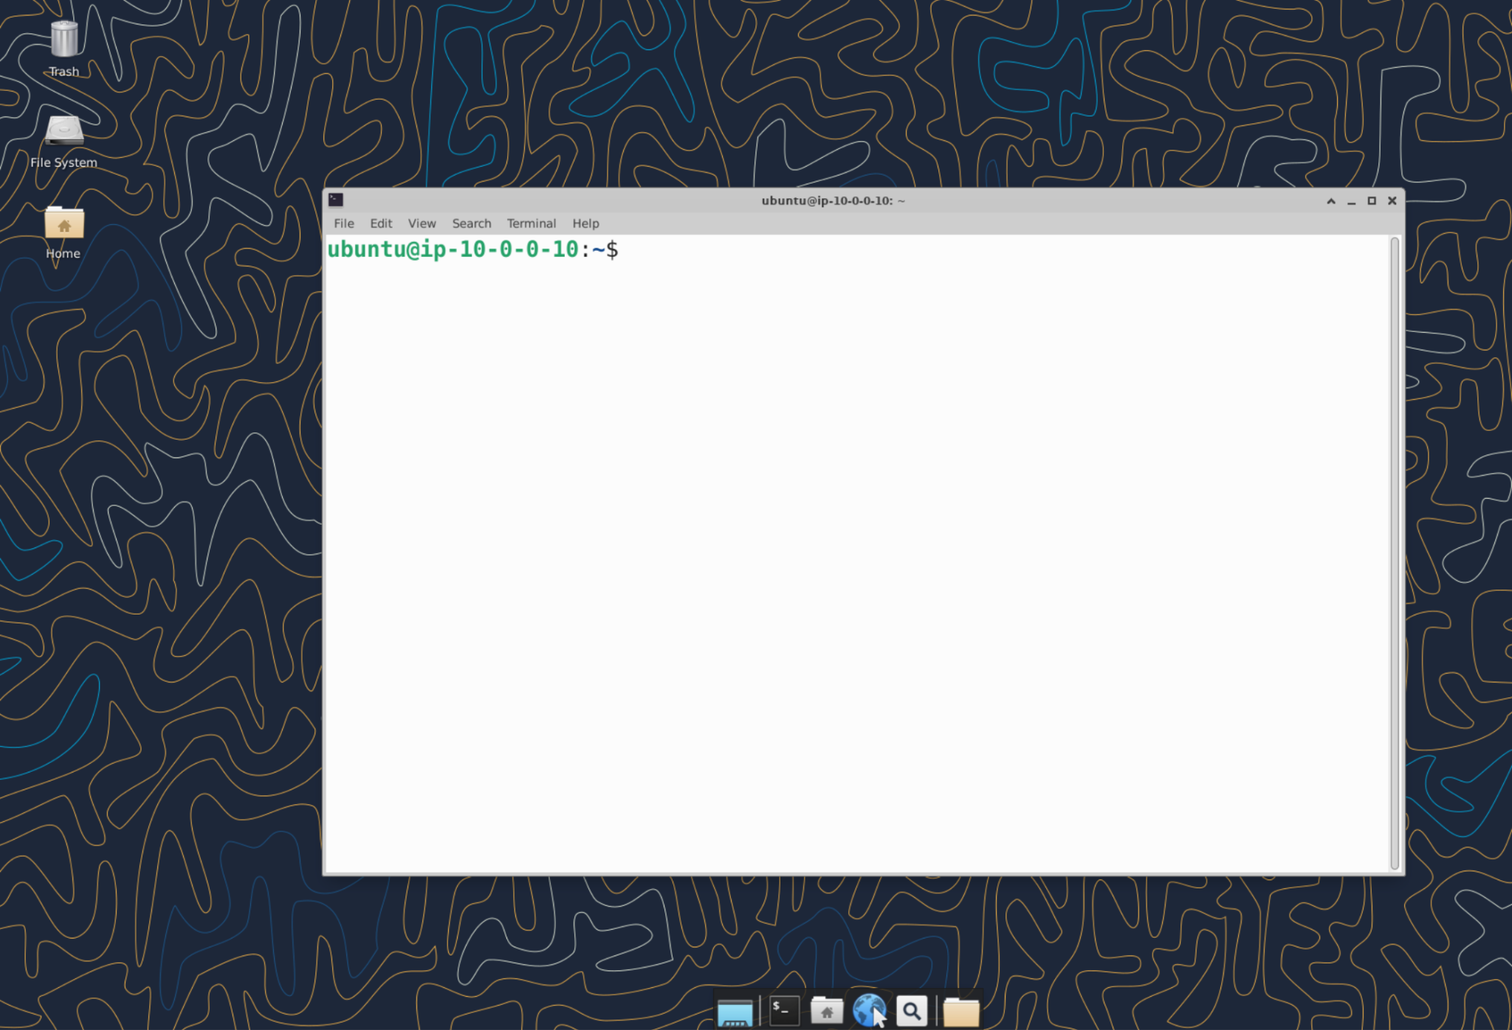
Sign in to your virtual desktop
Notes:
this is the preferred method of accessing the VM - for smoothest experience

Slide 8
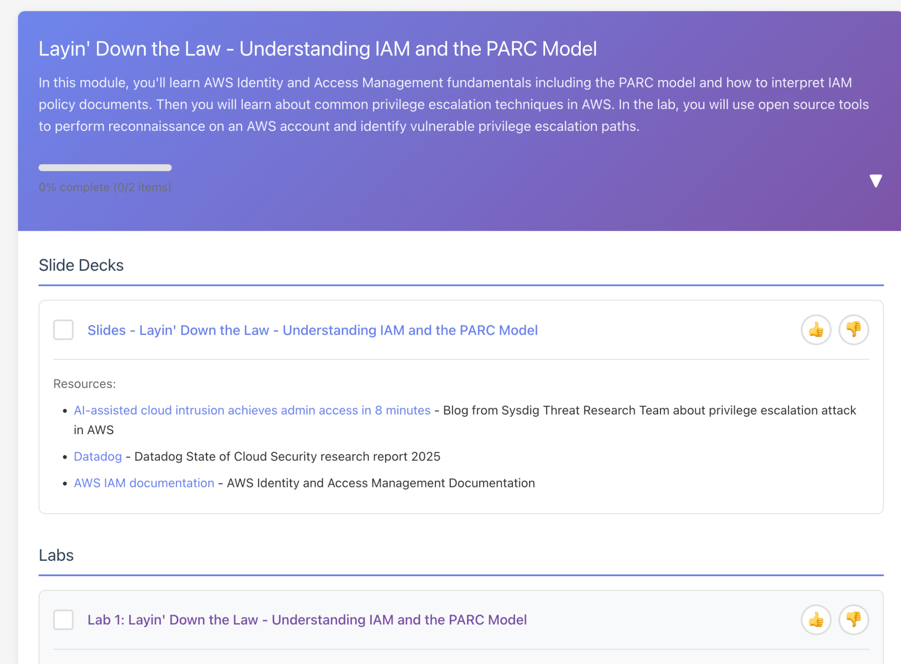
Find lab instructions here
Notes:
Do this first and everything will be ready for you when we start the lab in a few minutes

Slide 9
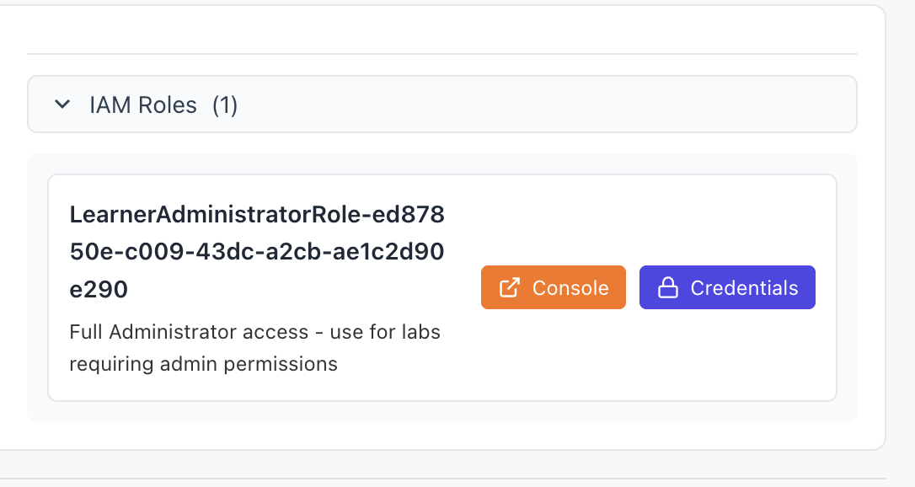
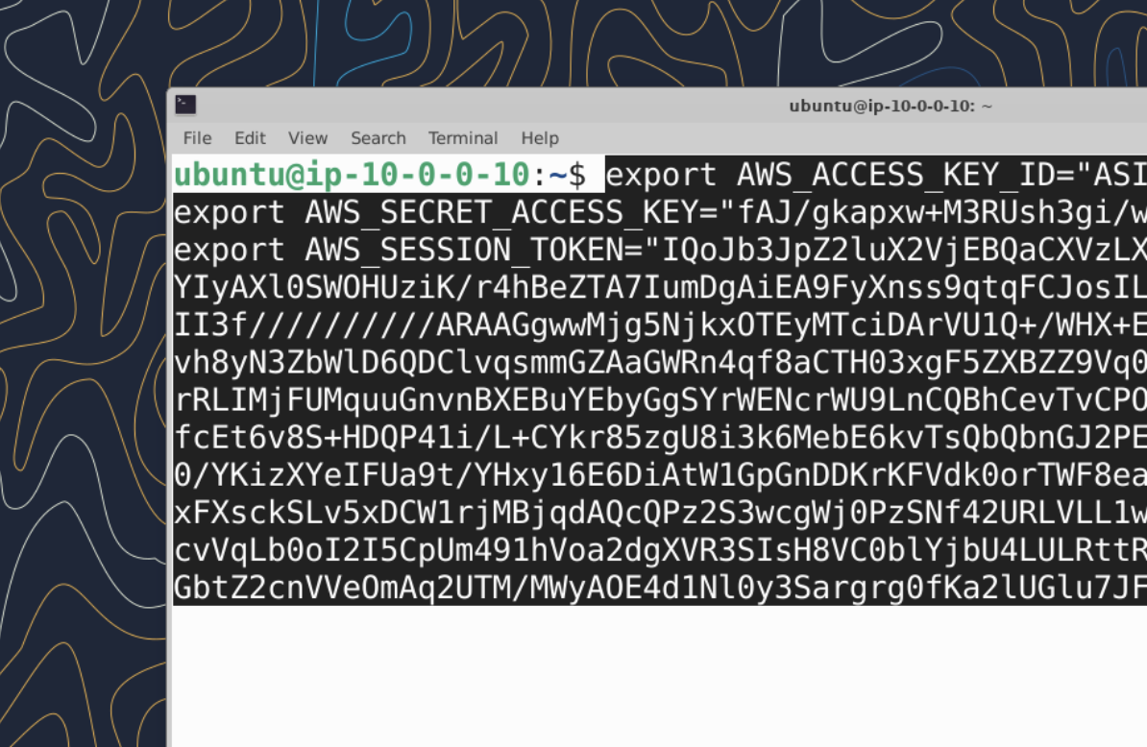
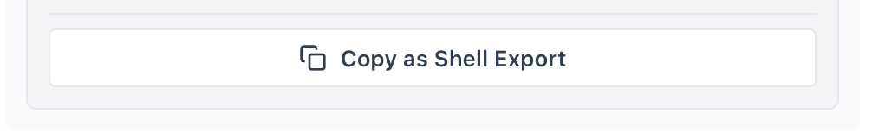
Paste your sandbox AWS creds into virtual workstation terminal
Notes:
Do this first and everything will be ready for you when we start the lab in a few minutes

Slide 10
Lab 1: Your Mission
# | Exercise | You Will...
1 | Environment Setup | Get set up in lab environment
2 | Initial Recon | Map attack paths with iam-recon
3 | Lab Scenario 1 | Self escalation lab scenario
Notes:
You will try most of these strategies hands-on in the workshop

Slide 11
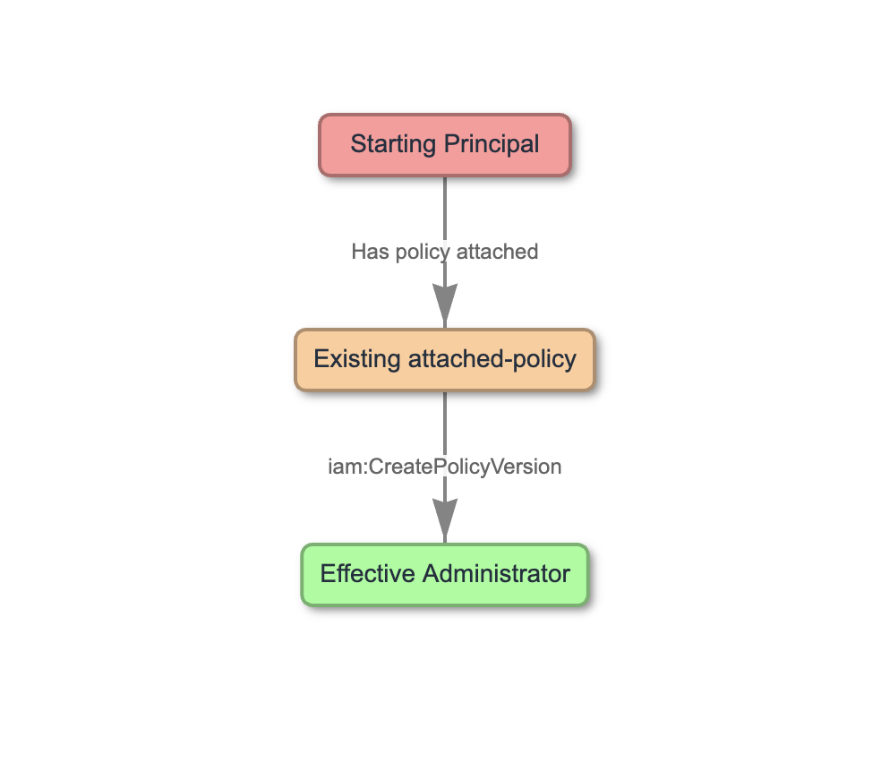
Scenario 1 CreatePolicyVersion self-escalation
The scenario
`iamws-policy-developer` user has `iam:CreatePolicyVersion` on a customer-managed policy that's attached to themselves.
The misconfiguration
No constraint → user can create a v2 policy granting admin and set it as default.
Privesc category
Self-Escalation scenario
Notes:
You will try most of these strategies hands-on in the workshop

