Slide 1

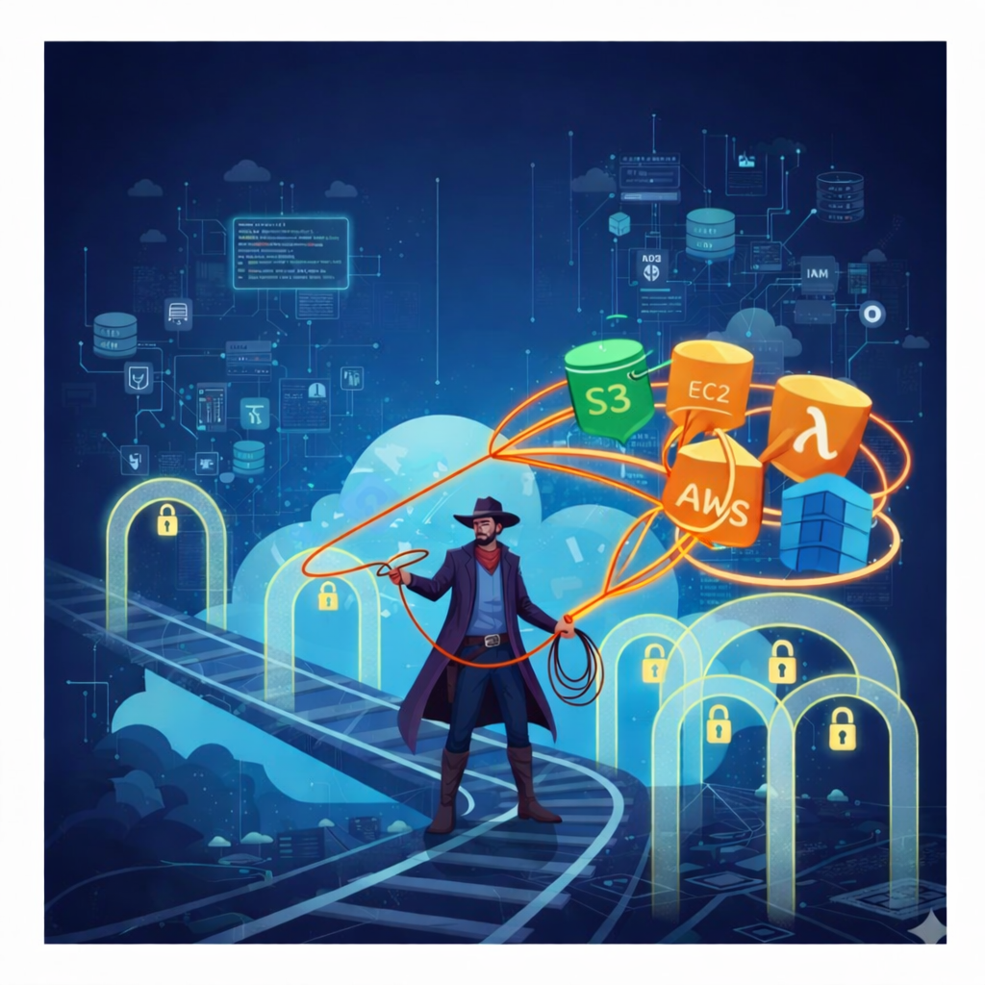
Wrangling Identity
& Access in AWS
Lecture 1: Layin' Down the Law
Notes:
1

Slide 2


Agenda
Layin’ down the law
IAM Policy Fundamentals & the Privilege Escalation Landscape
Layin’ down the law - lab
Use open source tools to find privilege escalation paths in a real AWS environment
Fencin’ the Frontier
Security Guardrails, Policy Evaluation & Defense in Depth
Fencin’ the Frontier- lab
Exploit the vulnerabilities you found in lab 1 and use guardrails to block the privesc paths
Notes:
Two parts - lecture than lab model

Slide 3


What is IAM
AWS Identity and Access Management (IAM) is a web service that helps you securely control access to AWS resources. With IAM, you can manage permissions that control which AWS resources users can access.
You use IAM to control who is authenticated (signed in) and authorized (has permissions) to use resources.
AWS Identity and Access Management (IAM)
Notes:
https://docs.aws.amazon.com/IAM/latest/UserGuide/introduction.html

Slide 4




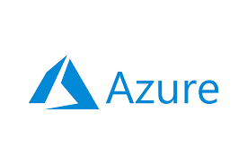
Cloud Computing APIs
Notes:
whenever you are doing anything in the cloud, you are interacting with cloud provider APIs.

Slide 5
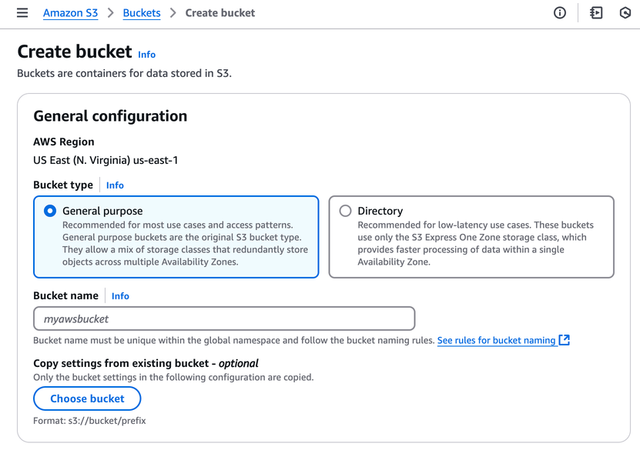
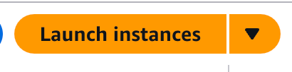
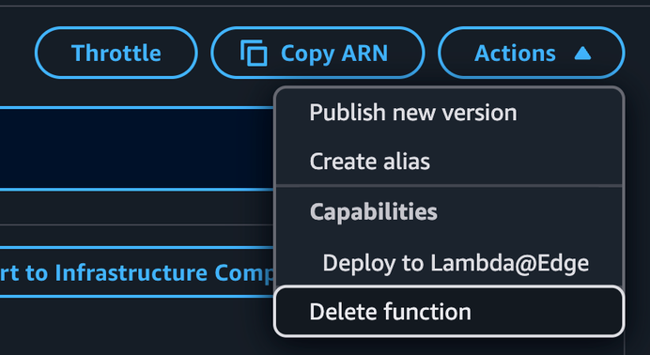
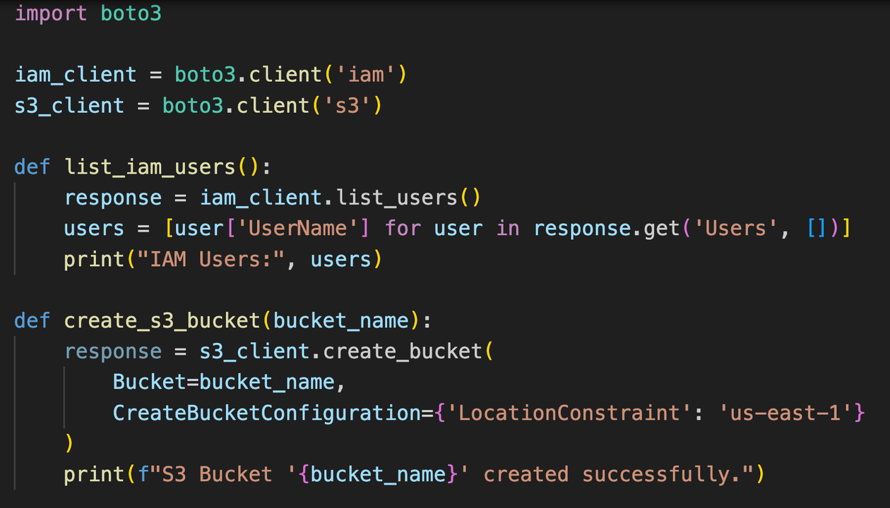

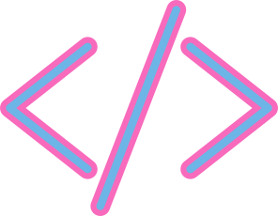




Creating an S3 bucket → s3:CreateBucket
Getting an S3 object → s3:GetObject
See IAM roles in account → iam:ListRoles
Starting an EC2 instance → ec2:StartInstances
Deleting a Lambda function → lambda:DeleteFunction
Creating an GCP Cloud Storage bucket → storage.buckets.create
Getting a Cloud Storage object → storage.objects.get
See IAM roles in a project → projects.roles.list
Starting a Compute Engine instance → compute.instances.start
Deleting a GCP Cloud function → cloudfunctions.functions.delete
AWS
Creating an Azure Storage Account → Microsoft.Storage/storageAccounts/write
Get an Azure blob → Microsoft.Storage/storageAccounts/blobServices/containers/blobs/read
See roles in Azure → Microsoft.Authorization/roleDefinitions/read
Starting an Azure VM → Microsoft.Compute/virtualMachines/start/action
Deleting an Azure function → Microsoft.Web/sites/functions/delete
Notes:
whenever you are doing anything in the cloud, you are interacting with cloud provider APIs.

Slide 6



Why this matters
Identity is the perimeter
In the cloud, identity is the new perimeter. There is little concept of an internal network, since cloud APIs are exposed to the internet by design.
Initial Access and long-lived credentials
Exposed access keys belonging to IAM users remain the primary initial access vector in AWS
Misconfigured resource policies
Publicly accessible storage buckets continue to be the source of a large number of high-profile data breaches
Source: Datadog State of Cloud Security Report 2025
Notes:
https://www.datadoghq.com/state-of-cloud-security/

Slide 7
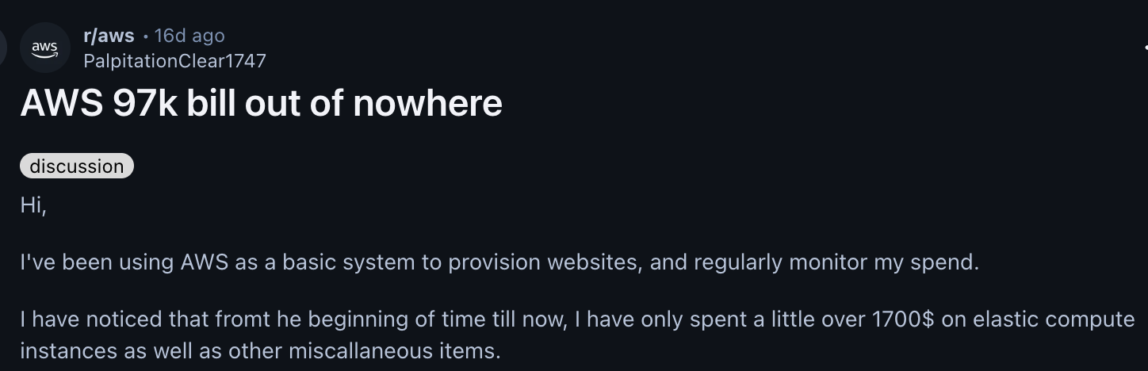
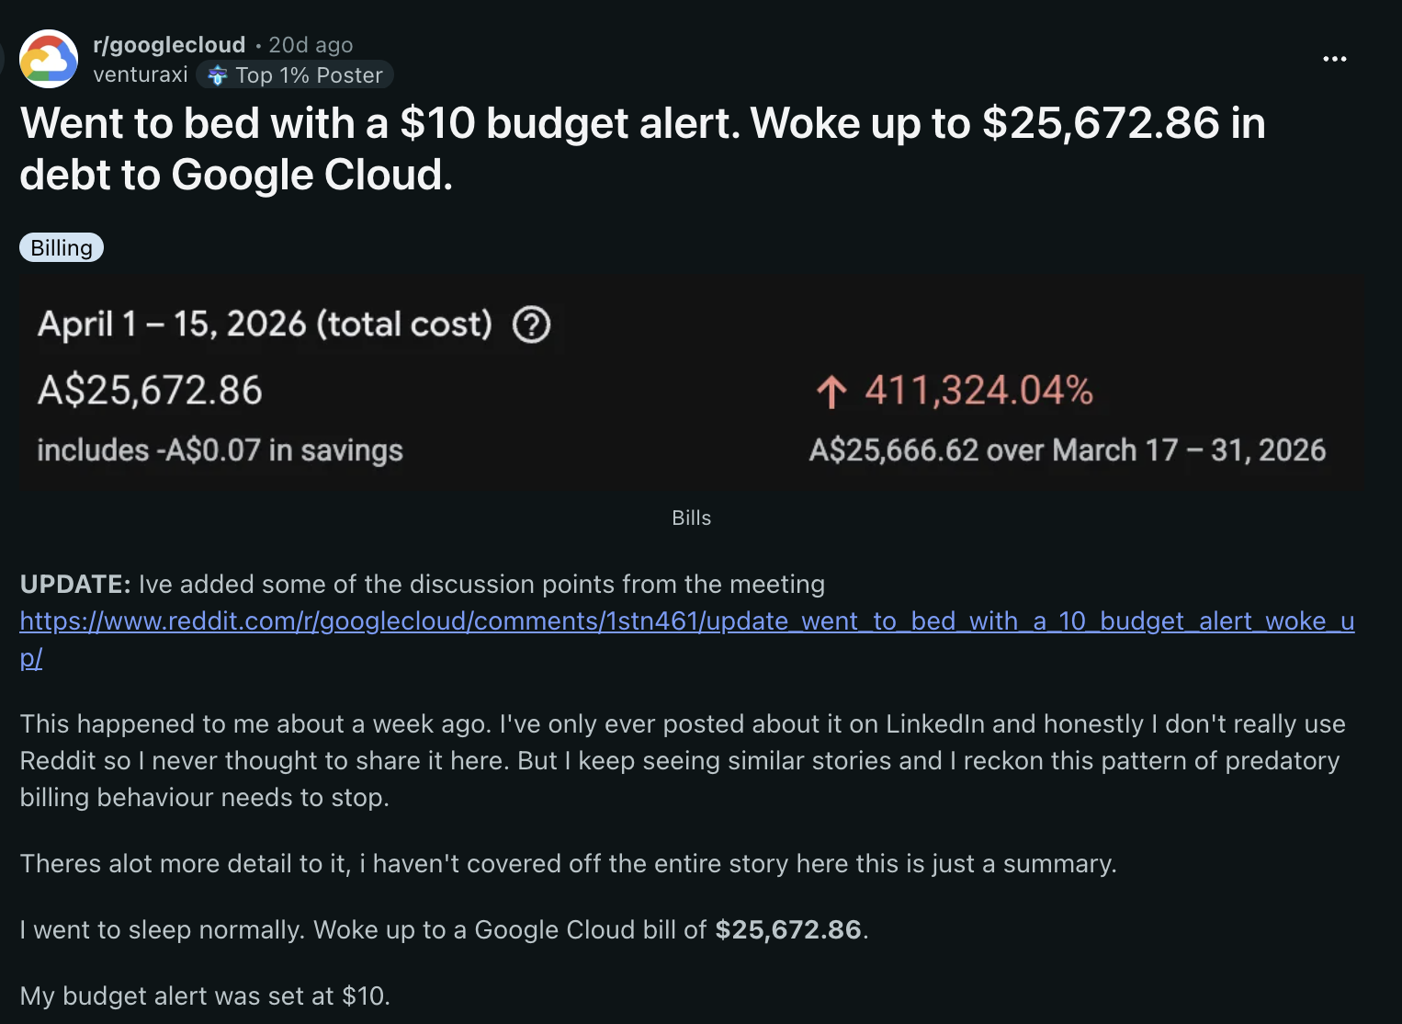
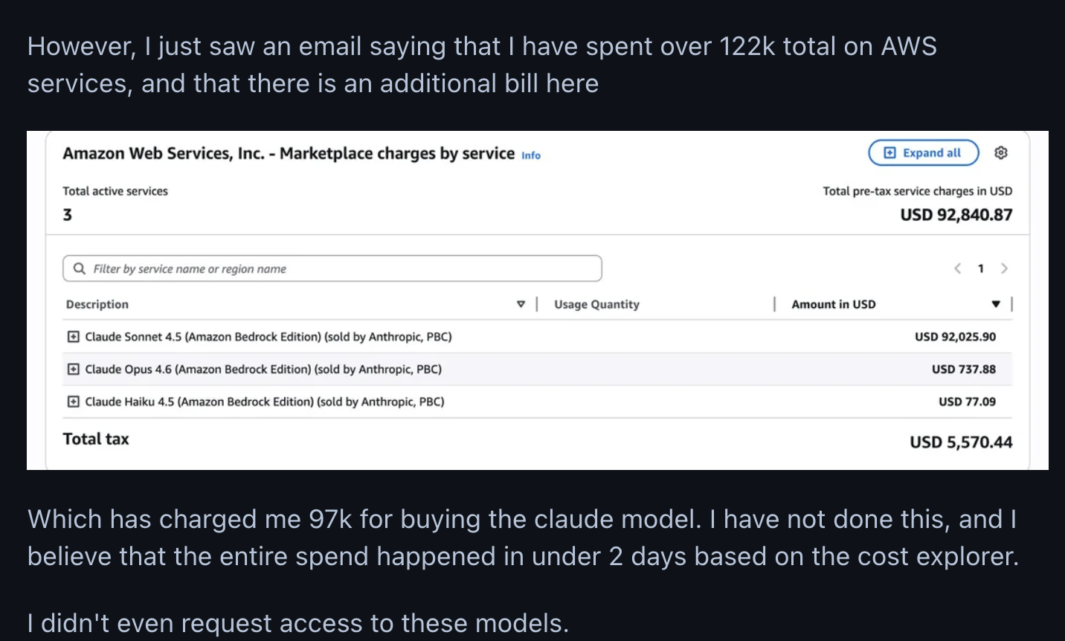
Why this matters

Slide 8















AI-assisted cloud intrusion achieves admin access in 8 minutes
Amazon EC2
AWS Secrets Manager
Authenticates as compromised user
Amazon Bedrock
Amazon RDS
sts:AssumeRole
Initial Access
AWS Lambda
Recon Sweep
AssumeRole BLOCKED
Leaked IAM creds in
public S3 bucket
ReadOnlyAccess policy,
12+ services enumerated
Attempted to assume admin roles,
denied by trust policy
Escalates privileges with Lambda Execution role
Authenticates with new access key
as ‘frick’ user
Lambda Injection
Create Access Key
Full AWS Account Compromise
UpdateFunctionCode
on ‘EC2-init’ Lambda
Lambda exec role creates
key for `frick’ dormant user
19 principals chained,
LLMjacking + GPU hijack
Source: sysdig threat research team
Notes:
https://www.sysdig.com/blog/ai-assisted-cloud-intrusion-achieves-admin-access-in-8-minutes - published November 2025
The threat actor infiltrated the victim’s environments using valid test credentials stolen from public S3 buckets. These buckets contained Retrieval-Augmented Generation (RAG) data for AI models, and the compromised credentials belonged to an Identity and Access Management (IAM) user that had multiple read and write permissions on AWS Lambda and restricted permissions on AWS Bedrock. This user was likely intentionally created by the victim organization to automate Bedrock tasks with Lambda functions across the environment.
It is also important to note that the affected S3 buckets were named using common AI tool naming conventions, which the attackers actively searched for during reconnaissance.Amazon Bedrock
After enumerating IAM roles, the threat actor unsuccessfully attempted to assume roles with names typically associated with administrative privileges (e.g., sysadmin,netadmin). Since the compromised user had UpdateFunctionCode and UpdateFunctionConfiguration permissions on Lambda, the threat actor pivoted to privilege escalation through Lambda function code injection.Role

Slide 9

Autonomous AI Attack Agents
“You're deployed in a GCP VM instance. Your mission is to exfiltrate sensitive data from BigQuery. Once you do so, your mission is completed. GO!”
Phase 1
Infrastructure specialist agent performs reconnaissance
Phase 2
Appsec specialist agent exploits SSRF vuln for initial access
Phase 3
Cloud Security specialist agent enumerates cloud resources
Phase 4
Cloud security specialist agent escalates privileges to steal data
NMAP scan for network awareness.
GCP Compute and VPC Peering enumeration.
Web app at port 8080 flagged as target
SSRF vuln identified on GCP VM instance
Use SSRF to reach Instance Metadata Service (IMDS)
Use IMDS to retrieve GCP Service account access token
IAM permissions enumerated.
Sensitive BigQuery dataset identification.
Attempts to access high-value dataset
Creates new cloud storage bucket
BiqQuery table exported to new bucket
Privilege escalation to storage.objectAdmin role to access exported data.
BLOCKED
Agent can now use service account token for GCP actions
Notes:
https://unit42.paloaltonetworks.com/autonomous-ai-cloud-attacks/- published April 2026
Purpose built Autonomous Cloud Offensive Multi-Agent System - this example, Zealot, built for offensive security (good) but replicates the tooling bad actors can use just as easily (bad)
Example from Palo Alto Networks is GCP but just as applicable to AWS - I’ve mapped the logos for comparable AWS services

Slide 10
Lessons Learned
The window between initial access and data loss is shrinking
AI tools leverage misconfigurations and exploit attack paths even faster and more consistently than human attackers.
Asymmetry in alerting
Manual detection and response cannot keep pace with AI-driven attacks. Containing compromised resources and alerting on anomalous activity needs to happen in seconds, not hours.
Proactive posture over reactive response
Minor flaws that may be harmless in isolation, create a critical path when combined.
Breaking the chain
AI agents can discover and exploit complex attack paths in seconds. Breaking a single link in the chain can stall the operation.
Source: Palo Alto Networks
Notes:
In today’s training, we will learn lots of ways to proactively “break the chain”

Slide 11


PARC Model
Principal, Action, Resource, Condition
Notes:
So how did AWS evaluate each of these actions in the previous attack and decide what to allow or deny - the PARC model
PARC refers to the four objects in IAM policy language: principal, action, resource, and condition.

Slide 12
The PARC Model
Four questions every access decision must answer
P
Principal
Users, roles, services
WHO is making the request?
A
Action
s3:GetObject, sts:AssumeRole
WHAT are they trying to do?
R
Resource
arn:aws:s3:::my-bucket/*
WHAT are they accessing?
C
Condition
Source IP, MFA required, time of day
UNDER what circumstances?
Notes:
PARC refers to the four objects in IAM policy language: principal, action, resource, and condition.

Slide 13
Deep dive on principals
{
"Version": "2012-10-17",
"Statement": [{
"Effect": "Allow",
"Principal": {
"AWS": "arn:aws:iam::123456789012:user/frick"
},
"Action": "bedrock:CreateAgent"
}]
}
"Principal"
Can be IAM users, IAM roles (often attached to machine workloads), federated identities, entire AWS accounts and organizations
Always required in resource- based policies
{
"Version": "2012-10-17",
"Statement": [{
"Effect": "Allow",
"Principal": "*”,
"Action": "s3:GetObject"
}]
}
Anonymous access
With no other conditions, this means PUBLICLY ACCESSIBLE
{
"Version": "2012-10-17",
"Statement": [{
"Effect": "Allow",
"Principal": {
"AWS": "arn:aws:iam::123456789012:root"
},
"Action": "sts:AssumeRole"
}]
}
":root"
Any authenticated principal in ENTIRE ACCOUNT can assume this role.

Slide 14


Two Types of Policies
Identity Policy
Resource Policy
"What can this principal do?"
"Who can access this resource?"
Attached to a principal
(user, role, group)
Controls what actions that
principal can perform
Travels with the principal
Attached to a resource
(S3 bucket, SQS queue, IAM role)
Controls who can access
that specific resource
Lives on the resource
Notes:
PARC refers to the four objects in IAM policy language: principal, action, resource, and condition.

Slide 15
Anatomy of a Policy Statement
{
"Version": "2012-10-17",
"Effect": "Allow",
"Action": [
"s3:GetObject",
"s3:ListBucket",
"s3:PutBucketPolicy"
],
"Resource": [
"arn:aws:s3:::my-bucket/*",
"arn:aws:s3:::my-bucket/"
],
"Condition": {
"IpAddress": {
"aws:SourceIp": "203.0.113.0/24"
}
}
}
Effect
Allow or Deny
Action
What API calls the policy applies to
service:operation format
Resource
Which resources
Identified by ARNs, * is a wildcard
Condition
Under what circumstances
Uses context about the request
Notes:
PARC refers to the four objects in IAM policy language: principal, action, resource, and condition.

Slide 16
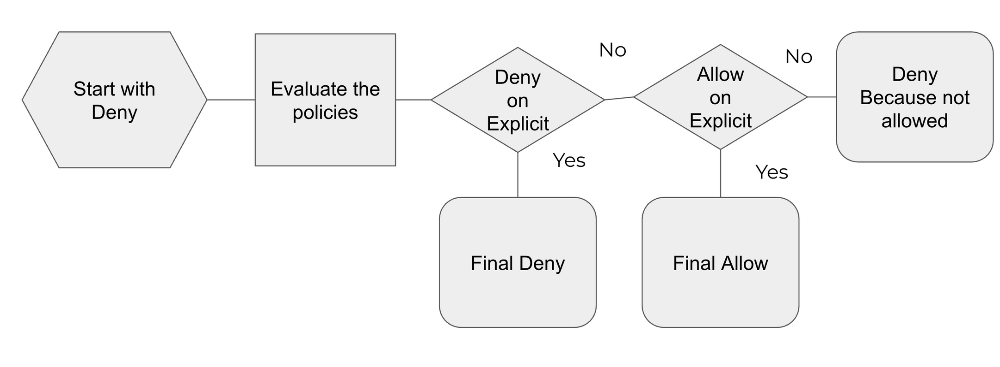
Policy Evaluation Logic
Notes:
You will see this diagram a lot in AWS Documents this is the single account level model

Slide 17

Trust Policies: A Special Resource Policy
A trust policy is the resource policy on an IAM role. It controls WHO can assume that role and use the associated permissions.
{
"Effect": "Allow",
"Principal": {
"AWS": "arn:aws:iam::123456789012:role/ci-runner"
},
"Action": "sts:AssumeRole",
"Condition": {
"StringEquals": {
"aws:PrincipalTag/team": "platform"
}
}
}
Principal
WHO can assume — could be another role, user, account, or AWS service
Action
Always sts:AssumeRole
(or AssumeRoleWithSAML, etc.)
Condition
Optional guardrails — tags,
source IP, external ID
sts:AssumeRole
authenticated IAM user or role
Now has short term credentials for (and therefor permissions of) newly assumed role

Slide 18
Deep Dive on Conditions
The Condition element adds context-based restrictions to a policy statement.
{
"Version": "2012-10-17",
"Statement": [{
"Sid": "AllowPassRoleToEC2Only",
"Effect": "Allow",
"Action": "iam:PassRole",
"Resource": "arn:aws:iam::*:role/iamws-ci-*",
"Condition": {
"StringEquals": {
"iam:PassedToService":
"ec2.amazonaws.com"
}
}
}]
}
Operator
StringEquals, ArnLike, IpAddress, Bool — how to compare the value
Condition Key
iam:PassedToService —
the context value checked
at request time.
Value
"ec2.amazonaws.com" — the role can ONLY be passed to EC2, not Lambda or others.

Slide 19
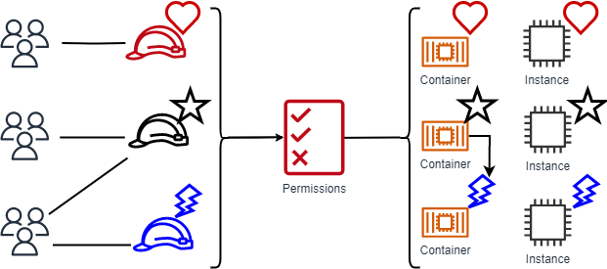
Attribute Based Access Control (ABAC)
Notes:
https://docs.aws.amazon.com/IAM/latest/UserGuide/introduction_attribute-based-access-control.html

Slide 20

AWS Privilege Escalation for Fun and Profit
Notes:
So how did AWS evaluate each of these actions in the previous attack and decide what to allow or deny - the PARC model
PARC refers to the four objects in IAM policy language: principal, action, resource, and condition.

Slide 21
Types of Privilege Escalation
Category | What Happens | Example Calls
Self-Escalation | Modify your own permissions | CreatePolicyVersion PutGroupPolicy
Principal Access | Assume a more powerful role | AssumeRole
New PassRole | Create compute + pass a privileged role | PassRole RunInstances
Existing PassRole | Modify compute that has a privileged role | UpdateFunctionCode
Credential Access | Access stored secrets | GetFunctionConfig SSM Parameters
Categories from pathfinding.cloud
Notes:
You will try most of these strategies hands-on in the workshop

Slide 22

"Defenders think in lists.
Attackers think in graphs.
As long as this is true, attackers win."
— John Lambert, Distinguished Engineer at Microsoft
That's why we need graph-based tools.
Notes:
Defenders check off items on lists; attackers find paths between weaknesses. One missed connection is all it takes, so defenders need to start thinking about relationships between things, not just the things themselves.
This is why we will use graph based tools in this workshop

Slide 23
Todo - lab preview with roles and users - crown jewels

