Slide 1
College Football Attendance Analysis
Tara Wilson
Data 512
Autumn quarter 2019
Notes:
Hi all! As a huge college football fan, I wanted to do my project on something I had a fair amount of domain knowledge about and that had an interesting mix of quantitative and qualitative data.

Slide 2
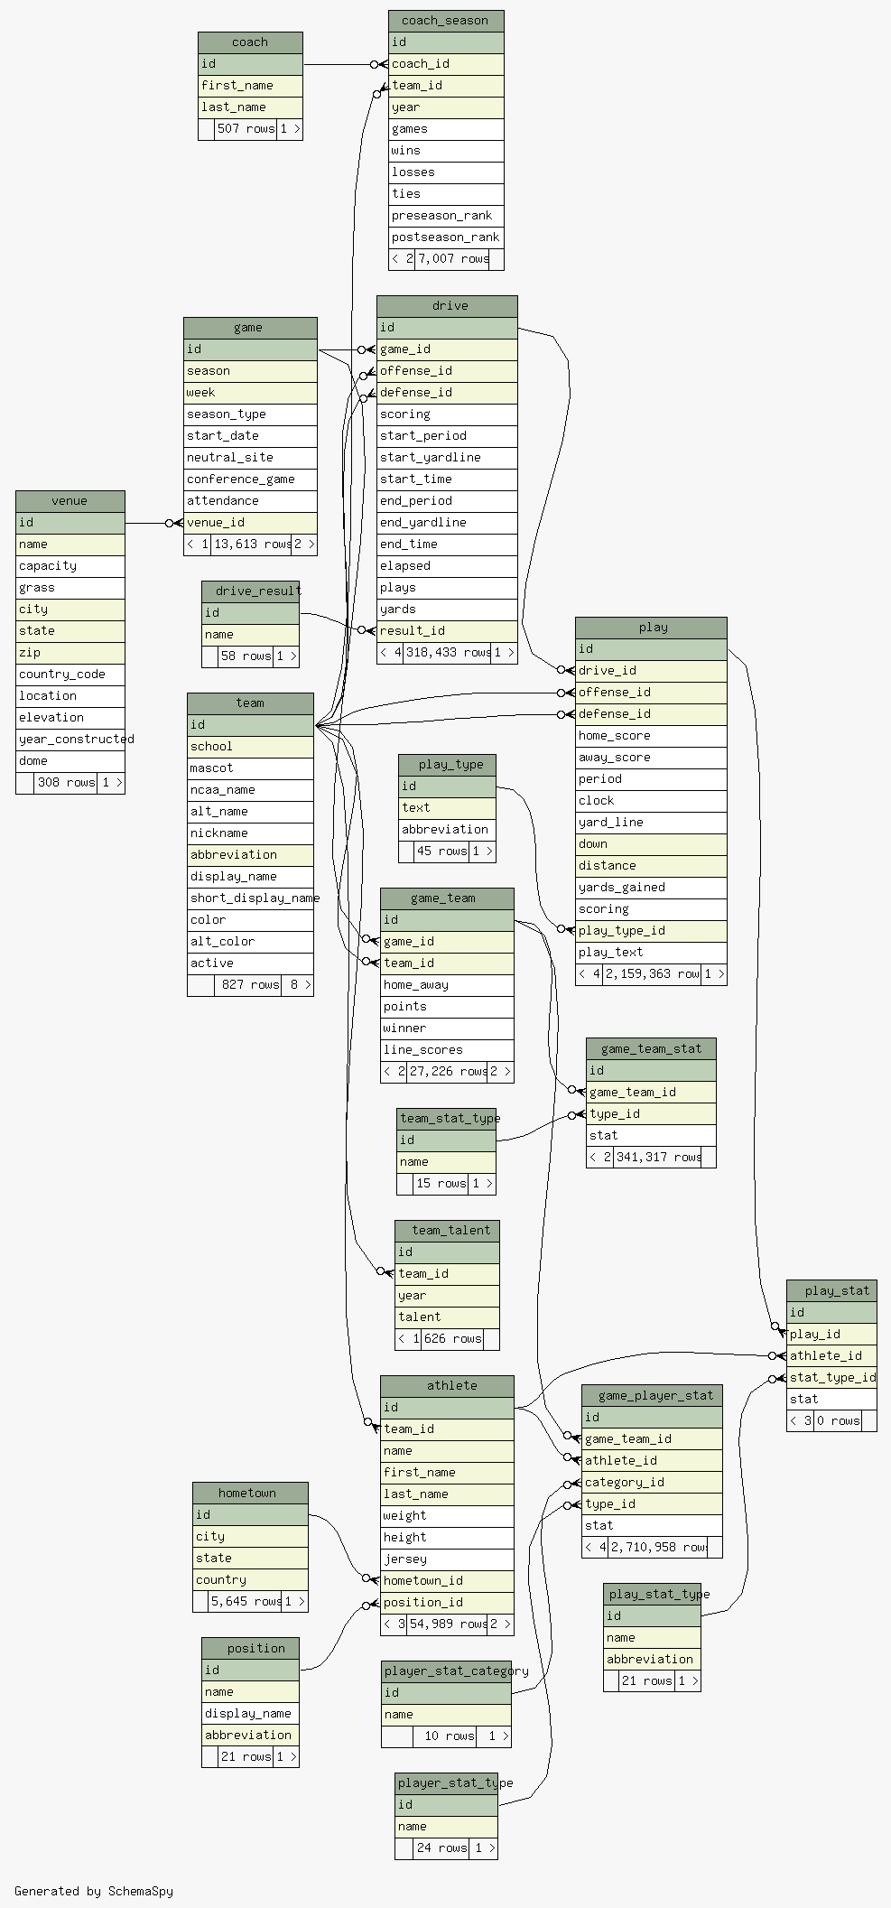
Data sources
All sorts of NCAA college football data:
games
players
teams
rankings
coaches
& much more
Accessed via Swagger API endpoint
Weather data from NOAA
Notes:
I found a dataset of essentially all college football data you could ever want. The image on this slide is the data ERD so while you can’t see much you can get a feel for the many different fields available, there is everything from player and coaching data to play by play data at a game level. I supplemented this with weather data available via NOAA API calls.

Slide 3
What factors drive attendance at college football games?
Notes:
The question I wanted to investigate was what factors drive attendance at college football games? Attendance is important for a school’s reputation and program funding. The gameday experience is integral for fans so exploring this question from a human-centered perspective is beneficial to both parties. I created 6 hypotheses to go with this question that have my predictions for how several factors will relate to attendance, some of which I will walk you through now.

Slide 4
Relevant works
Attendance is currently at a 22-year low¹
From 2004 to 2018, the average stadium capacity has fallen over 2,000 seats²
Decline attributed to use of cell phones³, kickoff times, team success⁴ and many more reasons
2018 was the 7th time in the last 8 years that attendance has declined⁵
1: https://techcrunch.com/2019/09/08/as-college-football-attendance-slumps-new-ways-to-ticket-may-hold-an-answer/
2: https://www.npr.org/2019/08/24/753962604/attendance-drops-for-college-football
3: https://frntofficesport.com/college-football-attendance/
4: https://www.offtackleempire.com/2019/7/24/20707199/millennials-terrible-phones-pat-fitzgerald-college-football-attendance-decline-big-ten-media-days
5: https://fanbuzz.com/college-football/cfb-attendance-2019/
Notes:
This is a conversation that is popular right now. Attendance has been dropping lately across the board as you can see by some statistics here from related works. There have been many ideas tossed around as to what is causing this, everything from the accessibility of watching game at home, to the time of the day for games to the team’s performance that season and many more.

Slide 5
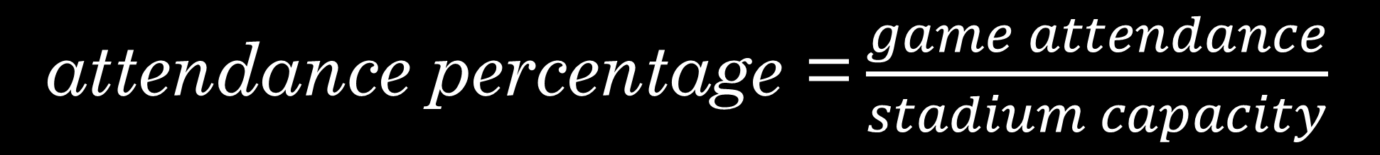
attendance percentage = $\frac{game attendance}{stadium capacity}$
Notes:
This is the metric I will be using to measure attendance. Since this dataset contains information from a whole spectrum of college football programs, simply looking at game attendance would not be telling us much about how attendance for that particular game compares to the total potential attendance for that stadium. I created this attendance ratio you see here to allow us to normalize for stadium size. A quick note also that in several cases this ratio actually exceeds 100% and while I haven’t investigated every occurrence of this the most likely causes are bleacher seats allowing more people to squeeze in than the number of listed seats which is a common occurrence in student sections as well as just data errors so I eliminated all points over 120% for this analysis.

Slide 6
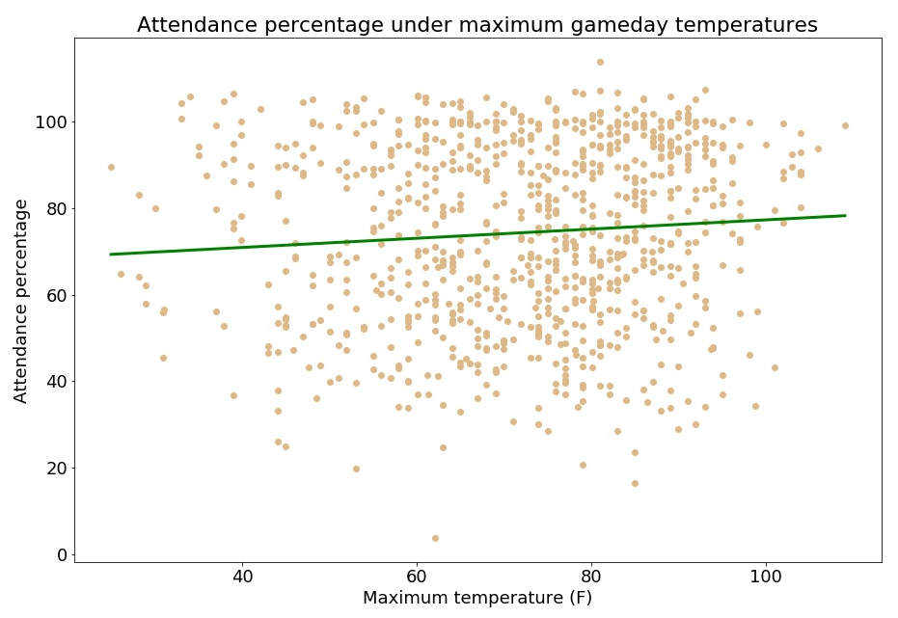
Nobody cares about the thermostat
Notes:
One thing I was really excited to look into was how the gameday weather influenced attendance. I have sat through some miserably hot games and many more that have been freezing with rain and snow. Most college stadiums are open air, leaving fans, and players, completely exposed to the elements for the entire 3+ hour game. Here you are looking at a plot of attendance percentage on the y axis, and maximum temperature on gameday on the x-axis and the games included plotted as the gold dots. I hypothesized that we would see a parabolic shape here, with lower attendance at extremely cold and extremely hot temperatures and higher attendance on those ideal 80-degree days. However, you see that trend does not appear at all, the attendance percentages appear essentially uniformly distributed across all temperatures. The green line is the best fit trend line and you can see it is essentially horizontal and there doesn’t appear to be any relationship between these two. There are a few caveats to this, mainly that this is just maximum temperature on the day of the game and ignores kickoff time which was proposed as a significant contributor to attendance decline. Additionally, this does not control for any other metrics which might be confounding factors.

Slide 7
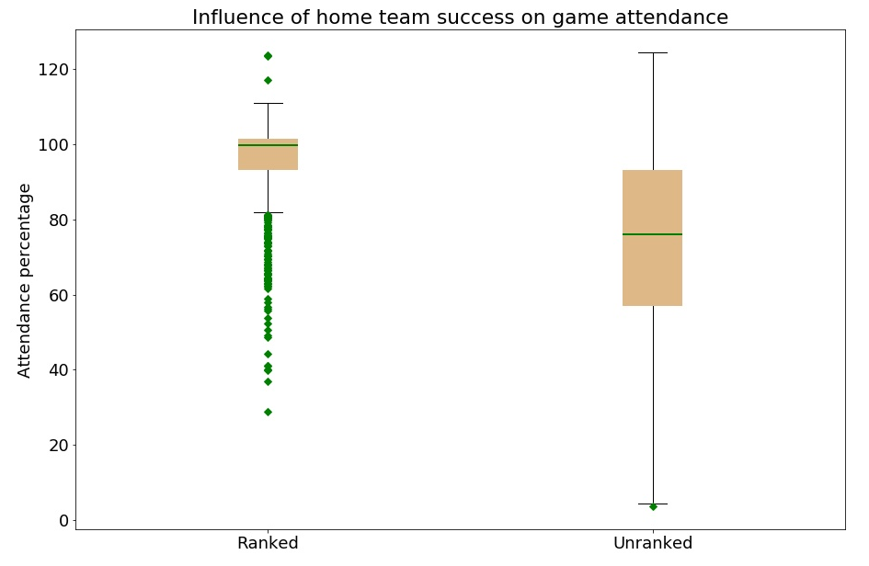
Winning helps
Notes:
Every week during the college football season, the Associated Press releases a list of rankings for the top 25 teams. There are about 130 college football programs competing at this level, so the AP poll is essentially an indication of the elite teams at that point in the season. I figured the success of the teams playing would increase attendance and on this hypothesis I was correct! So here you’re looking at 2 boxplots, where the y axis is attendance percentage and then we have games where the home team is ranked on the left and the home team is unranked on the right. As you can see, attendance percentages are much higher when the home team is ranked, so when they are doing well that season. I ran a t-test on this and the p-value is significant at the 0.005 level so highly impactful. I will include some potential confounding factors here such that the best performing schools likely have more money in their athletic departments and come from bigger schools which can have alternate impacts on attendance such as larger school and alumni population nearby, gameday giveaways, etc. But overall, it is clear that attendance is higher when people want to see a good team hopefully add another W.

Slide 8
If you build it, they will come
Smallest stadiums
Largest stadiums
Stadium name | Capacity | Average attendance
Jerry Richardson Stadium | 15,314 | 86.1%
Kibbie Dome | 16,000 | 76.2%
Warren McGuirk Alumni Stadium | 17,000 | 69.4%
Foreman Field | 20,118 | 100.0%
Houchens Industries – L.T. Smith Stadium | 22,113 | 77.8%
Stadium name | Capacity | Average attendance
Bristol Motor Speedway | 162,000 | 96.9%
Michigan Stadium | 107,601 | 102.3%
Beaver Stadium | 106,572 | 94.2%
Ohio Stadium | 104,944 | 101.2%
Kyle Field | 102,733 | 94.3%
Notes:
Finally, back to the attendance percentage metric I mentioned earlier, I hypothesized that stadiums that have larger capacities would have higher attendance percentages. So here you can see 2 tables, on the left, we have the 5 smallest stadiums based on capacity and on the right we have the 5 largest. You can see that with the notable exception of Foreman Field, the average attendance percentages for the smaller stadiums is much lower than it is for the larger stadiums. Again, there are many drivers of this such as program funding, student population, city size, etc but without controlling for those you can see that objectively the hypothesis holds true.

Slide 9

Thanks & go dawgs!
https://www.akc.org/expert-advice/news/university-of-washington-mascot-dubs/
Notes:
Thanks for listening!

