Slide 1
College Football Attendance Analysis
Tara Wilson
Data 512
Autumn 2019

Slide 2
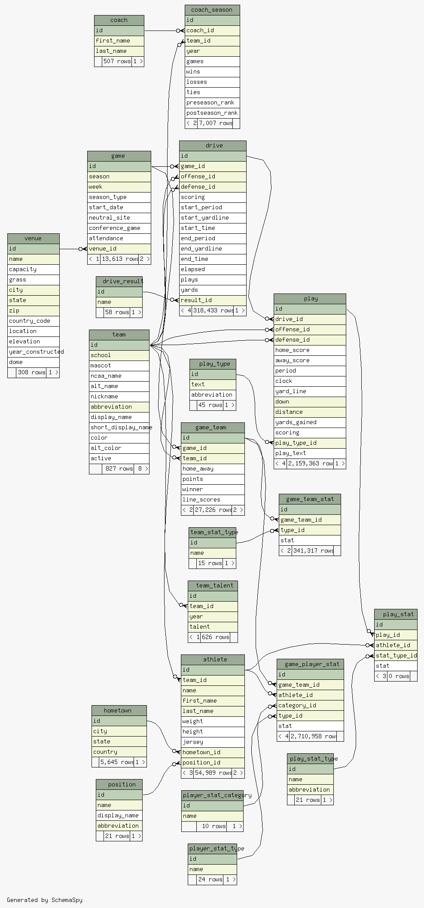
Data sources
All sorts of college football data
games
players
teams
rankings
coaches
& much more
Accessed via Swagger API
Weather data from NOAA

Slide 3
What factors drive attendance at college football games?

Slide 4
If you build it…they will come

Slide 5

Thanks & go dawgs!
https://www.akc.org/expert-advice/news/university-of-washington-mascot-dubs/

