Slide 1
ClassBoard
A LAN-based multi-user collaborative whiteboard for teaching - raw TCP sockets, no internet
Alahari Tarak Ram
CS24B1031
Ponnangatti Bala Murugan
CS24B1039
Vallipalli Lokesh Kumar
CS24B1046
Bellala Parthasaradhi
CS24B1069
Computer Networks Lab (CS3001) | IIITDM Kancheepuram | November 2026
Notes:
Member 1 opens: what we built and why it matters for a classroom.

Slide 2
The problem we solved
Real time
LAN only
Consistent
Every stroke appears on every screen in a few milliseconds, in the same order.
Works on Wi-Fi, Ethernet or a phone hotspot with the internet switched off.
Every client converges to an identical board - even with drops, duplicates and reconnects.
Built for teaching: pages, presentation mode, laser pointer, quick polls, raised hands, timer, roles - on top of every mandatory requirement.
2 ms
110
0
average delivery, 5 clients
automated tests
internet needed
Notes:
Three promises: real time, LAN only, consistent. Mention the classroom angle.

Slide 3
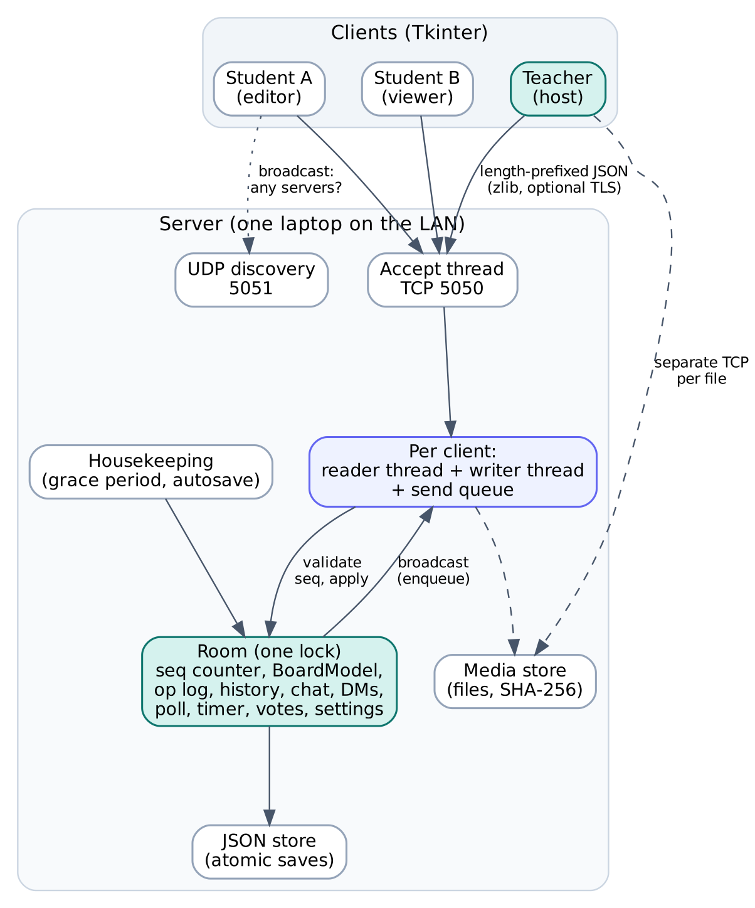
Architecture: an authoritative server, clients in a star
Server binds 0.0.0.0:5050 and prints its LAN IP
Per client: a reader thread + a writer thread with its own send queue
One lock per room: validate, seq, apply, log, enqueue - atomically
Clients never talk to each other; files go over separate short TCP connections
UDP 5051 only for 'find servers on this network'
Housekeeping: 30 s seat grace, autosave every 30 s
Notes:
Member 1. Server binds 0.0.0.0:5050. Thread pair per client. One lock per room. Clients never talk to each other.

Slide 4
Protocol and framing over TCP
4-byte length
big-endian (!I)
N bytes of UTF-8 JSON: {"type":"STROKE", "op_id":"3fa9c1-17", "stroke":{...}}
Framing
Envelope
Why TCP?
Handles TCP fragmentation and coalescing
4 MB frame guard before allocating
zlib for big frames: snapshots shrink by 85%
op_id: client id for ACK and de-duplication
seq: global order, added by the server
user and ts stamped by the server
Reliable and ordered - a lost erase would corrupt the board
~1 ms on a LAN
UDP only for discovery (broadcast, loss harmless)
Notes:
Member 3. TCP is a byte stream - explain fragmentation and coalescing, and why the length prefix fixes it.

Slide 5
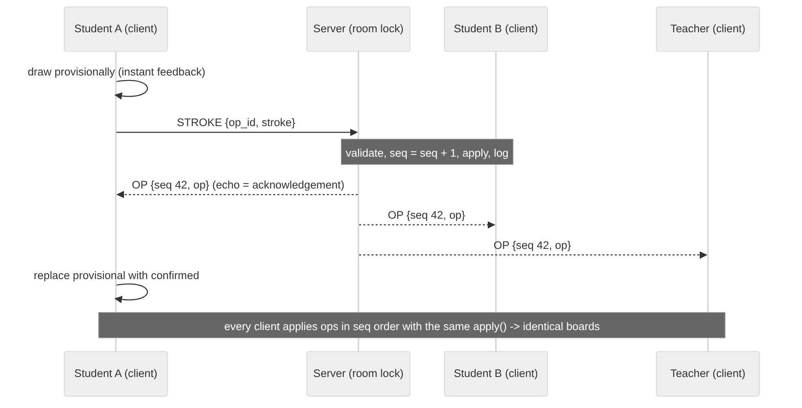
Synchronisation: one global order
1
Server-sequenced total order
seq = seq + 1 under the room lock; the same bytes go to everyone
2
Deterministic replicas
Same BoardModel.apply() on server and clients; fingerprints compared in tests
3
Nothing is overwritten
Moves and edits are layers; undo just flips an 'active' flag
Notes:
Member 3. Same ops, same order, same function = same board. Explain provisional drawing.

Slide 6
Concurrency without freezes or deadlocks
One lock per room
No I/O under a lock
Fixed lock order
Simultaneous edits from many reader threads are serialised into one order - no lost updates.
Broadcast = put on queues; each writer thread does its own sendall. A frozen laptop stalls nobody.
Manager lock, then room lock - deadlock is impossible.
Rate limit, no loss
Responsive GUI
Optimistic drawing
Token bucket per connection: a flooding client's reader pauses, TCP pushes back, nothing dropped.
Only the Tk thread touches widgets; network threads feed a queue drained every 15 ms.
Your stroke shows instantly; the server echo confirms it, an error rolls it back.
Notes:
Member 1/3. No I/O under a lock; slow clients isolated; flooding clients throttled without dropping anything.

Slide 7
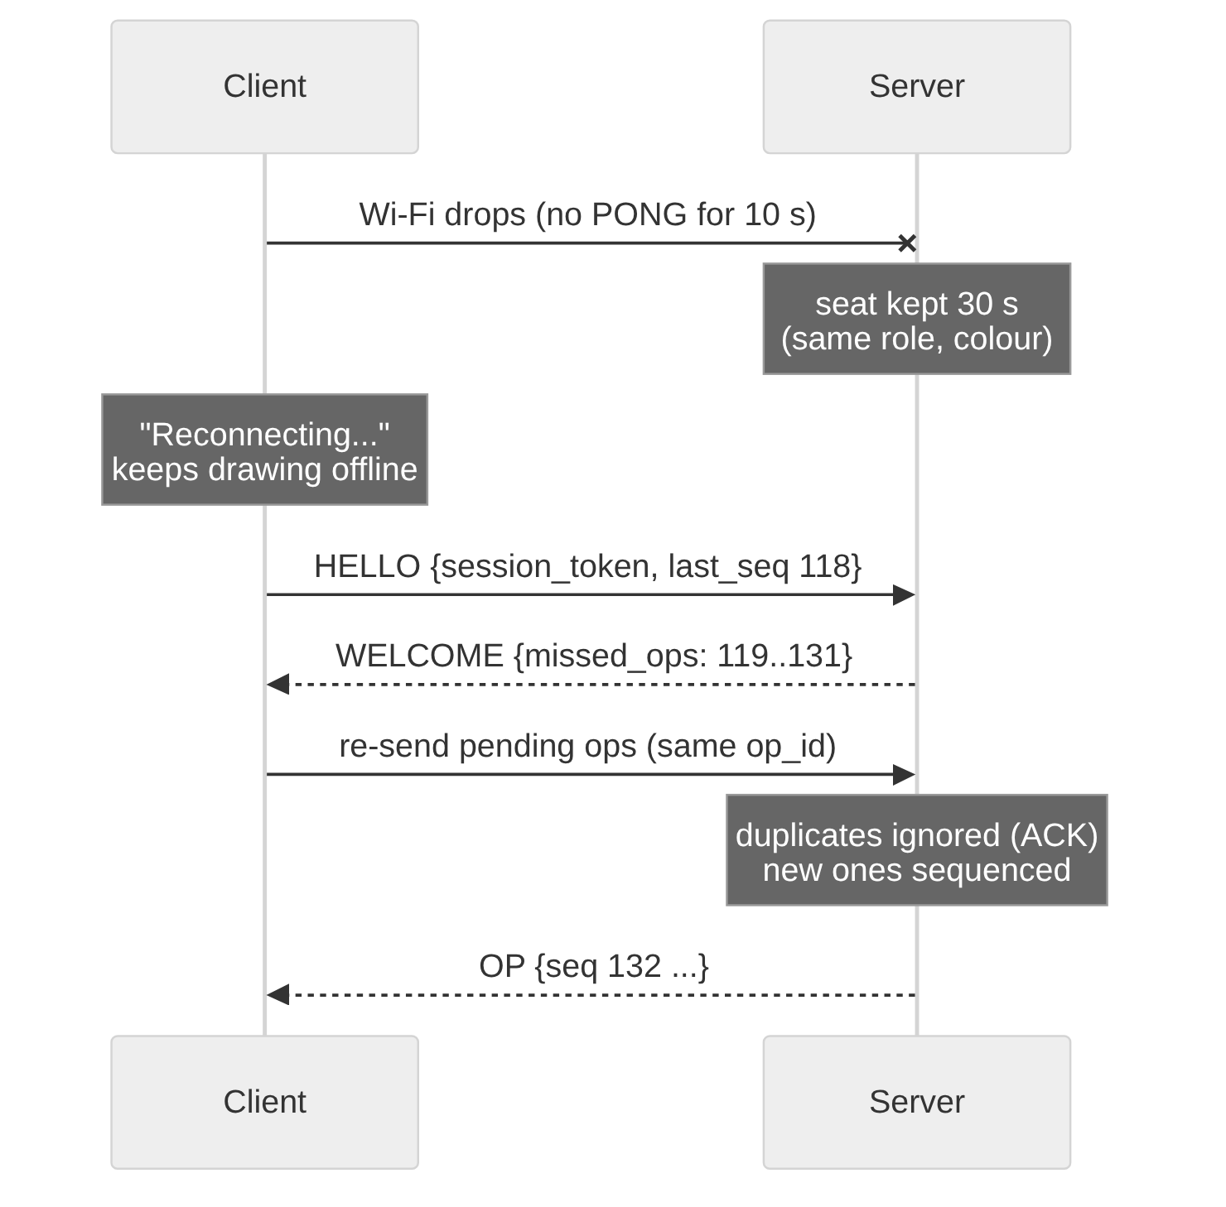
Ordering, duplicates and recovery
Problem | Handling
Out of order | Buffer until the gap is filled; deliver contiguous seq only
Duplicate | op_id remembered: ACK, not re-applied; client drops seq <= last
Dead link | PING every 3 s; 10 s of silence = dead
Reconnect | Seat kept 30 s; HELLO(token, last_seq) -> only missed ops
Offline edits | Pending ops re-sent with the same op_id: applied exactly once
Server restart | Atomic autosave; rooms restored; clients reconnect by themselves
Notes:
Member 1. Demo moment: turn Wi-Fi off for 15 s, keep drawing, turn it on.

Slide 8
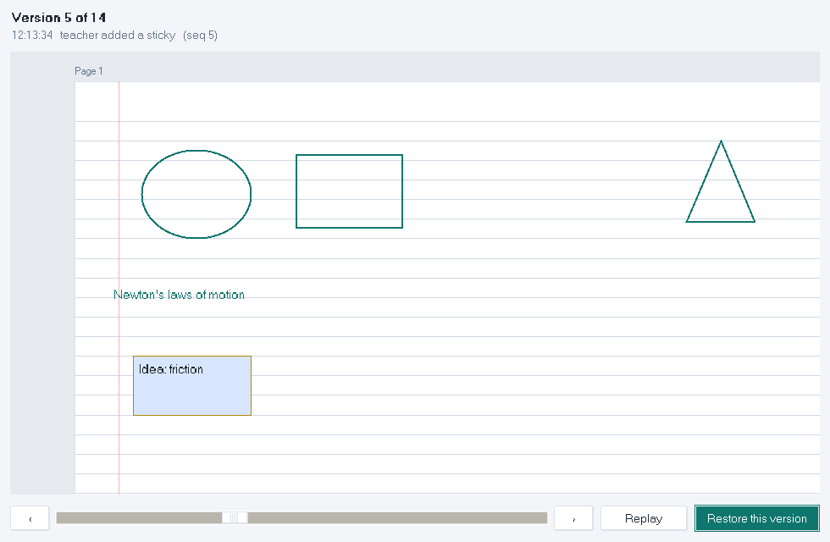
Undo, redo and version history
Per-user undo
Ctrl+Z undoes only your own last action. The server flips that op's 'active' flag and broadcasts it as a sequenced op - so every board agrees.
Edge cases
Already-erased stroke: skipped. Concurrent undos: serialised by the lock. New action clears redo. Clear board is undoable.
Notes:
Member 3. Undo is per user. History = replay of the same log.

Slide 9
Security and access control
Passwords
Roles on the server
PBKDF2-SHA256, 120k iterations, salt; 3 wrong tries = 30 s block
Teacher, student, view-only; lock; own-work-only; kick = ban
Validation
Encryption
Whitelisted fields, bounds, type checks; fuzz-tested with ~2,000 bad messages
Optional TLS 1.2+ (--tls-cert/--tls-key) for sessions and files
Notes:
Member 3. Demo moment: untick 'Students can draw', a student's forced draw is refused by the server.

Slide 10
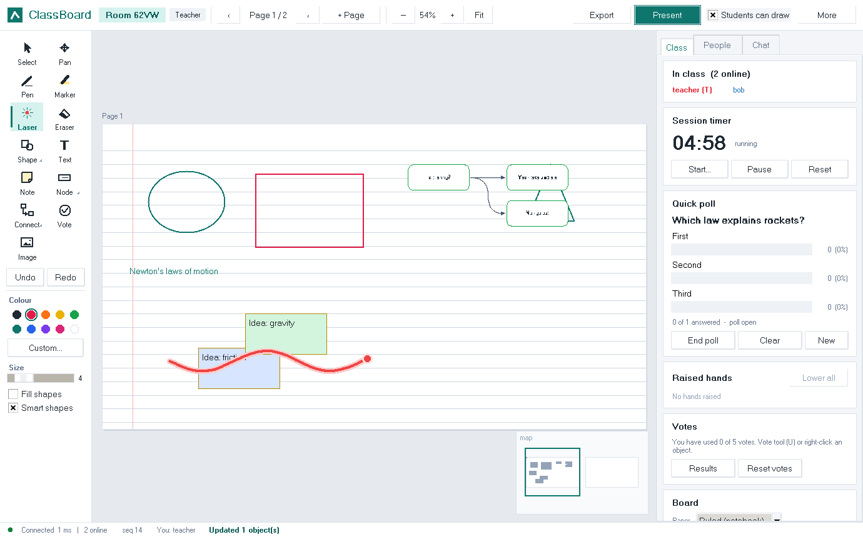
Built for the classroom
Pages on ruled, grid, dot or graph paper
Present: students follow the teacher's view
Laser pointer, smart shapes, sticky notes
Flowcharts and mind maps (Tab / Enter)
Quick polls, raised hands, timer, dot voting
Private messages, images, video, voice
Export all pages as PDF notes
Notes:
Member 2. Walk through the teacher window.

Slide 11
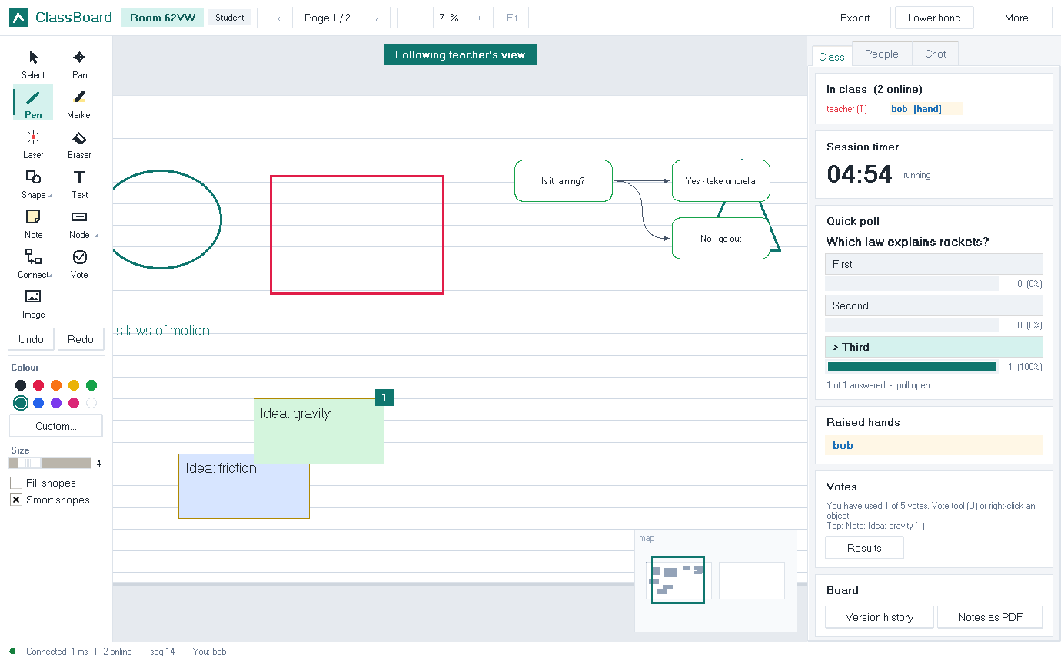
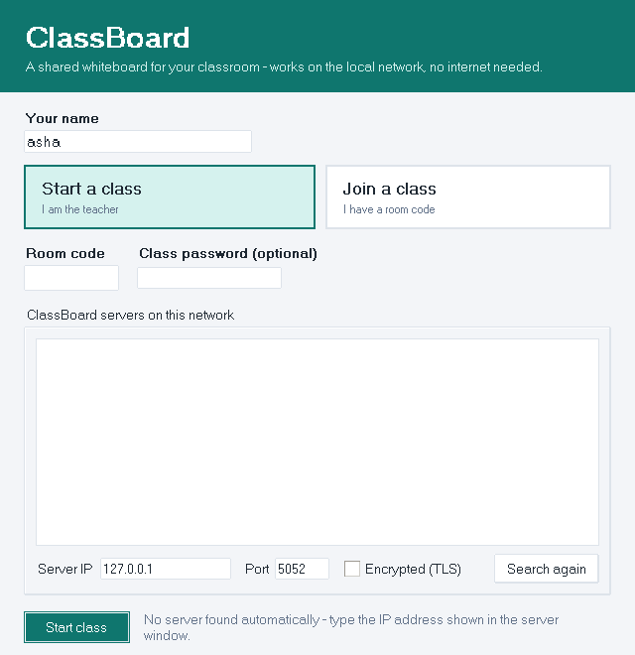
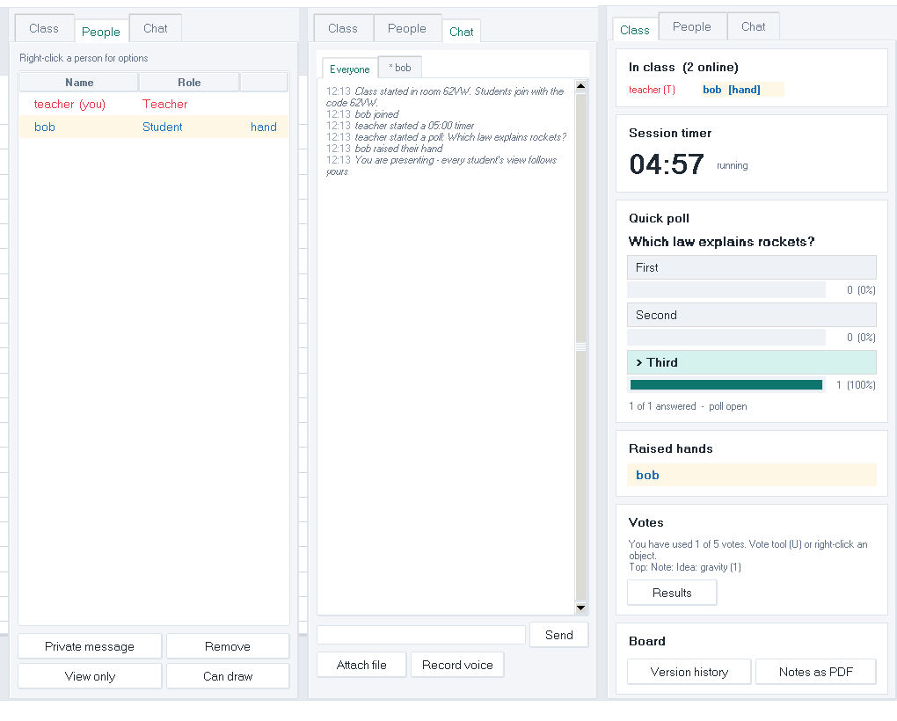
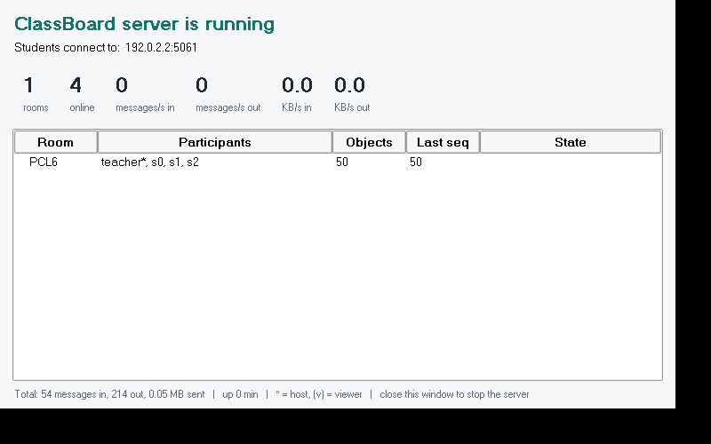
The app in action
Notes:
Member 2. Student view following the teacher, panels, dashboard.

Slide 12
Performance: measured, not guessed
11,111
deliveries / s in a burst
-85%
snapshot size with zlib
0.4 ms
stroke latency during a 60 MB upload
Notes:
Member 4. tools/benchmark.py. Paced = realistic class; burst = stress test.

Slide 13
Testing: 110 automated tests, all passing
Protocol
Consistency
Reliability
Byte-by-byte and coalesced streams, size guards, zlib bombs, validation
10 clients x 200 strokes; concurrent moves and edits - identical fingerprints
Reconnect, offline edits, heartbeat, rejoin after expiry, server restart mid-class
Security
Real GUI (27)
Platforms
Passwords, roles, lock, kick, TLS, fuzzing, a flooding client
Teacher + student windows driven by mouse events, checked on the other screen
Python 3.10, 3.12, 3.13; executables run with no internet
Notes:
Member 4. Show python -m pytest tests -q in the terminal.

Slide 14
Design decisions and trade-offs
Decision | Why | Cost we accepted
TCP, not UDP | Reliable, ordered; no own retransmission | Head-of-line blocking (files use separate connections)
Central sequencer, not CRDT | Simple proof, easy undo / history | Edits need a server round trip (hidden by provisional drawing)
Thread pair per client | Simple, isolates slow clients | Fine for a class, not for thousands of users
JSON messages | Readable, easy to debug and validate | Bigger than binary (zlib for big frames)
Plaintext by default | Zero setup on a trusted lab LAN | TLS is optional, self-signed certificates
Notes:
Member 4. Say the cost of each decision.

Slide 15
Our contributions
Alahari Tarak Ram
Ponnangatti Bala Murugan
CS24B1031
Server networking: sockets, threads, rooms, heartbeat, reconnect, persistence, dashboard
CS24B1039
Client GUI: canvas, tools, pages, presentation mode, polls, chat, history window
Vallipalli Lokesh Kumar
Bellala Parthasaradhi
CS24B1046
Protocol and sync: framing, message design, sequencing, undo/redo, security
CS24B1069
Testing and performance: test suite, benchmark, media sharing, exports
Notes:
Each member: name, roll number and 2-3 points you will explain.

Slide 16
Live demo, then questions
Internet off - server on one laptop - teacher and students join over Wi-Fi
1 Start the class, students join from the discovered list
2 Draw, Present, laser, flowchart, poll
3 Lock the board, Wi-Fi off and on: auto-recovery
4 Version history replay, export PDF notes
Notes:
Follow the live demo checklist in docs/Speaking_Script.md.

