Slide 1
Tri-Lingual Question-Answering System
Nithin Chandra Gupta Samudrala 200110076

Slide 2
Motivation
A trilingual question answering system provides students with the ability to ask questions and gain a deeper understanding of content across multiple languages.

Slide 3
Problem Statement
Building Question-Answering System in
Telugu, English and Hindi.
For each observation in the training set we have a context, question, and answer.
The goal is to find the answer for any new question and context provided.
I used “Extractive Question Answering” Method. This involves posing questions about a document and identifying the answers as spans of text in the document itself. This makes it a closed dataset meaning that the answer to a question is always a part of the context and also a continuous span of context.

Slide 4
Problem Statement - Contd.
Building Question-Answering System in
Telugu, English and Hindi.
The context can be in any of the three languages: Telugu, English and Hindi.
The question can also be in any of the three languages mentioned above.
I used google-translate API to translate any text to English before passing it to our model.

Slide 5
Literature Survey
Pranav Rajpurkar, Jian Zhang, Konstantin Lopyrev, Percy Liang:
SQuAD: 100,000+ Questions for Machine Comprehension of Text
Link to paper

Slide 6
Dataset
Stanford Question Answering Dataset (SQuAD) is a new reading comprehension dataset, consisting of questions posed by crowdworkers on a set of Wikipedia articles, where the answer to every question is a segment of text, or span, from the corresponding reading passage. With 100,000+ question-answer pairs on 500+ articles, SQuAD is significantly larger than previous reading comprehension datasets.

Slide 7

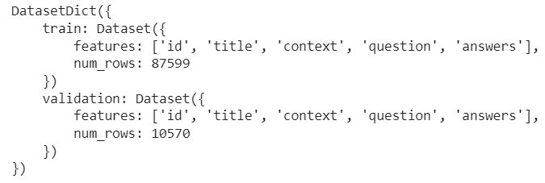
Dataset Contd.
Loading the Dataset:
print(raw_datasets):

Slide 8
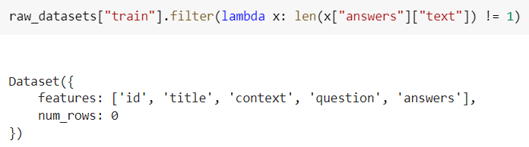
Dataset Contd.
The training dataset has only one possible answer while the validation dataset has several possible answers, which may be same or different

Slide 9
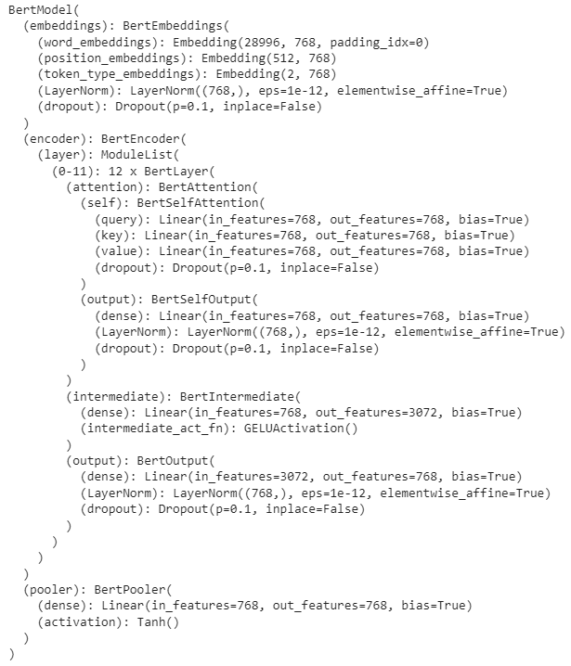
Model
I have used a BERT Model (Bidirectional Encoder Representations from Transformers) and fine-tuned it for our task.
The Architecture of this model is shown in the picture on the right-side.

Slide 10
Metrics
Exact match : This metric calculates exact similarity between predict answer and the ground truth. For question answering, it serves as a good metric as we need answer that has to be accurate to question asked
f1 : it is the harmonic mean of the precision and recall of the predicted answer and ground truth answer.

Slide 11
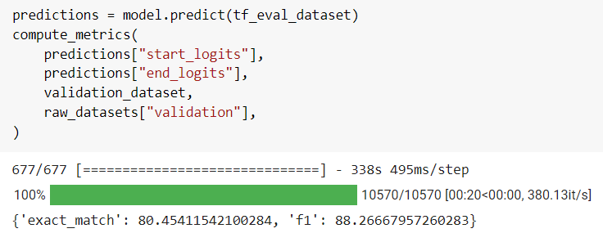
Results

Slide 12
Results and Analysis
BERT worked pretty well in extracting answers for factoid questions like “Who is the current captain of CSK?” but fared poorly when given open-ended questions such as “Is Dhoni the best captain?”.
This is because we trained the model on dataset which has fact-based questions with explicit answers. To answer open-ended questions, it needs better interpretation and understanding.
Answering open-ended questions might also come under the category of generative tasks which is tough for BERT as it’s language and concepts of relations between words is limited to the training data and also due to its MLM objective.
Although MLM objective is useful for learning representations of words and their relationships with other objects, it is not as effective for learning how to generate grammatically correct text.
When model is asked out of context question, model is hallucinating which is undesired

Slide 13
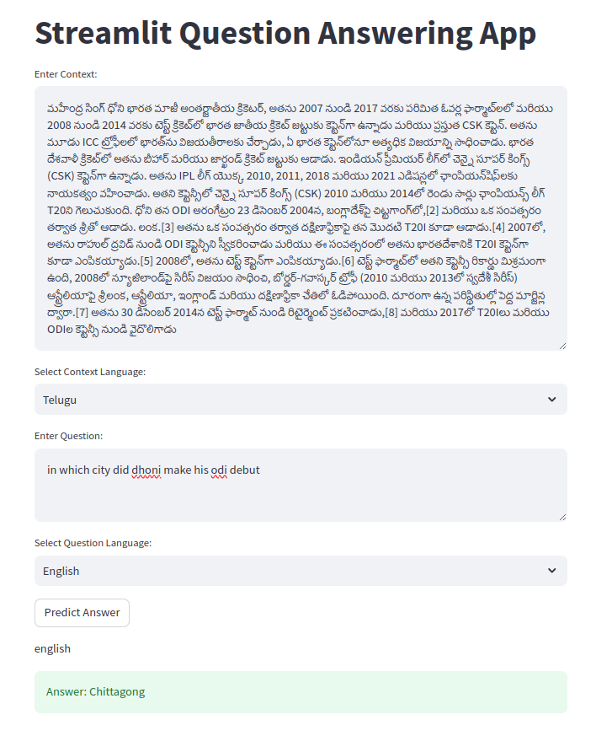
Results
Context-Telugu
Question-English

Slide 14
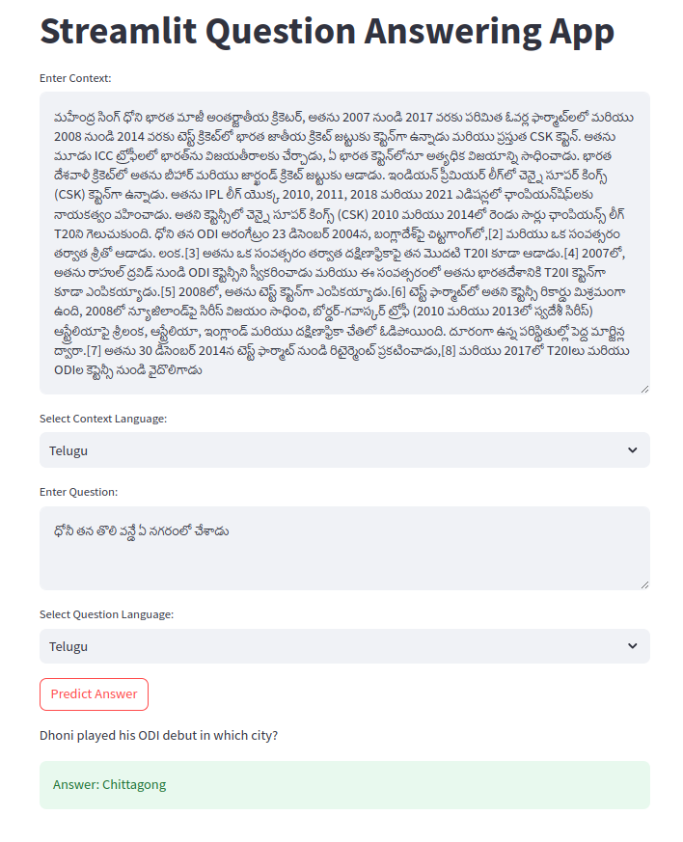
Results
Context-Telugu
Question-Telugu

Slide 15
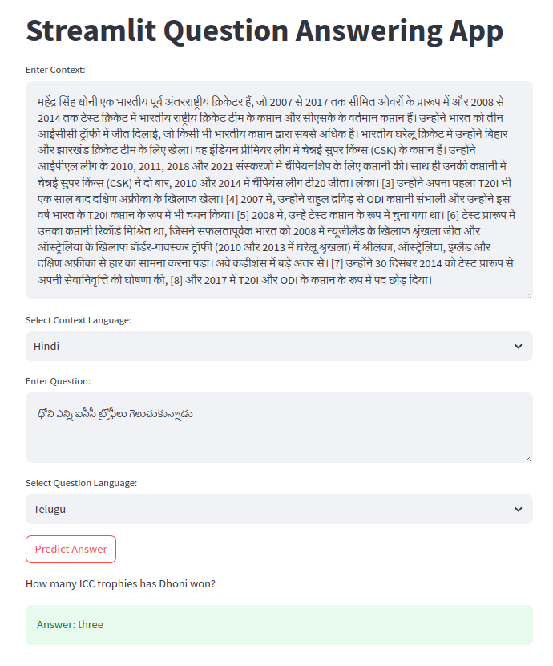
Results
Context-Telugu
Question-English

Slide 16
Demo

