Slide 1

MUSIFY- Music Composition using A.I.

Slide 2

_Mu_si_c Composition
Music Composition is a process of creating a new piece of music
Composition means “putting together”. Thus, music composition is something where music notes are put together in such a way that it gives pleasant sensation to our ears
Parameters such as pitch interval, notes, chords, tempo etc. are used for composing short piece of music

Slide 3

A_b_ou_t the Project
The Project mainly focusses on music from Piano instrument
Uses Long Short Term Memory (LSTM) , a type of Recurrent Neural Network (RNN)
Platform: Google Colab
Language: Python 3.8
Libraries Used: Tensorflow, Music21, Keras, NumPy, Sklearn, tqdm
Dataset: Classical Music MIDI | Kaggle

Slide 4

T_e_rm_inologies
Note: This is a sound produced by a single key
Chords: The combination of 2 or more notes is called a chord
Octave: The distance between two notes is stated as an octave in a piano
It is specifically the gap between the two notes that share the same letter name
Recurrent Neural Networks (RNN)
A recurrent neural network is a class of artificial neural information. They are called recurrent because they perform the same sequence, with the result being dependent on previous computations
networks function
that make
for every
use
single element of a
of sequential
Long Short Term Memory (LSTM)
LSTMs are a type of Recurrent Neural Network that can efficiently learn via gradient descent
Using a gating mechanism, they are able to recognize and encode long-term patterns
Useful to solve problems where the network has to remember information for a long period of time
Applications: Music and text generation etc.
Limitation: It requires lots of resources and time to get trained for real world applications

Slide 5

L_ib_ra_ries
Music21
Music21 is a Python toolkit used for computer-aided musicology
It allows us to teach the fundamentals of music theory, generate music examples and study music
The toolkit provides a simple interface to acquire the musical notation of MIDI files
Additionally, it allows us to create Note and Chord objects so that we can make our own MIDI files easily
Keras
Keras is a high-level neural networks API that simplifies interactions with TensorFlow
It was developed with a focus on enabling fast experimentation
TensorFlow
TensorFlow is a free and open-source software library for machine learning and artificial intelligence
It can be used across a range of tasks but has a particular focus on training and inference of deep neural networks
NumPy
NumPy is a Python library used for working with arrays
It also has functions for working in domain of linear algebra, Fourier transform, and matrices
tqdm
tqdm is a library in Python which is used for creating Progress Meters or Progress Bars

Slide 6

P_r_oje_ct Structure
All Midi Files/ : This is the dataset folder containing various midi files of different composers
code.ipynb : In this file, we will build, train and test our model
MOD/ : This directory contains optimizer, metrics, and weights of our trained model
AI_composed_music.mid: This is a music file of predicted notes

Slide 7

STEPS
(For developing Code from Scratch)

Slide 8
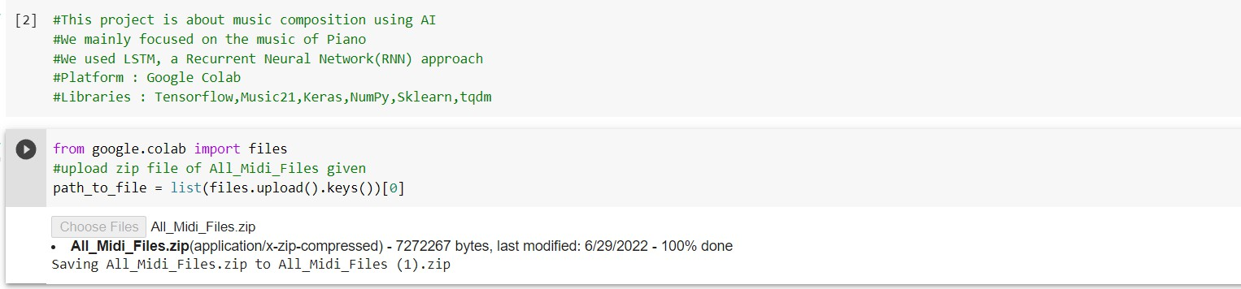
STEP 1 Choosing zip file
To load midi files in the code, I need to load the data first to the google colab session
I need to select the zip file of all music files
CODE SNIPPET

Slide 9
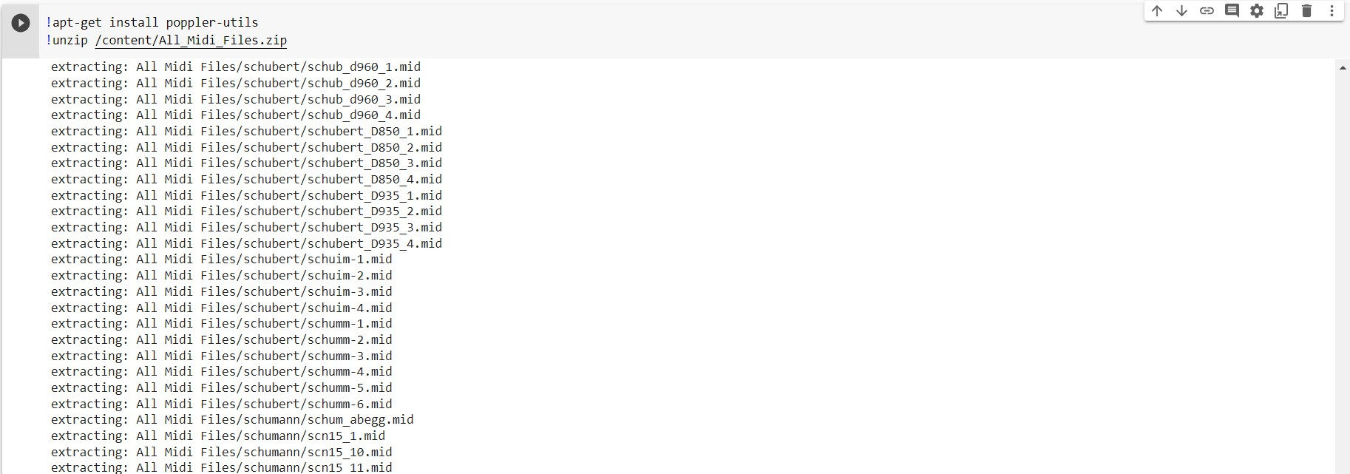
STEP 2 Extracting zip file
After uploading the zip file, I need to extract the music files in the session itself.
CODE SNIPPET

Slide 10
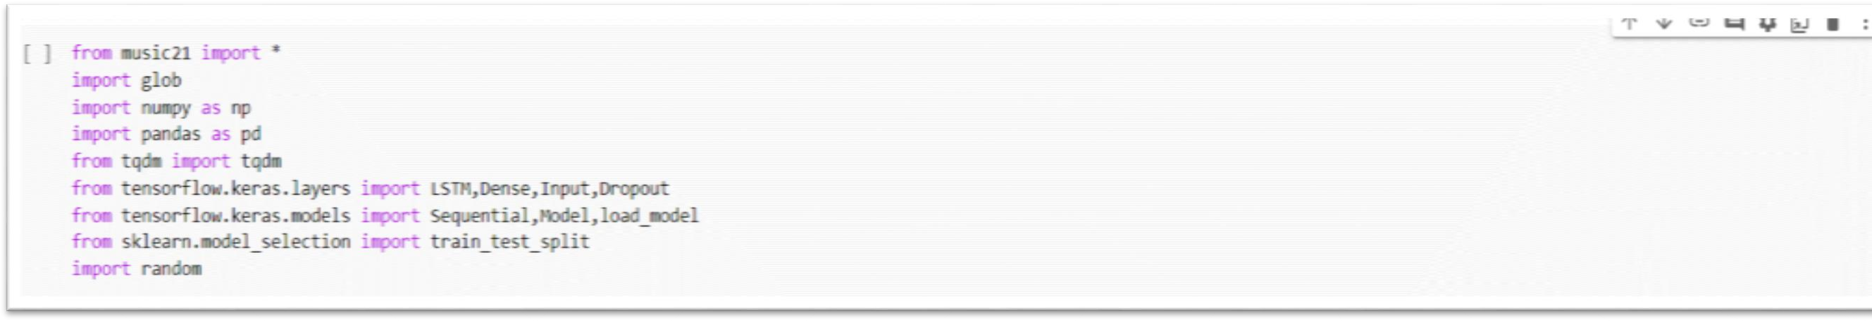
STEP 3
Import Libraries
Import all the important Libraries
CODE SNIPPET

Slide 11
STEP 4
Reading and Parsing the Midi File
The midi file dataset has to be read using Music21 library
“Haydn” composed files has been used. (You can use more or less depending on your system)
For this project, the files that contain sequential streams of Piano data has only been worked on
All files are separated by their instruments and Piano is used only
Piano stream from the midi file contains many data like Keys, Time Signature, Chord, Note etc.
We require only Notes and Chords to generate music
Lastly, the arrays of notes and chords has to be returned
_ _ _

Slide 12
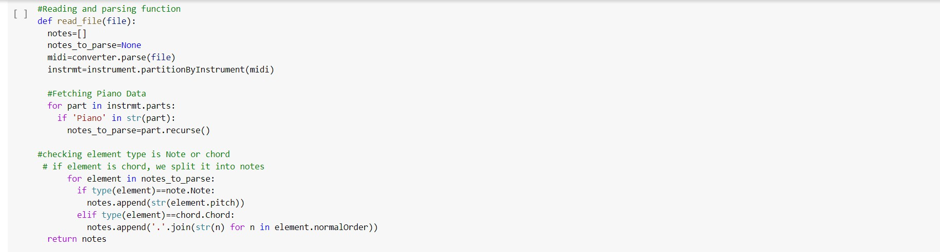
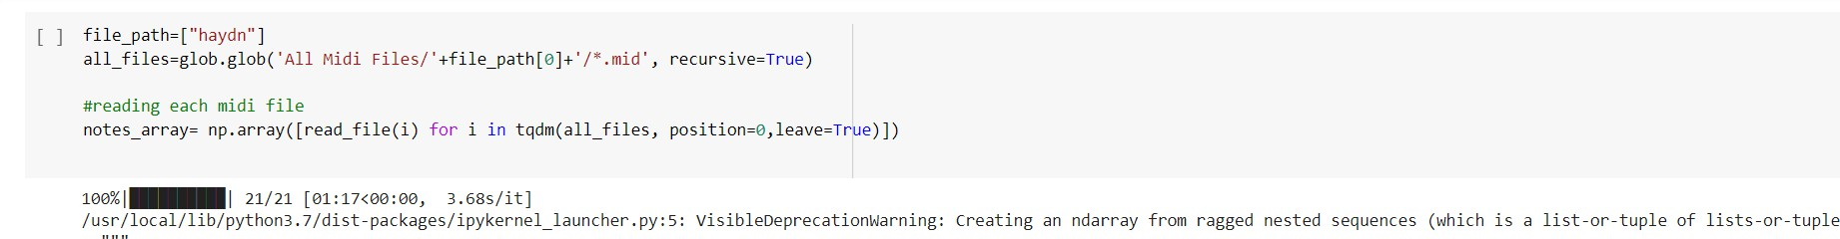
CODE SNIPPET

Slide 13
STEP 5
Exploring the Dataset
This is done to check the number of unique notes and their distribution
50 is used as a threshold frequency
Only those notes which have frequencies more than 50 have been considered
Two dictionaries are created where one will have notes index as a key and notes as value and other will be the reverse of the first i.e. key will be notes and value will be its respective index
These dictionaries will be used in the next steps
_ _ _

Slide 14
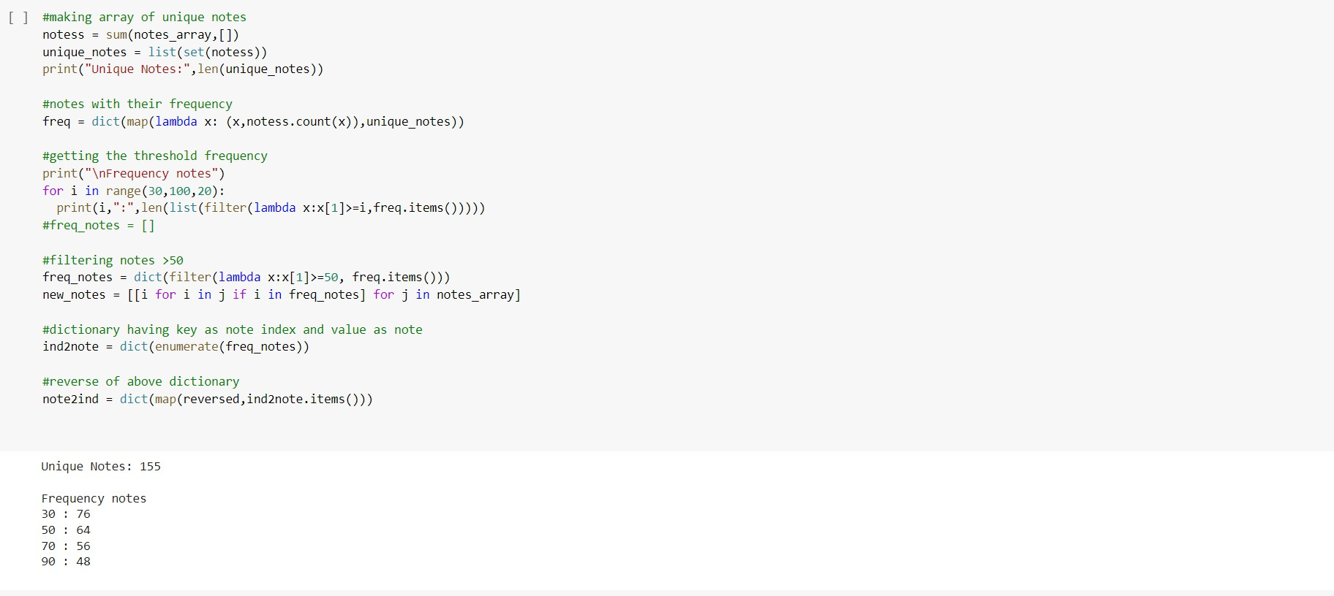
CODE SNIPPET

Slide 15
STEP 4
Input and Output Sequence for model
Input and output sequences for our model are created
A timestep of 50 has been used. So, if we traverse 50 notes of our input sequence then the 51st note will be the output for that sequence
Example:
While using ‘SOC stands for Seasons of Code’ sentence with a timestep of 2, we will have to provide 2 words at every input to get the output
(x)
SOC stands Stands for for Seasons Seasons of
(y)
for Seasons of
Code
As our model requires numeric data, all notes are converted to its respective index value using the “note2ind” (note to index) dictionary which has been created earlier
_ _ _

Slide 16
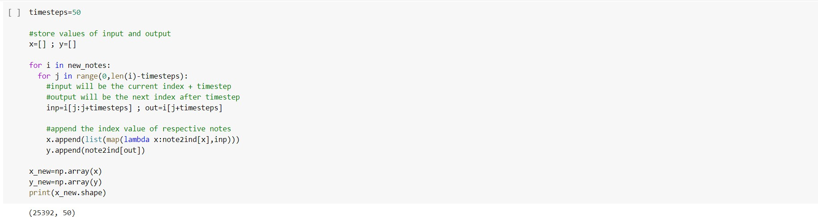
CODE SNIPPET

Slide 17
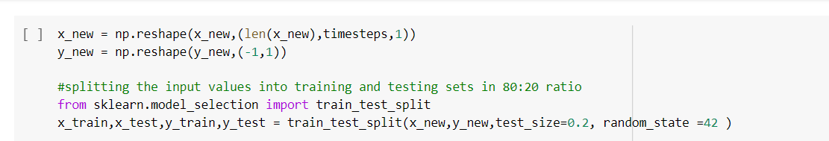
STEP 5
Training and Testing sets
Training set
Array for our model is re-shaped and the data is split into 80:20 ratio.
80 %
20%
Testing set
CODE SNIPPET
_ _ _

Slide 18
STEP 6
Building the Model
2 stacked LSTM layers with a dropout rate of 0.2 are used
A fully connected Dense layer has been used for output
Output dimension of the Dense Layer is taken same as the length of our unique notes along with the ‘softmax’ activation function (Used for multi-class classification problems)
Dropout refers to ignoring units (i.e. neurons) during the training phase of certain set of neurons which is chosen at random. It basically prevents overfitting while training the model, while it does not affect the inference model.
_ _ _

Slide 19
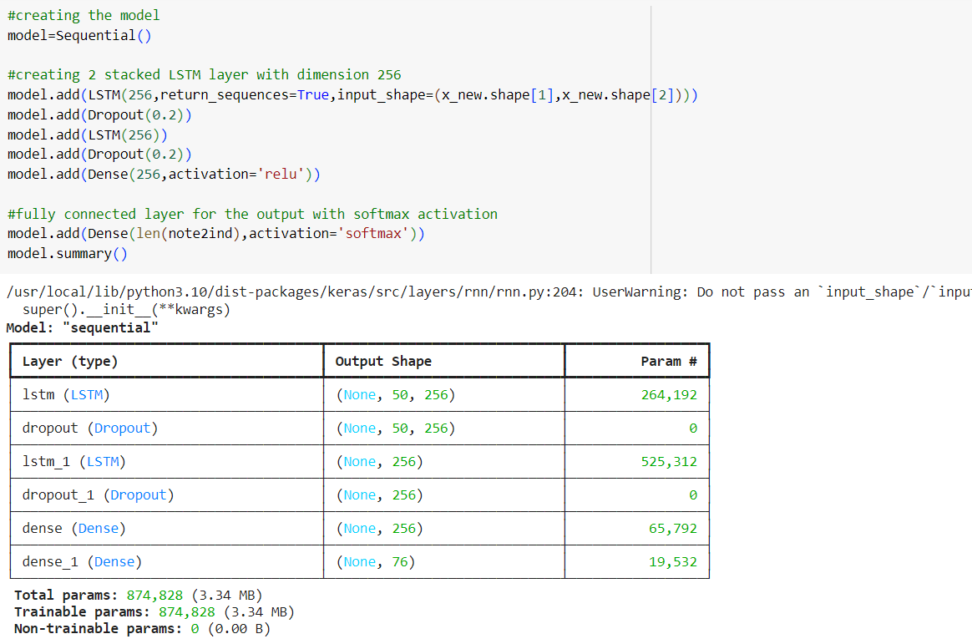
Building the Model using LSTMs
CODE SNIPPET

Slide 20
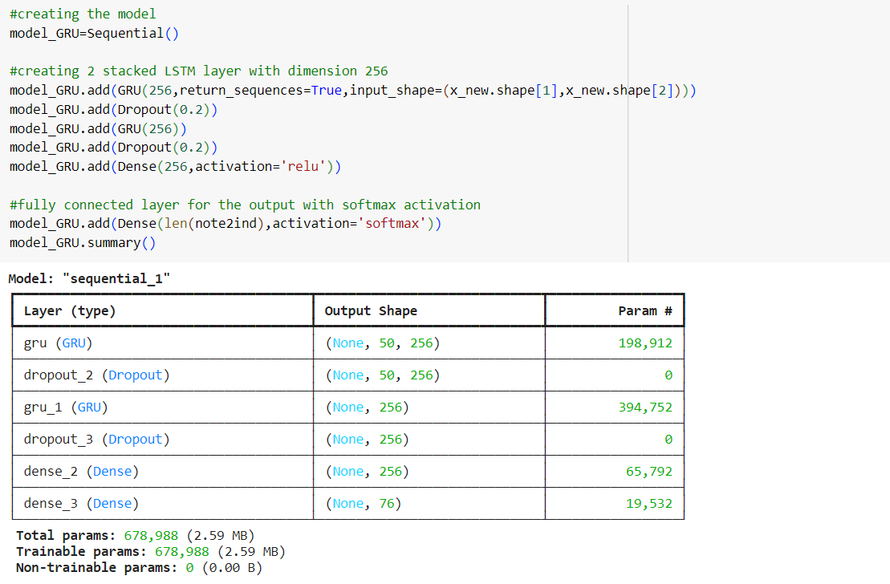
Building the Model using GRUs
CODE SNIPPET

Slide 21
STEP 7
Training the Model
After building the model, it is trained on the input and output data
For this, ‘Adam’ optimizer is used on batch size of 128 and for total 80 epochs
After Training, model is saved for prediction
_ _ _

Slide 22
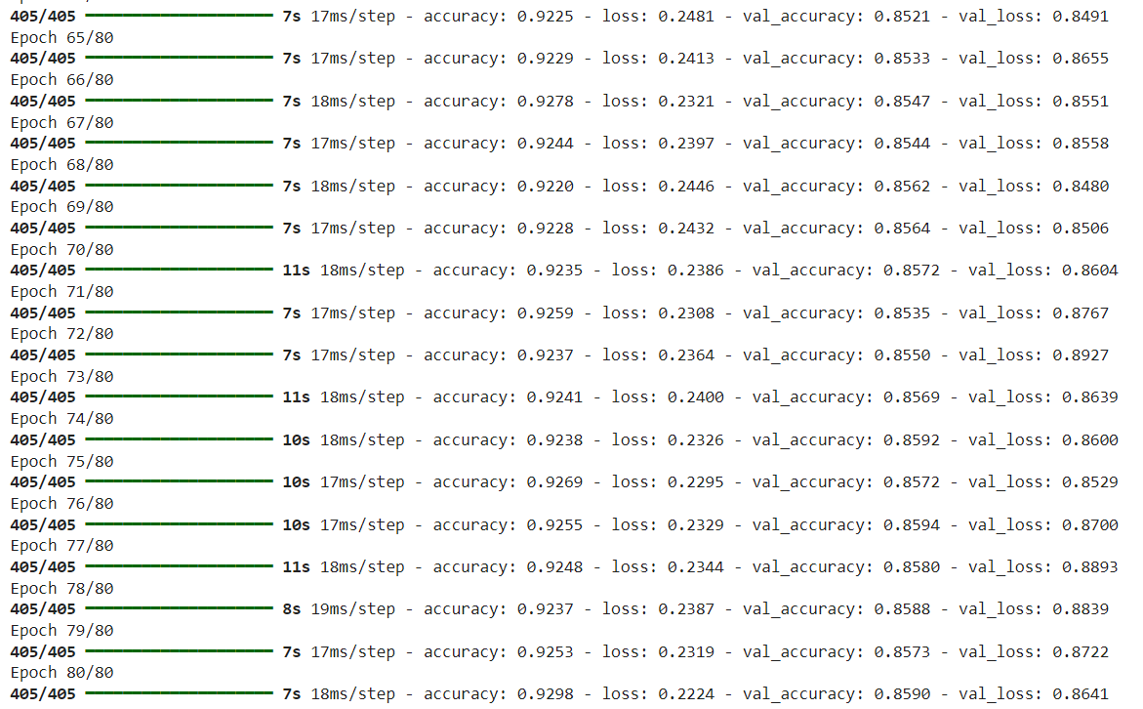
RESULTS FOR GRUs
_ _ _

Slide 23
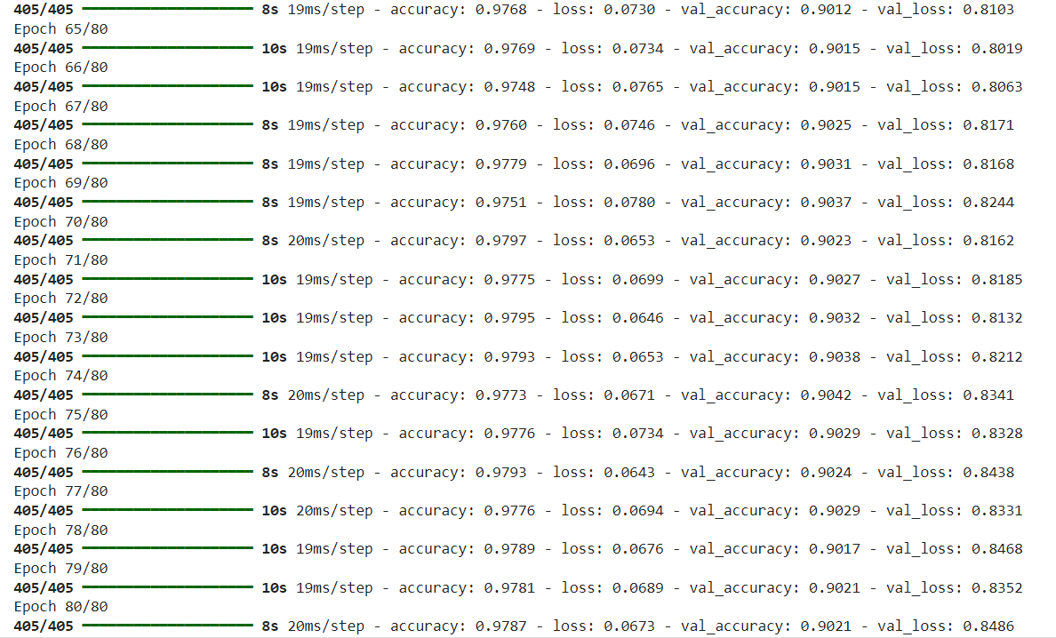
RESULTS FOR LSTMs
_ _ _

Slide 24
STEP 8
Inference Phase
Using the trained model, the notes will be predicted
A random integer(index) is generated for our testing input array which will be our testing input pattern
Our array is then re-shaped and the output is predicted
Using the ‘np.argmax()’ function, we get the data of the maximum probability value
This predicted index is converted to notes using ‘ind2note’(index to note) dictionary
Our next music pattern is one step ahead of the previous pattern
This process is repeated till we generate 200 notes
This parameter can be changed as per your requirements
_ _ _

Slide 25
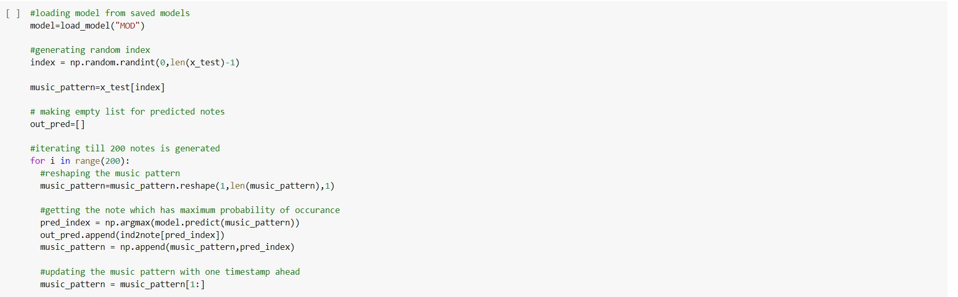
Inference Phase
CODE SNIPPET

Slide 26
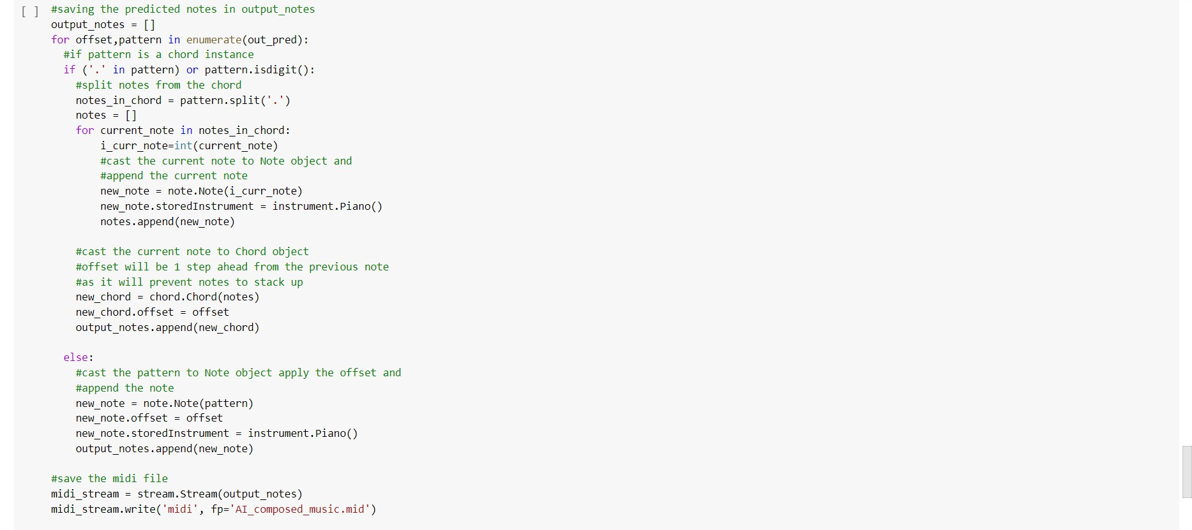
STEP 9
Saving the File
The predicted output notes are saved into a MIDI File
CODE SNIPPET
_ _ _

Slide 27
OUTPUT AUDIO FILE LINK:
https://drive.google.com/file/d/1A0se9zmoqUaVUjwIIiUAGMXGWdEm2uah/view?usp=sharing
REFERENCE ARTICLE LINK:
https://www.analyticsvidhya.com/blog/2021/12/step-by-step-guide-to-build-image-caption-generator-using- deep-learning/

Slide 28






