Slide 1

NVIDIA Structured Note Analysis Report Work performed By: Tarak Ktari Mohamed Mahdi Hannachi Mortadha Bahri

Slide 2
Table of Contents
 | Cover slide | 1 |  |  | Monte carlo steps | 17
 | ToC | 2 |  |  | Excel findings | 18
 | Structured Note Overview | 3 |  |  | Recommendation | 19
 | Issuer & Guarantee | 4 |  |  | Conseravative investor | 20
 | Features | 5 |  |  | Modearte investor | 21
 | Key features | 6 |  |  | Aggressive investor | 22
 | How the note functions | 7 |  |  | Final verdict | 23
 | Strategic Review and Opportunities | 8
 | Final Redemption Scenarios: | 9
 | Risks | 10
 | Risk Factors | 11
 | Illustration | 12
 | Excel model & python code | 13
 | Python Code Explanation | 14
 | Python code findings | 15
 | Excel pricing model and steps | 16

Slide 3
Structured Note Overview

Slide 4


Structured Note Overview
What is a Structured Note ?
A hybrid financial instrument that combines fixed income (providing periodic coupon payments) and derivatives (linking returns to the performance of an underlying asset) to offer a customized risk-return profile.
Issuer & Guarantee
Issuer
The issuer, BBVA Global Securities B.V., is responsible for issuing the structured note, backed by BBVA’s Structured Medium-Term Securities Program.
Guarantor
The BBVA New York Branch Ensures payments if the issuer defaults.
Product Structure and Key Details
Overview of This Structured Note:
Component | Details
Main Features | Conditional Coupon, early redemption, leveraged downside
Denomination | USD 1,000 per note
Underlying Asset | NVIDIA Corporation (NVDA) stock
Maturity Date | March 18, 2026
Credit Risk Implications
Investors rely on BBVA’s creditworthiness for returns, but the note is not FDIC-insured as it is not a deposit.

Slide 5
Features

Slide 6




Key Features
08
Placeholder
Insert your desired text here.
Quarterly Conditional Coupons (4.84%)
.
Memory Feature (Accumulated Missed Coupons)
Coupons are paid only if NVIDIA’s stock price is at or above 75% of its initial value, with payments scheduled for June 2025, September 2025, December 2025, and March 2026.
If a coupon payment is missed, it rolls forward and is paid in the next qualifying period
If NVIDIA stock rebounds above 75%, all accumulated coupons are paid out.
07
Placeholder
Placeholder
02
Insert your desired text here.
Investment Mechanics and Key Components
03
Automatic Early
Redemption
Final Redemption – Capital Protection vs. Loss Risk
If NVIDIA’s stock reaches 100% of its initial price on any valuation date, the note is redeemed early at full $1,000 principal value, and no further coupons are paid.
If NVIDIA’s final price ≥ 75%, full principal is returned
If NVIDIA’s final price < 75%, principal is reduced based on a 1.3333x leverage factor

Slide 7
How the Note Functions?

Slide 8
Strategic Review and Opportunities
Understanding Coupon Payments & Redemption Triggers
Each quarter, check if NVIDIA’s stock is ≥ 75% of its initial price.
✅ Yes: Pay 4.84% coupon
❌No: No coupon, but amount rolls over under the memory feature
Step 1: Quarterly Coupon Eligibility
Trigger Condition:
If NVIDIA reaches 100% at an evaluation date, early redemption occurs.
🔹 What Happens Next?
Investment terminates immediately.
Investor receives full $1,000 principal—no further coupon payments.
🔹 Investor Considerations: ✔ Capital Protection: Locks in principal, avoiding future downside risks. ✔ Limited Upside: No opportunity for further coupon income.
💡 Key takeaway: Early exit provides safety but cuts off future yield potential.
💡 Key takeaway: Coupon payments are market-dependent, but the memory feature helps mitigate missed payouts.
Step 2:
Early Redemption Check
If NVIDIA stock hits 100% at Full principal returned any quarterly valuation date:
✅ Yes: Stock = 100% → ($1,000), no more coupon payments
❌ No: Stock < 100% → Continue Investment
Step 3: Maturity-Based Payout Calculation
Final Stock Price | Investor Payout
≥ 75% | Full principal returned
< 75% | Capital loss applied (1.3333x leverage)

Slide 9
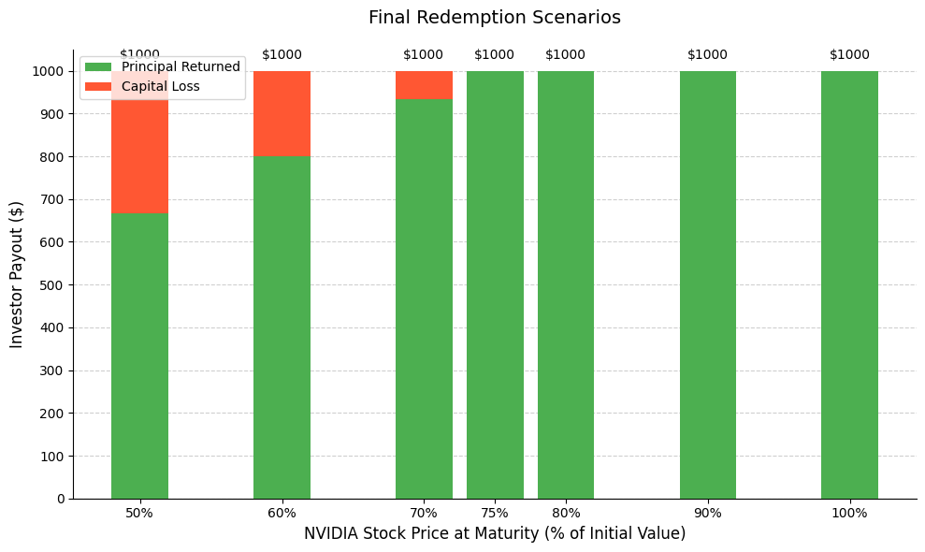
Final Redemption Scenarios:
Understanding Capital Protection vs. Loss
🔹 If NVIDIA Stock is at or Above 75% of Initial Price The full capital of $1,000 is returned, and all due coupons are paid.
🔹 If NVIDIA Stock is Below 75% Losses occur due to a leverage factor (1.3333x). Example: If NVIDIA drops to 60%, investor only gets $800.
🔹 Worst-Case Scenario
💡If NVIDIA drops significantly, investor can lose a large portion of capital.

Slide 10
Risks

Slide 11
Risk Factors
Market Risk
NVIDIA stock volatility directly impacts returns.
Credit Risk
Payments depend on BBVA’s financial health,
exposing investors to default risk.
Liquidity Risk
Structured notes lack an active secondary market,
and selling before maturity may result in losses.
No Guaranteed Returns
Coupons are conditional, and capital is not protected.

Slide 12
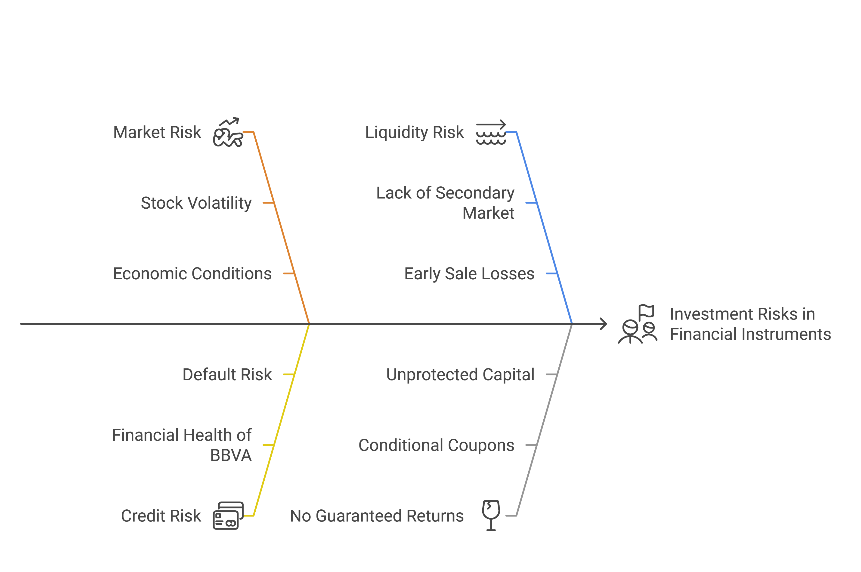
Risk Factors

Slide 13
Excel Model & Python Code

Slide 14
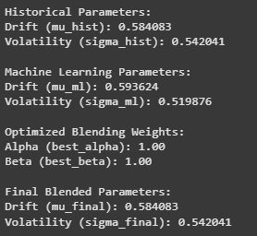
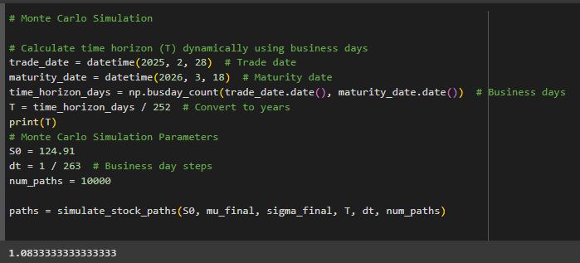
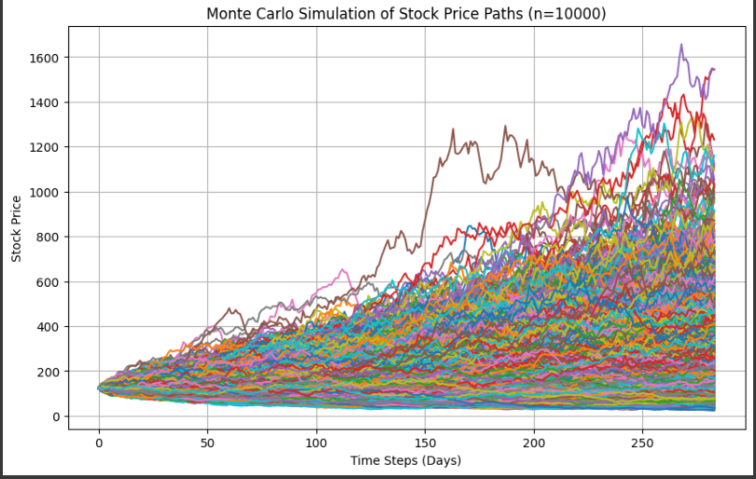
Python Code Explanation
Code Workflow
Illustrations
1-Data Collection:
Download NVIDIA stock data using yfinance.
2-Parameter Estimation:
Historical drift (mu) and volatility (sigma). Machine Learning (Random Forest) forecasts.
3-Blending Parameters:
Cross-validation optimizes weights for historical vs. ML estimates.
4-Monte Carlo Simulation
Generates 10,000 stock price paths using Geometric Brownian Motion
5-Payoff Calculation:
Simulates coupons, early redemption, and maturity payoffs.
6-Fair Price Estimation:
Neural network predicts average discounted payoff

Slide 15
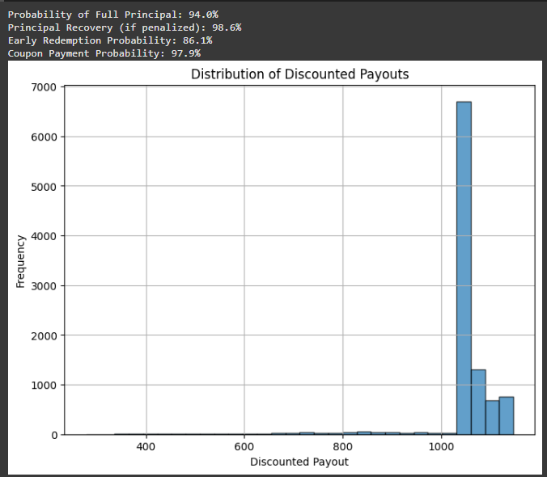
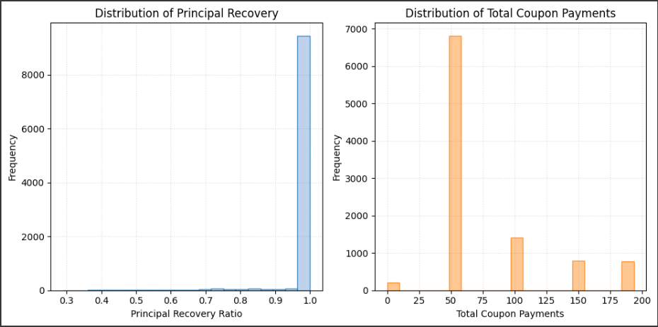
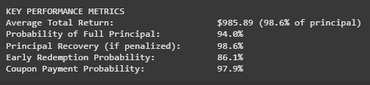

Python code findings
interpretation
Code output
Principal Safety:
94% probability of full principal repayment.
Even if penalized, 98.6% principal recovery (minimal loss).
Coupon Reliability: 97.9% probability of quarterly coupon payments.
Early Redemption Likelihood: 86.1% chance of automatic redemption if NVIDIA stock exceeds 100% of initial price.
Final result

Slide 16
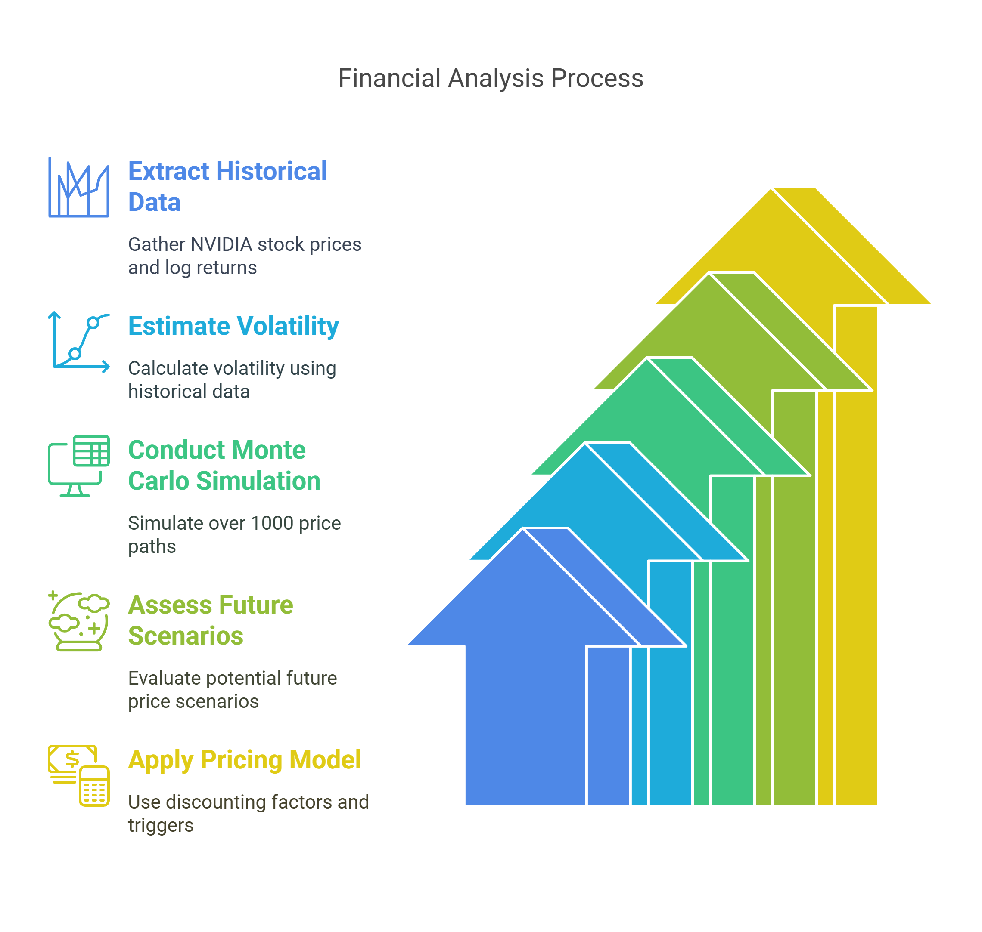
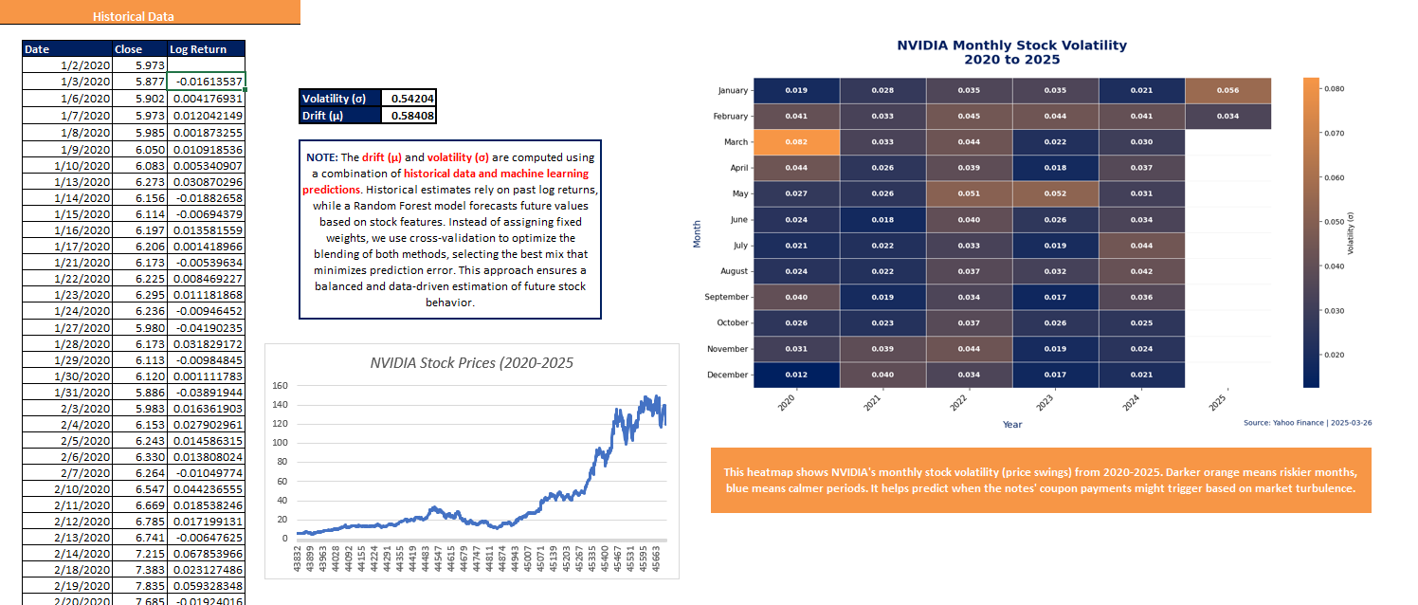
Excel pricing model
Excel steps
Data & Methodology
Historical Data: Extracted NVIDIA stock prices and log returns to estimate volatility.
Monte Carlo Simulation: Simulated 1000+ potential price paths to assess future price scenarios.
Pricing Model: Applied discounting factors, memory feature coupons, and redemption triggers to value the structured note.

Slide 17
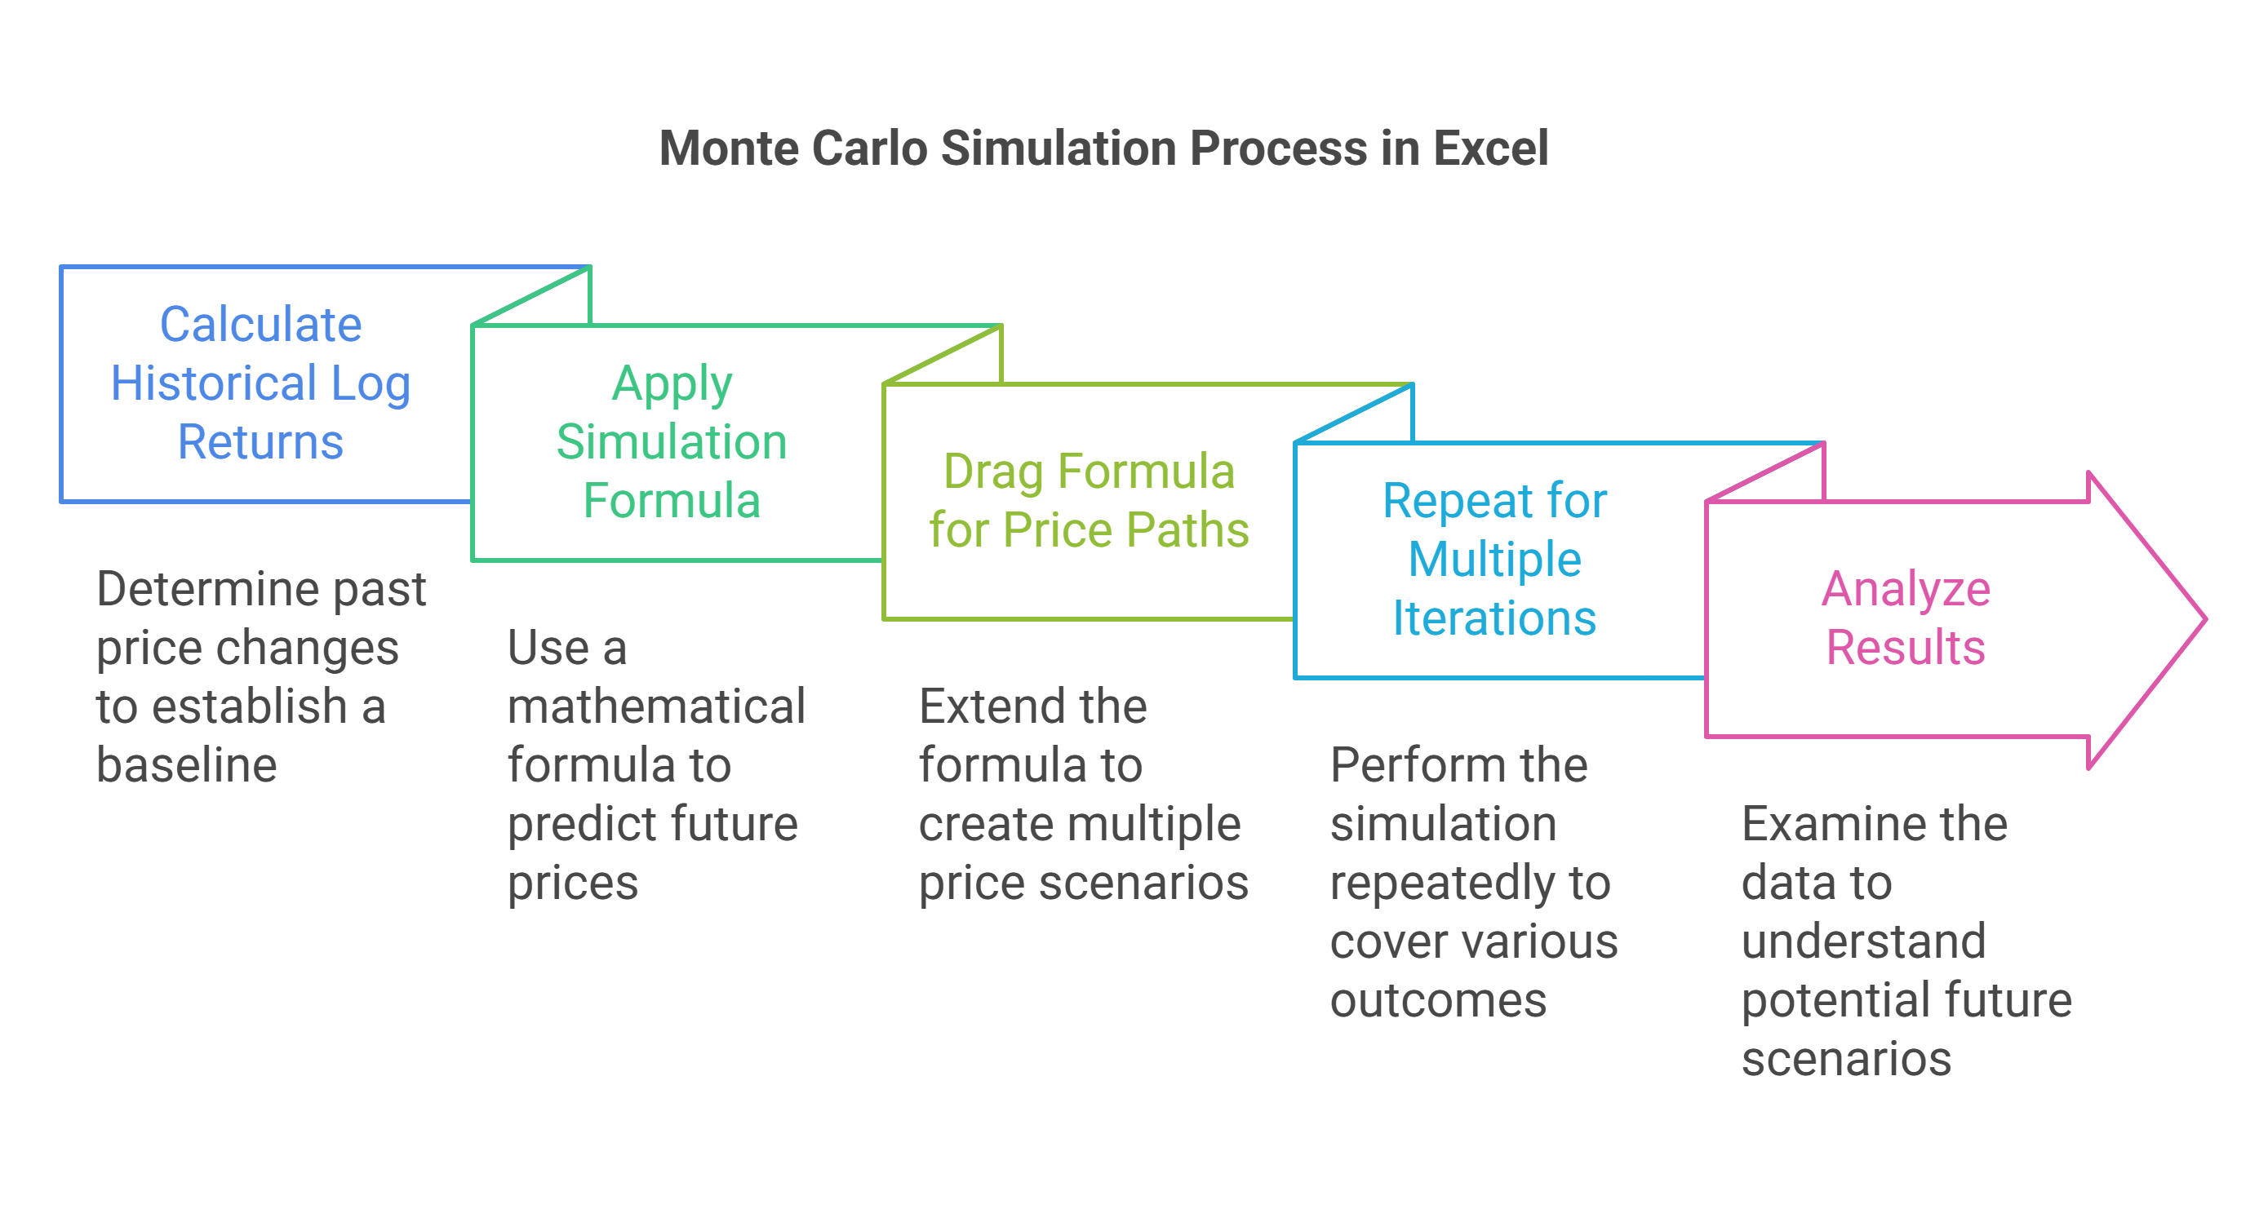
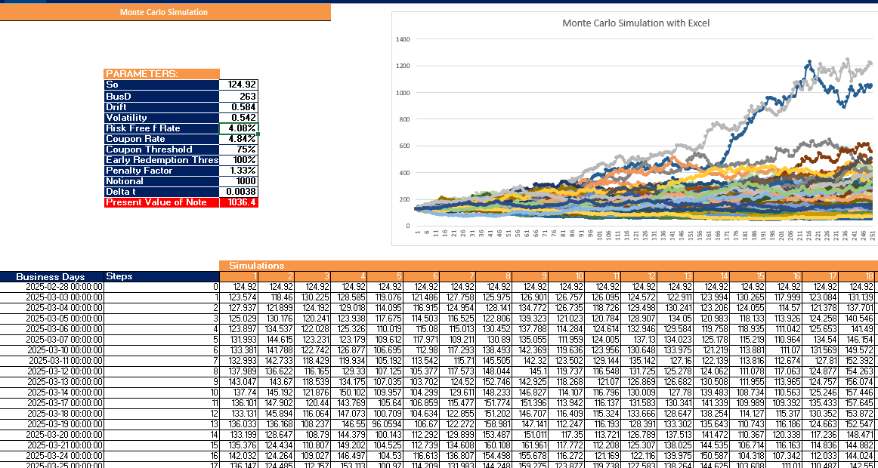
Excel pricing model
Monte Carlo
.
Step 1: Calculate historical log returns and standard deviation (volatility).
Step 2: Use the formula: Next Price = Current Price * EXP((Drift - 0.5 * Volatility^2) * Δt + Volatility * RAND() * SQRT(Δt)).
Step 3: Drag the formula across multiple columns to generate simulated price paths.
Step 4: Repeat for multiple iterations to model a range of possible outcomes.
Step 5: Analyze results using statistical summaries and probability distributions.

Slide 18
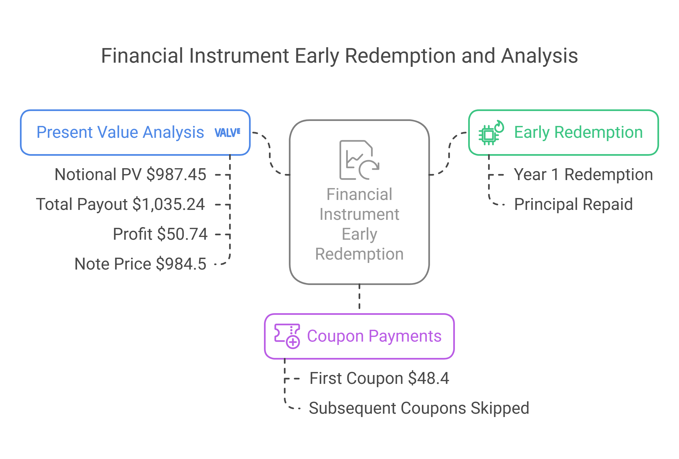
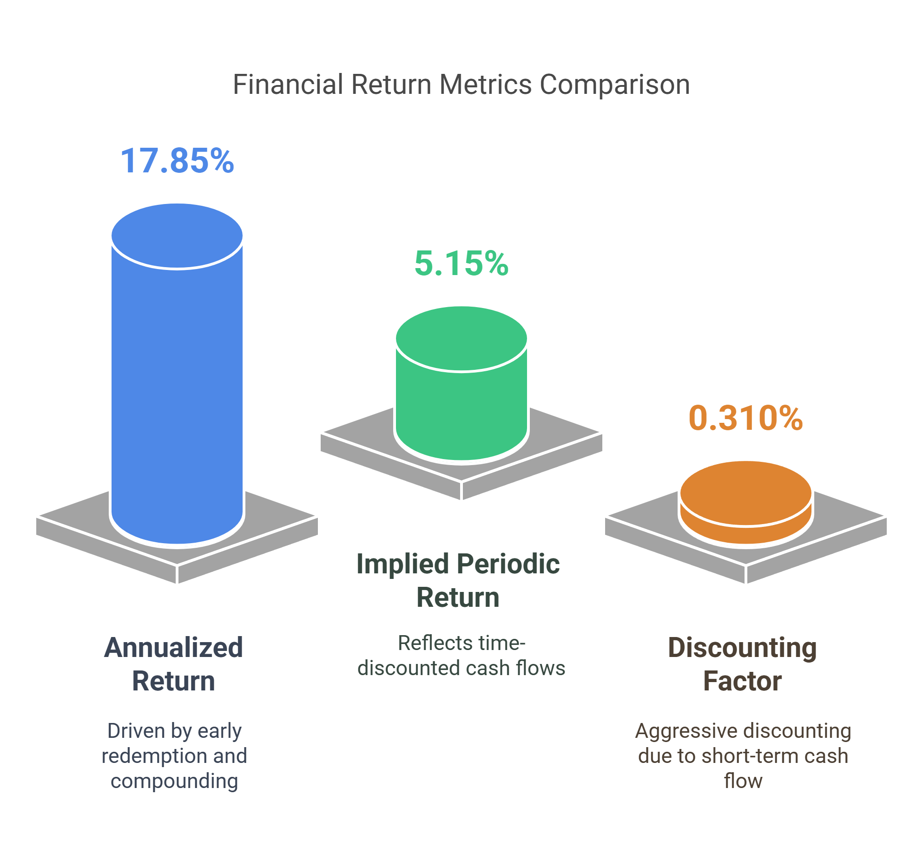
Excel pricing model
Findings
. Simulation Outcomes
Early Redemption Triggered:
Redemption occurred in Year 1 (Valuation Day 2) due to NVIDIA price surge to **137∗∗(≥100137∗∗(≥100128.92).
Impact: Principal repaid early, limiting exposure to future volatility.
Coupon Payments:
Only 1 coupon ($48.4) paid (Valuation Day 1). Subsequent coupons skipped due to early redemption.
Memory Feature: Unused (no cumulative missed coupons).
Present Value Analysis:
Notional PV: 987.45∣∗∗CouponsPV∗∗:987.45∣∗∗CouponsPV∗∗:47.79 → Total Payout: $1,035.24.
Profit: 50.74vs.NotePrice(50.74vs.NotePrice(984.5).
Return Metrics
Annualized Return: 17.85% (driven by early redemption and compounding).
Implied Periodic Return (IPR): 5.15% (reflects time-discounted cash flows).
Discounting Factor: 0.310 → Aggressive discounting due to short-term cash flow (Year 1 redemption).
Critical Observations
Volatility Advantage:
NVIDIA’s simulated average final price ($227.54, +76% vs. initial) offset early redemption’s coupon loss.
Model assumes bullish trajectory; sensitive to downside scenarios (e.g., final price <75% → capital loss).
Risk-Reward Tradeoff:
High annualized return hinges on early redemption and NVIDIA’s upside.
Key Risk: If redemption not triggered, reliance on final price ≥75% becomes critical (Example 6: 64% → payout $853).

Slide 19
Recommendation

Slide 20
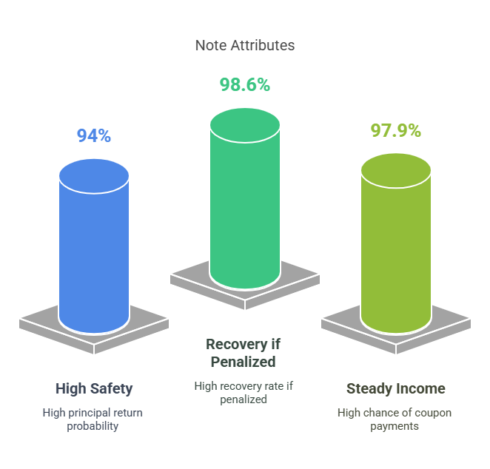
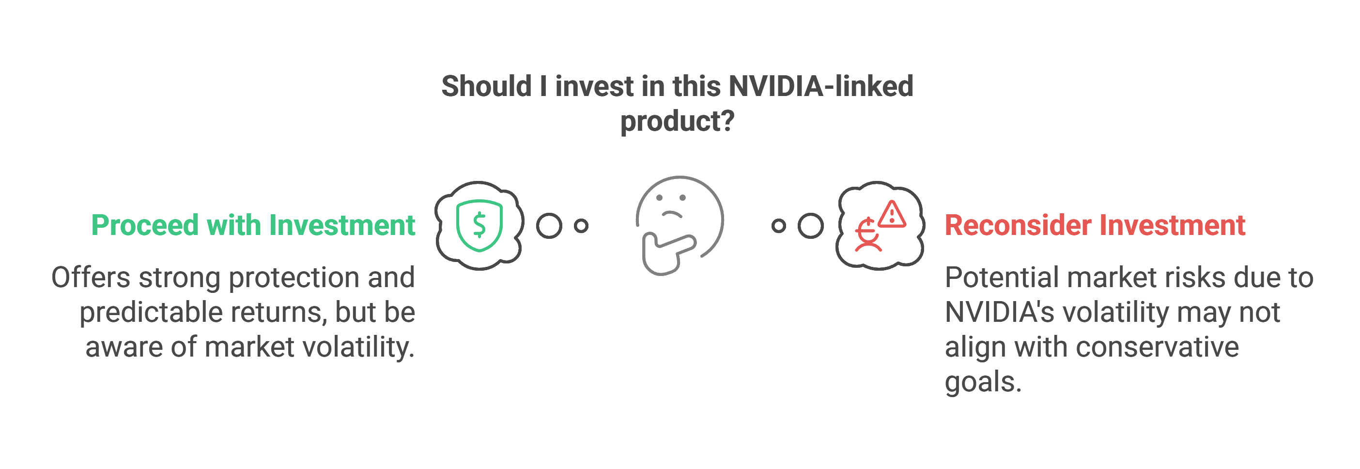
Conservative Investor Specific Advice
Final Advice: This might be a good investment for Conservative investors since it offers strong protection with a predictable return. However, since it's linked to NVIDIA (a volatile stock), you should still be aware of market risks.

Slide 21
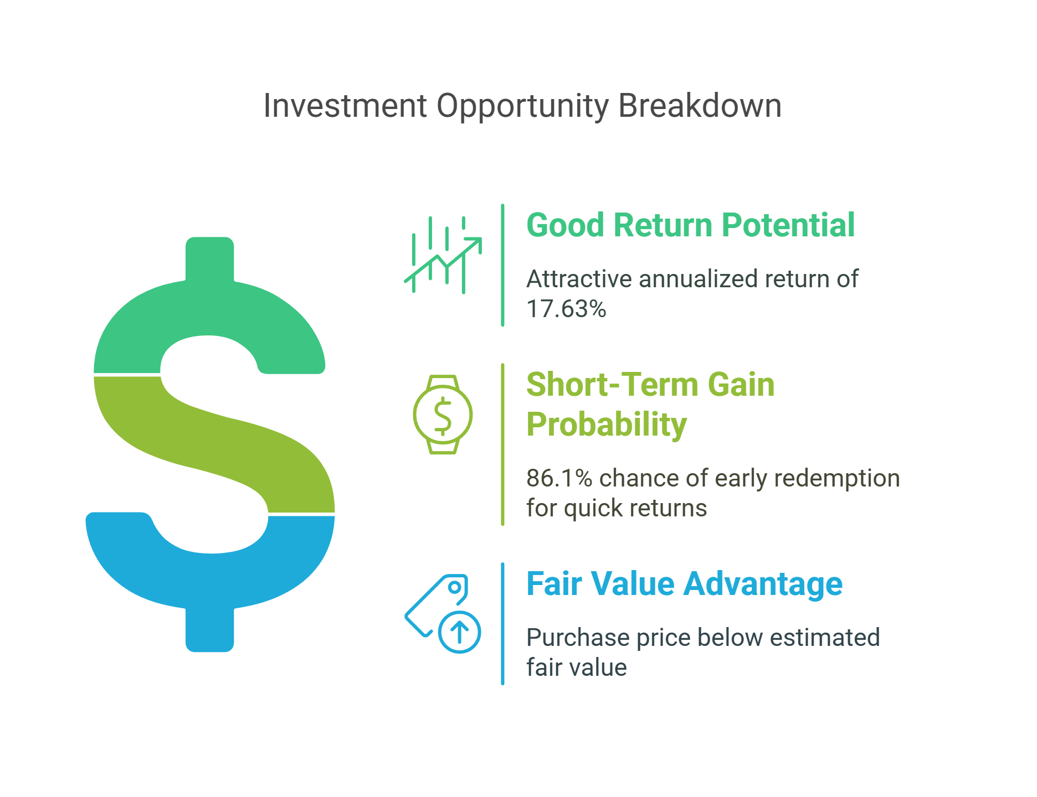
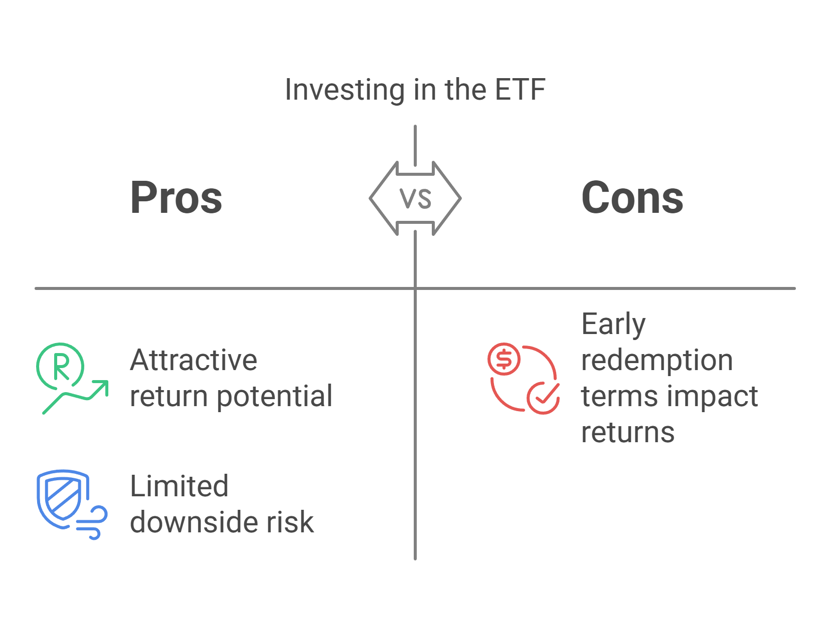
Moderate Risk Investor Specific Advice
Balanced Risk Investor:
What matters to you? A balance between risk and return with a preference for stable growth. How does this ETF fit?
Good return potential: The annualized return of 17.63% (if redeemed early) is attractive.
Short-term gain possible: The 86.1% probability of early redemption means a high chance of making a solid return quickly.
Fair value advantage: You're buying between $979.50 - $989.50, while fair value estimates range from $1029 - $1035—this suggests a possible gain.
Final Advice: This ETF might a good choice since it provides an attractive return potential with limited downside risk. However, make sure you understand the terms of early redemption, as it will impact your final return.

Slide 22
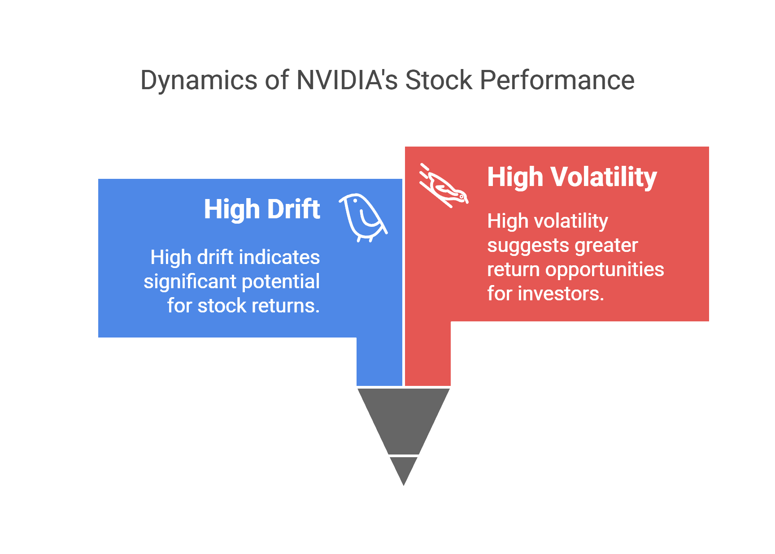
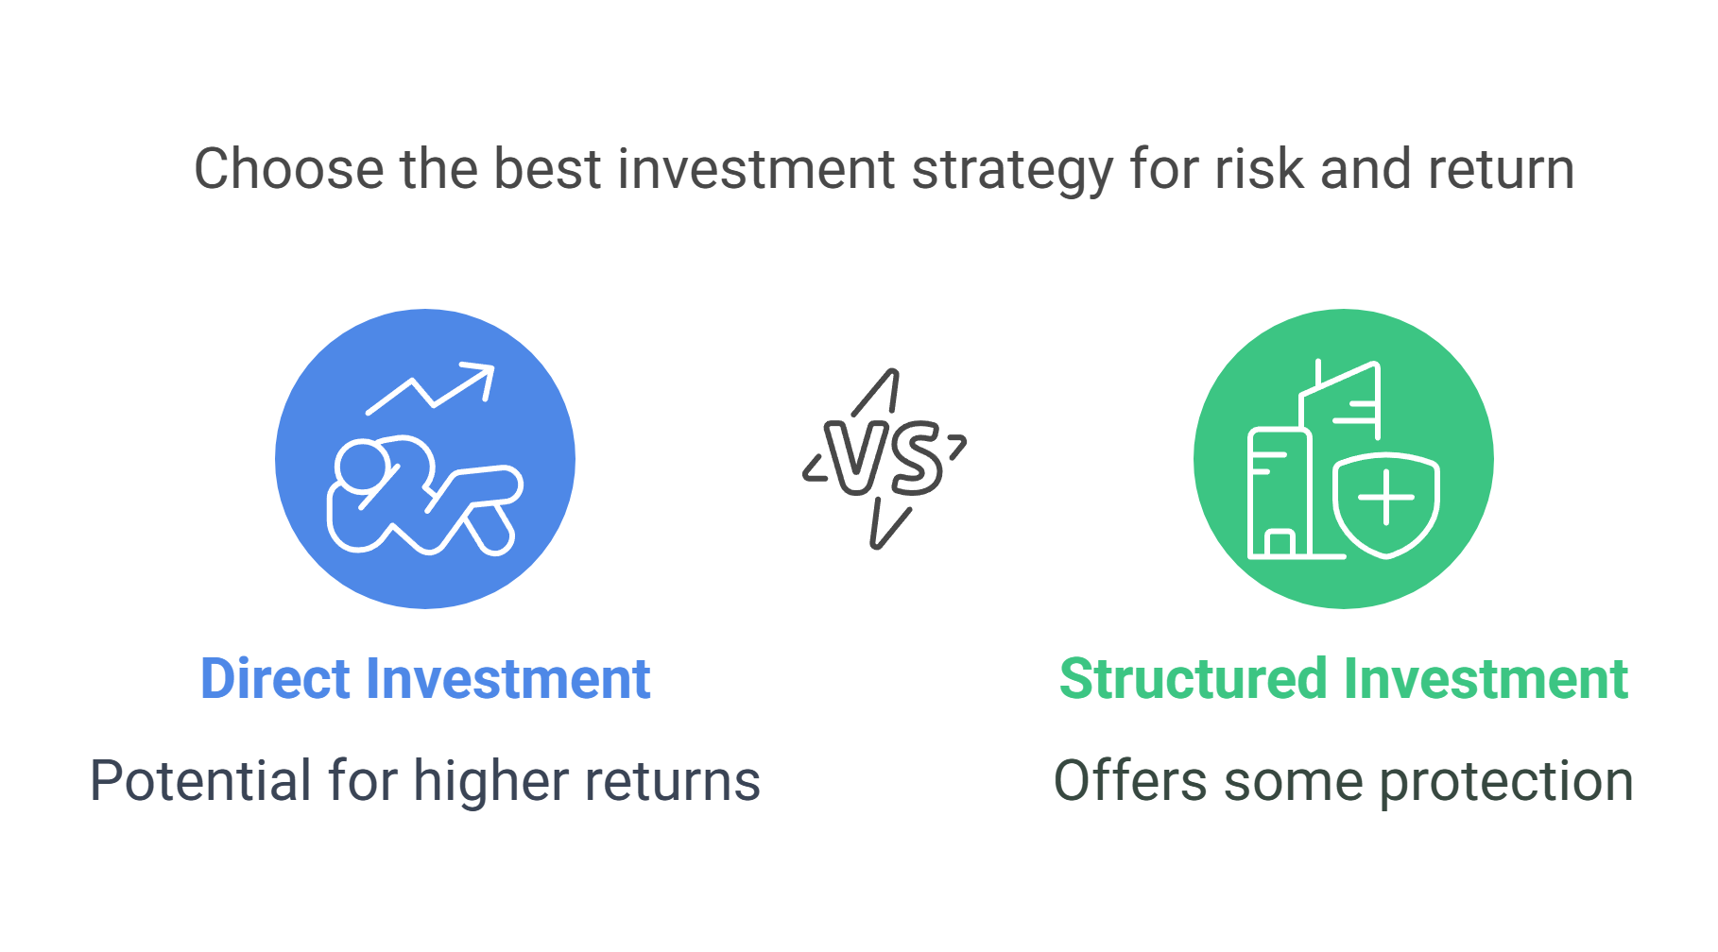
Agressive Investor Specific Advice
Growth Oriented Investor:
What matters to you? Maximizing returns, even if it means taking on higher risk. How does this ETF fit?
Capped upside: Since it’s structured, your return is limited compared to directly investing in NVIDIA stock.
High volatility potential: NVIDIA’s high drift (0.584) and volatility (0.542) mean that the stock itself might generate better returns than the ETF.
Less flexibility: You don’t fully control when you exit, as early redemption is built into the structure.
Final Advice: This might not be the best option for you. If you're comfortable with NVIDIA's risk, you might earn more by directly buying the stock or using options to enhance returns. However, if you like structured investments with some protection, it’s still worth considering.

Slide 23
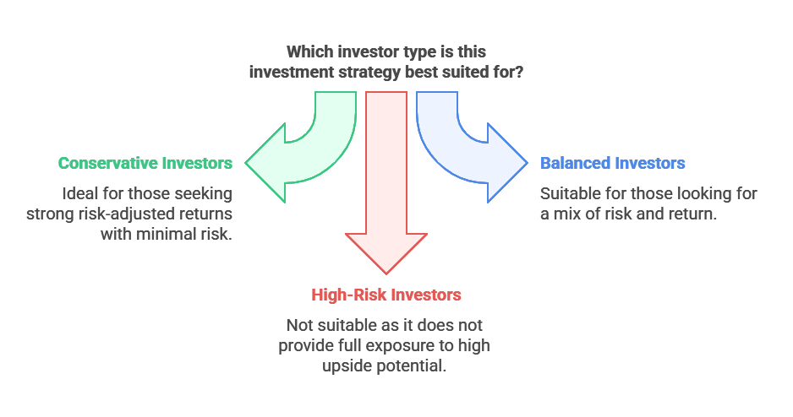
Investment Recommendation Overview
✅ Best fit: Conservative and balanced investors looking for strong risk-adjusted returns. ⚠️ Less ideal for: High-risk investors who want full exposure to NVIDIA's upside.

