Slide 1
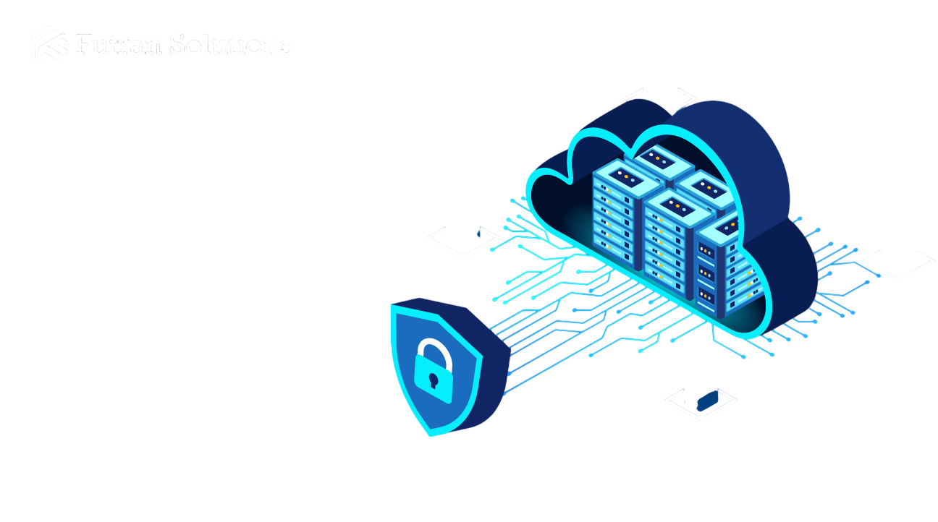
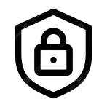
Enterprise SecOps Platform
Cloud Security
Monitoring System
with Incident Management Assistance
Team 4

Slide 2
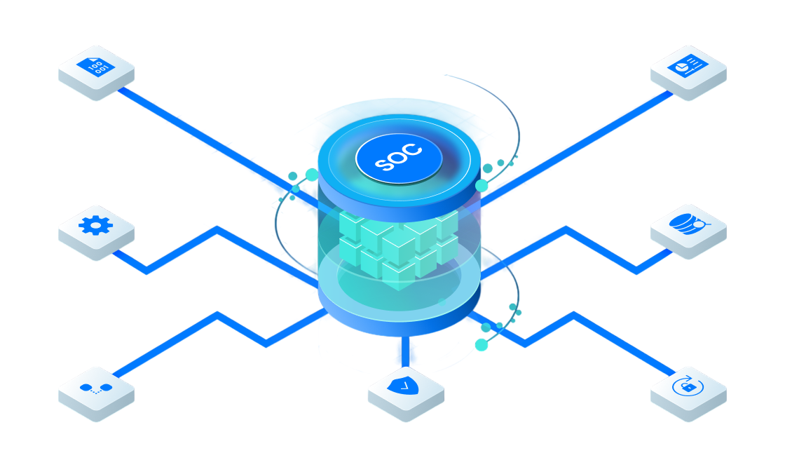
Introduction
The Cloud Security Monitoring System with Incident Management Assistance is a cloud-native, Java and Spring Boot enterprise platform designed to monitor, audit, and secure organizational infrastructure, applications, and cloud resources.
With its real-time telemetry, vulnerability tracking, and automated event processing via Apache Kafka, the system provides security teams with continuous visibility into asset health, active incidents, and potential system risks.
This intuitive platform empowers administrators to manage infrastructure anomalies and accelerate incident resolution workflows, while streamlining compliance reporting and immutable audit logging for the organization”

Slide 3
Platform Overview & Core Capabilities
An enterprise-grade, cloud-native Security Operations and Infrastructure Monitoring platform engineered to automate telemetry tracking, incident response, vulnerability lifecycles, and compliance auditing.
Core Operational Pillars :
  Infrastructure Telemetry: Real-time monitoring across 2,847+ servers and cloud nodes (AWS/Azure) with automated resource scaling.
  Incident Lifecycle Management: End-to-end detection, severity classification, team dispatching, and SLA-driven tracking.
  Vulnerability Assessment: Continuous CVE tracking, risk scoring reduction (from 8.7 to 2.3), and automated scanner integration.
  Audit & Compliance Governance: Immutable, encrypted audit trails ensuring 100% adherence to PCI DSS, SOC 2, and ISO 27001 standards.
  Unified SecOps Command: Centralized dashboard integrating telemetry, security alerts, and executive reporting.

Slide 4



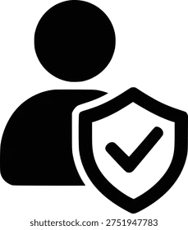
Role-Based Access Control (RBAC)
1
Employee
2
3
DevOps Engineer
4
Admin
Security Analyst
View personal dashboard & notifications
Interact with AI Security ChatBot
Submit admin privilege requests
Report suspected security incidents
View assigned infrastructure assets
Monitor & triage security alerts
Manage incident response & SLAs
Trigger incident simulations
Scan & track vulnerabilities
Export SOC & compliance reports
Register & inspect server assets
Monitor health & telemetry data
Submit asset patch requests
Triage infrastructure alerts
Collaborate on security fixes
Full user lifecycle management
Approve / reject access requests
Audit logging & compliance checks
Access executive analytics
Manage system security policies

Slide 5
Project Milestones & App Showcase

Slide 6
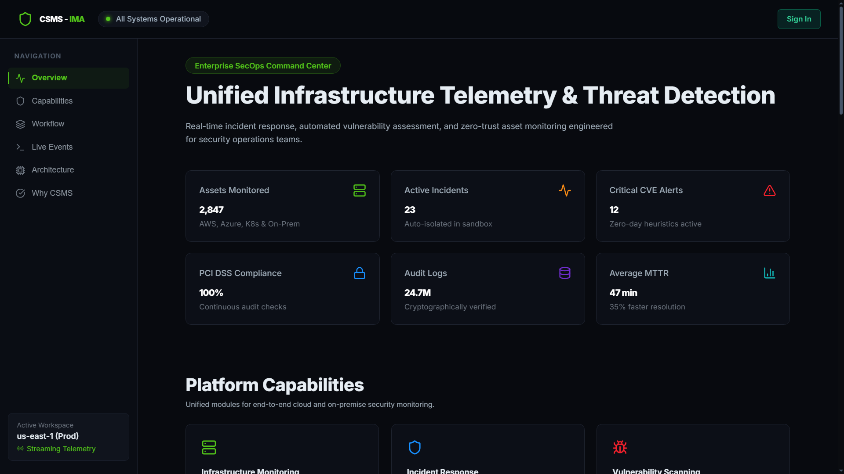
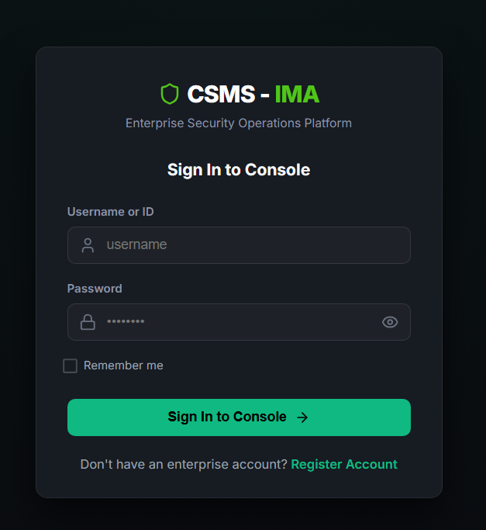
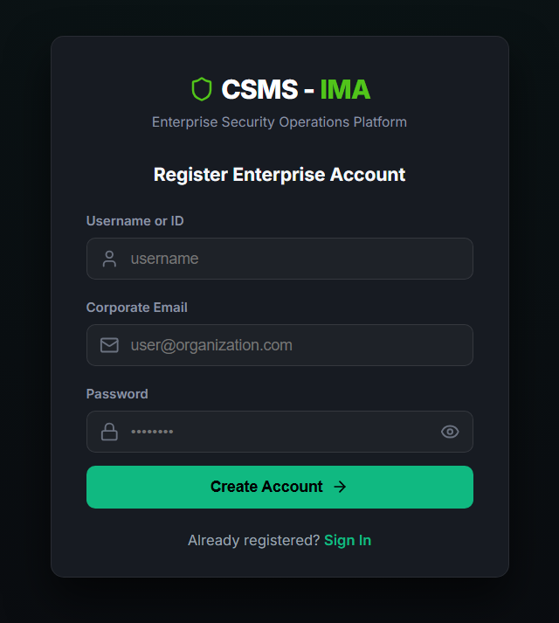
Landing Page & Authentication View

Slide 7
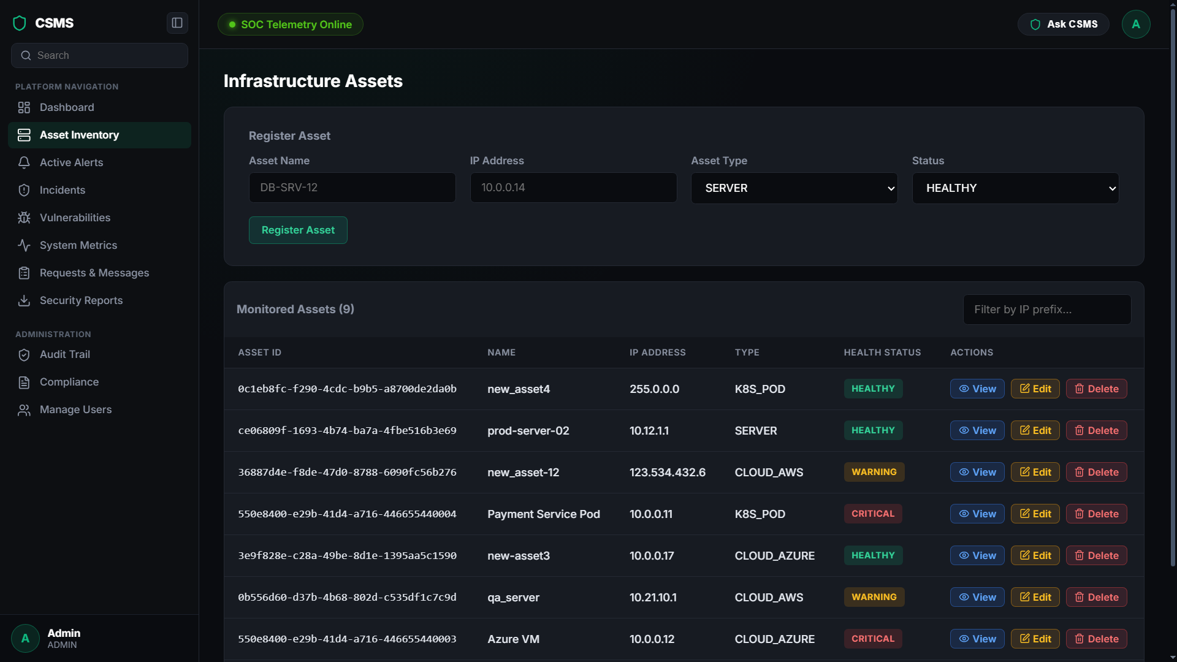
Milestone 1
Implements secure asset CRUD operations using RBAC to enforce strict role-based permissions. Continuously monitors real-time telemetry for servers and clouds, specifically tracking CPU, memory, disk, and network usage.

Slide 8
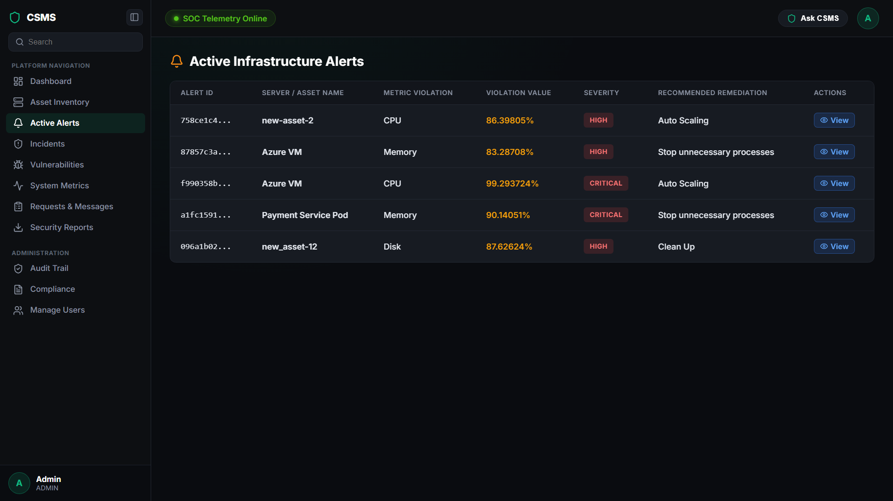
Milestone 1
Automatically detects metric violations to generate instant alerts and trigger automated remediation like auto-scaling.
Displays active infrastructure alerts with detailed metric violations, severity & classifications.

Slide 9
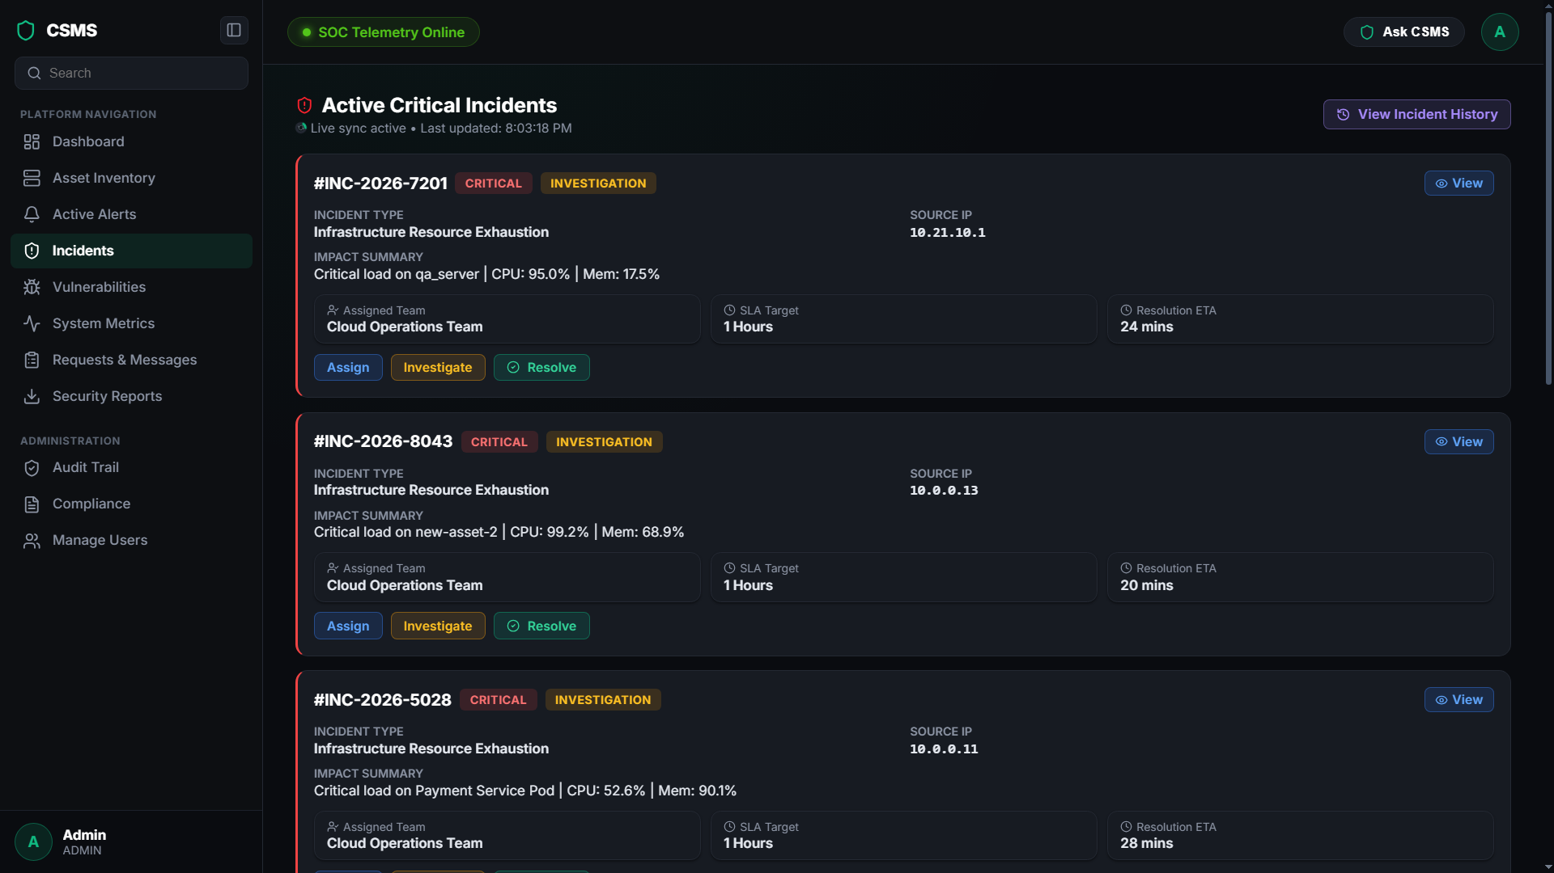
Milestone 2
Implemented a dedicated Incident Service for end-to-end incident tracking, featuring severity classification, automated assignment workflows, SLA monitoring, and complete resolution management.

Slide 10
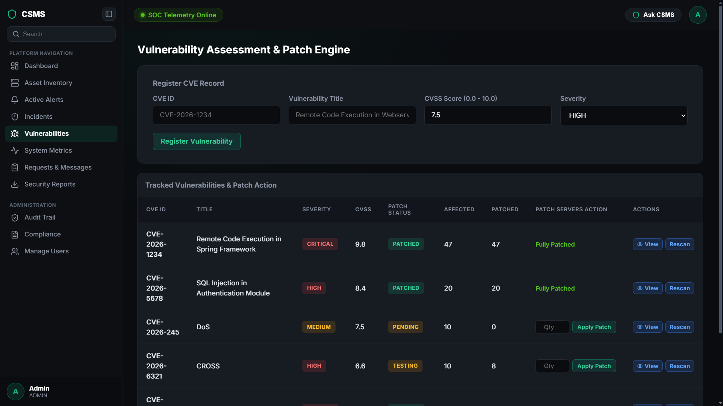
Milestone 3
Implements a comprehensive Vulnerability Service to centrally manage CVEs, perform accurate risk assessments, and track patching progress to reduce overall system risk.

Slide 11
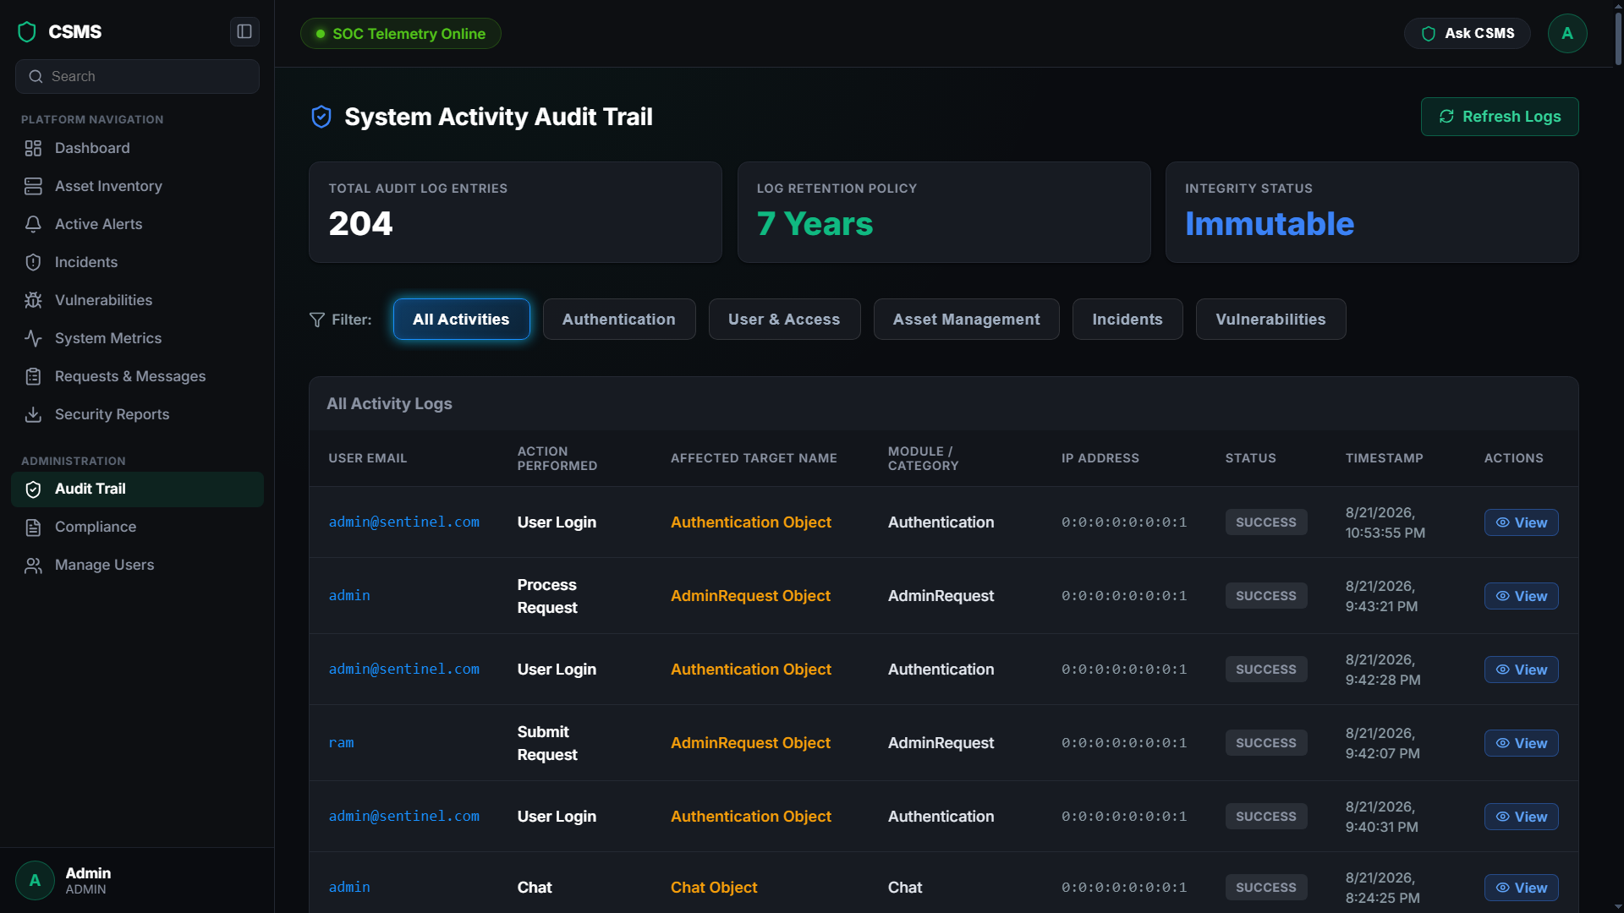
Milestone 4
Manages an immutable, encrypted trail of 24.7 million logs with a 7-year retention policy to strictly track all user and system activities.

Slide 12
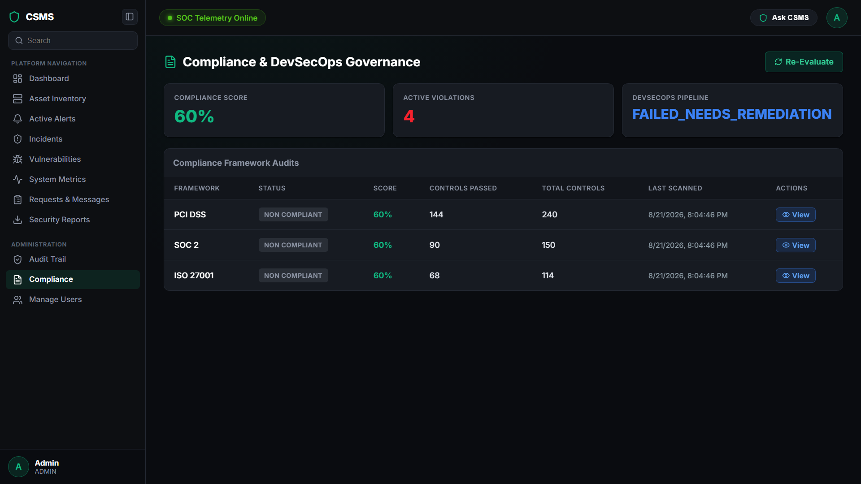
Milestone 4
Continuously enforces and verifies 100% adherence to critical regulatory frameworks, including PCI DSS, SOC 2, and ISO 27001.

Slide 13
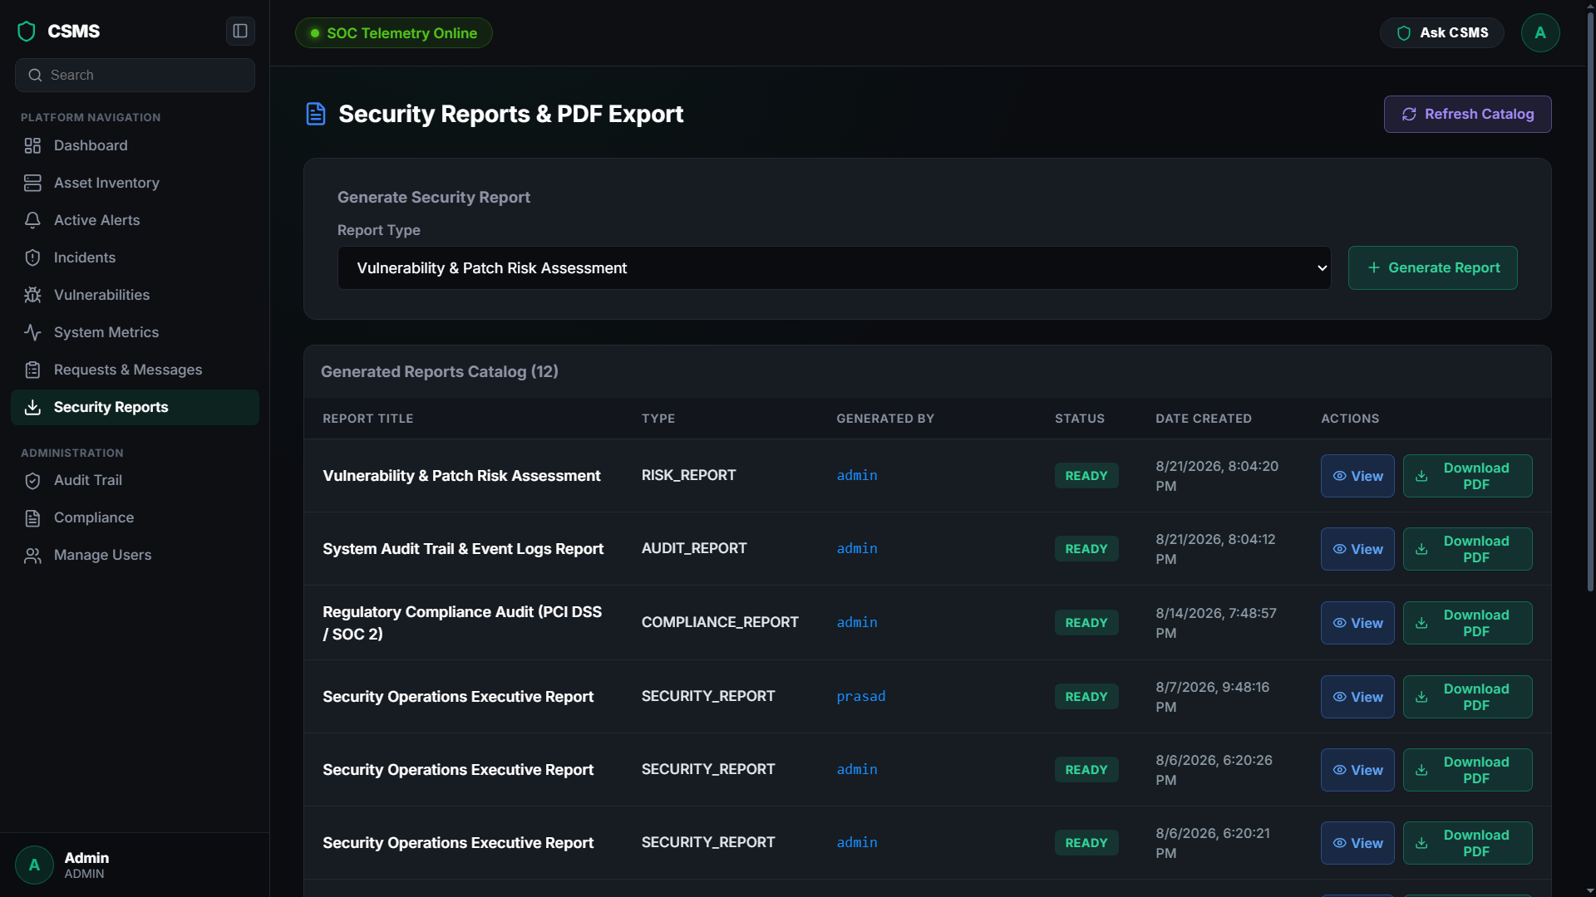
Milestone 4
Automatically compiles and exports comprehensive access, security, and compliance status reports for organizational stakeholders.

Slide 14
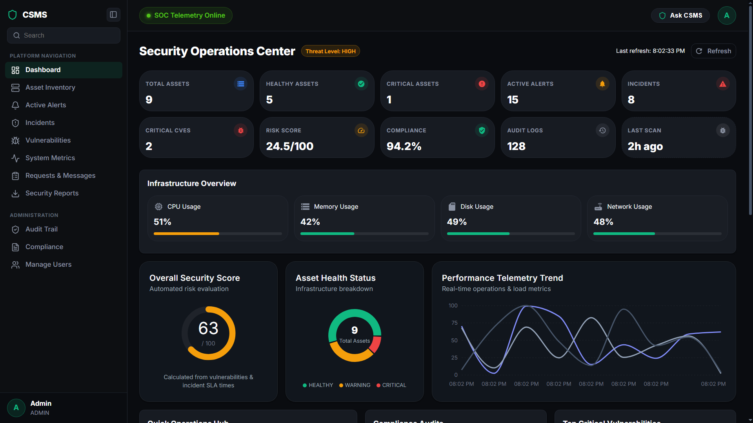
DevSecOps Dashboard

Slide 15
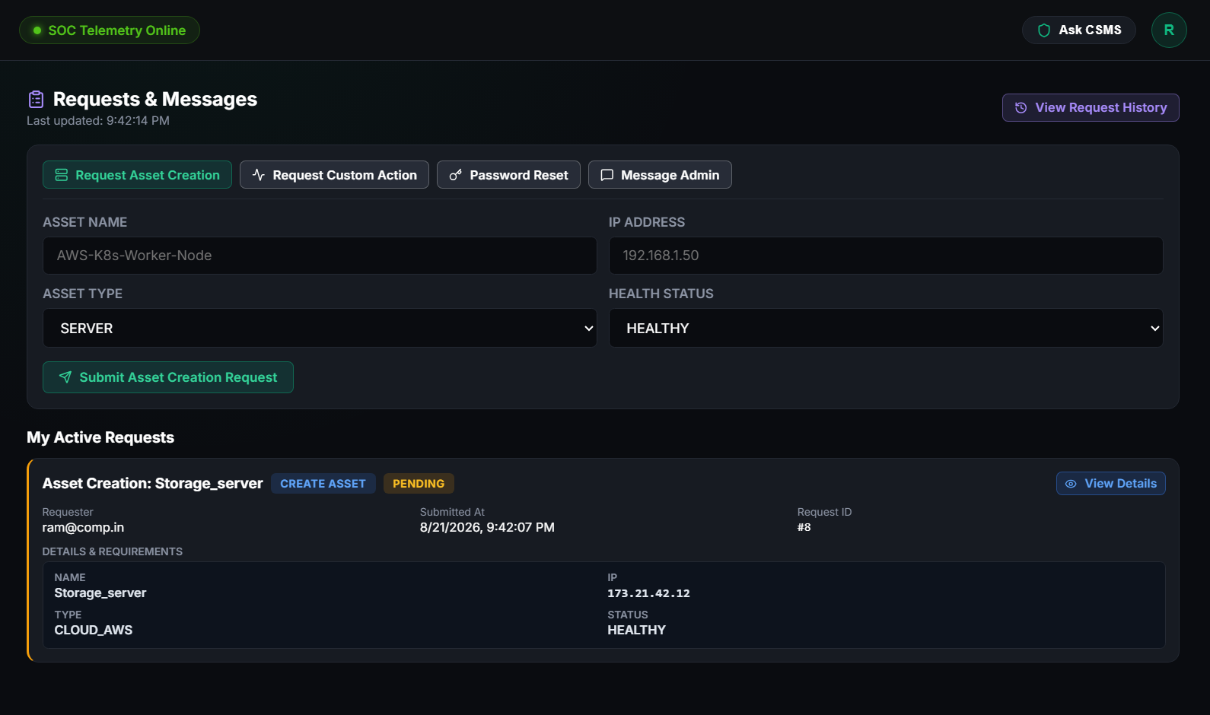
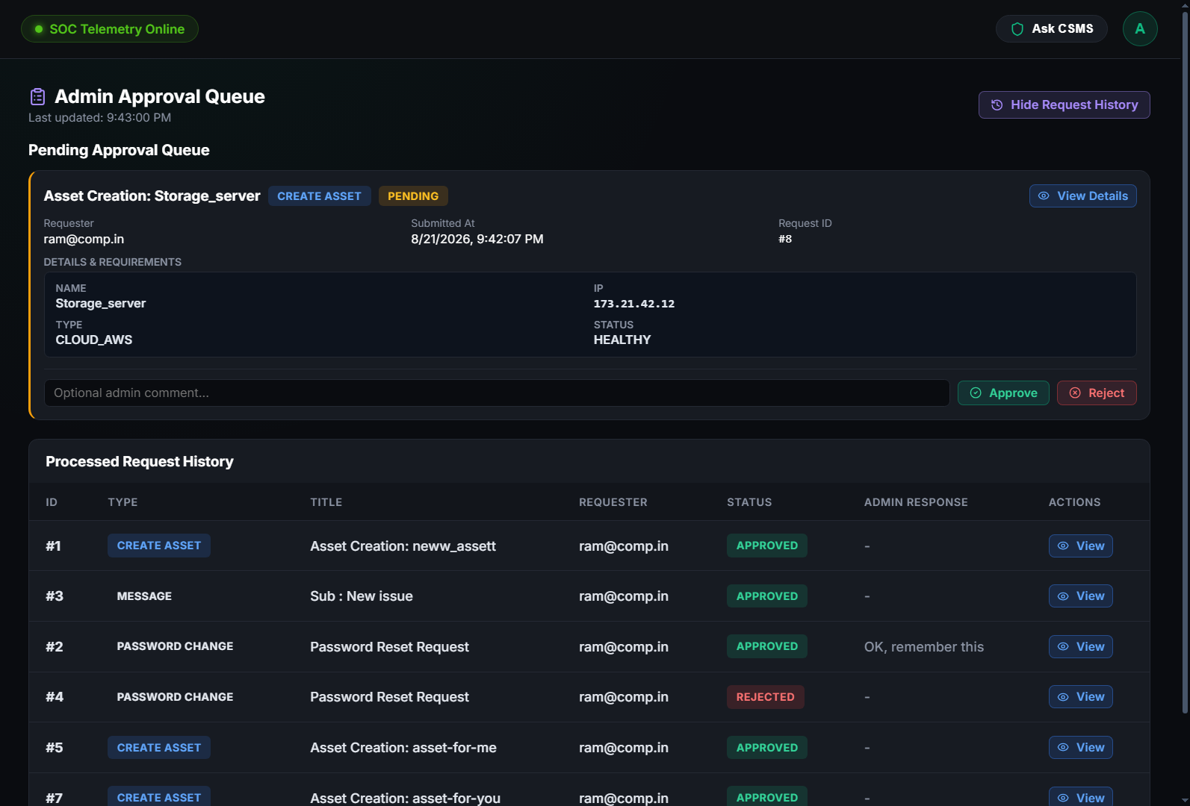
Requests & Messages

Slide 16
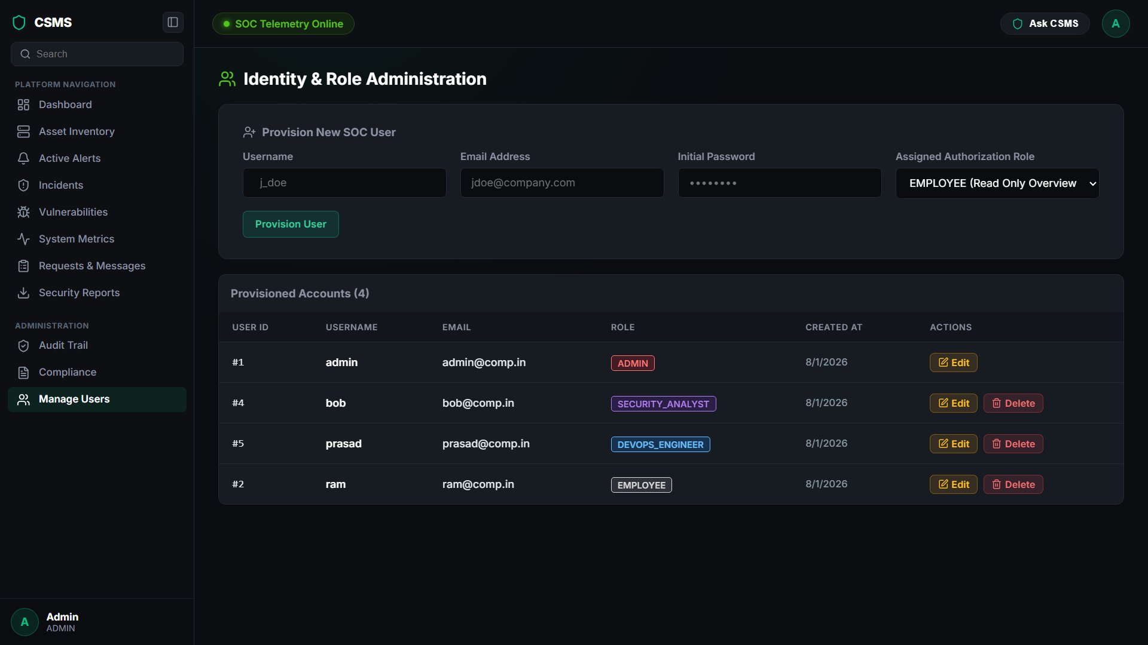
Manage Users

Slide 17
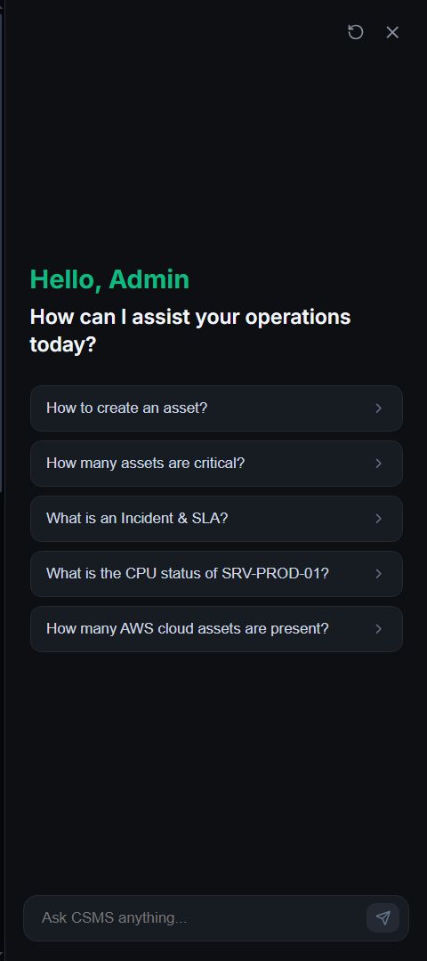
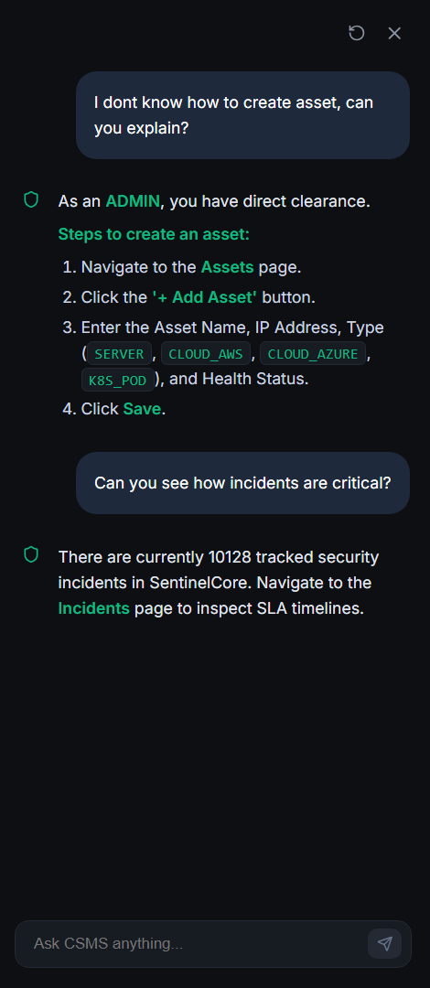
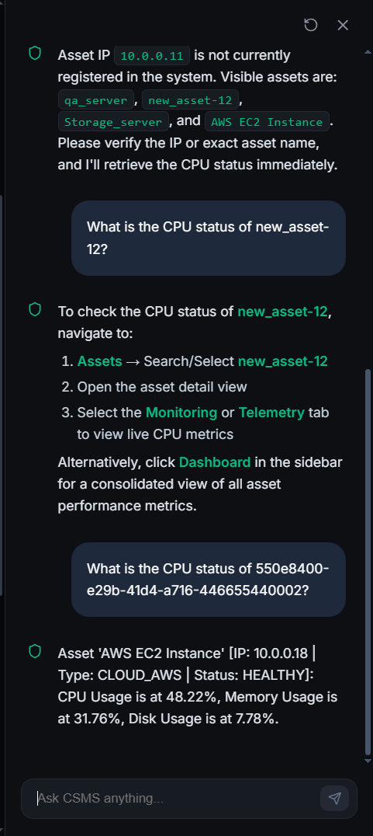
CSMS ChatBot

Slide 18
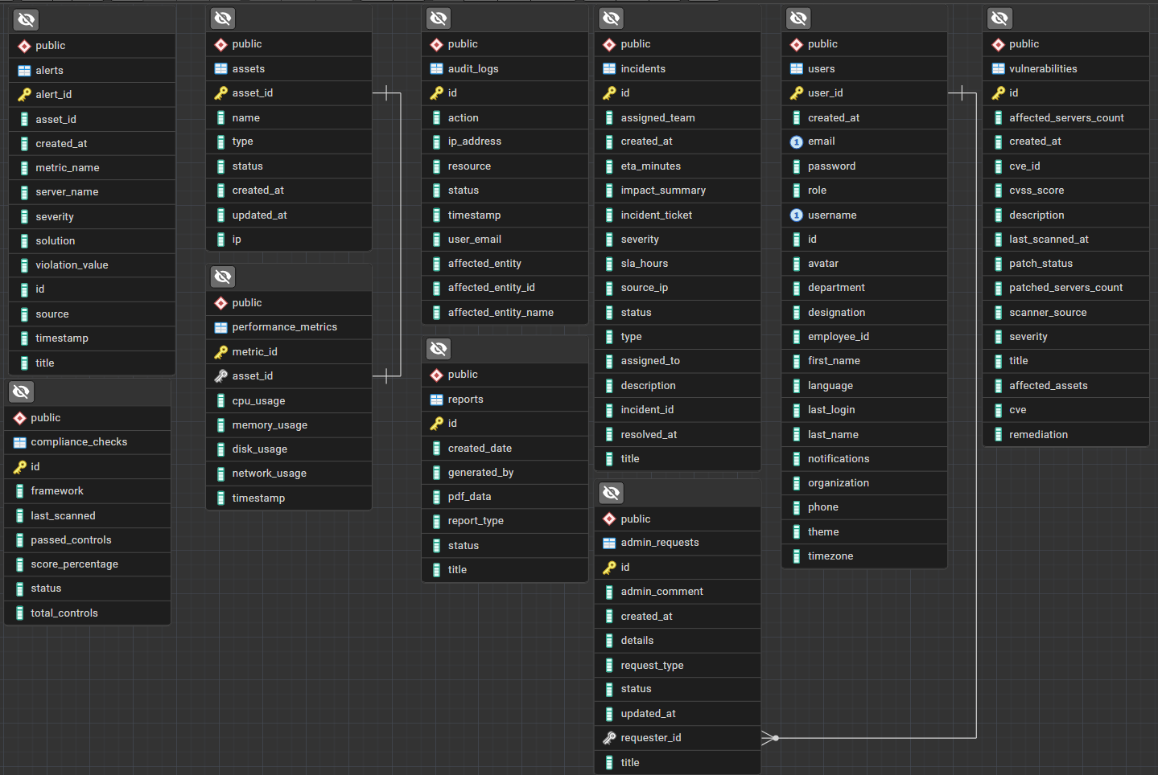
Entity-Relationship Diagram (ERD)

Slide 19
Milestones Overview

Slide 20
Milestone 1
Milestone 2
Implement infrastructure telemetry and health monitoring across servers, networks, and cloud nodes. Track CPU, memory, disk, and network usage in real time, achieve 99.99% uptime SLA, and trigger automated anomaly alerts with auto-scaling.
Deploy security incident management and tracking workflows. Implement incident severity classification, team assignments, and resolution tracking to reduce the mean time to resolution (MTTR) while maintaining detailed audit logs.
Milestone 3
Milestone 4
Build a vulnerability management and risk assessment system. Integrate scanning tools like SonarQube and Trivy to identify CVEs, track patch statuses across affected servers, and generate risk evaluation reports.
Implement audit logging and compliance reporting modules. Store immutable, encrypted audit logs and track user activity to generate security reviews and verify compliance with standards like PCI DSS, SOC 2, and ISO 27001.

Slide 21
Conclusion
The Cloud Security Monitoring System with Incident Management Assistance is a full-stack security platform built using React and Java with Spring Boot to deliver centralized visibility across organizational infrastructure. By combining real-time telemetry monitoring, automated vulnerability tracking, SLA-driven incident workflows, and an integrated AI ChatOps assistant, the system equips security teams with the tools needed to rapidly triage and remediate security events. Enforced by custom JWT authentication, role-based access control, and comprehensive audit logging, the application provides a reliable, scalable foundation for enterprise security operations and infrastructure governance.

Slide 22

Team Members
Tarak Ram Jonnadula
Bhanu Prasad Burri
Tanisha Lokhande
Badinehal Sundi Tejaswini
Dharanika K

Slide 23


Thank you!

