Slide 1
Autonomous AI-Driven Financial Planning System

Slide 2
Autonomous AI-Driven Financial Planning System
Problem Statement
Technical solution
Conventional financial planning relies heavily on manual oversight and rigid investment strategies, rendering it ineffective in responding to dynamic market fluctuations.
While AI-powered investment advisory services are available, they lack true autonomous adaptability driven by comprehensive real-time financial and behavioral analytics.
There exists a critical demand for a fully autonomous financial planning system capable of continuously learning, optimizing, and dynamically adjusting investment portfolios without the need for direct human intervention.
The proposed invention introduces an AI-driven financial planning system that autonomously manages and optimizes investment portfolios using Federated Reinforcement Learning (FRL).
Traditional financial planning systems rely on static models and manual intervention, making them inefficient in volatile market conditions.
Existing AI-based investment platforms lack real-time adaptability and require periodic human adjustments.
The proposed solution leverages distributed, privacy-preserving reinforcement learning to create a fully autonomous financial advisory system that continuously learns from diverse financial environments without exposing sensitive user data.

Slide 3
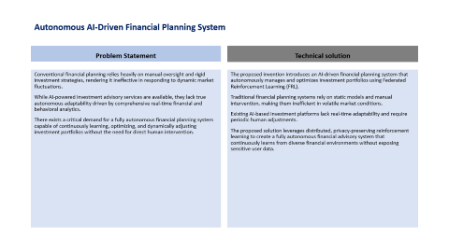
Autonomous AI-Driven Financial Planning System
Core Incentive features
Innovation Data
Autonomous, self learning financial planning: Unlike conventional AI-driven investment tools that require manual fine-tuning, this system continuously learns and evolves using Federated Reinforcement Learning (FRL) without human intervention.
Federated Learning for Privacy-Preserving AI Training: Instead of aggregating sensitive financial data in a central server, the system trains decentralized AI models across multiple user devices, banks, and financial institutions while preserving data privacy.
Real-Time Adaptive Investment Strategies: Uses Deep Q-Networks (DQN) within a multi-agent reinforcement learning framework to dynamically rebalance investment portfolios based on real-time financial market shifts, investor behaviour, and macroeconomic indicators.
Edge AI for Ultra-Low-Latency Decision Making: Unlike traditional cloud-based AI financial advisors, this system deploys Edge AI models that process investment decisions locally and instantly, ensuring millisecond-level response times in volatile market conditions.
Digital Twin-Based Financial Simulation for Predictive Portfolio Adjustments: Unlike conventional investment advisory systems that react to past data, this invention uses a Digital Twin simulation of an investor’s financial profile, enabling predictive analysis and proactive adjustments.
AI-Driven Anomaly Detection for Preventive Risk Management: Existing AI-powered investment tools primarily focus on return maximization, whereas this system integrates self-learning anomaly detection to anticipate financial crises and mitigate risks before losses occur.

Slide 4
Technical Details
The architecture diagram will include: ✅ User Interaction Layer (Investor Apps, Dashboards) ✅ Federated Learning Nodes (Distributed AI Training) ✅ Edge AI Execution (Real-time Processing) ✅ Risk & Anomaly Detection ✅ Blockchain & Smart Contracts (Security & Transparency)

Slide 5


Technical Details
Federated Reinforcement Learning (FRL))
Algorithmic trading
Risk Management
Porpolio optimization
User Financial Data
Global Finance Insights

Slide 6
Generalization Framework
Market Data
User Financial Data
Global Financial Insights
Input
Federated Reinforcement Learning Model
Final Autonomous Portfolio recommendation system
Privacy-Preserving Learning
Decentralized Optimization
Real-Time Model Updates
Local Modelling
Send Model Updates
Global Model Aggregation
Optimized Model
Multiple Financial Institutions
Local Optimization
Parameter Sharing(no Raw data)
Global Model Update
Market Data Streaming
Continuous Learning
Model Update Trigger
Personalized Recommendations

