Slide 1
CASE STUDY #3
Finance — pricing & sales
URBAN HAMSTER
C L O T H I N G
Pricing & Sales Performance Review
Where we're growing, how our margins hold, and the next move on price
29,120 products · 2,756 brands · 10 distribution centers · 5 years of orders
T. Schlichtmann | GB884 | June 2026

Slide 2
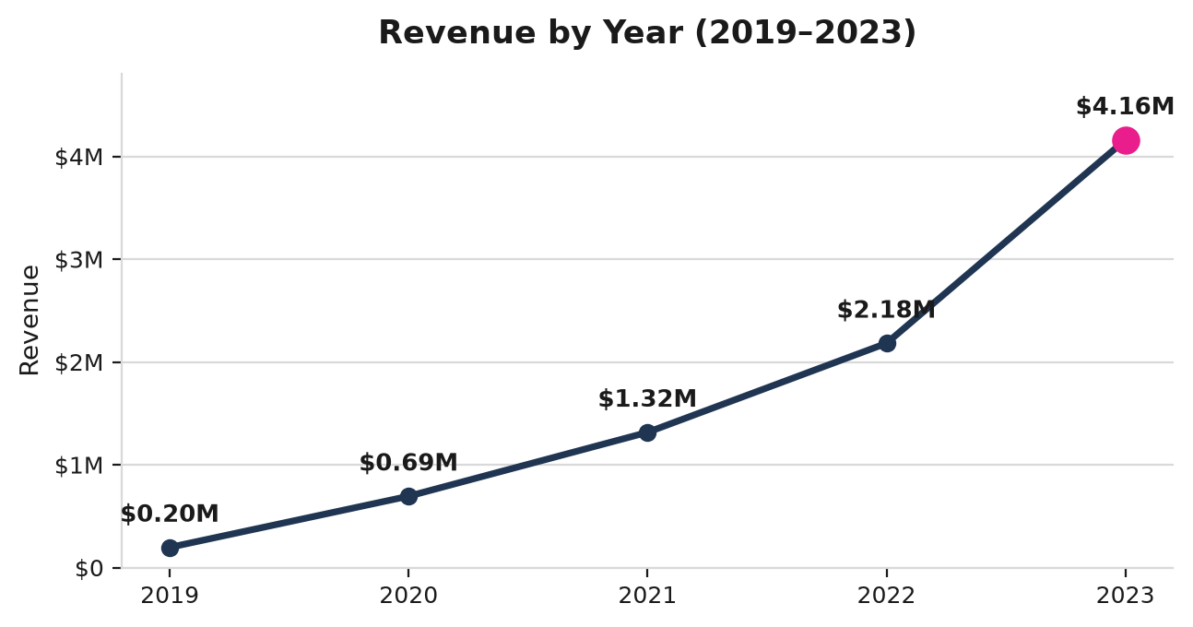
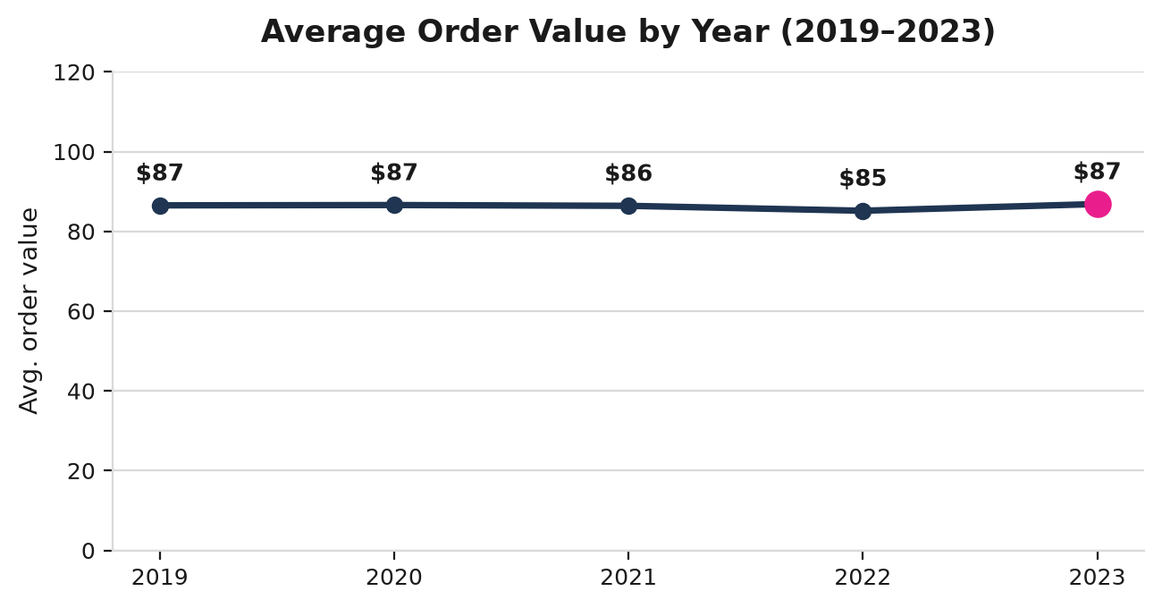
Five Years of Volume-Led Growth — Revenue Up 90.7%
Revenue grew 21× since 2019, yet average order value never left ~$86
What This Means
Revenue climbed from $197K in 2019 to $4.16M in 2023 — about 21× — and growth re-accelerated last year, from +65.8% in 2022 to +90.7% in 2023.
But average order value held near $86 every single year, so roughly 96% of the growth came from more orders, not higher prices. We've been growing on volume and have left price untouched — a clear, untapped lever. (Revenue uses actual sale price, all orders included per the team's request.)

Slide 3
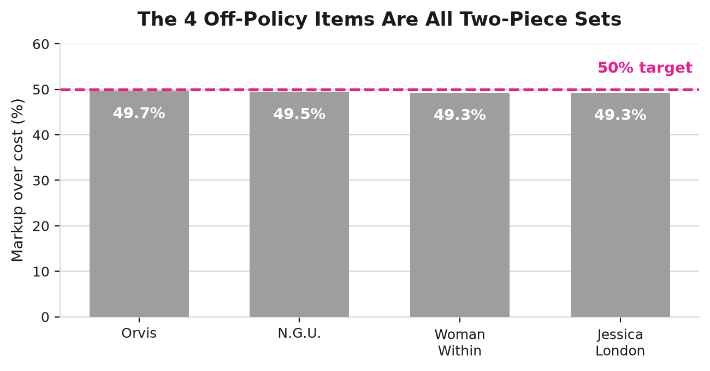
Disciplined Pricing — and a Pattern in the Exceptions
No loss-makers; 99.99% follow cost-plus-50%; the 4 exceptions are all two-piece sets
0
4
sold below cost
below 50% markup
of 29,120 — just 0.01%
All four are two-piece sets (Orvis, N.G.U., Woman Within, Jessica London) at ~49% — a bundle-pricing quirk, not a systemic leak. A quick re-price closes it.
Margins are otherwise wide: our best single item earns $594/unit (Alpha Industries Darla); premium labels like Nobis list near $830.
The catch: this checks list price, not the price we actually collect.
What This Means
On paper pricing is healthy — nothing sells below cost and the catalog follows the cost-plus-50% playbook almost perfectly. Two gaps remain: the rule prices off our costs, not the market (cost+50% may still be off vs. competitors), and it ignores checkout discounts that quietly erode margin — the “sale we never intended.” Recommend tracking realized margin (sale price vs. cost), not just list.

Slide 4
Pricing to the Market, Not Just to Cost
How to compare our prices to competitors — and where to start
What to Benchmark
How to Run It
Start Focused, Not Boundless
Match Cadence to Volatility
The top 200–500 products that drive most revenue — not all 29,120.
Monthly baseline; weekly / near-real-time for fast-moving and seasonal items.
Prioritize by Volume and Value
Compare Two Ways
Lead with our biggest lines (Intimates 2,363; Jeans 1,999; Tops & Tees 1,868) and highest-ticket ones (Outerwear ~$146; Suits & Sport Coats ~$127).
Industry average for context; named competitors for prices we can act on directly.
Mind Brand Concentration
Source from Snowflake Marketplace
Allegra K alone is 1,034 products (3.5% of the catalog) — a natural place to start.
Pull third-party pricing datasets and join them to our products table — no scraping or ETL to build.
Bottom Line
Growth is strong and pricing is disciplined — so the next dollar of margin comes from pricing to the market, not just to cost. Stand up competitor benchmarking and realized-margin tracking, and we can align price with both our costs and the market.

