Slide 1
TensorFlow Workshop
Taran Xulang Wan

Slide 2
Content
Introduction
Installation
Sample Models
Appendix

Slide 3
Popular Deep Learning Toolkits
TensorFlow, Theano, Torch, Caffe, Kerras …
TensorFlow is the most popular one now

Slide 4
Why TensorFlow?
Large popularity which means you can have a strong support from user communities
Developed by Google which means frequently update and API stability guarantees
Support Python and R which are the top two popular languages for data science
Easy installing and configuration

Slide 5
What is TensorFlow?
It is an open-source library for machine learning
Compare with Scikit-learn:
Scikit-learn is like a car vendor where you can buy different finished cars (models). With Scikit-learn, very limited modifications of car parts are supported (especially for deep learning models).
TensorFlow is like a car part vendor where you can buy different car parts and make your own cars or even you can build your own car parts as TF has provided a convenient plant.

Slide 6
Building Models with TF
Python
Object Function (a criterion to define the goodness of learning)
Optimizer (a method to increase or decrease object function)
Building Computation Graph
TensorFlow
Learning Target (Basically it is a set of rules to classify/calculate things)
Compile to C/C++
C/C++
Data
Running by Machine
Machine

Slide 7
Installing (Python Version)
1. Install Python and pip(a package controller for python) in the Machine
2. Install python packages:
pip install numpy
pip install pandas
3. In your cmd/terminal, type in:
pip install tensorflow (normal version)
pip install tensorflow-gpu (special version with GPU support which currently only support NVIDIA’s GPU)

Slide 8

Linear Regression
Learning Target: $y=Wx+b$
Object Function: Sum of squares of differences between real data and model output
Optimizer: Gradient Descent

Slide 9
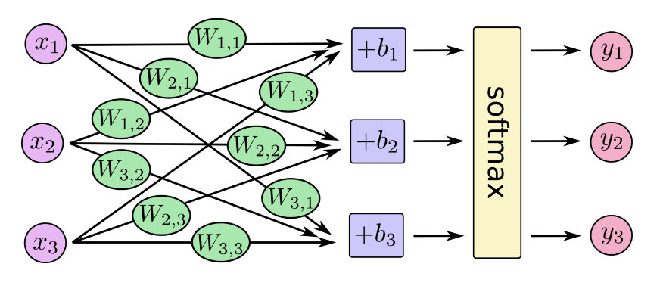
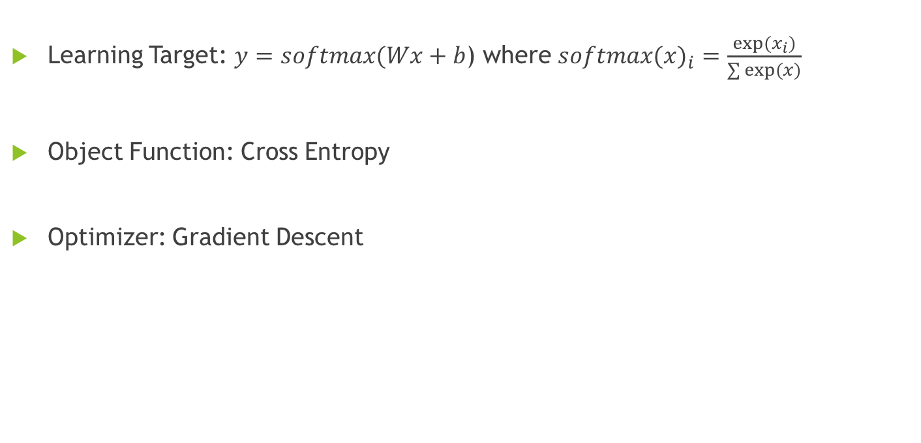
Multinomial Logistic Regression with MNIST dataset
Learning Target: $y=softmax(Wx+b$) where ${softmax(x)}_{i}=\frac{exp⁡(x_{i})}{\sum{exp⁡(x)}}$
Object Function: Cross Entropy
Optimizer: Gradient Descent

Slide 10
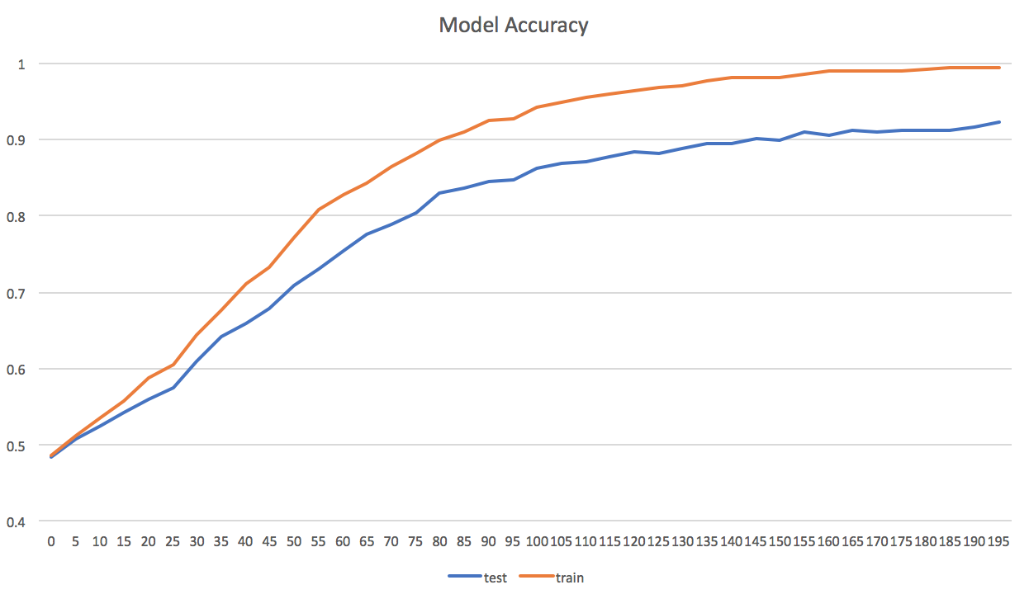
Deep CNN with Kaggle datasets
Datasource: https://www.kaggle.com/c/the-nature-conservancy-fisheries-monitoring
Learning Target: 7-hidden layer neural network
Object Function: Cross Entropy
Optimizer: Adam Optimizer

Slide 11
Other Materials
Cross Entropy: http://colah.github.io/posts/2015-09-Visual-Information/
Convolutional Neural Network:
http://colah.github.io/posts/2014-07-Conv-Nets-Modular/
http://cs231n.github.io/convolutional-networks/

