Slide 1
Front End Engineering-II Project
Typing speed enhancing website
TEAM DETAILS:
TARANDEEP (TEAM LEADER) 2310992228(G-25)tarandeep2228.be23@chitkara.edu.in
YASHASVI 2310992248(G-25)yashasvi2248.be23@chitkara.edu.in
SUPREEM 2310992221(G-25) supreem2221.be23@chitkara.edu.in
Supervised By Batch-2023; G-25; Semester - III
Mr. Shivam Singh & Ms. Meenu
:
Chitkara University Institute of Engineering and Technology,
Chitkara University, Punjab

Slide 2
Abstract
Typing Train is an interactive web-based application designed to help users improve their typing skills through a structured, level-based approach. Developed using HTML, CSS, JavaScript, and React, the application provides a responsive and engaging experience. The platform features a welcoming homepage, as well as Contact Us, About Us, and Login pages for a complete user experience. Users can access multiple typing levels, each offering a dedicated page where they can practice typing exercises tailored to enhance both speed and accuracy.

Slide 3
Table of Contents
Introduction
Problem Statement
Modules/Key Features
Code Snippets
Output
Project Github Link
Conclusion
References/Links used

Slide 4
Introduction
Background
Typing is an essential skill in today's digital age, where the majority of communication and work tasks are carried out on computers and other digital devices. With the increasing reliance on technology, the ability to type quickly and accurately has become a fundamental requirement in both personal and professional environments. Traditional typing practice tools often lack engagement and fail to provide effective feedback, leading to slow progress for learners. Recognizing this gap, the "Typing Train" project was initiated to create a modern, interactive typing practice platform that leverages the latest web technologies to offer a superior user experience.

Slide 5
Introduction
Objectives
To Create an Interactive Typing Platform: Develop a user-friendly web application that allows users to practice typing through various exercises and tests.
To Improve Typing Speed and Accuracy: Provide real-time feedback and detailed performance metrics to help users enhance their typing skills.
To Engage and Motivate Users: Incorporate interactive elements and responsive design to make the learning process enjoyable and engaging.

Slide 6
Introduction
Significance
The significance of "Typing Train" lies in its ability to provide an effective learning tool for users of all ages and skill levels. Unlike traditional typing programs, which often use repetitive and uninspired exercises, "Typing Train" offers a dynamic and motivating environment where users can track their progress and compete with themselves to achieve better results. The use of HTML, CSS, and JavaScript ensures that the application is lightweight, easily accessible, and runs smoothly across different devices and browsers, making it a versatile solution for improving typing proficiency.

Slide 7
Problem Statement
Many people struggle with typing efficiency, which can hinder their productivity in both academic and professional settings. Existing typing tools often lack the engaging features needed to maintain user interest and do not provide sufficient feedback for meaningful improvement. "Typing Train" addresses these issues by offering an interactive platform that delivers immediate, personalized feedback and supports users in developing their typing skills through consistent practice.

Slide 8
Key Features
Level-Based Typing Practice: Offers multiple typing levels for users to practice and improve their typing skills progressively.
User-Friendly Interface: Simple, intuitive design for easy navigation across the homepage, Contact Us, About Us, and Login pages.
Typing Accuracy and Speed Tracker: Real-time display of typing speed and accuracy on each level page to help users monitor their performance.
User Authentication: Secure login feature allowing users to save progress and return to their typing levels.
Responsive Design: Optimized for various screen sizes, ensuring a smooth experience on both desktop and mobile devices.

Slide 9
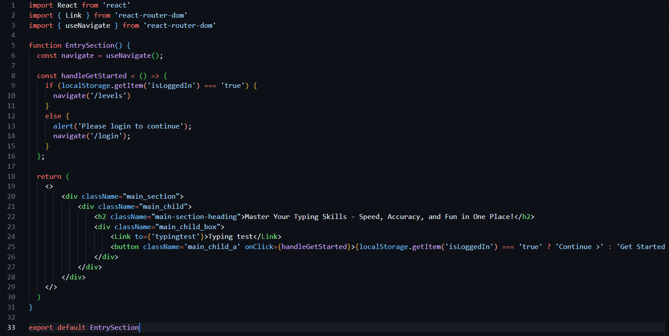
Code Snippet
From Home Page

Slide 10
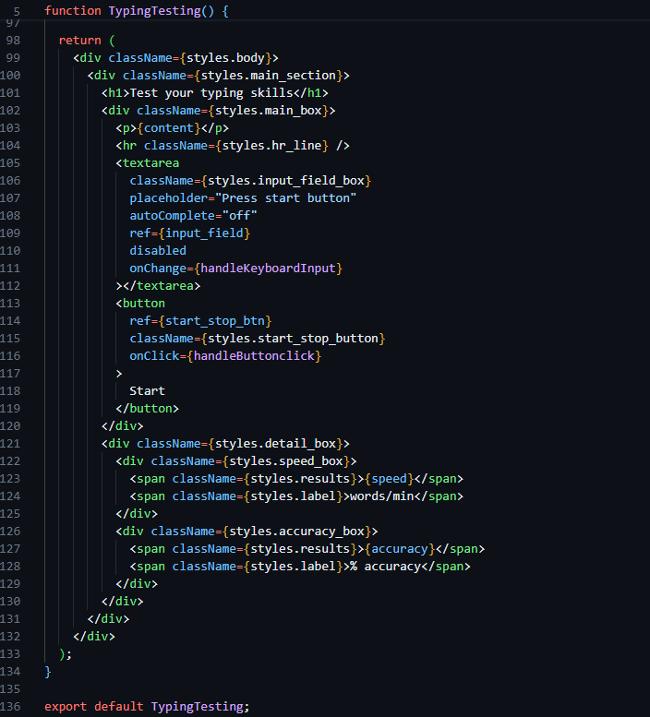
Code Snippet
Typing Testing Page

Slide 11
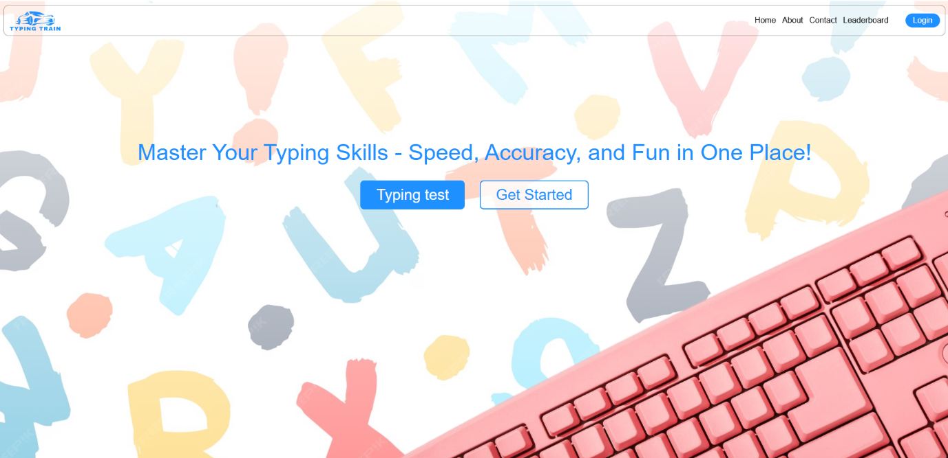
Output
Fig 1. Home Page

Slide 12
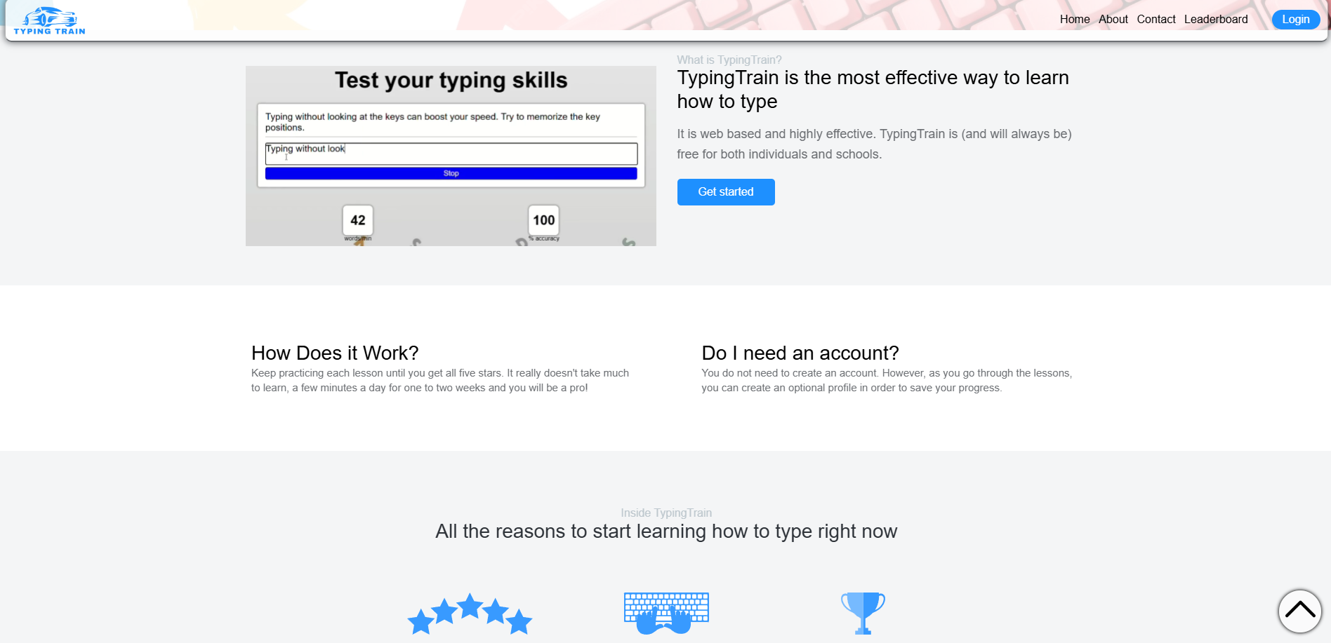
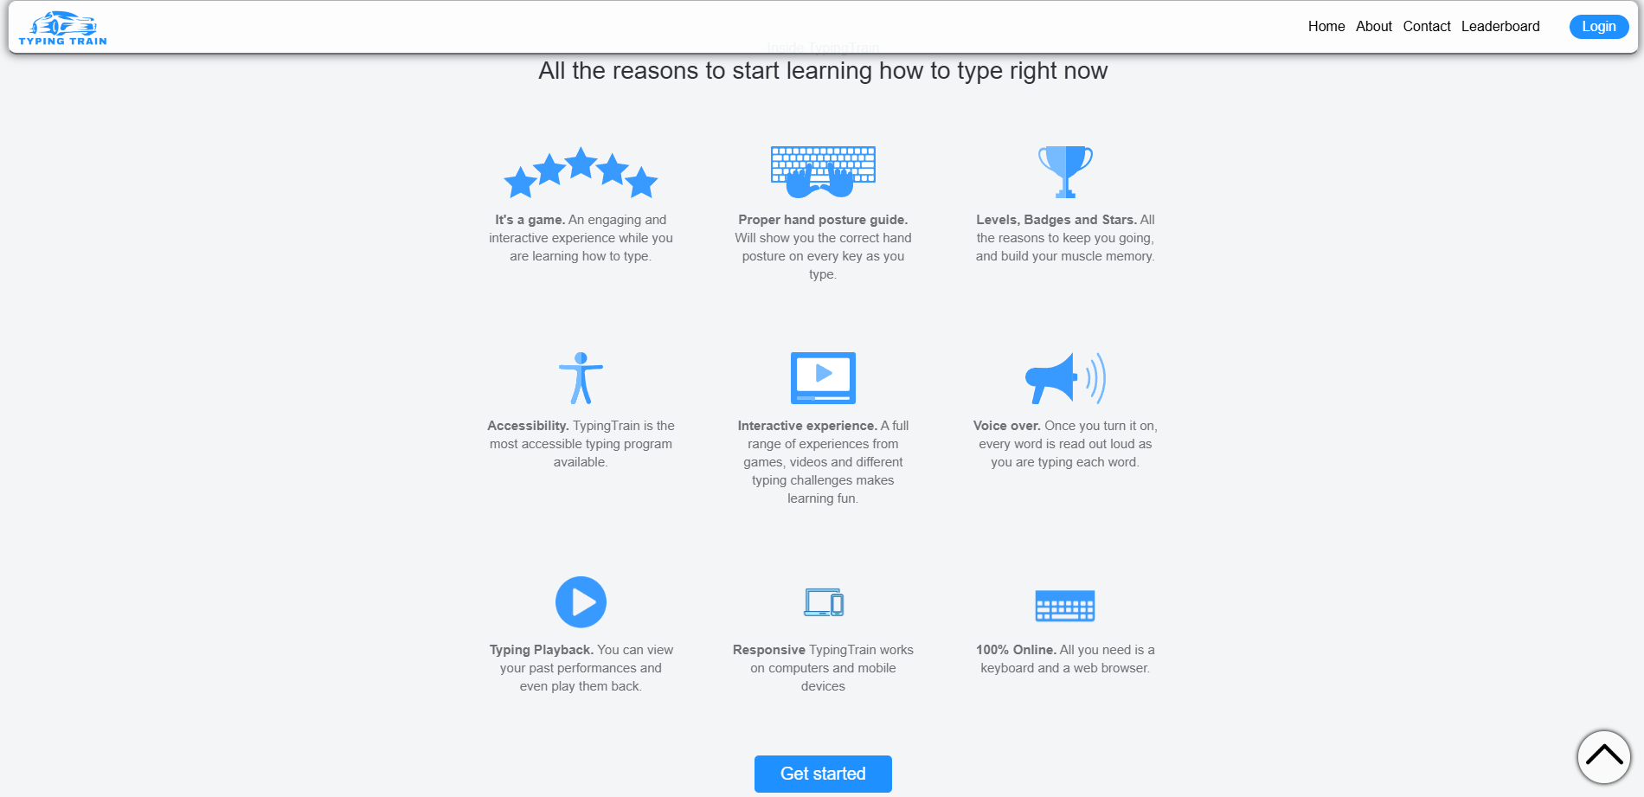
Output
Fig 2.
Fig 3.
Home Page Continued

Slide 13
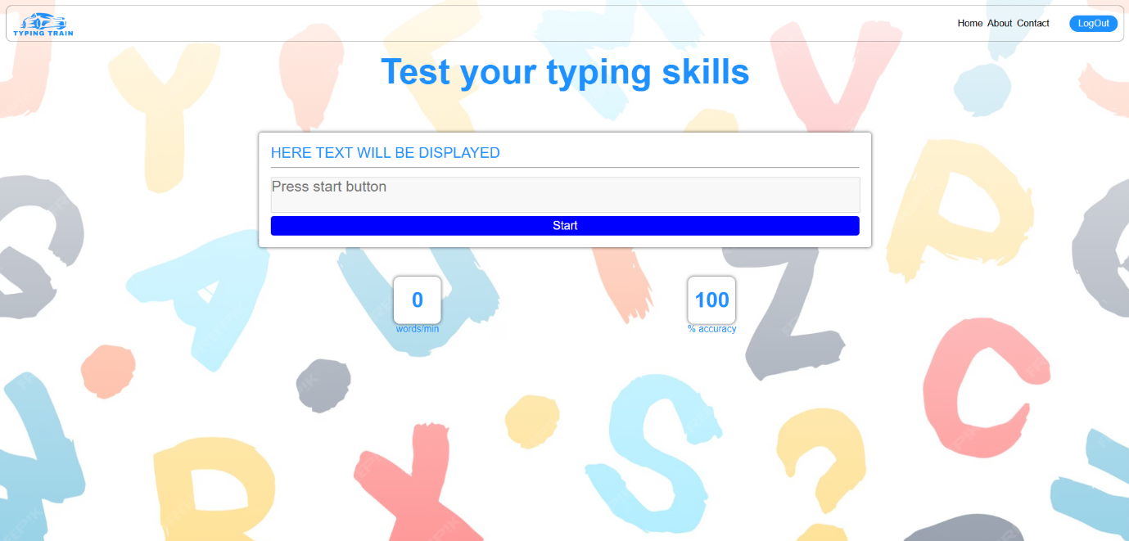
Output
Fig 4. Typing Testing Page

Slide 14
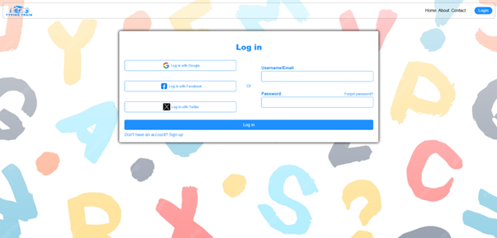
Output
Fig 5. Login Page

Slide 15
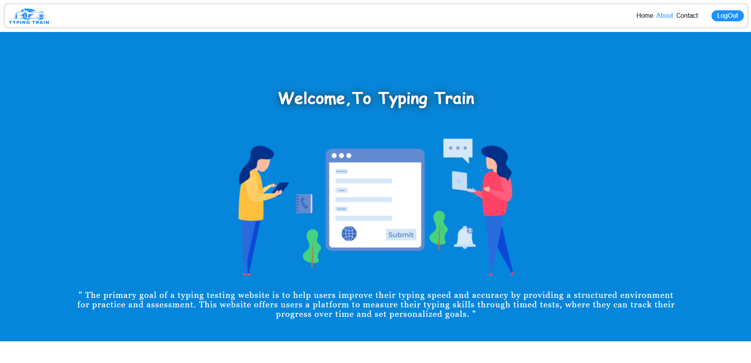
Output
Fig 6. About Us Page

Slide 16

Output
Fig 7. Contact Us Page

Slide 17
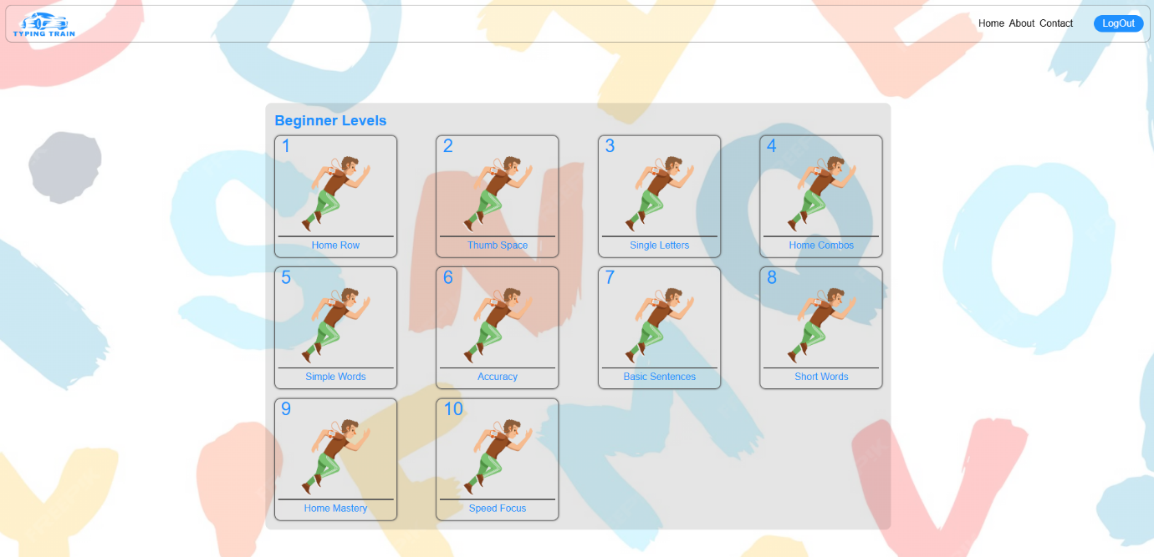
Output
Fig 8. Levels Page

Slide 18
Github Link
https://github.com/Tarandeep9988/FEE-PROJECT

Slide 19
Conclusion
In conclusion, Typing Train is a comprehensive and interactive platform designed to enhance users' typing skills through a structured, level-based approach. Its user-friendly interface, real-time performance tracking, and responsive design make it accessible and engaging for typists of all skill levels. With added features like an on-screen keyboard for guided practice, secure login for personalized experiences, and well-documented resources, Typing Train stands as a robust tool for effective typing education. This platform is ideal for anyone looking to improve their typing accuracy and speed while enjoying a seamless, supportive learning experience.

Slide 20
References

