Slide 1
Online Food Ordering System
Project Name : Click To Eat
Language : Dart
Technology : Flutter
By
IT067 Vatsal Malaviya
IT073 Tarang Mavani

Slide 2
Software Requirement Specification
Functional Requirements
R 1 : For Admin
R 1.1 : Managing User
R 1.1.1 : Add User
R 1.1.2 : Delete User
R 1.1.3 : View User Info.
R 1.2 : Managing Restaurants
R 1.2.1 : Add Restaurants
R 1.2.2 : Delete Restaurant
R 1.2.3 : View All Restaurant Info.

Slide 3
R 2 : For Customer
R 2.1 : Need For an Account
R 2.1.1 : Register to The System
R 2.1.2 : Login to the System
R 2.1.3 : Logout From the System
R 2.2 : Searching
R 2.2.1 : Search Based on Food
R 2.2.2 : Search Based on Restaurant
R 2.3 : Add to Cart
R 2.4 : Place Order
R 2.5 : Feedback
R 2.5.1 : Like the Items
R 2.5.2 : Rating

Slide 4
R 2.6 : Profile
R 2.6.1 : View Profile
R 2.6.2 : Edit Profile
R 3 : For Restaurant’s Admin
R 3.1 : Restaurant's Menu
R 3.1.1 : Add Food Items
R 3.1.2 : Edit the Menu
R 3.1.3 : Delete the Food Items
R 3.2 : Orders From Restaurants Side
R 3.2.1 : View Orders
R 3.2.2 : Update the Order Status

Slide 5
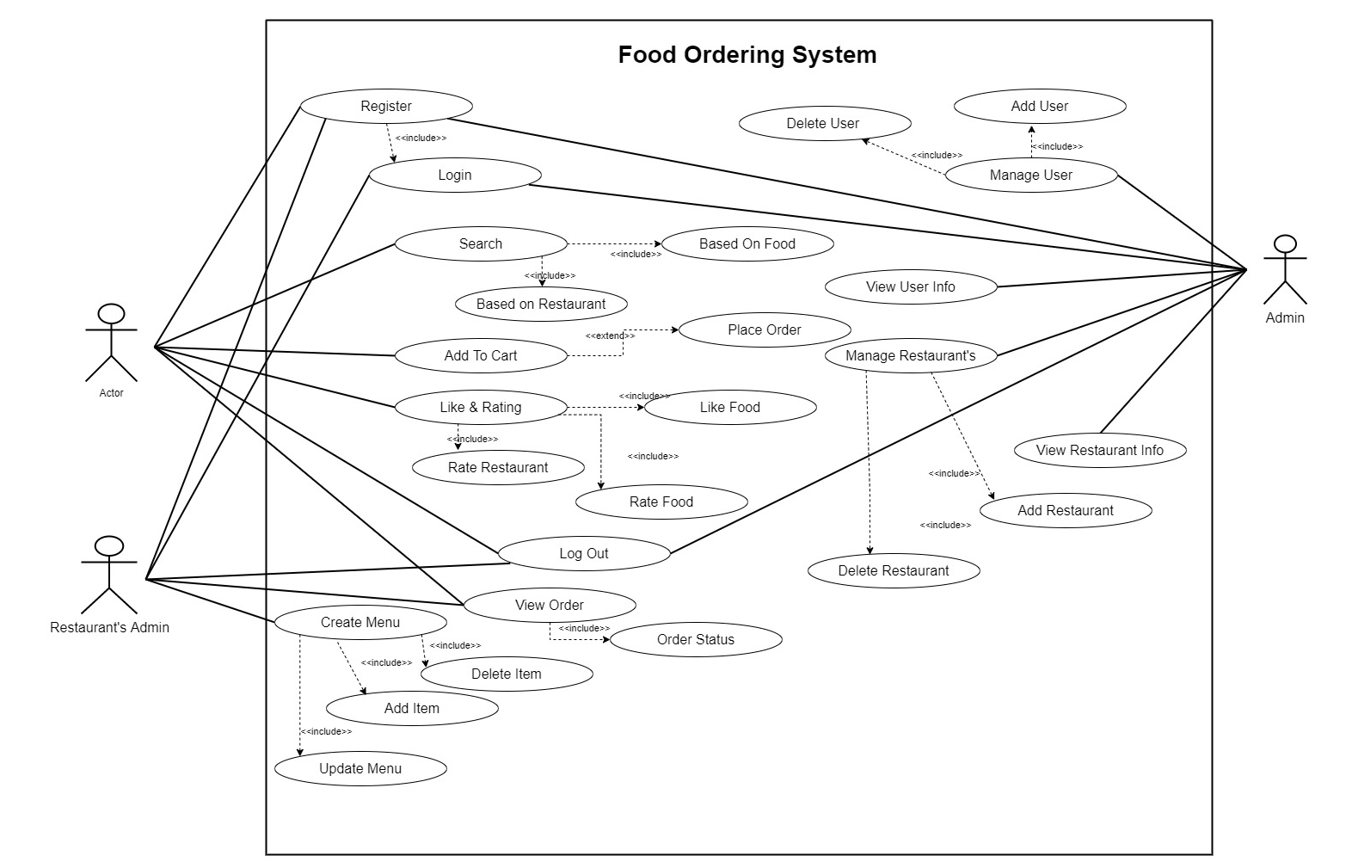
Use case Diagram

Slide 6
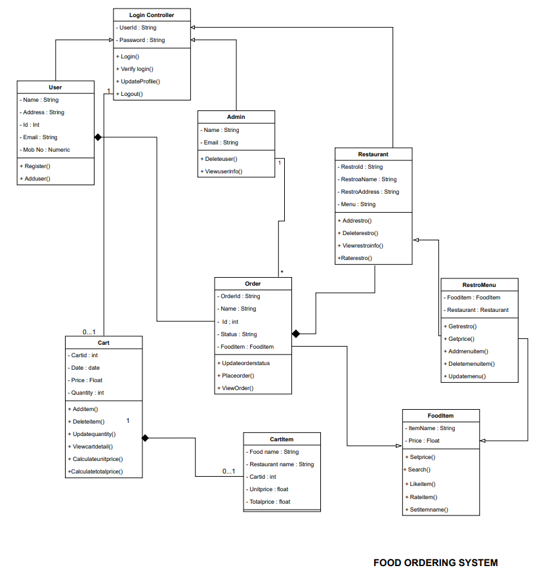
Class Diagram

Slide 7
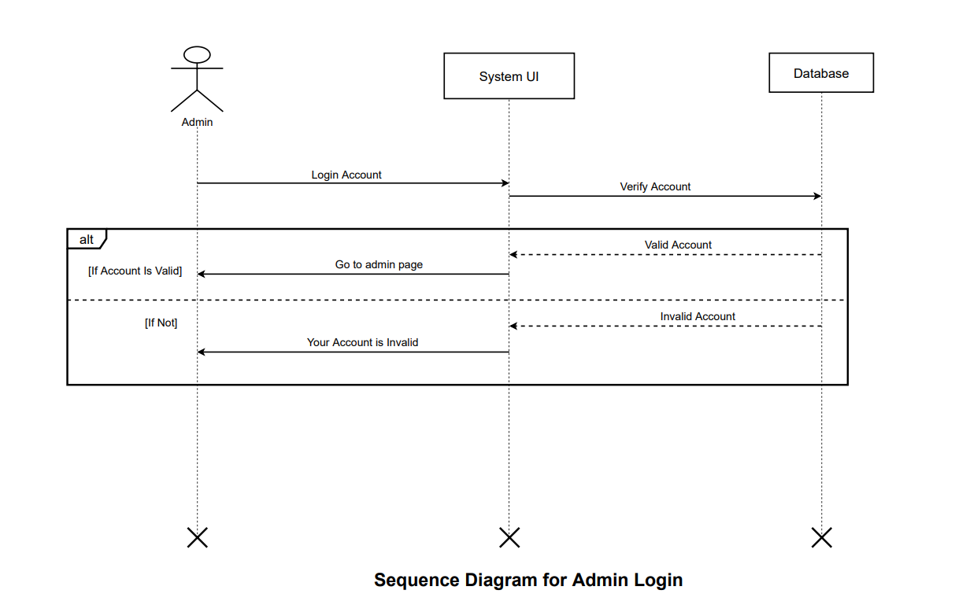
Sequence Diagram

Slide 8
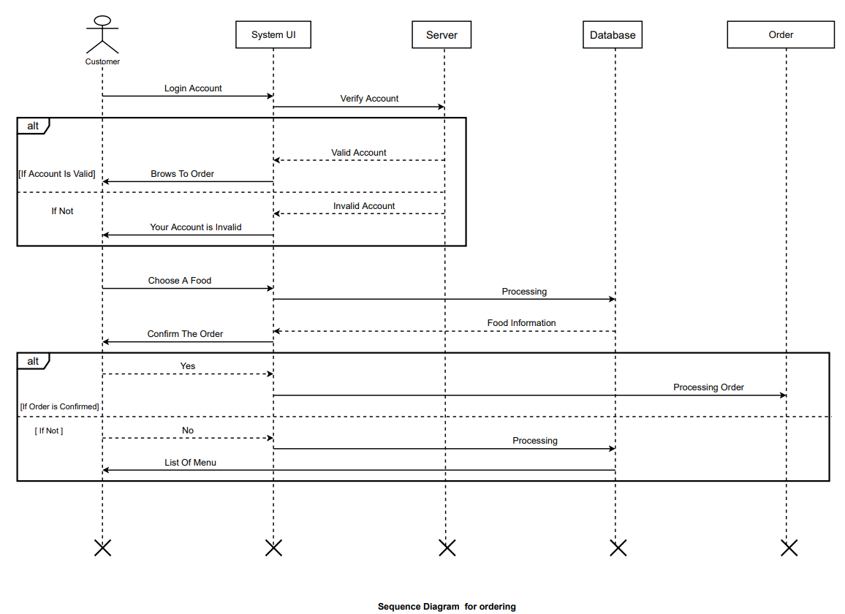
Sequence Diagram

Slide 9
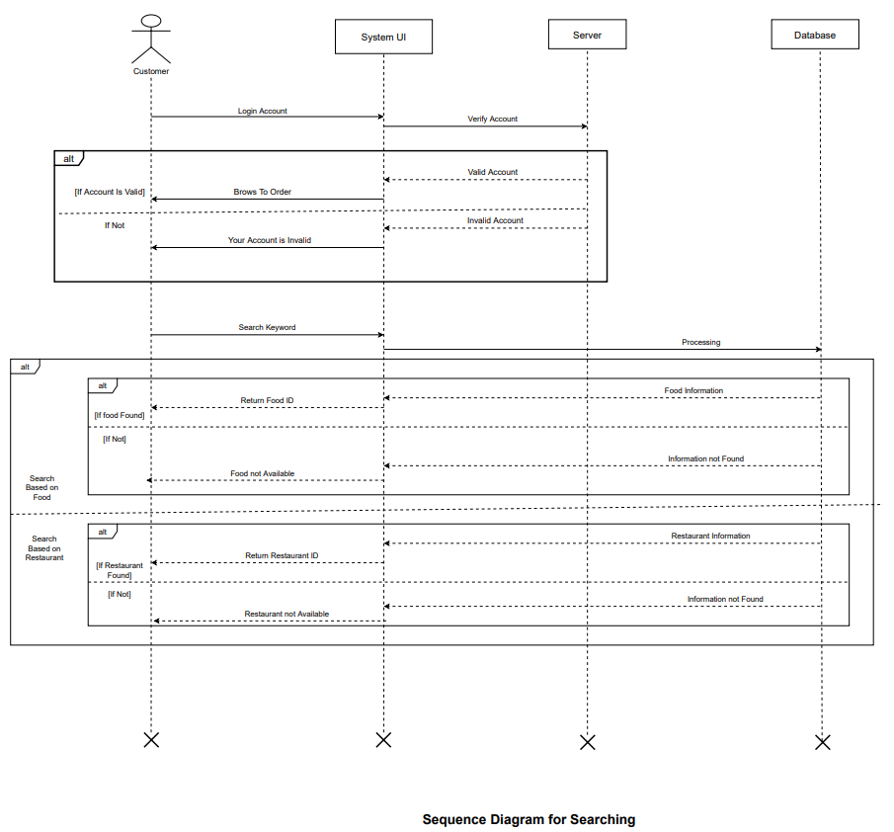
Sequence Diagram

Slide 10
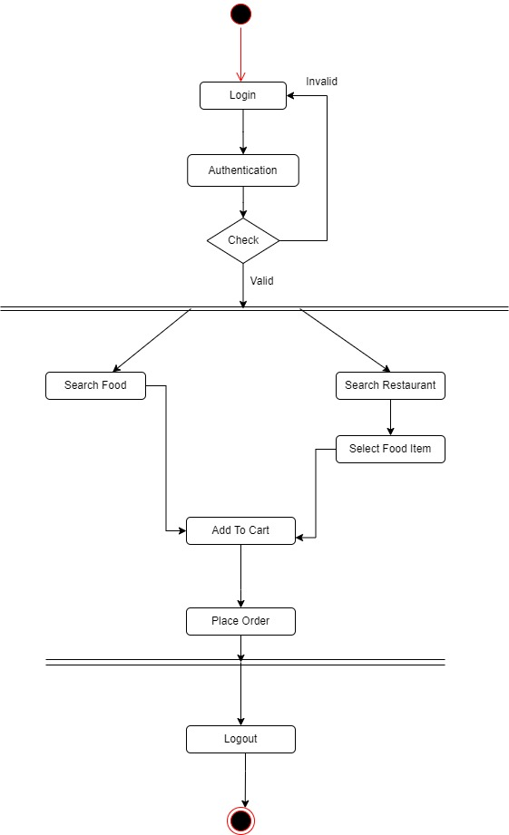
Activity Diagram

Slide 11
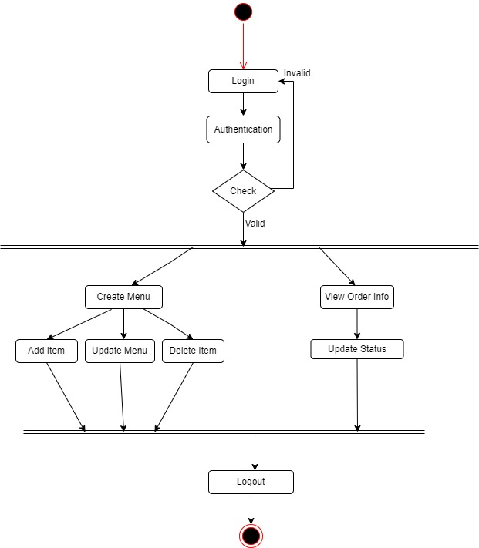
Activity Diagram

Slide 12
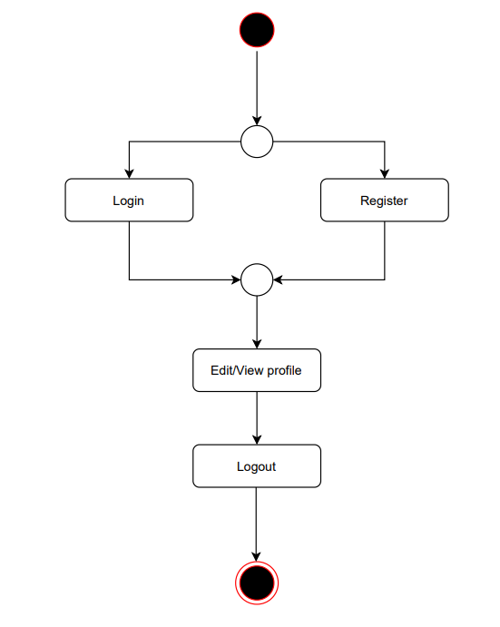
State-Chart Diagram
For Login/Register

Slide 13
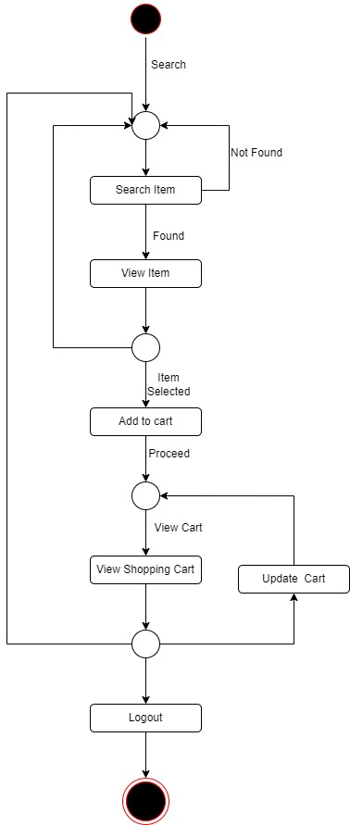
State-Chart Diagram
For Searching

Slide 14
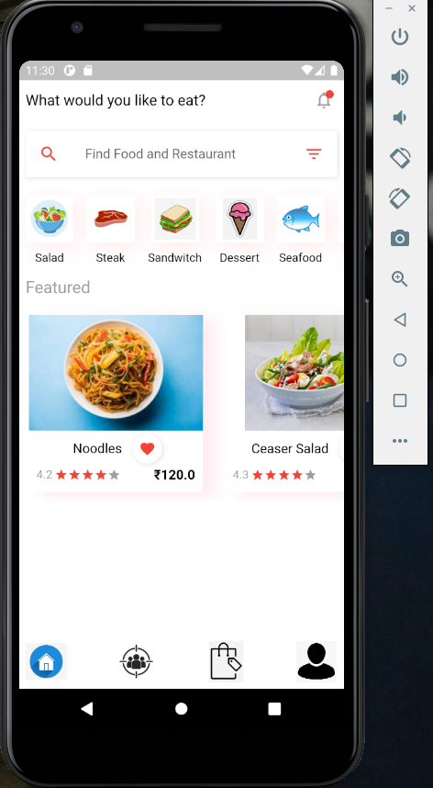
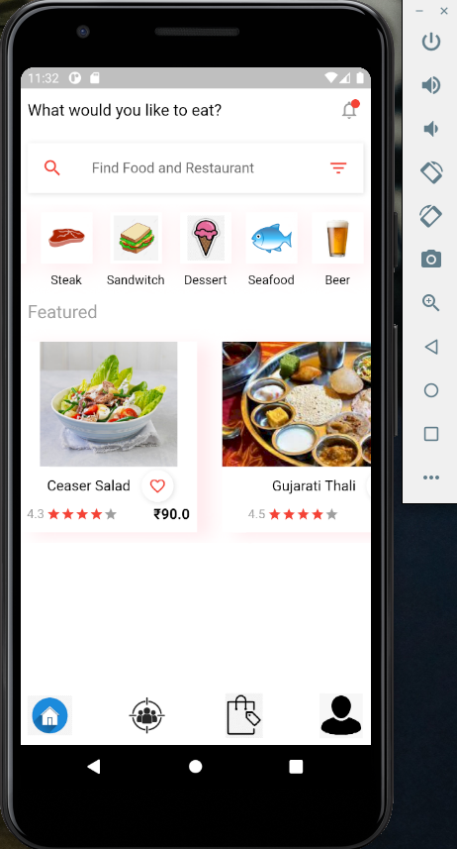

Slide 15
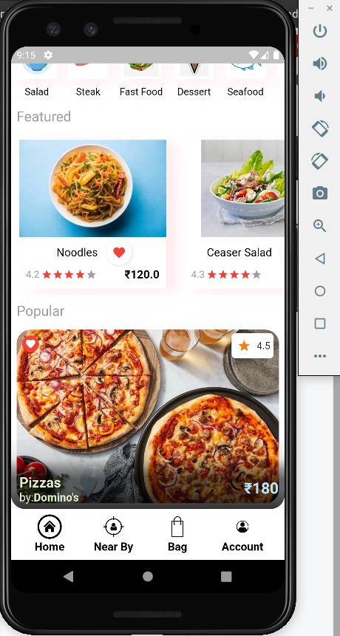

Slide 16
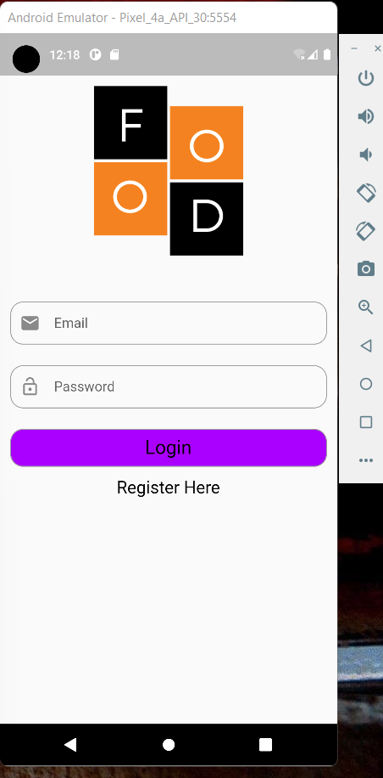
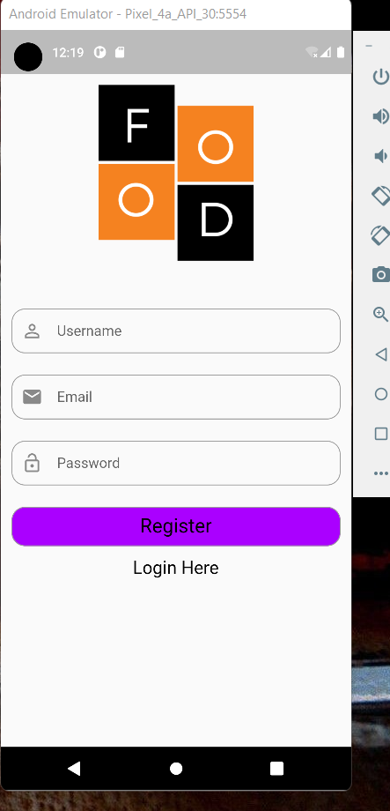

Slide 17
