Slide 1
Basics of Docker

Slide 2
Docker is an open-source platform that allows developers to automate the deployment in lightweight, portable containers.
Containers are standalone, executable packages that contain everything needed to run an application, including code, runtime, libraries, and system tools. This approach ensures that applications run consistently across different environments, whether on a developer's local machine, a staging server, or in production.

Slide 3
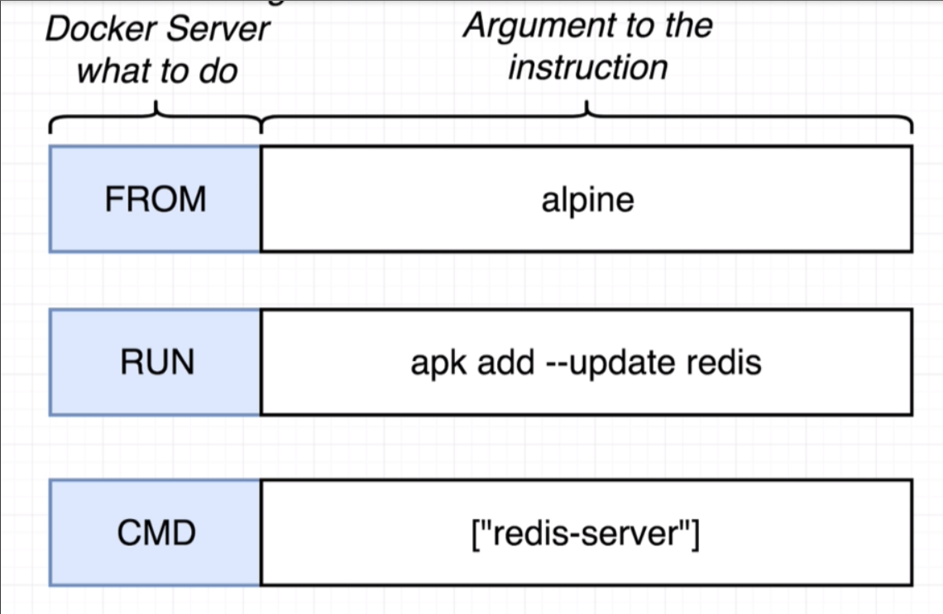
Dockerfile
Dockerfile is a text file containing a series of commands and instructions that Docker uses to build a container image.

Slide 4
Common Instructions in a Dockerfile
FROM: Sets the base image for the container (e.g., FROM python:3.9).
WORKDIR: Sets the working directory within the container where the application files will reside.
COPY: Copies files from the host machine to the container (e.g., COPY . /app).
RUN: Runs commands to install dependencies or set up the environment (e.g., RUN pip install -r requirements.txt).
EXPOSE: Specifies the port on which the application will run inside the container (e.g., EXPOSE 8080).
CMD or ENTRYPOINT: Defines the command to run the application when the container starts (e.g., CMD ["python", "app.py"]).

Slide 5
CMD (Command)
Specifies default arguments for the container's main process.
Can be overridden by passing a command during docker run.
Only one CMD instruction is allowed per Dockerfile. If multiple CMD instructions are present, only the last one is used
CMD ["python", "app.py"]
ENTRYPOINT
Specifies the main command that will always run when the container starts.
Cannot be overridden by arguments passed during docker run, but additional arguments can be appended to it.
Used to configure containers to behave like executable binaries (e.g., running specific applications).
ENTRYPOINT ["python", "app.py"]

Slide 6
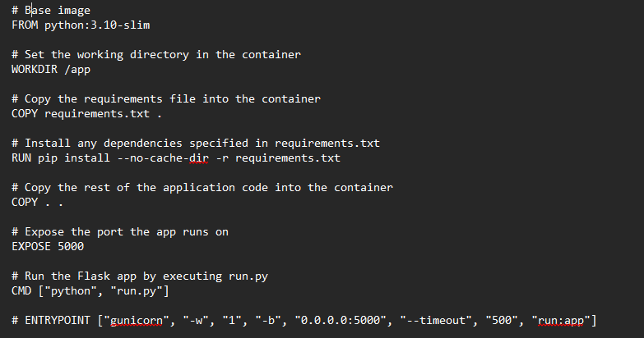

Slide 7
Image Creation
Create docker image by below commands:
docker build -t name:tag .
By word docker we are telling its a docker command.
Build means build an image of project.
. means from current path
Tagging: giving name and tag to image. -t name:tag - gives name and tag to image. Generally is like summarization:1.0 then summarization:1.1
sudo docker images : list all the images
docker images --filter "reference=*chatbot*": lists images with names containing "chatbot“
docker build -t name:tag –f Dockerfile.dev .
-f tag use to give filename which will be used

Slide 8
Container run commands
sudo docker run --name chatbot -p 5000:5001 chatbot:latest. By default, Docker uses a bridge network, meaning the container has its own isolated network namespace. Port mapping allows traffic from the host to reach the container on the specified ports.
sudo docker run --name chatbot --network=host chatbot:latest. The container directly uses the host machine's network stack. There’s no port mapping because the container's ports are the same as the host’s.
Invalid: sudo docker run chatbot:latest --name chatbot -p 5000:5001. This will fail because --name and -p are options, and they must appear before the image name.
Use -it when you need to work interactively with the container (e.g., for debugging or running shell commands inside the container).
Use -d when you want to run a container as a background service (e.g., running a web server).

Slide 9
List containers
sudo docker ps
sudo docker ps -a --filter "name=chatbot"
sudo docker ps -a --filter "ancestor=chatbot"

Slide 10
Other Common Docker Command
sudo docker stop container
sudo docker start container
sudo docker rm container
sudo docker rmi image
sudo docker exec -it wx /bin/bash
sudo docker cp wx:/python-docker/homeSpark/static/output /home/app/home-services-ai-python-backend/homeSpark/static/output
sudo docker cp wx:/python-docker/chatbot_app/queries_kb /home/app/chatbot/db-chatbot/chatbot_app/queries_kb

Slide 11
Pruning
sudo docker image prune: remove dangling images
sudo docker image prune –a: remove all unused images
sudo docker builder prune
sudo docker volume prune
sudo docker network prune
sudo docker system prune
sudo docker container prune: remove all unused images

Slide 12
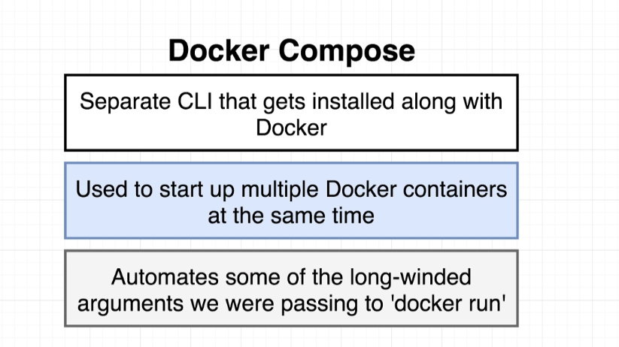

Slide 13
.
A docker-compose.yml file is a configuration file used with Docker Compose to define and run multi-container Docker applications. It describes the services, networks, and volumes that make up your application in a declarative way, enabling you to start all of them with a single command (docker-compose up).
Services: Defines the individual services (containers) in your application. Each service can be thought of as a single container instance
Version: Specifies the version of the Compose file format. Different versions support different features. Common versions are 2, 2.4, and 3.x.

Slide 14
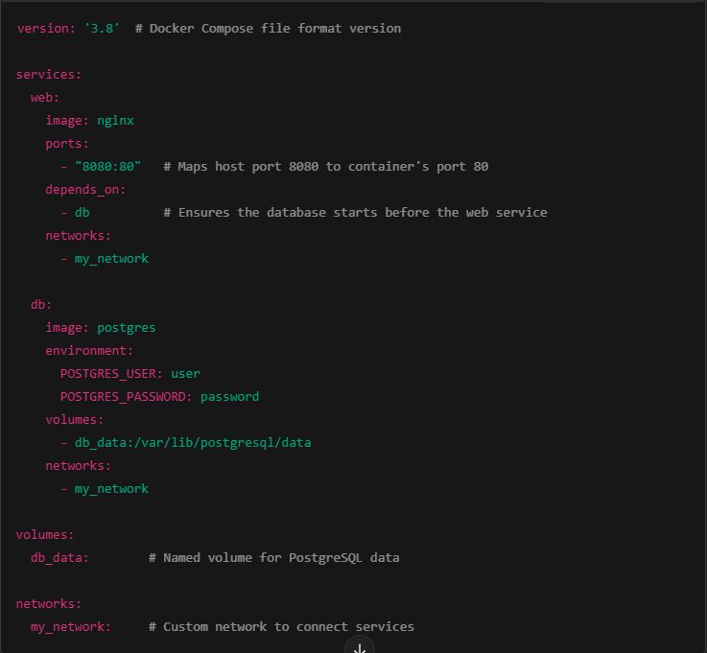

Slide 15
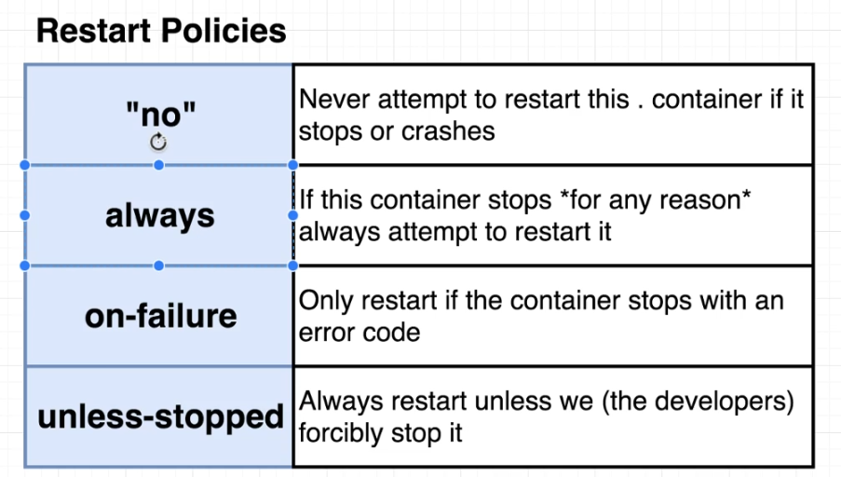
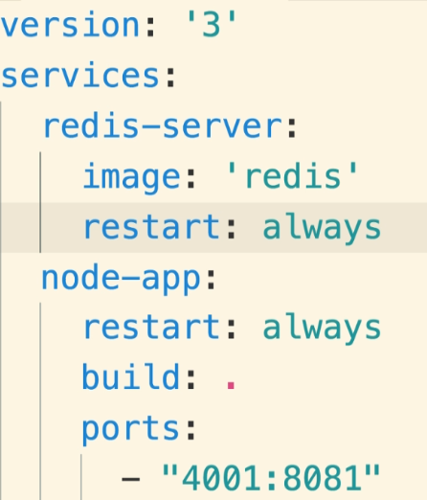

Slide 16
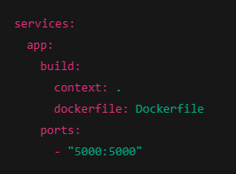
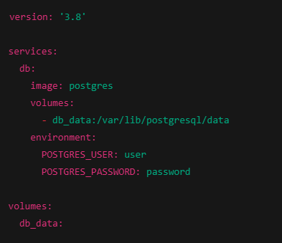
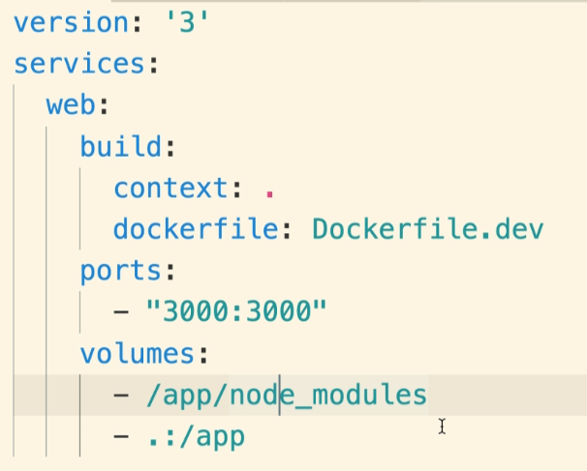
Build from a Custom Docker file
Docker Compose with Volumes and Environment Variables

Slide 17
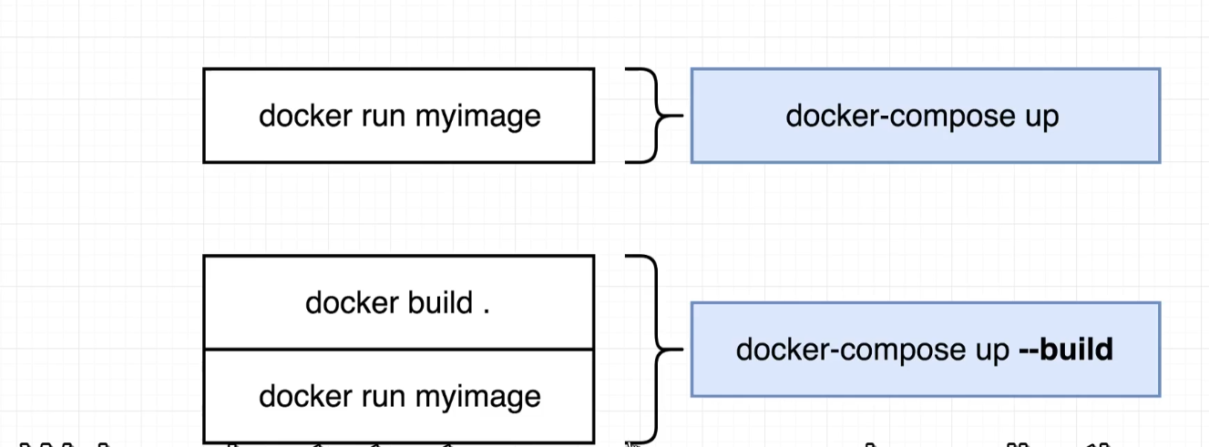

Slide 18
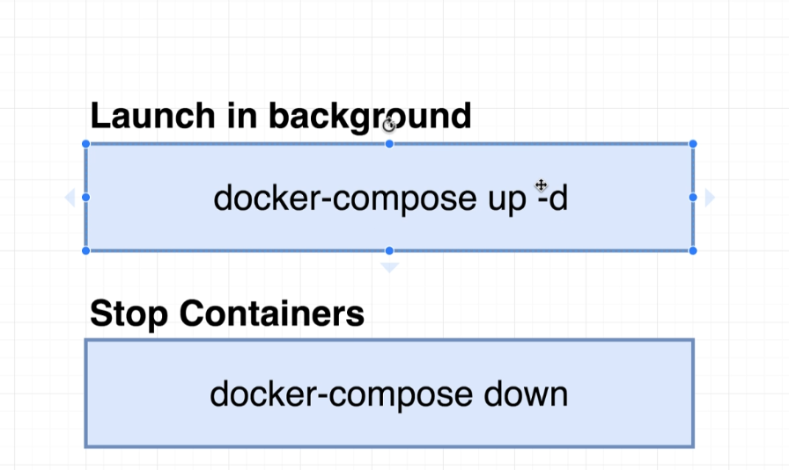

Slide 19
