Slide 1
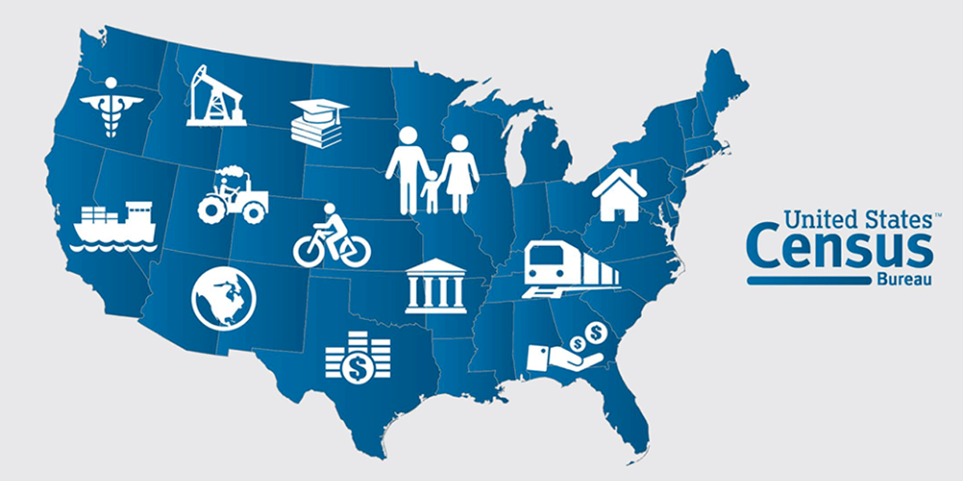
Project: Predict the Income level of population of the U.S. by using Machine Learning Algorithm

Slide 2
Abstract
Income is one of the most important source of well-being, but it is difficult to measure accurately of each person. In the United States, income data are available from surveys, tax records, and government programs, but each of these sources has important power and major limitations when used alone. This data set contains to the census data extracted from the 1994 and 1995 current population surveys conducted by the U.S. Census Bureau. The aim of my this project is to apply several machine learning algorithms to accurately model individuals' income, whether he makes more than $50,000 or not, using data collected from the 1994 U.S. Census. I have choose to this dataset, probably the most interesting topics for census data users are income and poverty. I want to know how many people live in a place and also want to know something about how well those people are living. Income is generally used as a measure of the economic well-being of individuals and communities. So, according to this, my purpose here is to address these questions by presenting descriptions and evaluations of the most commonly used measures of income and poverty in the census. My attention will be on if, when and why you should consider using each.

Slide 3
Research Questions
Does an individual make more than 50k income or not?
What are the most important features that help to define the income of an individual?
Which model more helpful to know about the income level of each person?
Which kind of people affected by their income level including: job type such as Private Job, Government Job, Self-employed – not incorporated?

Slide 4
Data Initialization

Slide 5
Data Initialization
Detailed Data Dictionary
Summary of Data
When it comes to numerical attributes, we should start by observing various statistics like count, mean, standard deviation, etc. In the present look at few of those for all our numerical categories of my dataset.
As per sort description we have seen in ‘count’ there is no null values in the dataset.
We can also see ‘mean’ it shows variation among the features and values are on different scales so we have to scale the features in similar scale.
This statistics give us an idea about the features which contains to missing values, the average value and maximum for a particular attribute, which are going to be very useful on that time when we decide to do preprocess our data before sustainable it into our models.
 | count | mean | std | min | 25% | 50% | 75% | max
age | 199523 | 34 | 22 | 0 | 15 | 33 | 50 | 90
det_ind_code | 199523 | 15 | 18 | 0 | 0 | 0 | 33 | 51
det_occ_code | 199523 | 11 | 14 | 0 | 0 | 0 | 26 | 46
wage_per_hour | 199523 | 55 | 275 | 0 | 0 | 0 | 0 | 9999
capital_gains | 199523 | 435 | 4698 | 0 | 0 | 0 | 0 | 99999
capital_losses | 199523 | 37 | 272 | 0 | 0 | 0 | 0 | 4608
stock_dividends | 199523 | 198 | 1984 | 0 | 0 | 0 | 0 | 99999
unknown | 199523 | 1740 | 994 | 38 | 1062 | 1618 | 2189 | 18656
num_emp | 199523 | 2 | 2 | 0 | 0 | 1 | 4 | 6
own_or_self | 199523 | 0 | 1 | 0 | 0 | 0 | 0 | 2
vet_benefits | 199523 | 2 | 1 | 0 | 2 | 2 | 2 | 2
weeks_worked | 199523 | 23 | 24 | 0 | 0 | 8 | 52 | 52
year | 199523 | 94 | 1 | 94 | 94 | 94 | 95 | 95

Slide 6
Exploratory Data Analysis (EDA)

Slide 7
Data Cleaning
Feature name | Description | Missing Values(?) [Count]
state_prev_res | State of previous residence | 708
mig_chg_msa | Migration code - change in MSA | 99696
mig_chg_reg | Migration code - change in region | 99696
mig_move_reg | Migration code - move within region | 99696
country_father | Country of birth father | 6713
country_mother | Country of birth mother | 6119
country_self | Country of birth | 3393
It is possible that when the census data was taken, few people denied to provide information about their occupation and work-class. As a result, in my dataset the few columns relates to not any kind of data for those people.
It contains with some missing values, a good practice is to replace the missing values by NAN of the column.

Slide 8
Variance of the features
The variance is used to measure the variability of data. If dataset values contains the large variance, so it indicates to data spread out , and in other words small variance indicates that data is clustered closely around the mean.
It’s underlying idea is that if a feature of dataset is constant (e.g.: it has zero variance), then it cannot be used for any interesting patterns, and can be dropped from the dataset. In the picture show that, features such as own_or_self and year are related to zero variance but I haven’t dropped these features in my dataset because this is contains the important values.
Features | variance
age | 498
industrycode | 326
occupationcode | 209
wages | 75568
capital_gains | 22066800
capital_losses | 73928
stock_dividends | 3936905
others | 987575
num_emp | 6
own_or_self | 0
vet_benefits | 1
weeks_worked | 596
year | 0

Slide 9
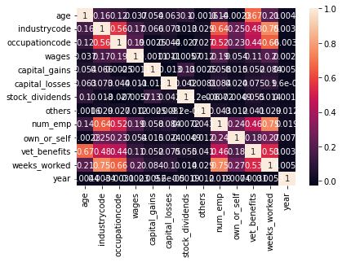
Correlation
Now I checked for variables with high correlations to each other. Correlation measures the relationship between two variables. When two variables are so highly correlated that they explain each other (to the point that one can predict the variable with each other).
It is evident that none of the predictors are highly correlated to each other. With the help of this I don't need to drop any variable from dataset and it proceed to building the prediction model.

Slide 10
Data Visualization

Slide 11
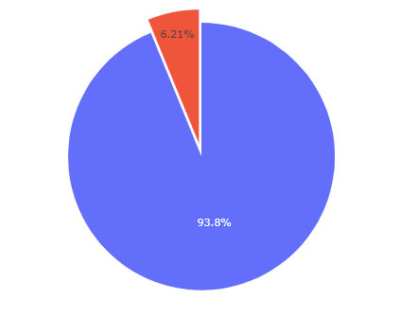

Does an individual make more than 50k income or not?
According to the original dataset the majority of the people have an income of less than 50,000, indicating that the data is somewhat skewed.
After visualization with the distribution of each attribute and I achieve the possibility of earning more than $50,000 per year. Due to this study, I culminate that age’, ‘education’, ‘hours per week’, and ‘sex’, these attributes play a crucial rule for predict the income of individual in U.S. Finally, after applying the four models and also using cross validation technique, I have chosen to The Random Forest Classifier, which provides the highly accuracy to known about the income level.

Slide 12
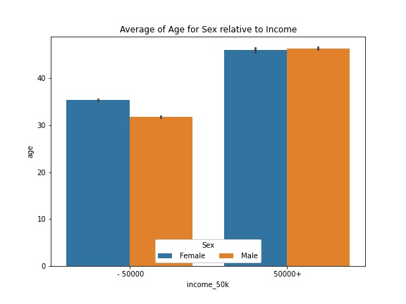
What are the most important features that help to define the income of an individual?
During analysis, I find that ‘age’, ‘education’, ‘hours per week’ and ‘sex’ play an important role to determine the income level of individuals in the United State.
‘Age’ is certainly to be a noteworthy component, and should be an important feature considered in my prediction model.
We can see that here is almost double the sample size of males in comparison to females in the dataset. While this may not affect our predictions too much, as well as distribution of income. However, the percentage of males who make greater than $50,000 is much greater than the percentage of females that make the same amount of income.

Slide 13
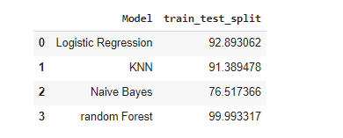
Which model more helpful to know about the income level of each person?
The given picture show that the information about models which I have applied on my dataset to predict the income level of individuals in U.S. For instance, I have used to KNN, Logistic Regression, Random Forest, Naïve Bayes classifier. After applied to these models on my dataset, I get 99.99% accuracy by Random forest classification model. As a result, Random forest is the best fit model to predict the income level of individuals ,and this is more helpful to know about the income level in future.

Slide 14
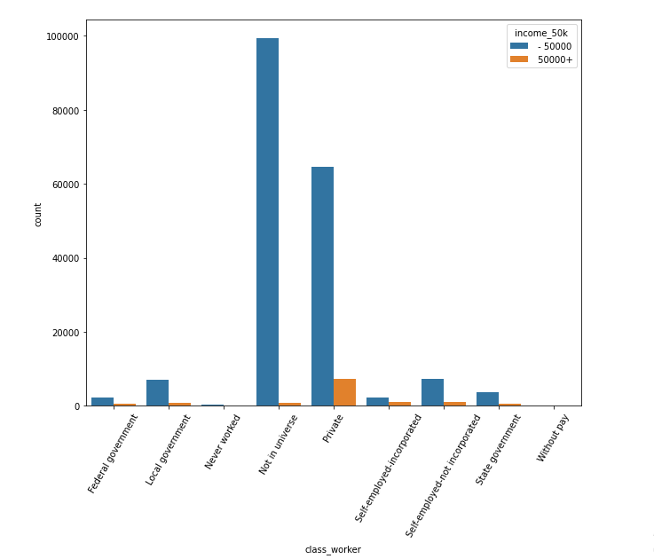
Which kind of people affected by their income level including: job type such as Private Job, Government Job, Self-employed – not incorporated?
By visualization, People who was working in Private sector earned more income as compared to those who were working in Government, and run their own business. The probabilities of making above $50,000 are similar among the all work classes except for self-employed-incorporated and federal government. Federal government is seen as the most elite in the public sector, which most likely explains the higher chance of earning more than $50,000.

Slide 15
Normalization

Slide 16
Normalize the Dataset
It is recommended to perform some type of scaling on numerical features. It is used to change the values of numeric columns in the dataset to a common scale, without distorting differences in the ranges of values. So, that's why I normalize the dataset to get the best accuracy without effecting the range of values.
Preprocess Categorical Features
If we see that there are some features like ‘occupation’ or ‘race’ that are not numerical, they are categorical in my dataset. Machine learning algorithms expect to work with numerical values, so these categorical features should be transformed. So, then I proceed to one of the most popular categorical transformations is called ‘One-hot encoding’.

Slide 17
Experimental Evaluation

Slide 18
Imblearn Technique
In everywhere, when we model the real-world data, one of the challenges is the imbalance among different classes, in some cases, it is extremely imbalanced, which makes modeling almost impossible without some manipulation. Sampling can be used to deal with this issue, the Synthetic Minority Over-sampling technique(SMOTE) is one of the most commonly methods. It aims to balance class distribution by randomly recreate samples in minority. By seeing to this example in pie chart, it represented my target variable which is imbalanced with majority data values, so that is the only reason I need to balance my dataset before performing the models.
How smote is work:
SMOTE selects the data points of the minority class in feature space to draw a line between those points and generate new points along with the line. Thus this technique synthesizes new data points for minority class and oversample that class.

Slide 19
Cross Validation
Cross Validation is a technique which involves preserve a specific test of a dataset on which we do not train the model. After that, we test our model on this specific test before finalizing it.
Here are the steps involved in cross validation:
First, we reserve a sample or specific test of data set.
Train the model using the remaining part of the dataset.
In the final, we use the reserve sample of the test (validation) set. This will help in measure the effectiveness of our model’s performance. If our model delivers a positive result on validation data, then go ahead with the current model.

Slide 20
Train and Test Split Approach: Training and testing is a method, which helps to compute the accuracy of our model. It is called Train/Test because of we split the data set into two sets: a training set and a testing set. I have used 70% for training, and 30% for testing. I train the model using the training set and, after that test the model using the testing set.
K-Fold Cross Validation : In this method, the dataset is split into ‘k’ number of subsets, k-1 subsets then are used to train the model and the last subset is kept as a validation set to test the model. Then the score of the model on each fold is averaged to evaluate the performance of the model. I have implemented 5 fold cross-validation with the help of sklearn.model_selection module which provides with K-Fold class (I have used four classes with K-fold), and this helps to make it easier to implement cross-validation. So in this way, my K-Fold classes used to split method which requires a dataset to perform cross-validation on as an input arguments.

Slide 21
Stratified K-Fold:
Stratified K fold cross-validation object is a variation of K Fold that returns stratified folds. The folds are made by preserving the percentage of samples for each class. It provides train/test indices to split data in train/test sets. Specifically, when we are split a dataset randomly, although in that way it maintains the same class distribution in each subset. For example, by using a k-fold cross-validation which preserves the imbalanced class distribution in each fold. It is called stratified k-fold cross-validation and will enforce the class distribution in each split of the data to match the distribution in the complete training dataset.
Shuffle Split k-fold:
This is a very flexible strategy of cross-validation. In this technique, the datasets get randomly partitioned into training and validation sets.Unlikely k-fold cross-validation split of the dataset into not in groups or folds but splits in this case in random.
As a result, the number of iterations is not fixed and decided by analysis. Then results are averaged over the splits. The proportion of train and validation splits is not dependent on the number of iterations. Some samples may not be selected for either training or validation.
The most important thing about it, this is not suitable for an imbalanced dataset. If our dataset is balanced then we can use to this technique.

Slide 22
Models Implementation and Evaluation

Slide 23
Over the last two decades, humans experience grown a lot of dependence on data and information in community and with this origin growth, technologies have advance for their storage, analysis and processing on a large scale. The fields of Data Mining and Machine Learning have not only make the most of them for knowledge and discovery but also to explore certain hidden patterns and concepts which relate to the prediction of future events, actually this is not easy to obtain.
The problem of variation in income has to become great concern in the recent years. Making the poor better off does not seem to be the unique criteria to be in search for eliminate this issue. The folks of the United States believe that the approach of diversity is unacceptable and demands a fair share of wealth in the society. My project actually aims to conduct a comprehensive analysis to highlight the key factors that are necessary in improving an individual's income. Such an analysis helps to set focus on the important areas which can significantly improve the income levels of individuals. Using the python language and several visualizations, I have attempted to fit 4 machine learning models (Logistic Regression, Random Forest, Naive Bayes classifier, KNN) , to predict the income level of individual’s make whether greater than $50,000 per year or not with the help of Train and Test approach, K-Folds Cross validation, Stratified k-fold cross-validation, Shuffle Split k-fold technique ,and finally find the best model to describe the data.

Slide 24
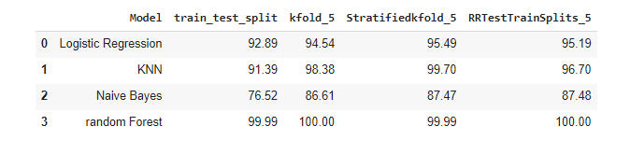
Accuracy Result

Slide 25
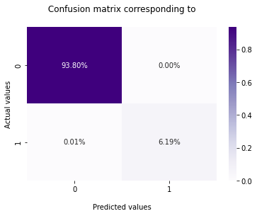
Confusion matrix
A Confusion matrix is an N x N matrix used for evaluating the performance of a classification model, where N is the number of target classes(In my dataset the target variable is Income_50k, which means individuals makes income over 50k or not by performing the the target classes such as KNN, Random Forest, Naïve Bayes and Logistic Regression ). The matrix compares the actual target values with those predicted by the machine learning model. This gives us a comprehensive outlook of how well our classification model is performing and what kinds of errors it is making. In this example, my confusion matrix is corresponding to Optimal model which is Random Forest Classifier according to highly accuracy which I have chosen to it.

Slide 26
Understanding True Positive, True Negative, False Positive and False Negative in a Confusion Matrix
True Positive (TP)
The predicted value matches the actual value.
The actual value was positive and the model predicted a positive value.
True Negative (TN)
The predicted value matches the actual value.
The actual value was negative and the model predicted a negative value.
False Positive (FP) – Type 1 error
The predicted value was falsely predicted.
The actual value was negative but the model predicted a positive value.
Also known as the Type 1 error.
False Negative (FN) – Type 2 error
The predicted value was falsely predicted.
The actual value was positive but the model predicted a negative value.
Also known as the Type 2 error.

Slide 27
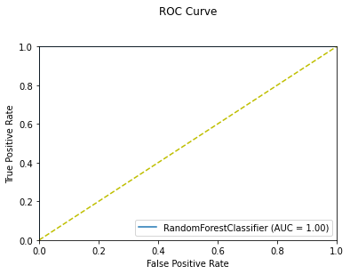
ROC curve corresponding of the optimal model
The Receiver Operator Characteristic Curve (ROC) class will be used for creating an ROC AUC curve for our model. It accepts prediction function and feature names for creating explainer sample. We'll then call the show () method passing it this explanation instance to generate the ROC curve on given data.
According to the obtained Training and Validation accuracy, it can be seen that my model is a good fit. The Area Under the Curve (AUC) shown in the above figure, which is 1.00, which is represent a better performance of the model because this is perfectly differentiate between all the Positive and the Negative class points correctly.

Slide 28
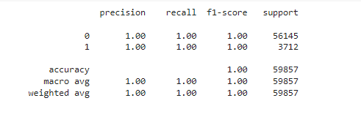
Classification Report
It seems to be precision as the proportion of times that when we predict its positive which is actually turns out to be positive. (In other words Precision tells us how many of the correctly predicted cases actually turned out to be positive.) Whereas recall can a accuracy over just the positives, so, all in all it is the proportion of times which we have labeled with positive correctly over the amount of times which was actually positive(it tells us how many of the actual positive cases we were able to predict correctly with our model.).
Note: Precision is a useful metric in cases where False Positive is a higher concern than False Negatives. Recall is a useful metric in cases where False Negative better than False Positive.
I have received precision, recall and f1-score (weighted average of precision and recall) are same result with 1.00 that means my algorithm has classified as equal amount of values.

Slide 29
Conclusion

Slide 30
I have successfully trained my model to predict the income of a person, with an accuracy of 99.99%.
I have moved step by step, analyzing, cleaning and modeling the data, and applied various machine learning models to achieve the desired predictions. I also tuned the model to improve the accuracy, and were able to achieve a model with a good accuracy.Finally, after applying the four model and also using cross validation technique, I have chosen to The Random Forest Classifier, due to the fact that for achieving very high results in terms of evaluation metrics. It has 99.99% accuracy score, also the same result for F1-score, it is reached at 1.00. So, this means, that people earned more than $50,000 per year behalf of the features and accuracy.
The future scope of my this work involves achieving an over-all better set of results by using hybrid models with addition of Machine Learning and Deep Learning together, or by applying many other advanced preprocessing techniques without further decrease in the accuracy.

Slide 31
Thank You

