Slide 1


SMART INDIA HACKATHON 2025
Problem Statement ID – SIH25082
Problem Statement Title-. Digital Health Record Management System for migrant workers in Kerala aligned with sustainable development goals
Theme- MedTech / BioTech / HealthTech
PS Category- Software
Team ID-
Team Name (Registered on portal)- Code Conquerors

Slide 2
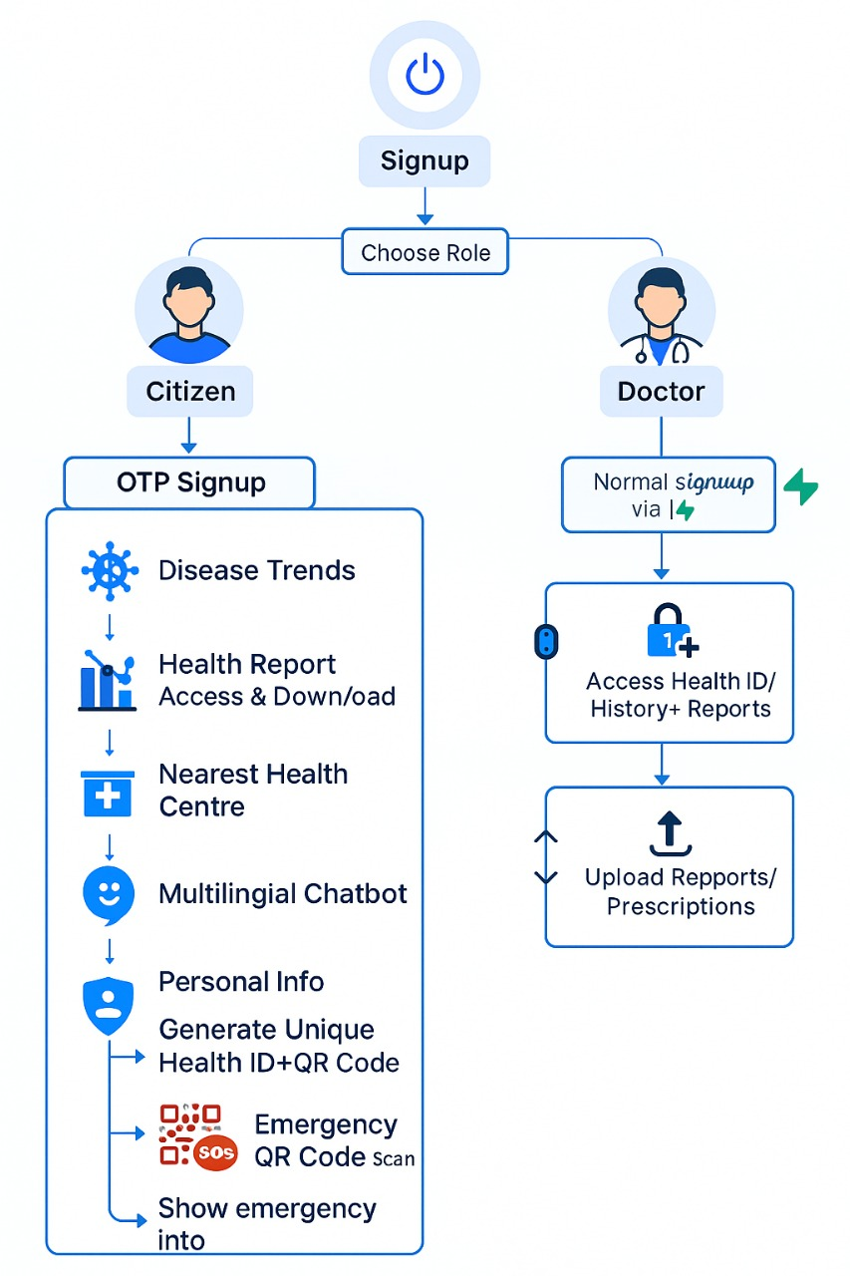
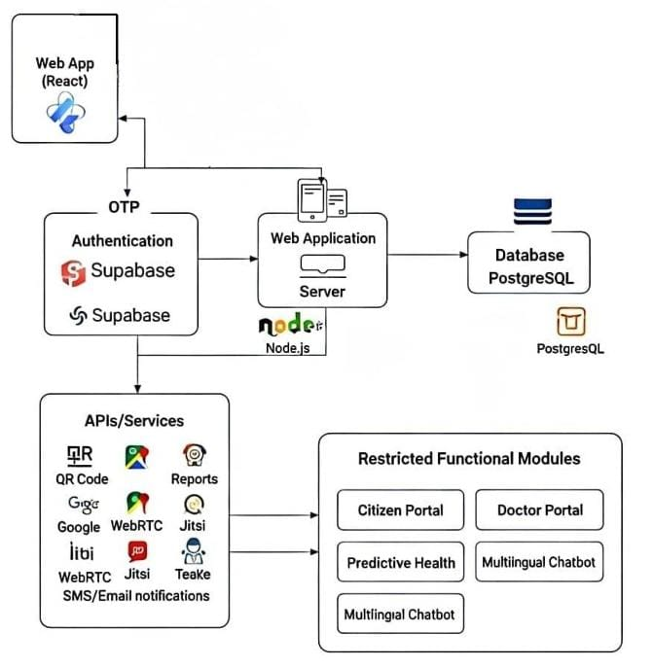
JEEVANID
CODE CONQUERORS
SOLUTION APPROACH
Citizen & Doctor Signup – Role-based secure login with OTP/manual verification.
Unique Health ID + QR – Auto-generated ID for quick access to records anywhere.
Personal Info & Health Data – Store demographics, medical history, allergies, surgeries, vaccinations.
Health Report Access – Citizens can view, download, and share reports easily.
Nearest Health Centre Finder – Location-based map integration for quick hospital/clinic discovery.
Predictive Health Risk – Job-specific disease risks shown with preventive guidelines and videos.
Multilingual Chatbot Support – AI chatbot answers queries, ensures inclusivity for low-literacy users.
Doctor’s Portal – Doctors access patient history by scanning QR or Health ID.

Slide 3
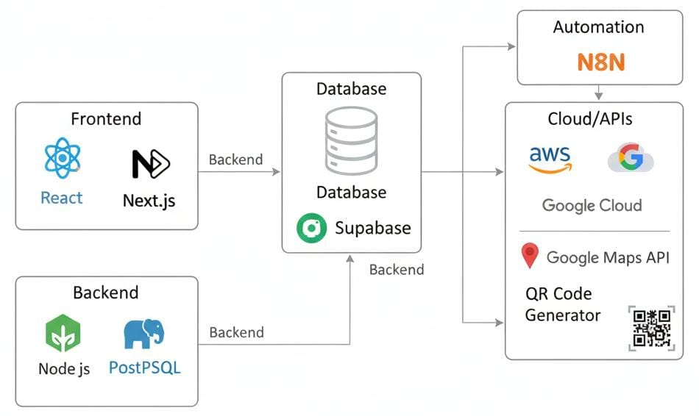








TECHNICAL APPROACH
CODE CONQUERORS
Frontend: React.js, Next.js
Backend: Node.js,
Database: Supabase
Authentication:, Supabase Auth
Maps Integration: Google Maps API
QR Code: qrcode.js / QRCode Generator API
Chatbot: Dialogflow / Rasa (multilingual NLP support)
Automation: N8N (workflow automation and scheduled tasks)
Cloud Hosting: AWS

Slide 4
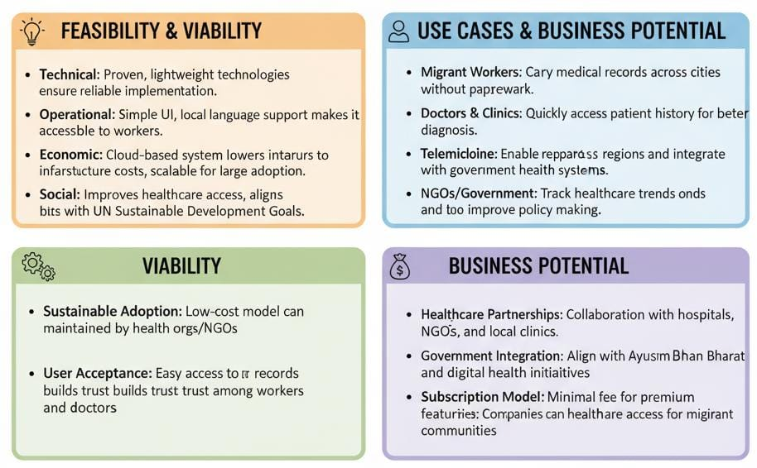
FEASIBILITY AND VIABILITY
CODE CONQUERORS

Slide 5
IMPACT AND BENEFITS
CODE CONQUERORS
Impacts & Benefits of the Solution
Social
Economic
Healthcare
Social Impact
Improves healthcare access for migrant workers and families.
Multilingual support ensures inclusivity across diverse regions.
Builds trust in digital health systems among underserved groups.
Economic Impact
Reduces cost of repeated tests and long-distance travel.
Saves workdays, boosting productivity and income stability.
Scalable cloud system minimizes government and NGO expenses.
Healthcare Impact
Ensures continuity of care with centralized records.
Faster emergency response via QR-linked health ID.
Disease prevention through awareness, predictive risks, and guidelines.
For Migrant Workers
Easy access to health records anytime, anywhere.
Faster emergency care through QR-based health ID.
Greater awareness of job-related health risks and prevention.
Inclusive access with multilingual and simple interface.
For Doctors & Healthcare Providers
Quick retrieval of patient history with a unique health ID.
Better diagnosis through consolidated medical records.
Saves consultation time, improving efficiency.
Provides data for disease trend analysis and community health planning.

Slide 6


RESEARCH AND REFERENCES
CODE CONQUERORS
Healthcare Platforms:
Aarogya Setu: https://www.digitalindia.gov.in/initiative/aarogya-setu/
eSanjeevani Telemedicine: https://esanjeevani.mohfw.gov.in/#/
Practo: https://www.practo.com/
Research & Best Practices:
WHO: Digital Health Strategies https://www.who.int/health-topics/digital-health
NITI Aayog: National Digital Health Blueprint
ResearchGate: Mobile Health Records for Migrant Workers
FFeatures | Our Solution | Aarogya Setu | eSanjeevani | Practo
Migrant-friendly Health ID + QR
Multilingual Support
Personal + Work-linked Health Records
Doctor Report Update & Access
Nearest Health Centre Locator
Predictive Health Risk (Job-related)
(Basic)

