Slide 1

Department of Computer Science and Engineering
Seminar(17CSS86)
A Detailed Study on Cryptocurrency
Under the Guidance of
Mrs. Soniya Komal V
Assistant Professor
Dept of Computer Science
LATHA S(1RG17CS022)

Slide 2
contents
ABSTRACT
INTRODUCTION OF CRYPOCURENCY
STEPS INVOLVED CRYPTOCURRENCY
BLOCKCHAIN
MINING
CRYPTOCURRENCY IN INDIA
ADVANTAGES OF CRYPTOCURRENCY
DISADVANTAGES OF CRYPTOCURRENCY
APPLICATION
CONCLUSION
REFERENCE

Slide 3
ABSTRACT
Virtual Currencies and cryptocurrency is a new digital addition to the cyber world as well as global financial system that has not yet been fully administered into the legal structure of many nations across the globe.
Cryptocurrencies are digital assets where cryptography is used to create and distribute currency through peer-to-peer network.
Cryptocurrency has now emerged as an important asset in financial and business applications.
They rely on a secure backbone technology called Blockchain Technology which allows storing all the transactions made in a secure distributed ledger, a data structure which is done by the process called mining.
Notes:
Insert a map of your country.

Slide 4
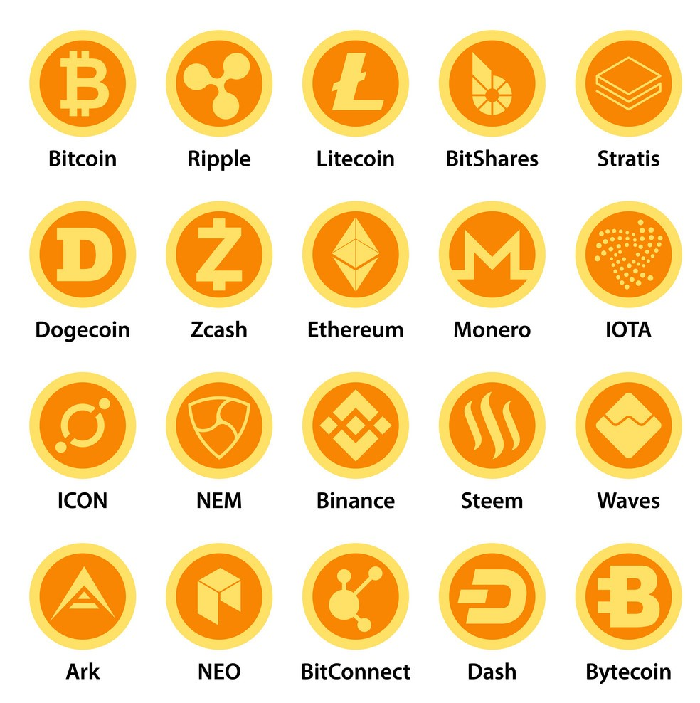
INTRODUCTION TO CRYPTOCURRENCY
Cryptocurrencies is divided into two parts cryptography and currency.
Cryptography is associated with the process of converting ordinary plain text into unintelligible text and vice-versa.
An encrypted message is ciphertext. The process of turning ciphertext back into plaintext is decryption.
It is a is the science of protecting information by transforming it into a secure format.
Since the development of Bitcoin in 2009 by Satoshi Nakamoto, the first-ever cryptocurrency, it has become an important component of the international financial market after ten years of development.
The cryptocurrency market has grown to a total market capitalization of 209 billion USD
Notes:
Insert a picture of one of the geographic features of your country.

Slide 5
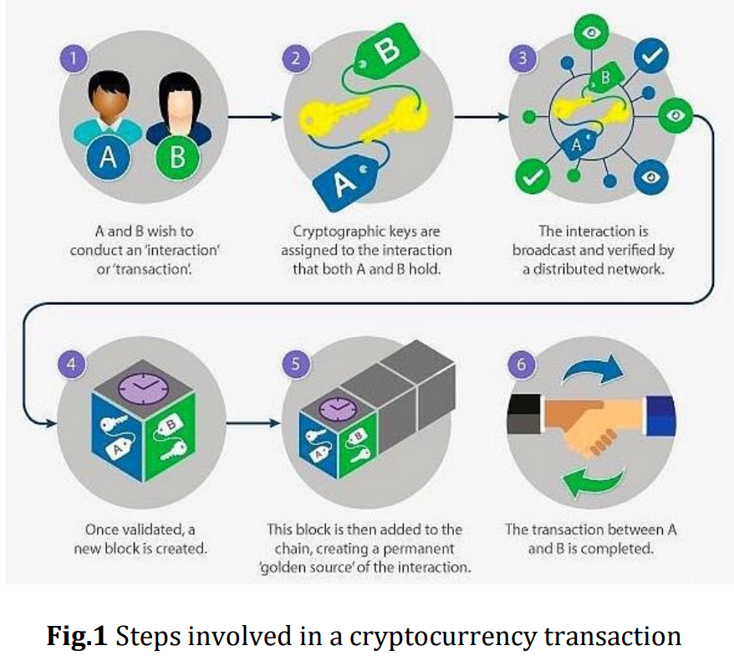
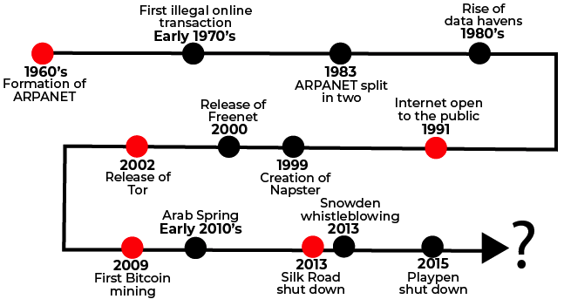
History and STEPS Involved IN CRYPTOCURRENCY
It is method of storing and transmitting data in a particular form so that ony those for whom it is intended can read and process it.
The art and science of concealing the messages to introduce secrecy in information security is recognized as cryptography.
Notes:
Insert a picture illustrating a season in your country.

Slide 6
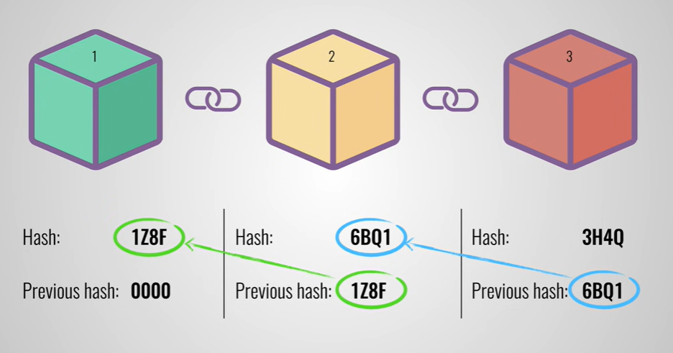
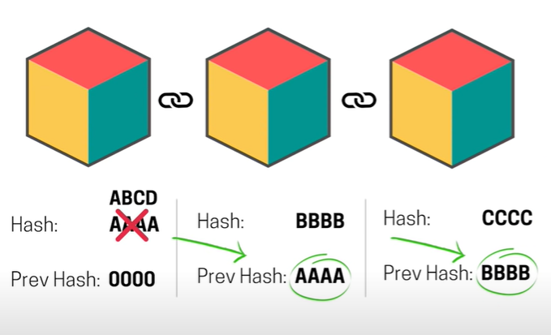
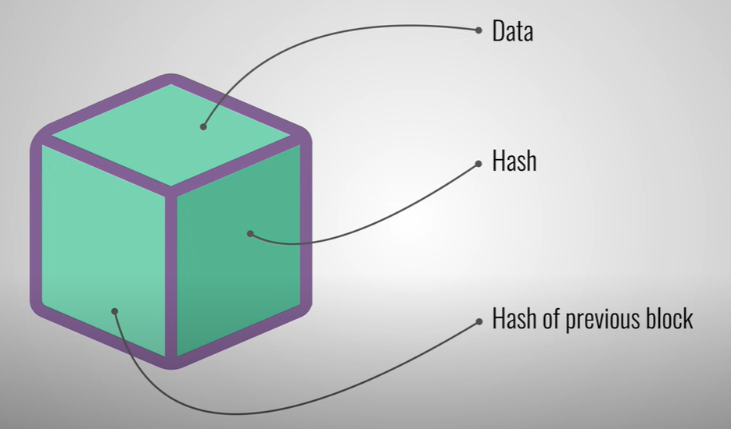
blockchain
Blockchain does not store any of its information in a central location. Instead, the blockchain is copied and spread across a network of computers.
Block structure - The Blockchain comprises a sequence of blocks, which stores the information of all the transactions, similar to a public ledger.
Proof of work : The algorithm is used to confirm the transaction and creates a new block to the chain.
For Bitcoin, this means that transactions are permanently recorded and viewable to anyone.
Notes:
Insert a picture of an animal and or plant found in your country.

Slide 7
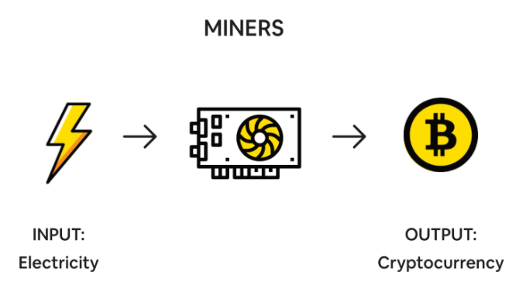
MINING
Mining one can earn cryptocurrency without having to put down money for it.
Bitcoin miners receive Bitcoin as a reward for completing "blocks" of verified transactions which are added to the blockchain.
Let’s take Bitcoin as an example.
Bitcoin is limited and it is 21million in total.
There are currently 18,728,693.75 bitcoins in existence. This number changes about every 10 minutes when new blocks are mined. Right now, each new block adds 6.25 bitcoins into circulation.
Bitcoin mining is the process by which new bitcoins are entered into circulation, but it is also a critical component of the maintenance and development of the blockchain ledger.
The cost to mine 1 BTC is 8206.64$. Meaning its still profitable.
144 blocks per day are mined on average, and there are 6.25 bitcoins per block.

Slide 8
Cryptocurrency in india
What's the government stand on cryptos? The Ministry of Corporate Affairs (MCA) has made it mandatory for companies to disclose crypto trading/investments during the financial year.
What's its legal status in India?
Cryptocurrencies are not illegal in India. Inter-Ministerial Committee (IMC) on November 2, 2017, to study virtual currencies.
The government does not consider cryptocurrencies as legal tender.
Is cryptocurrency taxable currently? Yes
Were cryptocurrencies ever banned in India? The RBI, through a circular in April 2018
However, the Supreme Court in March 2020 overturned RBI's circular, permitting banks to handle cryptocurrency transactions from traders and exchanges.

Slide 9
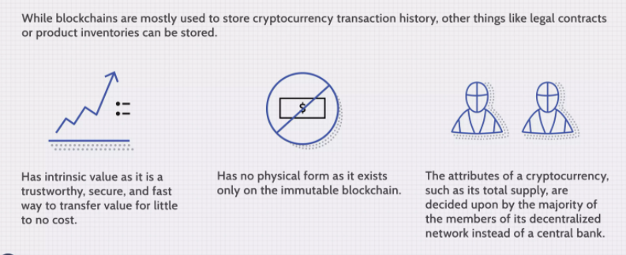
ADVANTAGES OF CRYPTOCURRENCY
Counterfeit ability.
Protection from inflation.
Self-governed and managed.
Secure and private.
Currency exchanges can be done easily.
Decentralized.
Cost-effective mode of transaction.
A fast way to transfer funds.
Notes:
Insert a picture illustrating a custom or tradition here.

Slide 10
Disadvantages OF CRYPTOCURRENCY
Transaction is irreversible.
Regulations.
High volatility and potential for large losses
Can be used for illegal transactions
Data losses can cause financial losses
Decentralized but still operated by some organization.
Some coins not available in other fiat currencies.
Adverse Effects of mining on the environment.
Susceptible to hacks
No refund or cancellation policy
Notes:
Insert a picture of the head leader of your country.

Slide 11
APPLICATIONS
Military applications.
Used by law Enforcement agencies.
Cryptocurrency can be used to encourage ethical business practices.
Cryptocurrencies are also environmentally friendly since they do not require any paper to create notes for the currency.
The cryptocurrency era has opened up new possibilities for game publishers and developers. Some online games have already started transacting with cryptocurrency.

Slide 12
conclusion
Cryptocurrency seems to have moved past the early adoption phase that new technologies experience
The future of blockchain technology is about to take over the world just because of solutions and not because of the availability of conventional technology offered.
Some economic analysts predict a big change in crypto is forthcoming as institutional money enters the market.
It would further add credibility to blockchain and its uses as an alternative to conventional currencies.
People may buy Bitcoins as a safer mode of investment similar to Gold.
Some nations like Iceland have even begun to start their own national cryptocurrencies (Hofman, 2014)

Slide 13
references
https://www.geeksforgeeks.org
https://www.investopedia.com/terms/b/blockchain.asp
https://kite.zerodha.com/
International Research Journal of Engineering and Technology (IRJET)
A Detailed Study on Cryptocurrency (April 2021)
Cryptocurrency, Security Issues and Upcoming Challenges to Legal Framework in India(Jan 2020)
Data Security and Privacy in Bitcoin System: A Survey(July 2020)
Security Of Cryptocurrency Using Hardware Wallet And QR Code(Jan 2019)

Slide 14
THANK YOU

