Slide 1
BUILT ON SOLANA · BUILD IRL VOL. 1 · DUBLIN, 26 SEP 2026
MEDTRACE SCAN
MedTrace
✓
Every medicine pack,
verifiable in 5 seconds
Genuine
Amoxicillin 500 mg Capsules
Sadman Araf · Tarannum Ahammed Noushin
Md Asif Rahman · Mohammad Fahim Haque
DUBLIN CITY UNIVERSITY
Batch AMX2609A
Exp 08/2028
Notes:
0:00–0:10 • Open with the promise: every medicine pack, verifiable in 5 seconds. • One line on who we are: four DCU students who built this weekend on Solana. • Hold up the physical box now — it comes back in the demo.

Slide 2
PROBLEM
In emerging markets, 1 in 10 medicines is fake or substandard, and patients can't tell
1 in 10
250,000+
Chalk
medicines in low- and middle-income countries are substandard or falsified (WHO)
Fake antibiotics and heart, diabetes & cancer drugs made from flour and chalk
medicine shops in Bangladesh — far too many to inspect
IN IRELAND
“Imagine 1 in 10 bottles of Calpol at your local pharmacy were fake.”
Sources: WHO · Bangladesh Pratidin · Dhaka Tribune
02
Notes:
0:10–0:35 • Lead with the WHO number: 1 in 10 in low- and middle-income countries. • Bangladesh scale: 250,000+ shops — no regulator can inspect that. • Make it visceral: antibiotics, heart, diabetes, cancer drugs made of flour and chalk. • Irish bridge: pause on the Calpol line — let the room imagine it.

Slide 3
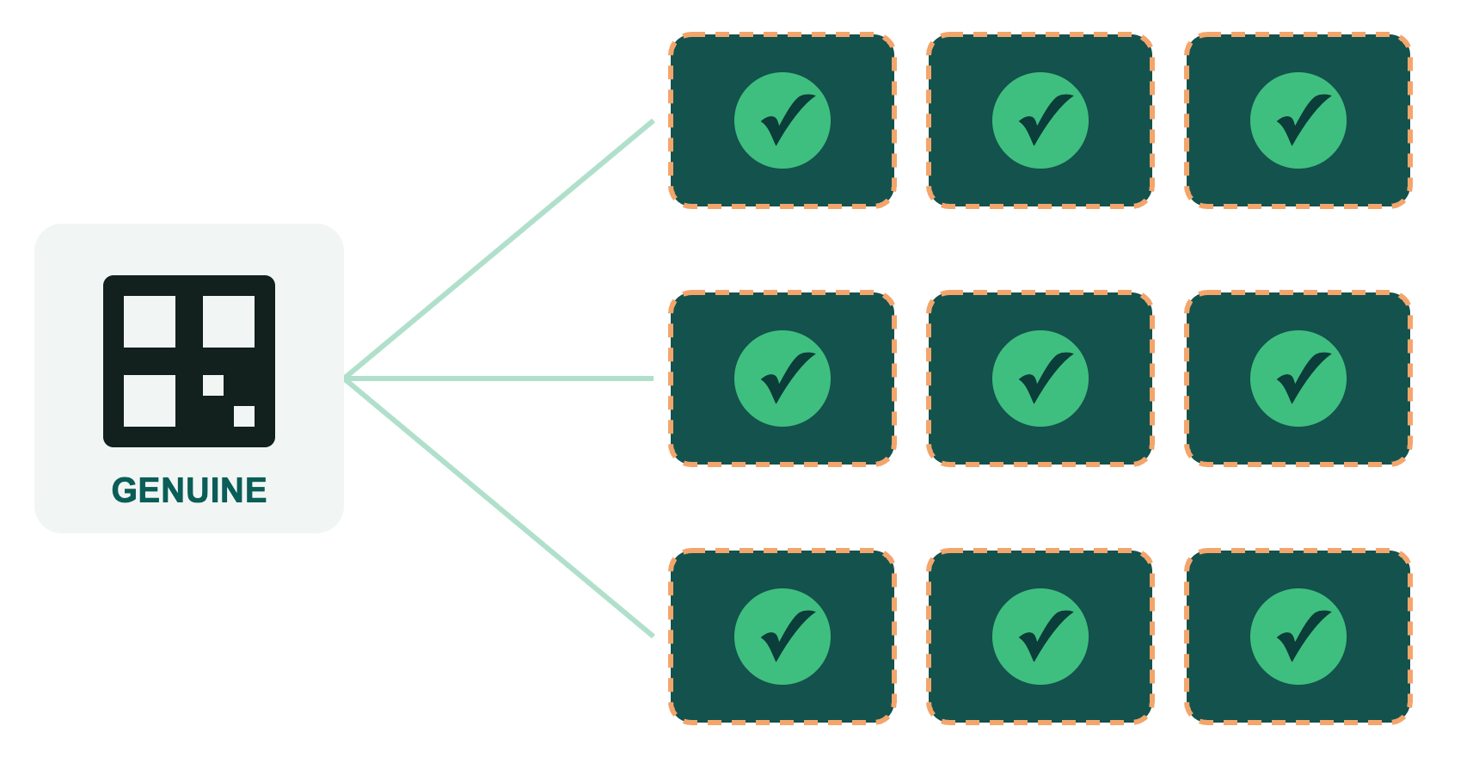
WHY CURRENT FIXES FAIL
Today's QR codes are like a screenshot of a concert ticket: easy to copy, nothing stops the copies
1 genuine QR → 1,000 fake boxes
Photocopied onto every box, each one scans “genuine”.
229+ manufacturers, 229+ silos
No shared record of which pack was already sold.
At the 3Arena, copies bounce
A screenshot gets in once. Medicine codes have no gate.
All verified. All fake.
03
Notes:
0:35–1:00 • Concert-ticket analogy: everyone in the room has seen a screenshot ticket. • The flaw: a QR code proves the code is real, not that this pack is the only one. • One genuine code photocopied 1,000 times = 1,000 “genuine” scans. • 229+ manufacturers each with their own system — no shared memory of what's been sold. • 3Arena: the gate remembers the ticket was used. Medicine has no gate. That's what we built.

Slide 4
SOLUTION
MedTrace adds the gate: every pack can be sold once, so copies get caught
01
02
03 · THE GATE
04
🏭
🚚
🎟️
📱
Register
→
Hand off
→
Dispense
→
Verify
Manufacturer creates the pack's unique identity
Each custody change (distributor → pharmacy) is recorded
Pharmacy sells it once, then it's marked “used”
Patient scans and gets a verdict in 5 seconds
IN IRELAND
Irish pharmacists have scanned and cancelled prescription packs since 2019. MedTrace brings that logic where it doesn't exist.
04
Notes:
1:00–1:25 • Four steps, left to right; the one that matters is step 3 — Dispense. • Once sold, the pack is marked used — exactly like a ticket scanned at the door. • Any later scan of the same code = a copy. • Irish bridge: this isn't a wild idea — Irish pharmacists have done this since 2019. We bring it to markets without the infrastructure.

Slide 5
HOW SOLANA IS INTEGRATED
Solana is the gate no single party controls, because in these markets no one is trusted by everyone
🔑
✍️
🔒
One serial, one record
Only the holder can act
Sold means sold, forever
Duplicates are impossible
Every handoff is signed
Tamper-proof audit trail
ARCHITECTURE
WHY NOT A DATABASE?
Web app
→
Solana program
→
Pack records
Manufacturers, distributors, pharmacies and the regulator don't trust each other — and some counterfeiters are manufacturers.
1 record per box · ≈ €0.0005 per step · ≈ €0.0016 per pack all-in
“Who runs the gate?” In Ireland, trusted institutions do. In Bangladesh, no one is trusted by everyone.
05
Notes:
1:25–1:45 • Three guarantees, each enforced by the Solana program — not by our goodwill. • One serial = one on-chain record, so a second registration fails. • Only the current holder's signature moves the pack; dispense is permanent. • Why not a database: whoever runs it can edit it — and some counterfeiters are licensed manufacturers. • Irish bridge: here, IMVO (the Irish Medicines Verification Organisation) runs the gate. In Bangladesh, no one is trusted by all parties. • Cost: a fraction of a cent per step — details in backup A5.

Slide 6
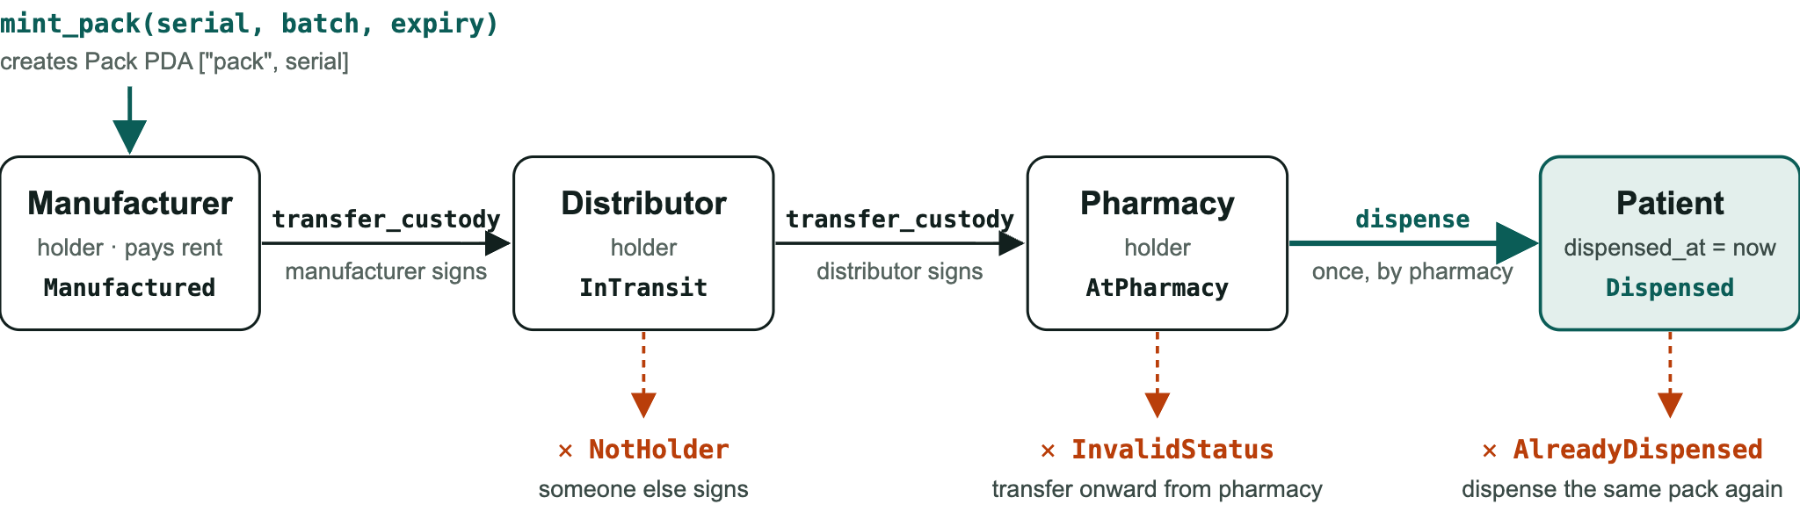
EXECUTION FLOW · ON SOLANA
Each handover is a Solana transaction signed by the holder
ONE-WAY DOOR
dispense is the only way into Dispensed, and nothing leaves it. That's the wall a copied QR code hits.
Red paths are rejected by the program itself. No server or admin can override them.
06
Notes:
1:45–2:00 • Left to right: mint_pack creates one on-chain record per serial (PDA ["pack", serial]). • transfer_custody moves one hop at a time, and only the current holder can sign it. • dispense happens once, by the pharmacy, and stamps dispensed_at. • Red paths: wrong signer, a pharmacy passing stock onward, or dispensing twice are all rejected by the program itself. No admin override exists. • Hand-off line: “Now let me show you that in the live app.”

Slide 7

LIVE DEMO
The genuine pack gets in, the photocopy bounces
Register
→
Hand off
→
Dispense
→
Scan genuine ✓
→
Scan clone ✕
✓
On-chain proof
✕
explorer.solana.com/tx/[signature]?cluster=devnet
Prop
Genuine
Already used
Physical box carrying the photocopied QR
Amoxicillin 500 mg
Batch AMX2609A · Exp 08/2028
Copied code: sold earlier
Backup
Recorded demo video [link]
Phone mockups are placeholders — swap in live screenshots
07
Notes:
2:00–2:30 • Switch to the live app. Narrate while clicking: register → hand off → dispense. • Scan the genuine pack: green, batch and expiry shown. • Pick up the photocopied box, scan it: red — “Already used. Copied code: sold earlier.” • Point at the Explorer link: this is a real Solana transaction, not a mock. • If Wi-Fi fails: play the recorded video, keep narrating.

Slide 8
BUSINESS MODEL
Manufacturers pay per pack to protect their brand. Patients and pharmacies verify for free.
PAYS
FREE
FREE
PARTNER
💊 Manufacturers
🏪 Pharmacies
👤 Patients
🏛 Regulator
Protect revenue, brand, exports
Prove clean stock
5-second check
Counterfeit hotspot data
①
Per-pack fee
②
Brand-protection analytics (SaaS)
③
Regulator / donor programmes
IN IRELAND Like ticketing: the promoter pays for the gate, not the fan.
Target fee ≈ €0.007 per pack (~1% of a €0.70 antibiotic pack) vs ≈ €0.0016 cost. To validate in the pilot
08
Notes:
2:30–2:47 • Who pays: the party that loses money to fakes — the manufacturer. • Everyone else verifies free, which drives adoption and data. • Three streams: per-pack fee, brand-protection analytics, regulator/donor programmes. • Ticketing analogy: promoter pays for the gate, not the fan. • Be upfront: pricing is an assumption we'll validate in the pilot.

Slide 9
GO-TO-MARKET & SCALE
Start with one antibiotic in one district, then scale to every market without a gate
0–6 MO
6–18 MO
18–36 MO
36 MO +
Pilot
Regulator
National
Regional
›
›
›
1 manufacturer · 1 antibiotic · 1 district
Regulator-approved manufacturer registry
Top 20–25 manufacturers + SMS checks for basic phones
South Asia & Sub-Saharan Africa
WHY WE WIN
Network effect
·
A gate no one owns
·
Counterfeit-hotspot data
Timelines indicative · Sadman Araf · Tarannum Ahammed Noushin · Md Asif Rahman · Mohammad Fahim Haque · DCU
09
Notes:
2:47–2:52 • Small, winnable start: one manufacturer, one antibiotic, one district, then regulator → national → regional. • Why we win in one breath: network effect, a gate no one owns, hotspot data.

Slide 10
TO THE JUDGES
A real problem, a proven fix, and a working build
REAL HARM
PROVEN FIX
WORKING BUILD
1 in 10
Since 2019
Live
medicines in low- and middle-income countries is substandard or falsified (WHO). In Bangladesh, ~€172 M of fakes are in circulation at any time.
Irish pharmacists cancel each prescription pack when they dispense it. The logic works. Emerging markets lack a neutral gate to run it.
mint, transfer and dispense run on Solana devnet. The program itself rejects copies, at ~€0.0016 per pack.
Every medicine pack,
verifiable in 5 seconds.
Thank you
Sadman Araf · Tarannum Ahammed Noushin · Md Asif Rahman · Mohammad Fahim Haque · DCU
10
Notes:
2:52–3:00 • “Judges: this is a real problem — 1 in 10 medicines, and patients can't tell.” • “The fix is proven — Ireland does it today — and we built the neutral gate that makes it work where no one is trusted by everyone.” • Close: “Every medicine pack, verifiable in 5 seconds. Thank you.” • Leave this slide up during Q&A; jump to the appendix as questions come.

Slide 11
BACKUP · Q&A ONLY
Appendix
A1 Why blockchain · A2 Clone detection · A3 Risks · A4 Regulatory fit
A5 Cost at scale · A6 Business model detail · A7 Sources · A8 “Isn't this what Europe does?”
A9 Architecture: who talks to what
Notes:
Jump here only for Q&A. Map questions to slides: • “Why not a database?” → A1 • “How do you catch clones?” → A2 • “What can't it do?” → A3 • “Is this legal / crypto?” → A4 • “What does it cost?” → A5 • “Why would manufacturers pay?” → A6 • “Isn't this what Europe does?” → A8 • “How is it built? Where are the keys?” → A9

Slide 12
A1 · BACKUP
Why blockchain, not a database?
Question | Central database | MedTrace on Solana
Who controls it? | One operator everyone must trust | No single party; rules live in the program
Can history be edited? | Yes, by whoever holds admin | No — signed, append-only trail
Duplicate serials? | Blocked only if the operator is honest | Impossible: one record per serial
229+ manufacturers | 229 apps or 229 integrations | One neutral, shared record
Regulator access | On request from the operator | Read the audit trail any time
Bottom line: multi-party, low-trust — the one setting where a neutral ledger beats a database.
A1
Notes:
• Concede: if one trusted body existed, a database would do — that's Europe (A8). • In Bangladesh that body doesn't exist and some counterfeiters are licensed manufacturers. • The chain is the neutral referee; nobody can quietly un-dispense a pack.

Slide 13
A2 · BACKUP
What the patient sees: one function, five verdicts
# | Check on scan of /verify/SQ-000123 | Verdict
1 | No pack account for this serial | ✕ Unknown: never registered
2 | Dispensed ≤ 10 min ago | ✓ Genuine: the patient's own purchase
3 | Dispensed more than 10 min ago | ✕ Already used: copied code, sold earlier
4 | Not dispensed, scanned at a pharmacy ≠ holder | ! Other pharmacy: belongs to other stock
5 | Not dispensed, at the holder or no pharmacy | ✓ Genuine: registered, in supply chain
Rules live in one pure function, computeVerdict(). A network error shows “Network busy, retry”, never “fake”.
A2
Notes:
• Checks run top to bottom: exists → dispensed → within 10 min → which pharmacy. • The 10-minute window lets the buyer confirm their own pack; a photocopy scanned later lands on “Already used”. • “Other pharmacy” flags diverted stock (pack scanned at a shop that doesn't hold it). • A network error never shows “fake”, so we don't scare patients with false alarms.

Slide 14
A3 · BACKUP
Out of scope and risks, stated plainly
Risk | Response
Substandard-but-genuine drugs | Out of scope: we prove origin, not quality. Pair with regulator lab testing
Unserialized stock | Phase in by product, starting with one antibiotic
Adoption | Lead with manufacturers' brand pain; regulator registry follows
Basic phones | SMS verification in the national phase
Label reuse | Dispensed stays dispensed, so reused labels scan as used. Tamper-evident seal from the national phase (~€0.003/pack, est.)
A3
Notes:
• Naming limits builds credibility — lead with “we don't test chemistry”. • Label reuse: an empty genuine box refilled with fakes still scans as “already dispensed” after first sale.

Slide 15
A4 · BACKUP
Regulatory fit: a records system, not a crypto product
Non-payment use
No tokens
Policy direction
The chain stores custody records. No money moves on-chain between users.
No token issued or sold. Customers pay in local currency; MedTrace covers network fees.
The ICT Division's National Blockchain Strategy names health among the sectors it targets for blockchain.
A4
Notes:
• Crypto trading is restricted in Bangladesh — stress: no tokens, no payments, records only. • Bangladesh Bank has repeatedly warned against crypto trading. We touch none of that: no token, no wallet for patients. • DGDA (Directorate General of Drug Administration) is the partner in the regulator phase.

Slide 16
A5 · BACKUP
Cost at scale: about €0.0016 per pack, all-in
Cost item | How it works | Per pack (est.)
Transaction fees | 5,000 lamports (≈ €0.0005) per signature. Register per lot, hand off per carton (GS1 aggregation), dispense per pack: ~1.1 tx per pack | ≈ €0.0006
Standard record | ~150-byte account needs a ≈ 0.0019 SOL deposit, returned when closed after expiry. Pilot only | ≈ €0.20 deposit (refundable)
Compressed record | ZK-compressed state from the national phase: no rent deposit per pack (≈ 0.00001 SOL) | ≈ €0.0010
NATIONAL PHASE
VS. REVENUE AT €0.007/PACK
500 M packs/yr × €0.0016 ≈ €0.8 M/yr
≈ €3.4 M/yr → ~77% gross margin
Estimates: SOL ≈ €103 ($120) · $1 = Tk 125 · €1 = Tk 145 · 500 M = high-risk categories, top 20–25 manufacturers
A5
Notes:
• Scanning to verify is a read — free, no transaction. • Fee math: 5,000 lamports = 0.000005 SOL ≈ €0.0005 per signature at SOL ≈ €103. Priority fees add a little under congestion; still a fraction of a cent. • Per pack: 1.1 tx × €0.0005 ≈ €0.0006, plus compressed record ≈ €0.0010 → ≈ €0.0016 (≈ Tk 0.23). • Standard account rent: (128 + ~150 bytes) × 6,960 lamports ≈ 1.9 M lamports ≈ 0.0019 SOL ≈ €0.20. A deposit, not a cost, but too much capital to lock at scale, so we compress. • Records stay until expiry + grace so clones keep bouncing; then they close and the deposit comes back. • Margin: 1 − €0.0016 / €0.0069 ≈ 77%. If SOL doubles, cost ≈ €0.0032, still under half the fee.

Slide 17
A6 · BACKUP
Business model detail: manufacturers adopt first
Pricing tiers (targets)
Why manufacturers pay first
Tier | Price
Pilot: 1 SKU, 1 district, 6 mo | Free (grant-funded)
Standard, per pack | €0.007
Volume, 50 M+ packs/yr | €0.004 per pack
Analytics SaaS | €10k/yr per manufacturer
Regulator / donor programme | €130–260k each
~€172 M of counterfeit medicine in circulation at any time (Daily Star)
Export markets increasingly expect serialization
Hotspot data shows where their brands are copied
Prices are targets, to validate in the pilot · €1 = Tk 145
A6
Notes:
• Customer = manufacturer; users = pharmacies and patients (free); partner = DGDA (the regulator). • Unit economics: ~€0.0016 cost per pack vs €0.007 fee (see A5). • Illustrative national phase: 500 M packs × €0.007 ≈ €3.4 M/yr, plus SaaS from ~25 manufacturers × €10k ≈ €0.26 M. • Anchor the price to lost revenue: Tk 25,000 M of fakes ≈ €172 M.

Slide 18
A7 · BACKUP
Sources
WHO (2017). Study on the public health and socioeconomic impact of substandard and falsified medical products: 1 in 10 in LMICs
The Daily Star (27 Feb 2022). “Countering counterfeit medicine in Bangladesh”: ~Tk 25,000 M (≈ €172 M) in circulation
Dhaka Tribune (30 Apr 2024). “Devil in disguise: Health concerns mount over rising tide of fake medicines”
Bangladesh Pratidin (20 Dec 2025). “Market flooded with counterfeit medicines”
New Age. “Counterfeit medicines flood markets across Bangladesh”
ICT Division, Bangladesh. National Blockchain Strategy: Bangladesh
HPRA (24 Mar 2026). “Over 750,000 units of illegal medicines detained by the HPRA in 2025”
GS1. General Specifications: GTIN + serial number, SSCC aggregation
Market data: SOL ≈ $120 ≈ €103 (25 Sep 2026) · $1 = Tk 125 · €1 = Tk 145
A7
Notes:
• Before presenting, check which article the 250,000+ shops, 229+ manufacturers and flour-and-chalk figures come from.

Slide 19
A8 · BACKUP
“Isn't this what Europe does?” Yes, deliberately.
 | Europe (Falsified Medicines Directive) | MedTrace
Core logic | Unique ID per pack, cancelled at dispense | Same
What made it work | An EU law | Manufacturer demand first, regulator next
Who runs the record | Central hub + national systems (IMVO in Ireland) | A Solana program — no hub operator
Needs | An institution everyone trusts | No trusted institution required
Ireland isn't immune: the HPRA detained 763,027 units of illegal medicines in 2025. Sedatives made up 27%.
A8
Notes:
• Own it: “We copied the logic that works in Ireland on purpose.” • Difference: Europe needed a law and a central hub; MedTrace replaces the hub with a neutral chain. • Only cite the HPRA seizure figure if asked about Ireland.

Slide 20
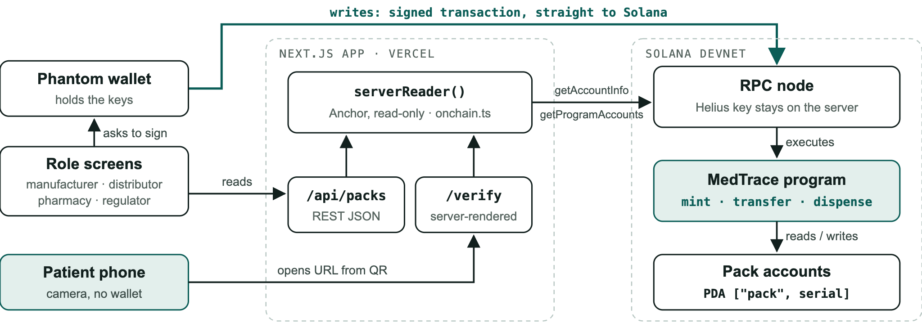
A9 · BACKUP
Who talks to what: keys never touch the server
Mock mode: serverReader() swaps to an in-memory store with the same rules; nothing else changes
A9
Notes:
• Writes: signed in Phantom and sent straight to Solana. Our server never holds a private key. • Reads: the API and the verify page share one reader (serverReader) over the RPC node; the Helius key stays server-side. • Patients need no wallet, just the phone camera and a URL. • Mock mode keeps the demo alive offline with identical rules.

