Slide 1
String primitives String objects RegEx
By Taras Dyda

Slide 2
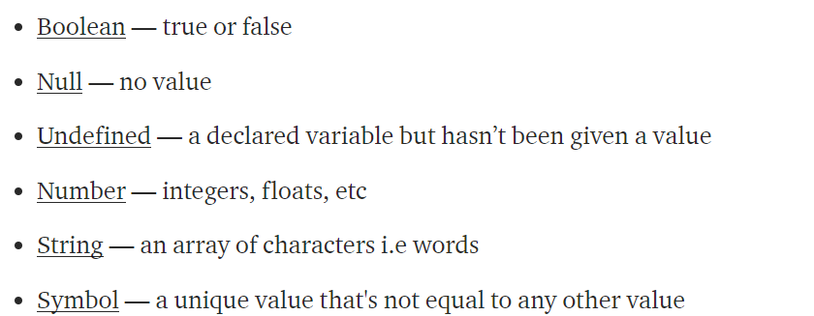
Primitive TYPES
There are 6 primitive types. A primitive is not an object and has no methods of its own.

Slide 3
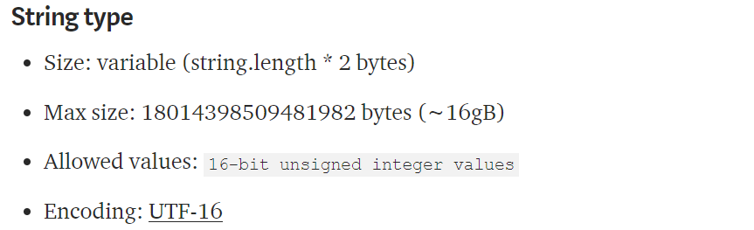
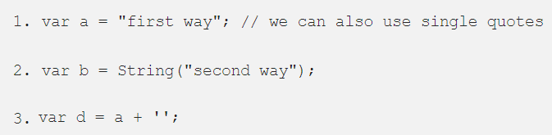
STRING PRiMITIVES
JavaScript’s string type is used to represent textual data. It is a set of "elements" of 16-bit unsigned integer values each treated as a UTF-16 code value.

Slide 4
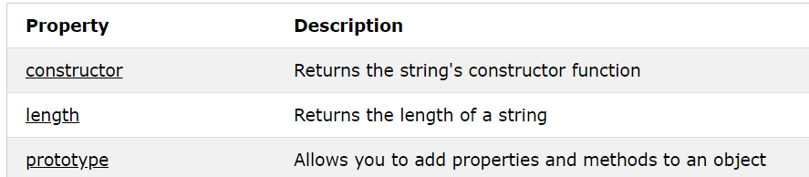
STRING objects
The String object lets you work with a series of characters; it wraps Javascript's string primitive data type with a number of helper methods.
As JavaScript automatically converts between string primitives and String objects, you can call any of the helper methods of the String object on a string primitive.

Slide 5
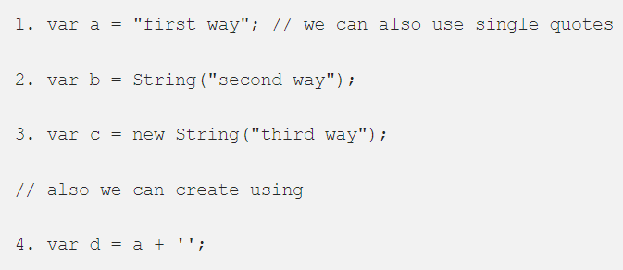
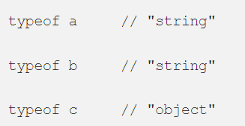
Distinction between string primitives and String objects
The 1 and 2 will create primitive string , where as 3 will create a String object. But we can call all the string methods on the primitive string created from 1 and 2 , when we call one of the String object method on primitive String the browser will automatically convert the primitive string into string object .

Slide 6
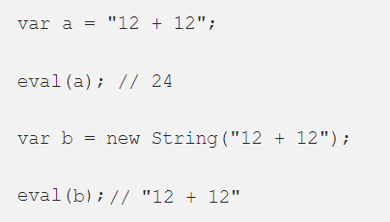
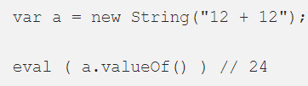
Distinction between string primitives and String objects
String primitives and String objects also give different results when using eval().
Primitives passed to eval are treated as source code
String objects are treated like other objects, and it returns the object

Slide 7
STRING METHODS
Method | Description
charAt() | Returns the character at the specified index (position)
charCodeAt() | Returns the Unicode of the character at the specified index
Includes() | Checks whether a string contains the specified string/characters
indexOf() | Returns the position of the first found occurrence of a specified value in a string
replace() | Searches a string for a specified value, or a regular expression, and returns a new string where the specified values are replaced
split() | Splits a string into an array of substrings
substring() | Extracts the characters from a string, between two specified indices
toUpperCase() | Converts a string to uppercase letters
toLowerCase() | Converts a string to lowercase letters
valueOf() | Returns the primitive value of a String object

Slide 8


RegEx
A regular expression is a sequence of characters that forms a search pattern.
When you search for data in a text, you can use this search pattern to describe what you are searching for.
A regular expression can be a single character, or a more complicated pattern.

Slide 9
Advanced searching
Character | Meaning
\d | Matches a digit character
\w | Matches any alphanumeric character from the basic Latin alphabet, including the underscore
\s | Matches a single character other than white space
\t | Matches a horizontal tab
\n | Matches a linefeed
[abcd]/[a-d] | Matches any one of the enclosed characters
[^abcd]/[^a-d] | That is, it matches anything that is not enclosed in the brackets
{n} | amount of repetitions
a|b | Matches either a or b
$ | Matches end of input

Slide 10

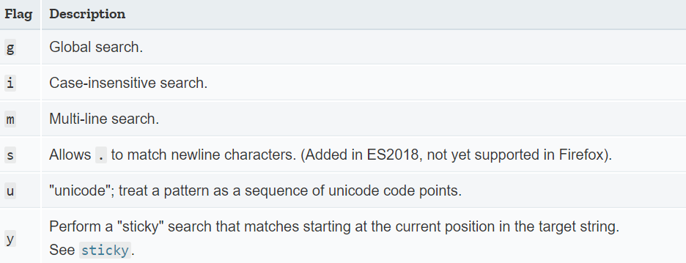
RegEx syntax

Slide 11
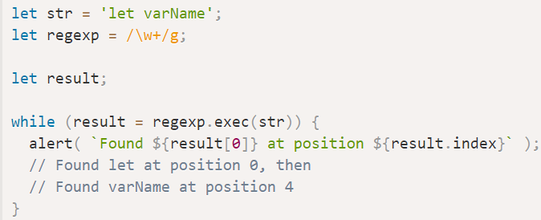
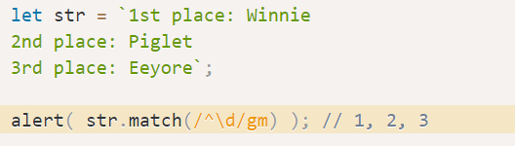
Examples

Slide 12
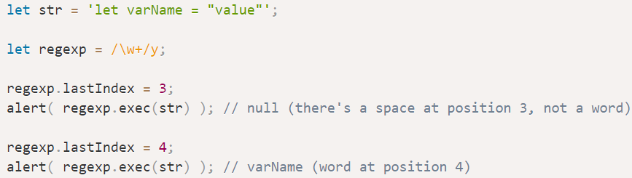
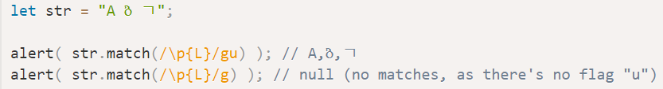
Examples

Slide 13
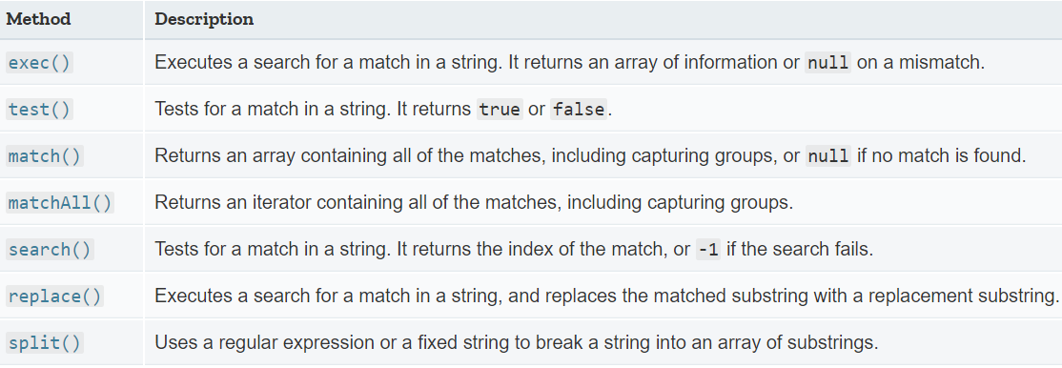
Methods that use regular expressions

Slide 14
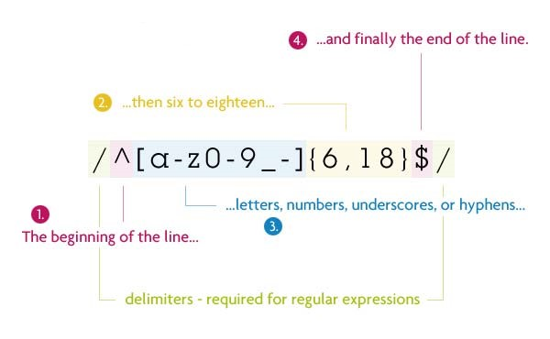
Example of usage

Slide 15
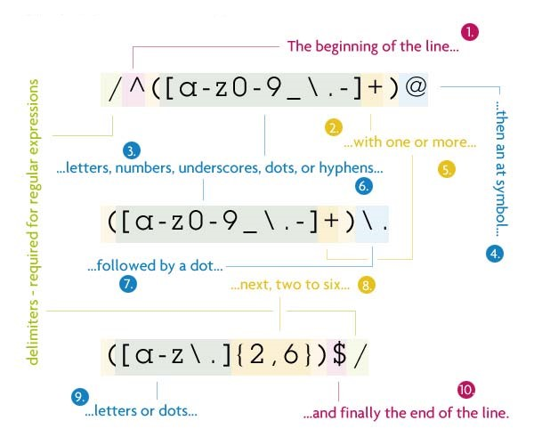
Example of usage

Slide 16

references
1) https://codeburst.io/javascript-essentials-types-data-structures-3ac039f9877b
2) https://medium.com/front-end-weekly/difference-between-string-primitives-and-string-object-d962b7ab8496
3)https://developer.mozilla.org/uk/docs/Web/JavaScript/Reference/Global_Objects/RegExp

Slide 17


