Slide 1
Render Prop Children Pass-Throught
By Taras Dyda

Slide 2

Render prop
Render prop is a function prop that a component uses to know what to render.
Components are the primary unit of code reuse in React, but it’s not always obvious how to share the state or behavior that one component encapsulates to other components that need that same state.

Slide 3
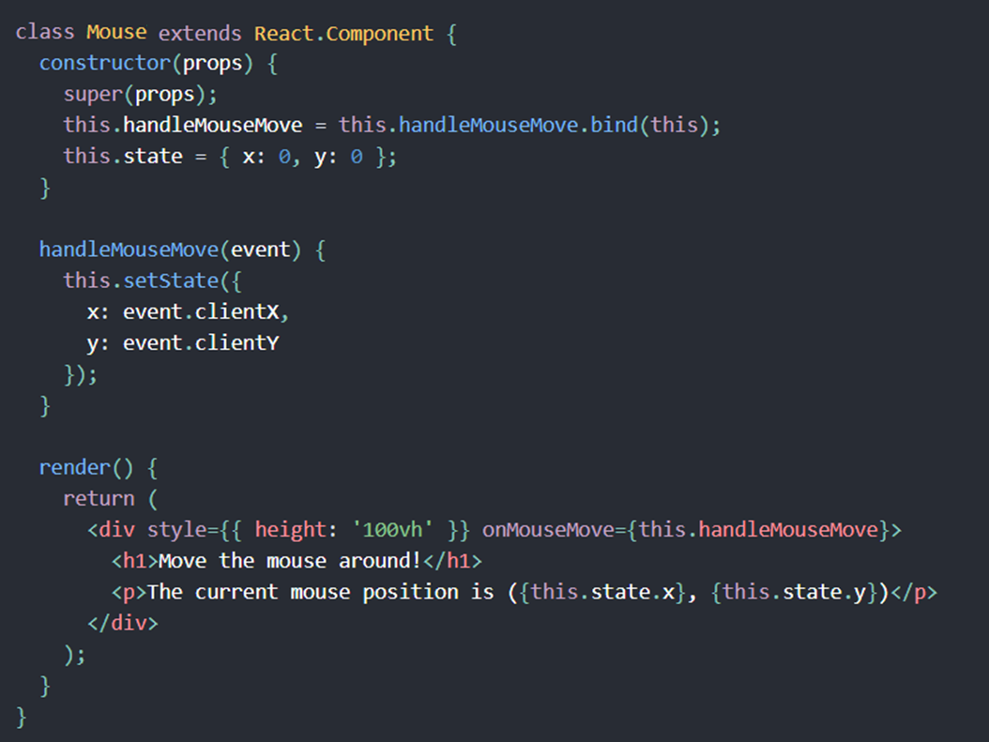
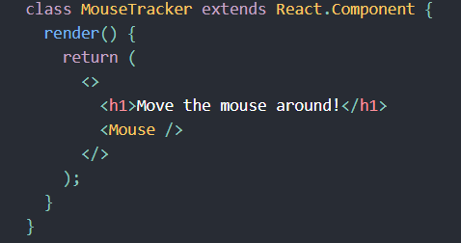
EXample

Slide 4
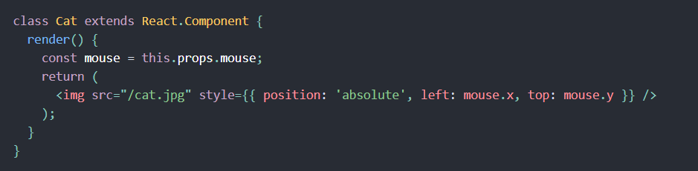
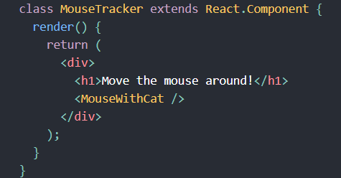
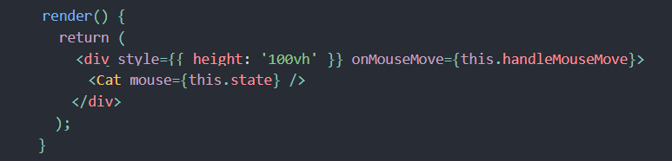
How to reuse?

Slide 5
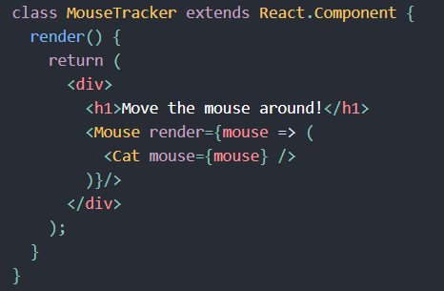
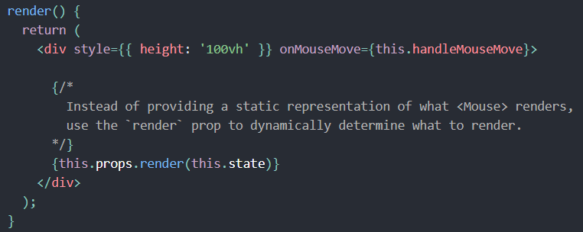
How to use render props?

Slide 6
Benefits of render props
Now, instead of effectively cloning the <Mouse> component and hard-coding something else in its render method to solve for a specific use case, we provide a render prop that <Mouse> can use to dynamically determine what it renders.

Slide 7

Using Props Other Than Render
It’s important to remember that just because the pattern is called “render props” you don’t have to use a prop named render to use this pattern

Slide 8
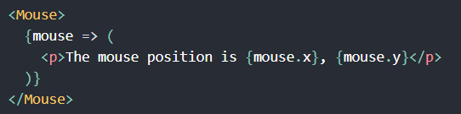
Name is not required
Prop doesn’t actually need to be named in the list of “attributes” in your JSX element. Instead, you can put it directly inside the element!

Slide 9

Children pass-through
JSX elements can be nested, like HTML elements. In React, children elements are accessible via the children props in each component

Slide 10
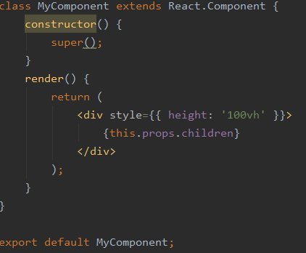
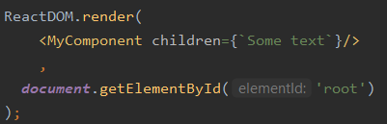
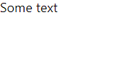
Props.children

Slide 11
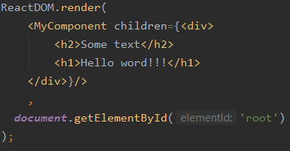

ADD TAGS

Slide 12
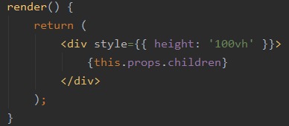
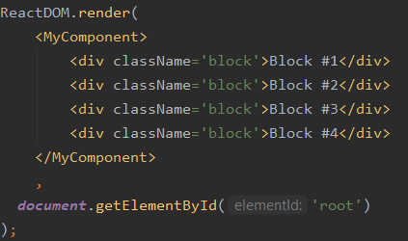

ADD TAGS

Slide 13
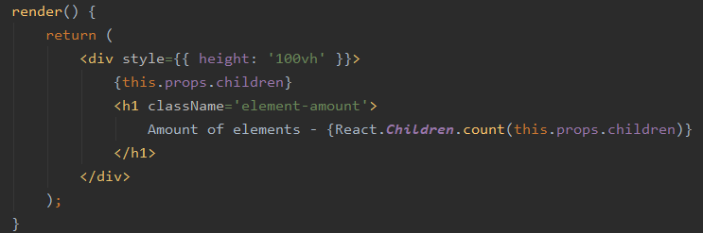
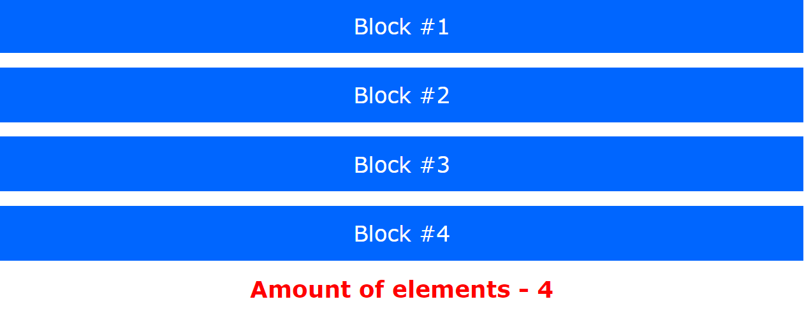
TAGS COUNTING

Slide 14
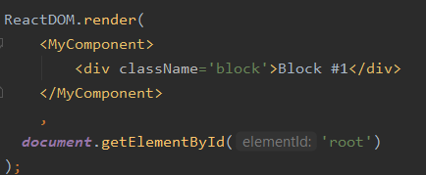
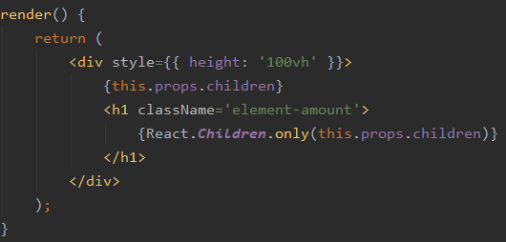

only

Slide 15
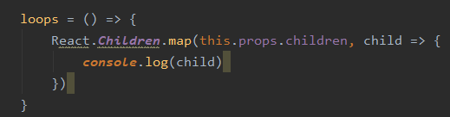
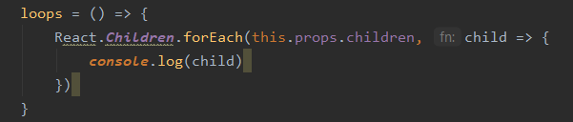
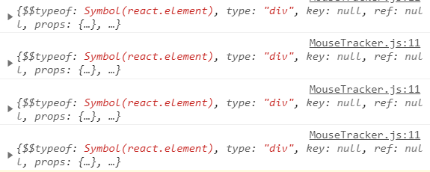
Map, foreach

Slide 16

references
https://reactjs.org/docs/render-props.html
https://uk.reactjs.org/docs/react-api.html
https://reactpatterns.com/#children-pass-through

Slide 17
THANKS FOR ATTENTION
Any questions?

Slide 18


