Slide 1
Concurrency model and Event Loop, Callbacks
By Taras Dyda

Slide 2
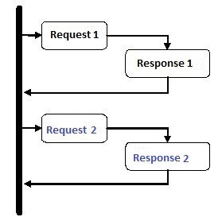
SYNCHRONOUS programMing
In a synchronous programming model, things happen one at a time. When you call a function that performs a long-running action, it returns only when the action has finished and it can return the result. This stops your program for the time the action takes.

Slide 3
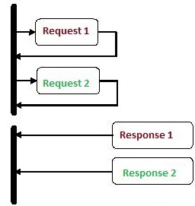
asynchronous model
An asynchronous model allows multiple things to happen at the same time. When you start an action, your program continues to run. When the action finishes, the program is informed and gets access to the result (for example, the data read from disk).

Slide 4
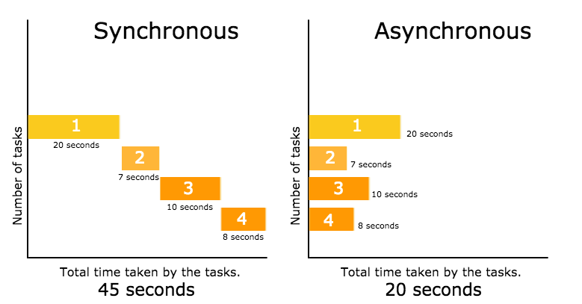
SYNCHRONOUS AND Asynchronous

Slide 5
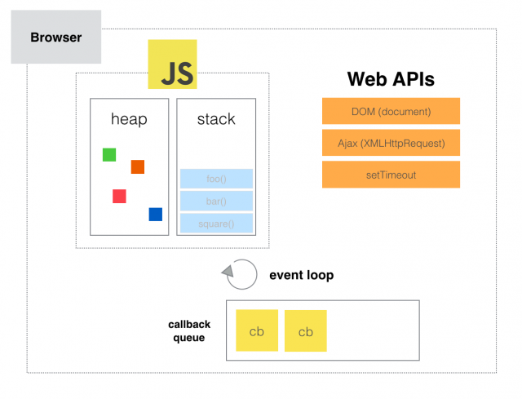
Concurrency Model and Event Loop
Javascript runtime is single threaded which means that it can execute one piece of code at a time. In order to understand the concurrency model and the event loop in Javascript we have to first get to know some common terms that are associated with it.

Slide 6
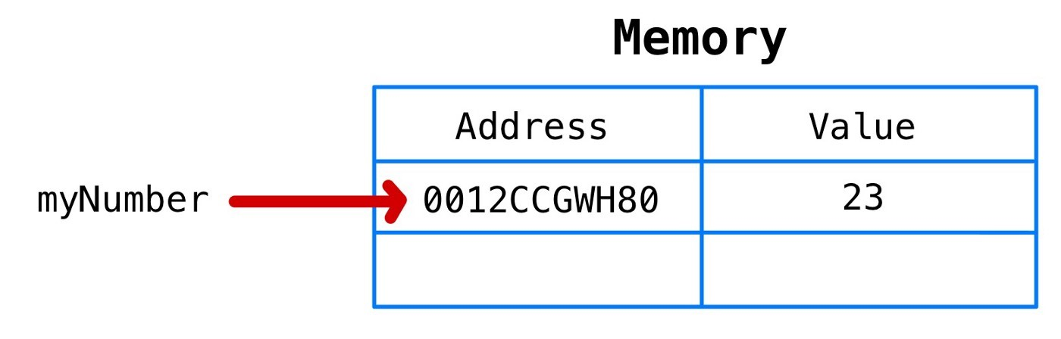
Memory Heap
Heap is the place (memory) where objects are stored when we define variables.

Slide 7
call stack
A call stack is a simple data structure that records where in the code we are currently. So if we step into a function that is a function invocation it is pushed to the call stack. When we return from a function it is popped out of the stack.
First when the code executes the runtime will read through each of the function definitions. But when it reaches the line where the first function is invoked it will push this function into the call stack.

Slide 8
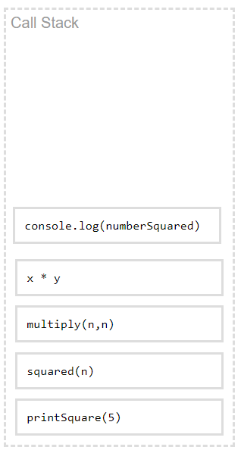
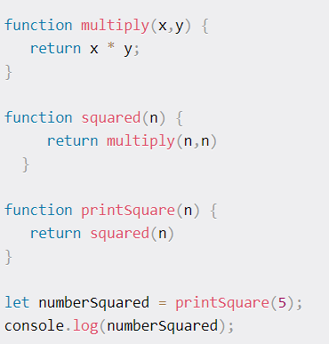


call stack - example

Slide 9
Web API
Browsers have defined API’s which developers can be used to make complex processes such as to get location of visitor. List of web APIs
Audio
Application cache
Canvas
Geolocation
Local storage
Notifications
Video
Web database

Slide 10
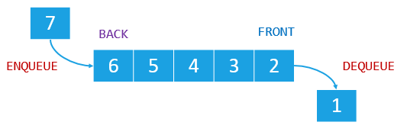
Callback Queue
When a process finished its job, such as a xhr call, it’s dropped in a callback queue. Callback queue is triggered by event loop process after our stack is empty which means the process waits in that queue until our stack is empty. Once our stack has no function call, then a process is popped-out from callback queue and pushed in to stack.

Slide 11
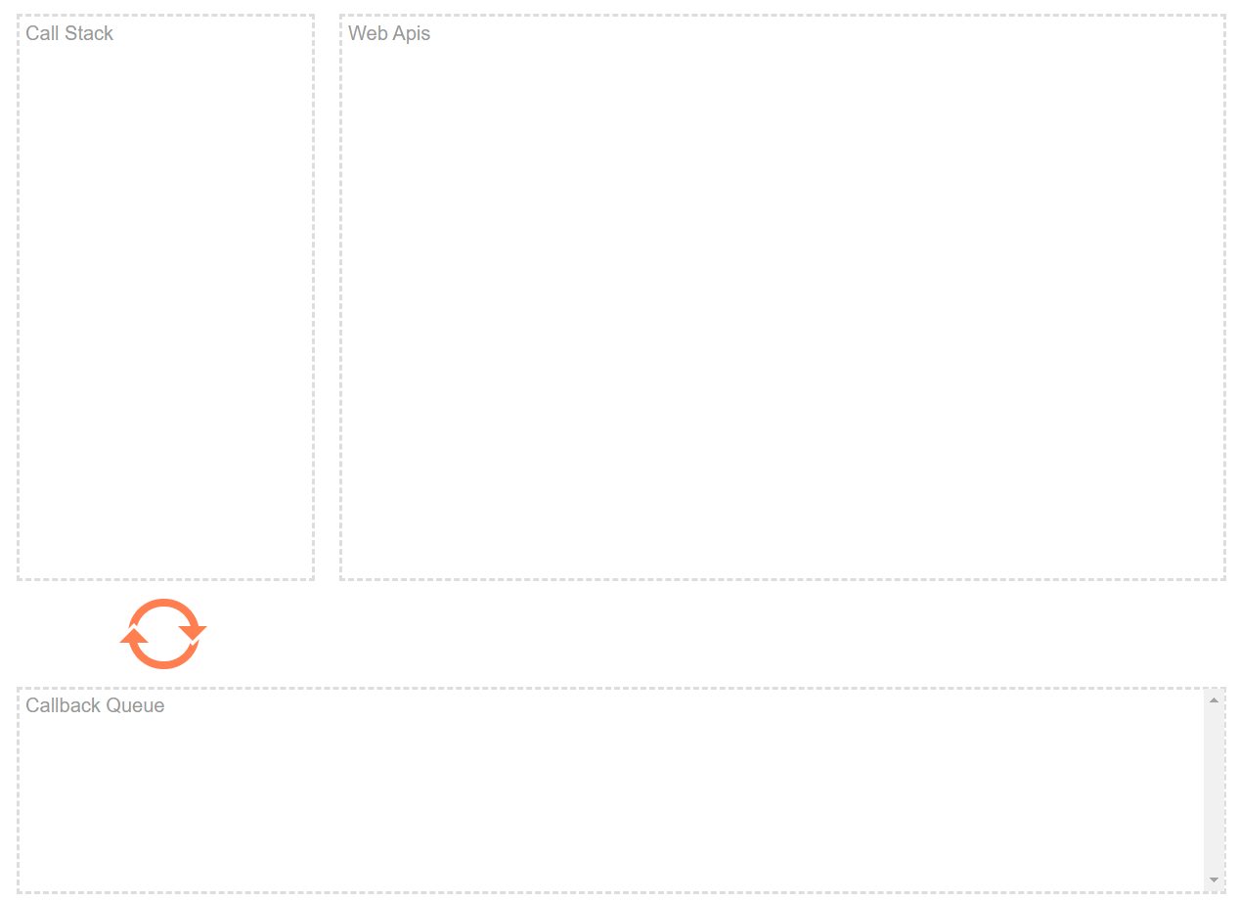

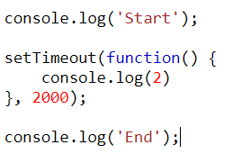






EXAMPLE

Slide 12
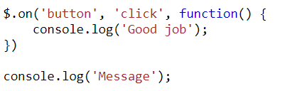





EXAMPLE

Slide 13
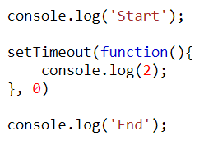






qUIZ

Slide 14
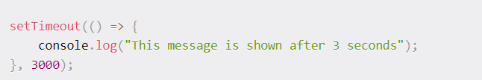
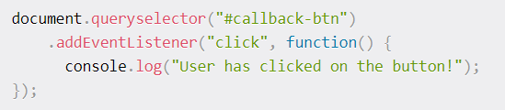
What is a callback?
Callback function – is a function that can be passed as parameter to another function and called inside the outer function.

Slide 15
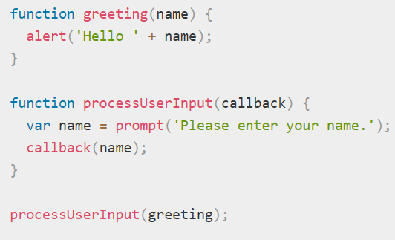
Why do we need Callback Functions?
Callbacks make sure that a function is not going to run before a task is completed but will run right after the task has completed. It helps us develop asynchronous JavaScript code and keeps us safe from problems and errors.

Slide 16
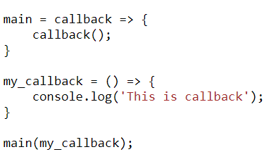
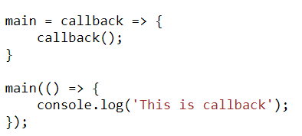

Some rules

Slide 17
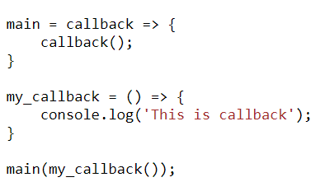
It is Important!!
//TypeError: callback is not a function

Slide 18
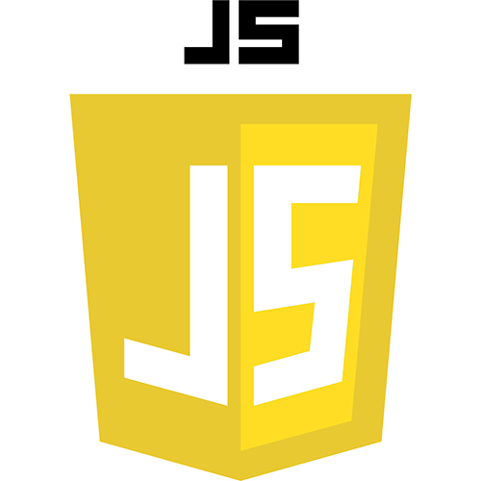
references
1)https://www.freecodecamp.org/news/javascript-concurrency-model-and-event-loop/
2) https://medium.com/@ethannam/javascripts-memory-model-7c972cd2c239
3)https://medium.com/javascript-in-plain-english/understanding-javascript-heap-stack-event-loops-and-callback-queue-6fdec3cfe32e

Slide 19
