Slide 1
WELCOME TO THE FUTURE
By Taras Dyda

Slide 2
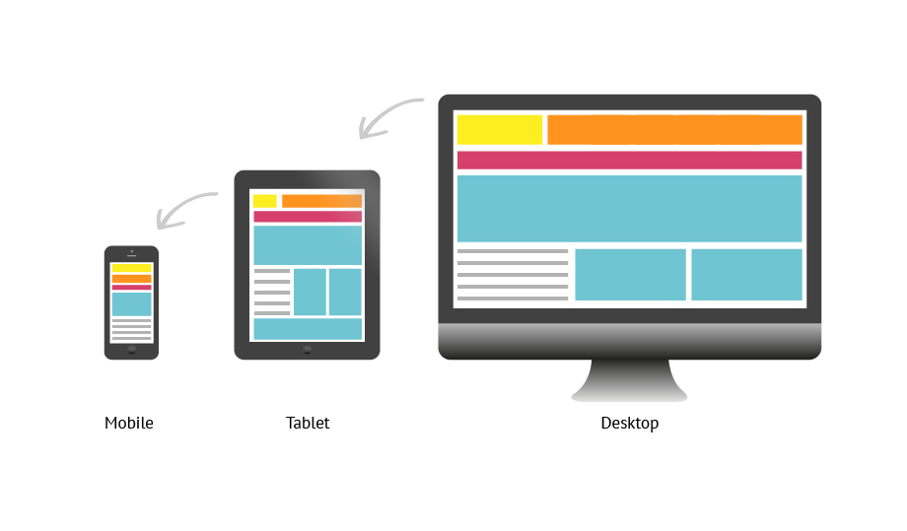
Responsive/adaptive web design
What is it?
Difference between responsive and adaptive
Media queries
Bootstrap 4 grid system
Mobile first
Fixed and fluid

Slide 3
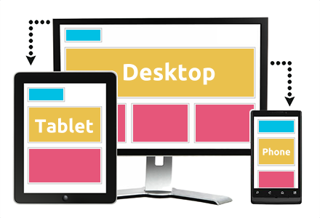
What is Responsive Web Design?
Responsive Web design is the approach that suggests that design and development should respond to the user’s behavior and environment based on screen size, platform and orientation.

Slide 4
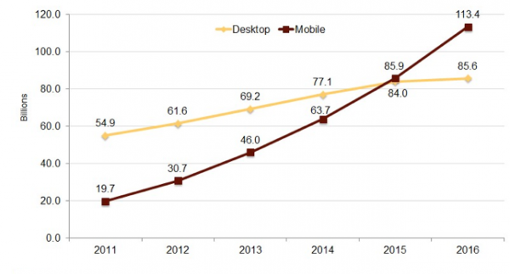
Advantages of responsive design
Faster mobile development
Cheaper
Lower maintenance needs
Easier analytics reporting

Slide 5
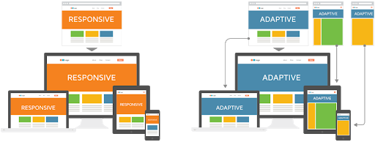
Adaptive and Responsive

Slide 6
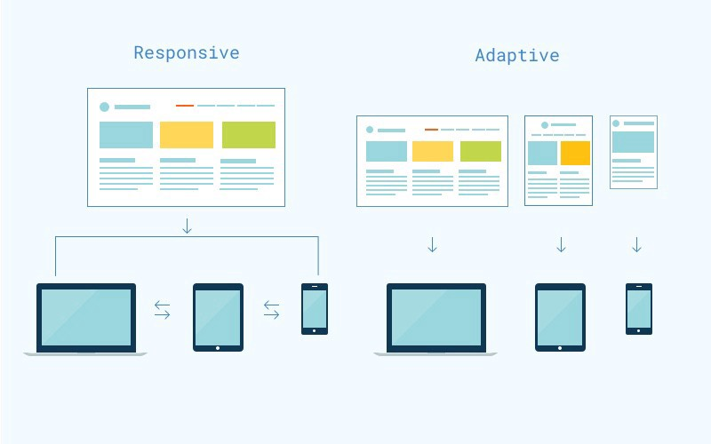
Responsive VS Adaptive
Adaptive web design uses distinct layouts for multiple screen sizes, the layout largely depends on the screen size being used so with each of these sizes in mind a layout would have to be designed for it.
Responsive web design adapts to the size of the screen no matter what the target device screen size is. The layout is ‘fluid’ and uses CSS media to change styles, this ‘fluid’ grid enables the page to resize its width and height to adapt to different screen sizes and show correctly.

Slide 7
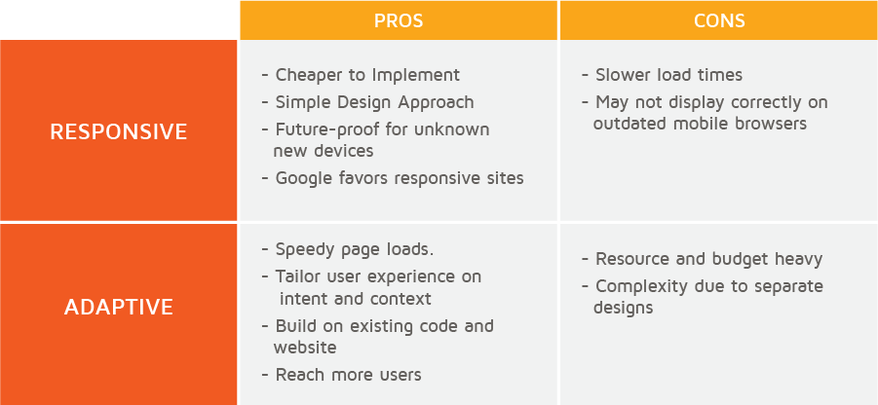
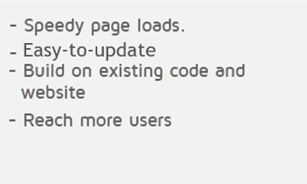
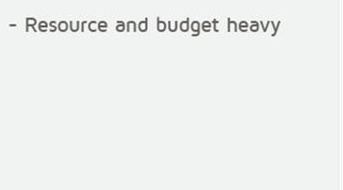
Pros and cons

Slide 8
Responsive
Adaptive
<head> <meta charset="UTF-8" /> <title>Title</title> <link href="css/adapt/mobile.min.css" rel="stylesheet" media="(min-width: 0px) AND (max-width: 760px)"> <link href="css/adapt/720.css" rel="stylesheet" media="(min-width: 760px) AND (max-width: 980px)"> <link href="css/adapt/960.css" rel="stylesheet" media="(min-width: 980px) AND (max-width: 1280px)"> <link href="css/adapt/1200.css" rel="stylesheet" media="(min-width: 1280px) AND (max-width: 1600px)"> <link href="css/adapt/1560.css" rel="stylesheet" media="(min-width: 1600px) AND (max-width: 1940x)"> <link href="css/adapt/1920.css" rel="stylesheet" media="(min-width: 1940px) AND (max-width: 2540px)"> <link href="css/adapt/2520.css" rel="stylesheet" media="(min-width: 2540px)"> </head>
<head> <meta charset="UTF-8" /> <title>Title</title> <link href="css/responsive.css" rel="stylesheet"> </head>

Slide 9
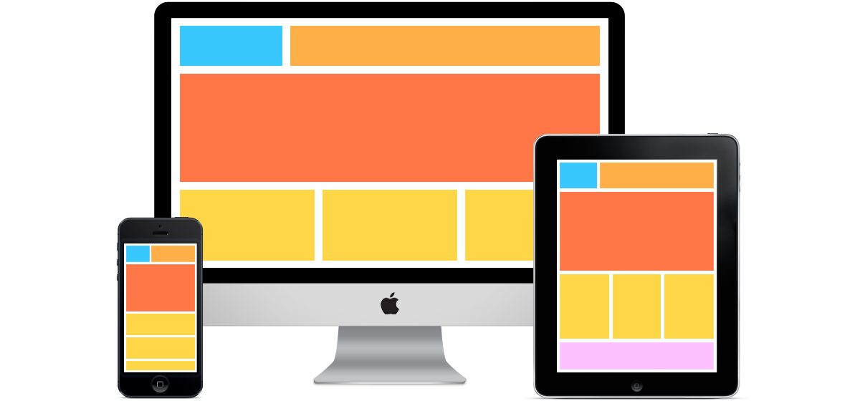
Responsive web design
Media queries
Twitter Bootstrap(4)

Slide 10
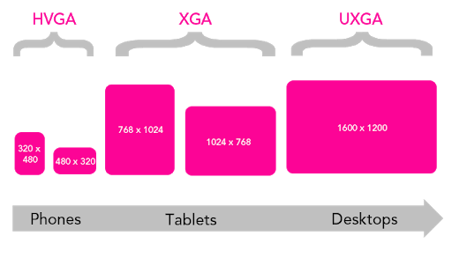
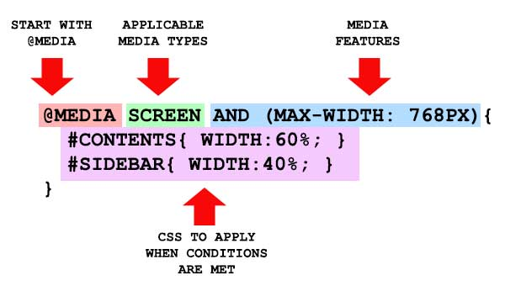
Media queries
Media queries are a popular technique for delivering a tailored style sheet to different devices. @media uses to include a block of CSS properties only if a certain condition is true.

Slide 11
Types of media queries
Type | Explanation
all | Used for all media type devices
speech | Used for speech and sound synthesizers
braille | Used for braille tactile feedback devices
embossed | Used for paged braille printers
handheld | Used for small or handheld devices
print | Used for printers
projection | Used for projected presentations, like slides
screen | Used for computer screens
tty | Used for media using a fixed-pitch character grid, like teletypes and terminals
tv | Used for television-type devices

Slide 12

Structure of media queries
@media (min-width:400px) { .form { width: 100%; } }
@media (min-width:400px),
(min-height:500px) { .form { width: 100%; } }

Slide 13
Not, Only, And
The AND keyword combines a media feature with a media type or other media features.
The ONLY keyword prevents older browsers that do not support media queries with media features from applying the specified styles. It has no effect on modern browsers.
The NOT keyword reverts the meaning of an entire media query.
@media (min-width:400px)
and (max-width: 600px) { .column { width: 100%; } }
@media only all
and (orientation: landscape) { .form { background-color: red; } }
@media not screen
and (device-width: 768px) { .form { color: white; } }

Slide 14
Meta tag
<meta name="viewport" content="width=device-width, initial-scale=1.0"> !!!
@media only screen
and (min-device-width: 414px)
and (max-device-width: 736px)
and (device-pixel-ratio: 3)
and (orientation: portrait) {
…
}
@media only screen
and (min-device-width: 414px)
and (max-device-width: 736px) {
…
}

Slide 15
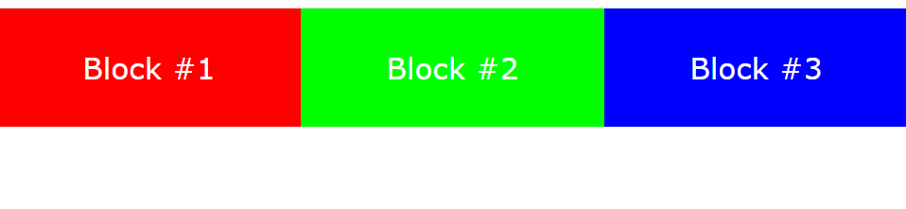
Example
<div class="container"> <div class="col">Block#1</div> <div class="col">Block#2</div> <div class="col">Block#3</div> </div>
.container{ display:flex; height:100px;
}
.col{ height: 100%; width: calc(100% / 3); display: flex; justify-content: center; align-items: center; color: white; font-family: Verdana; font-size: 25px; }

Slide 16
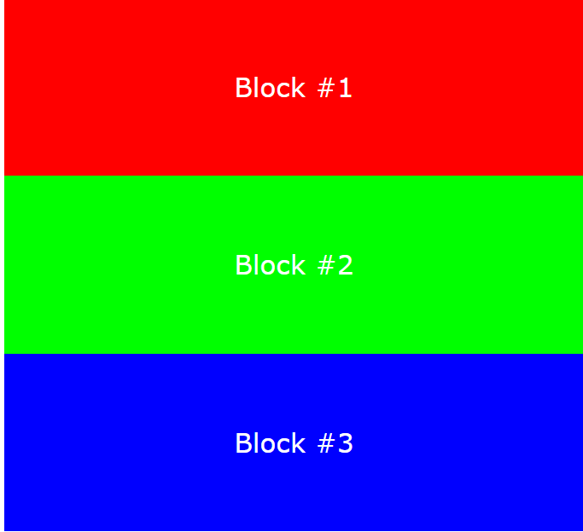
Example
@media all and (max-width: 700px){ .container{ flex-direction: column; align-items: center; height: 500px; } .col{ width: 80%; } }

Slide 17
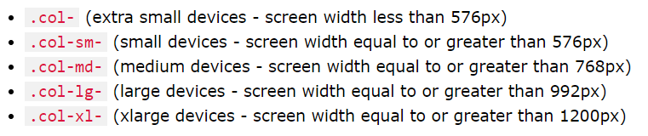
Bootstrap 4 grid system
Bootstrap’s grid system uses a series of containers, rows, and columns to layout and align content. It’s built with flexbox and is fully responsive.

Slide 18

Bootstrap’s grid system rules
Rows must be placed within a .container (fixed-width) or .container-fluid (full-width) for proper alignment and padding;
Use rows to create horizontal groups of columns;
Column widths are in percentage, so they are always fluid and sized relative to their parent element
Grid columns are created by specifying the number of 12 available columns you wish to span. For example, three equal columns would use three .col-sm-4

Slide 19


Example
<div class="row"> <div class="col-md-4 bg-primary">Block #1</div> <div class="col-md-4 bg-danger">Block #2</div> <div class="col-md-4 bg-warning">Block #3</div> </div>

Slide 20
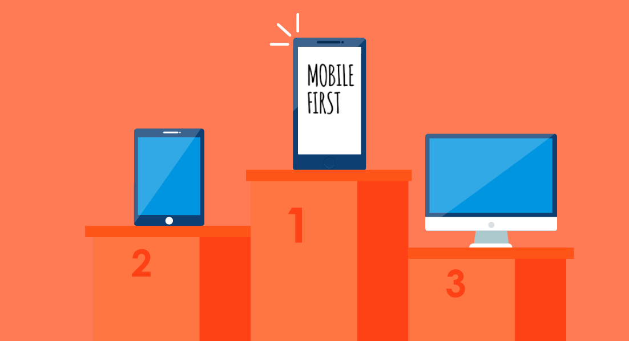
Mobile first
“Mobile first”, as the name suggests, means that we start the product design from the mobile end which has more restrictions, then expand its features to create a tablet or desktop version

Slide 21
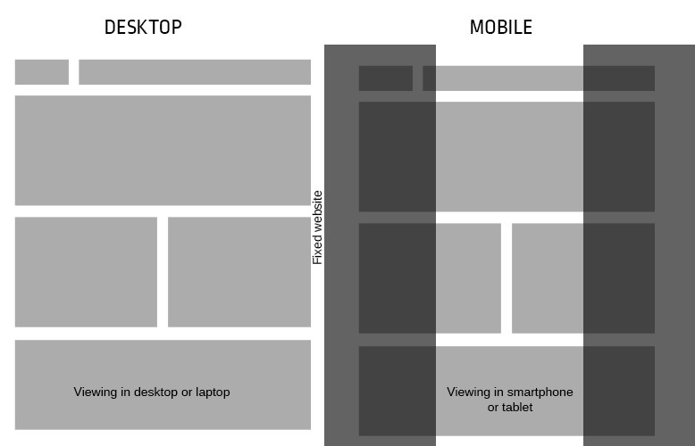
Fixed design
Fixed layout has a fixed width in pixels. The ‘container’ of the website is programmed to not move This width stays the same independently of which screen size or resolution the viewer has. It appears that the width of 960px is the most widely used size for fixed-layout websites

Slide 22
Fluid design
The drawback is that on smaller screens the columns can get really narrow. Now imagine how a block of text in a narrow and very tall cell looks like. Or, adding some elements like images and video which should stay of a fixed size. This combination is asking for trouble.

Slide 23
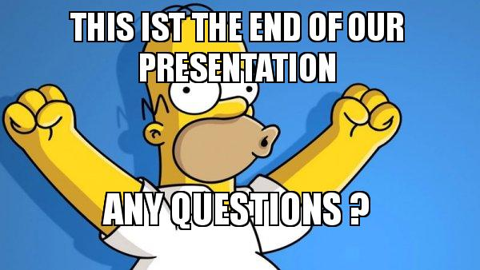
The END!!

Slide 24


