Slide 1
Angular
By Taras Dyda

Slide 2

INTRO
Angular is a platform and framework for building single-page client applications using HTML and TypeScript. Angular is written in TypeScript. It implements core and optional functionality as a set of TypeScript libraries that you import into your apps.
The architecture of an Angular application relies on certain fundamental concepts. The basic building blocks are NgModules, which provide a compilation context for components. NgModules collect related code into functional sets; an Angular app is defined by a set of NgModules.

Slide 3
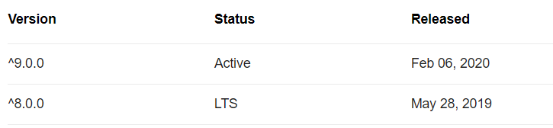
Brief history
The first version of Angular was released in the year of 2010. Some people call this as AngularJS and some people call as Angular 1. But it is officially named as AngularJS.

Slide 4




How to connect?
It can be added to an HTML page with a <script> tag.
2. Using NPM

Slide 5
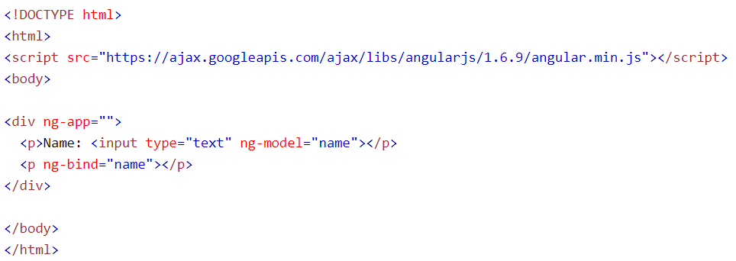
How to USE?
The ng-app directive tells AngularJS that the <div> element is the "owner" of an AngularJS application.
The ng-model directive binds the value of the input field to the application variable name.
The ng-bind directive binds the content of the <p> element to the application variable name.

Slide 6
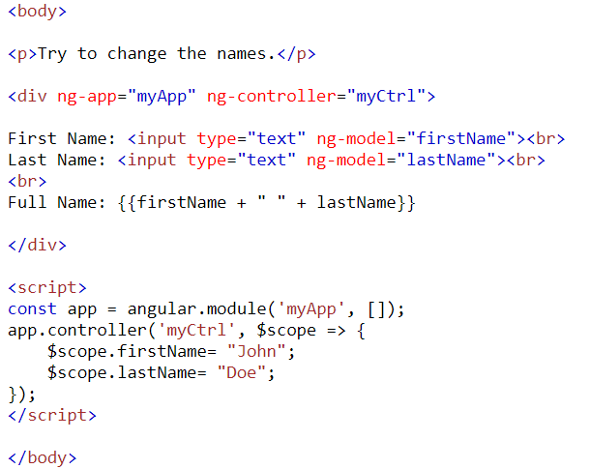
EXAMPLE

Slide 7
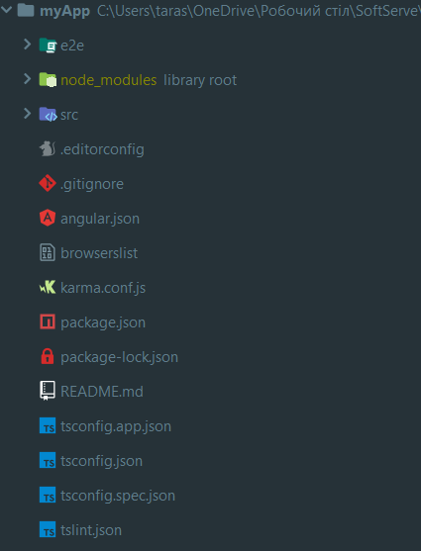
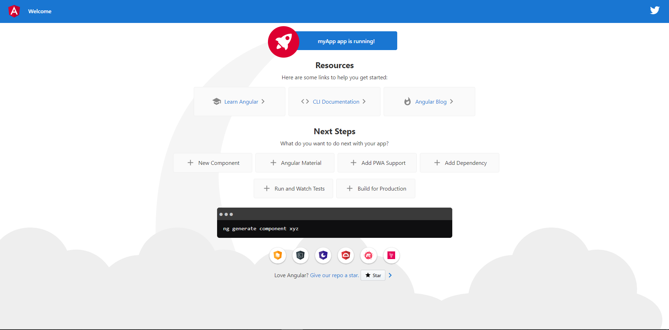
CREATING WITH NPM

Slide 8
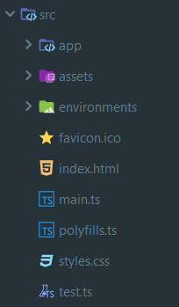
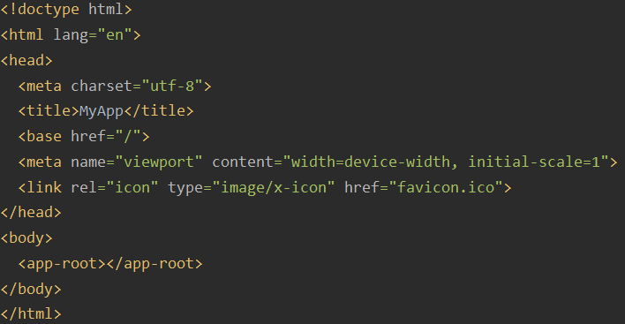

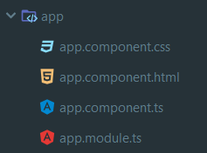
BASIC STRUCTURE

Slide 9
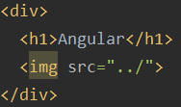


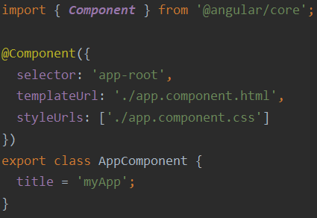

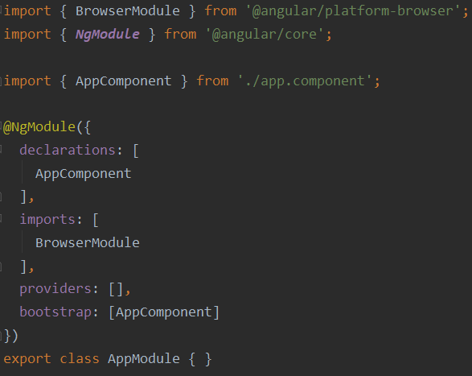
COMPONENTS

Slide 10


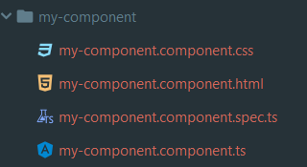
Create new component

Slide 11
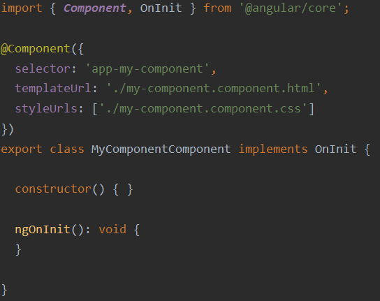
*.component.ts

Slide 12
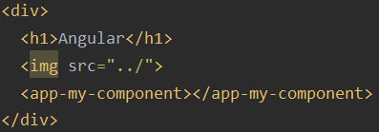
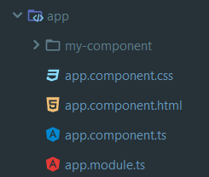
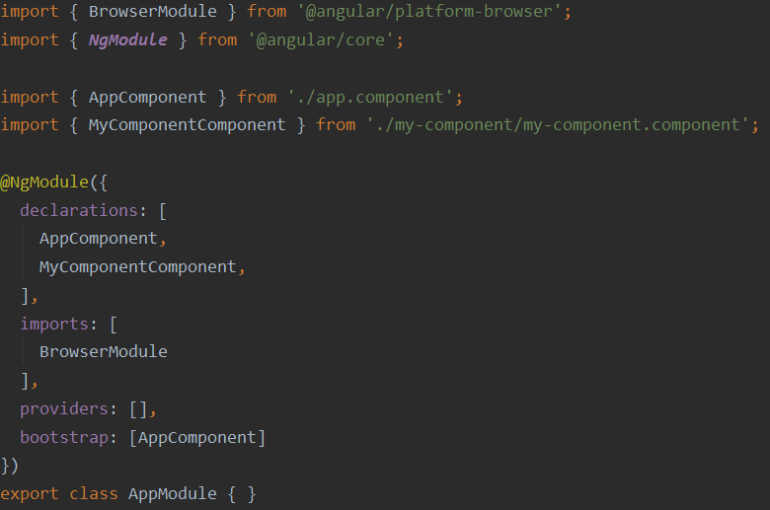

How to use?

Slide 13
HOOKS
Name | Timing
ngOnChanges() | Called before ngOnInit() and whenever one or more data-bound input properties change.
ngOnInit() | Called once, after the first ngOnChanges().
ngOnDestroy() | Called immediately before Angular destroys the directive or component.

Slide 14
public, private, protected
1. Public - can be accessed from the internal class methods as well as from the external scripts. This is a default access.
2. Protected - can be accessed either from the internal class methods or from its descendants.
3. Private - can be accessed from within the class only.

Slide 15

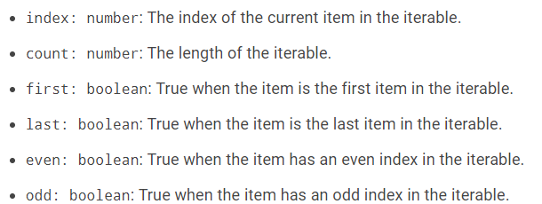
*ngFor, *ngIf

Slide 16
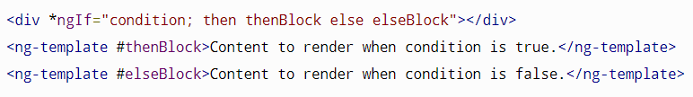
If else

Slide 17
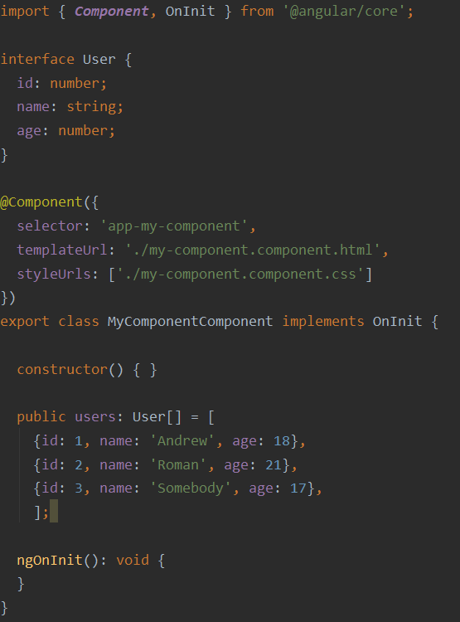
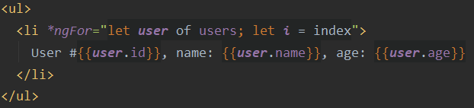


Example

Slide 18
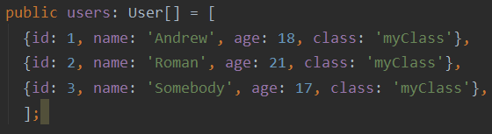
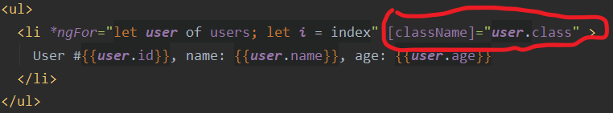


Attributes

Slide 19
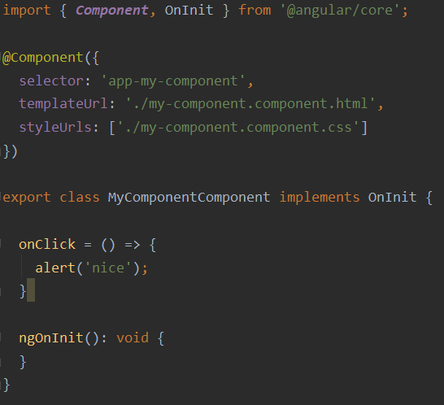
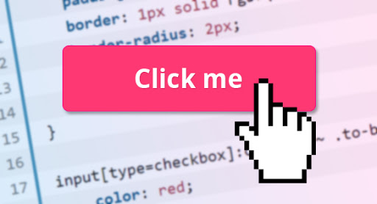
Events

Slide 20
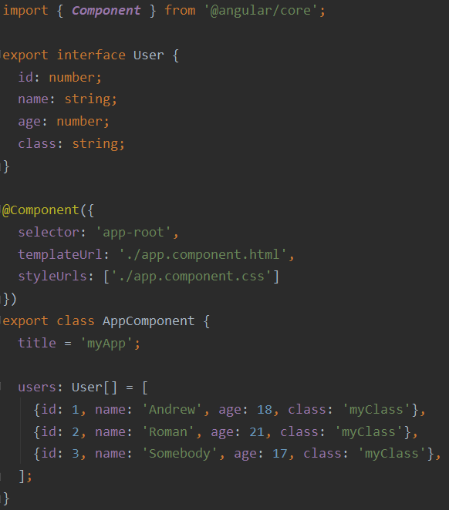

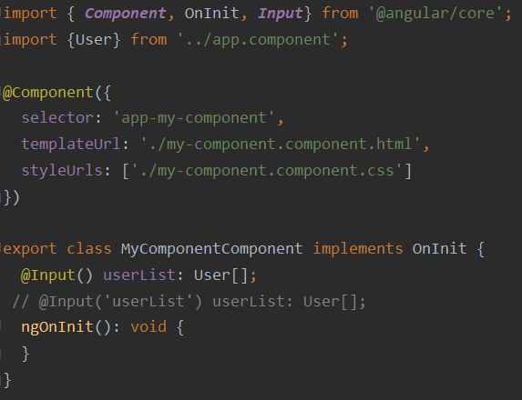

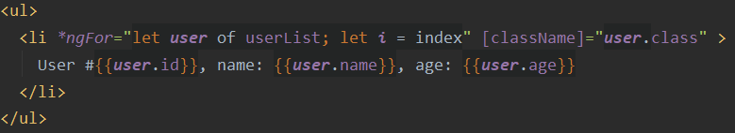
Decorators: @Input, @Output
1. app.component.ts
2. app.component.html:
3. my-component.ts
5. Results:
4. my-component.html

Slide 21
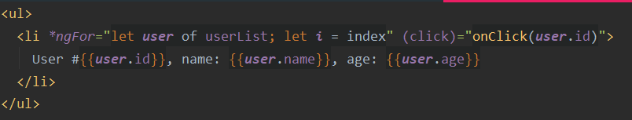
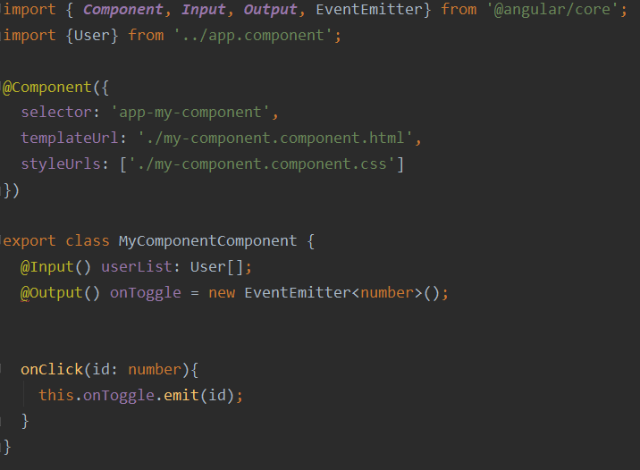
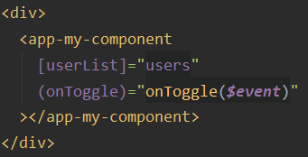
@Output
1. my-component.html
2. my-component.ts
3. app.component.html

Slide 22
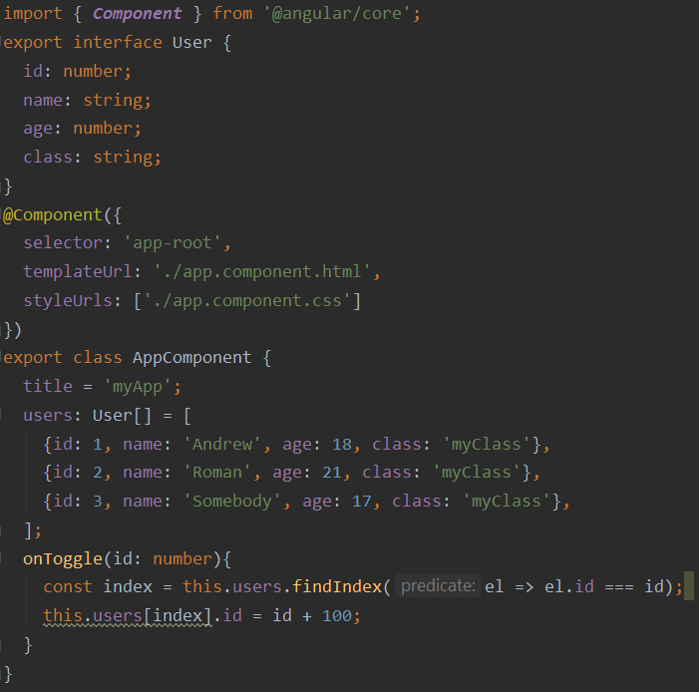

@Output
4. app-component.ts
5. Results:

Slide 23

references
https://angular.io/guide/setup-local
2) https://www.w3schools.com/angular/angular_intro.asp

Slide 24


