Slide 1
Node packages Modules Example of usages
By Taras Dyda

Slide 2

Module and package
A package is a directory with one or more modules inside of it and a package.json file which has metadata about the package
A module is a single JavaScript file that has some reasonable functionality.

Slide 3
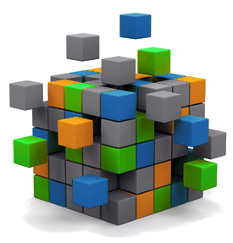
Modules
Module in Node.js is a simple or complex functionality organized in single JavaScript file which can be reused throughout the Node.js application. In the Node.js module system, each file is treated as a separate module.
1. Core Modules
2. Local Modules
3. Third Party Modules

Slide 4
Core modules
The core modules include bare minimum functionalities of Node.js. These core modules are compiled into its binary distribution and load automatically when Node.js process starts. However, you need to import the core module first in order to use it in your application.
Core module | Description
http | http module includes classes, methods and events to create Node.js http server.
url | url module includes methods for URL resolution and parsing.
querystring | querystring module includes methods to deal with query string.
path | path module includes methods to deal with file paths.
fs | fs module includes classes, methods, and events to work with file I/O.
util | util module includes utility functions useful for programmers.

Slide 5
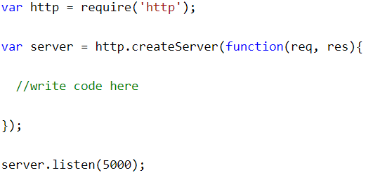
Loading Core Modules
In order to use Node.js core or NPM modules, you first need to import it using require() function as shown below.
As per above syntax, specify the module name in the require() function. The require() function will return an
object, function, property or any other JavaScript type, depending on what the specified module returns.

Slide 6
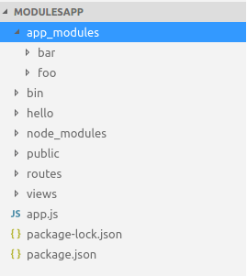
Local modules
Local modules are modules created locally in your Node.js application. These modules include different functionalities of your application in separate files and folders. You can also package it and distribute it via NPM, so that Node.js community can use it. For example, if you need to connect to MongoDB and fetch data then you can create a module for it, which can be reused in your application.
To use local modules in your application, you need to load it using require() function in the same way as core module. However, you need to specify the path of JavaScript file of the module.

Slide 7
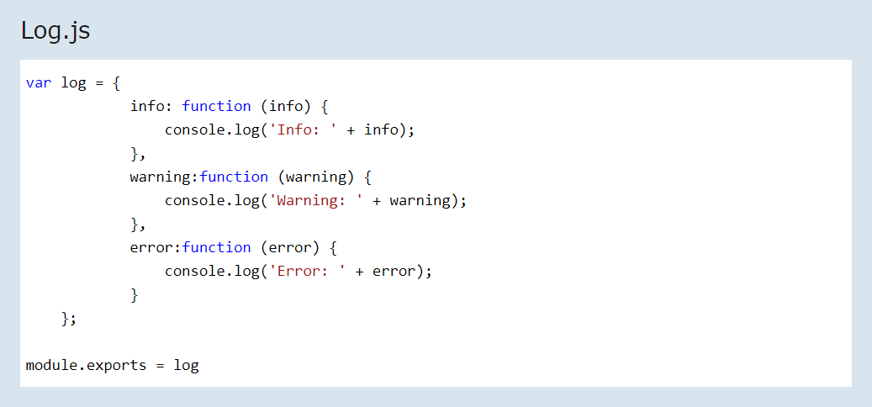
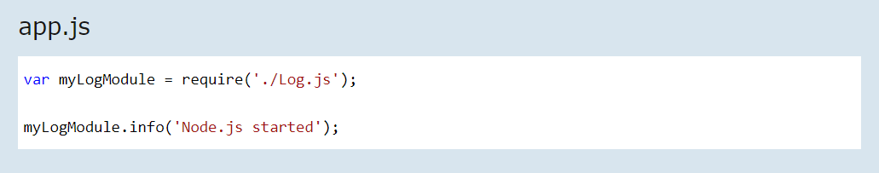
Loading LOCAL Modules
In order to use Node.js local modules or NPM modules, you first need to import it using require() function as shown below.

Slide 8
THIRD PARTY modules
The third party module can be downloaded by NPM (Node Package Manager). These type of modules are developed by others and we can use that in our project. Some of the best third party module examples are listed as follows: express, gulp, lodash, async, socket.io, mongoose, underscore, pm2, bower, q, debug, react, mocha etc. Third party modules can be install inside the project folder or globally.
To load a third party module in your node application you can just use "require()" function. whose syntax is given below

Slide 9
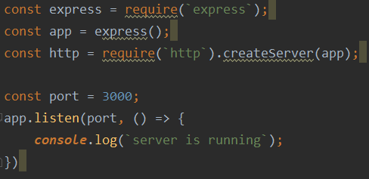
Loading third party Modules
In order to use NPM modules, you first need to import it using require() function as shown below.

Slide 10
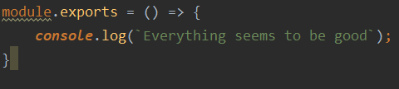



Module.exports

Slide 11
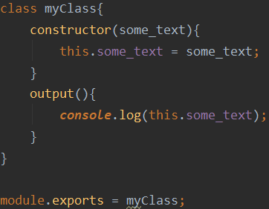
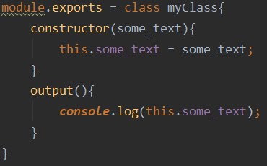

Module.exports

Slide 12
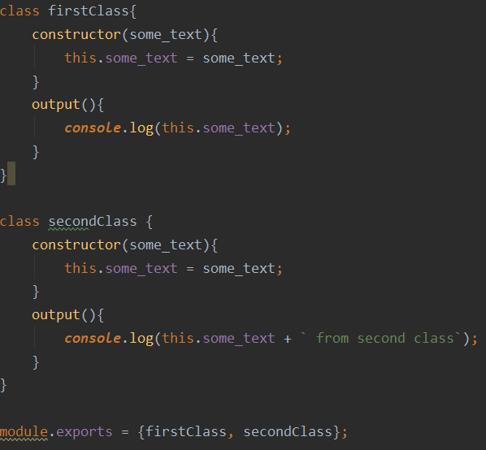
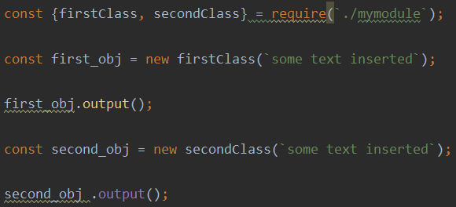

Few elements export

Slide 13
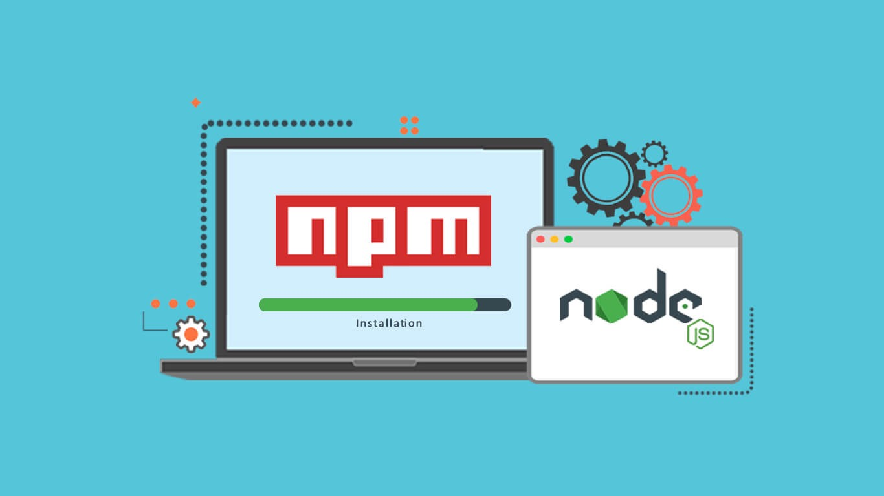
Node packages
A package is a directory with one or more modules inside of it and a package.json file which has metadata about the package
You can add a package.json file to your package to make it easy for others to manage and install .
A package.json file:
lists the packages your project depends on
specifies versions of a package that your project can use

Slide 14
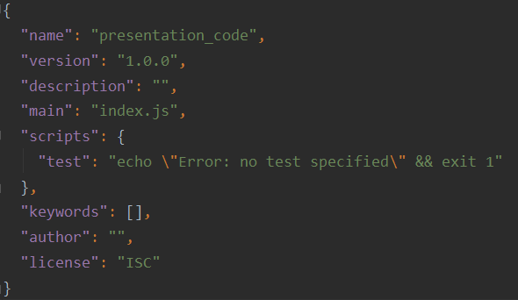
Package json
npm init
Package name
Version
Description
Entry point
Test command
Git repository
Keywords
Author
License
npm init –-yes/npm init -y

Slide 15
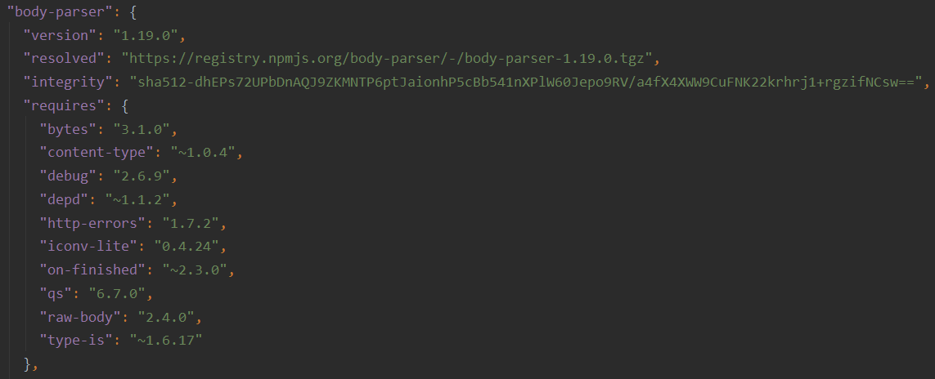
Package-lock.json
package-lock.json is automatically generated for any operations where npm modifies either the node_modules tree, or package.json. It describes the exact tree that was generated, such that subsequent installs are able to generate identical trees, regardless of intermediate dependency updates

Slide 16
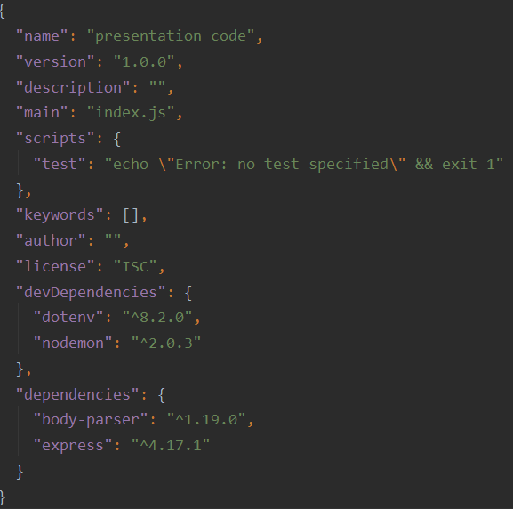
--save-dev vs --save
--save-dev - is used to save the package for development purpose. Example: unit tests
--save/-s - is used to save the package required for the application to run

Slide 17

Local and global
Installing a package globally allows you to use the code in the package as a set of tools on your local computer
local packages are installed in the directory where you run npm install <package-name>, and they are put in
the node_modules folder under this directory
Globally
Locally

Slide 18
Install specific version

Slide 19

REMOVE PACKAGE

Slide 20
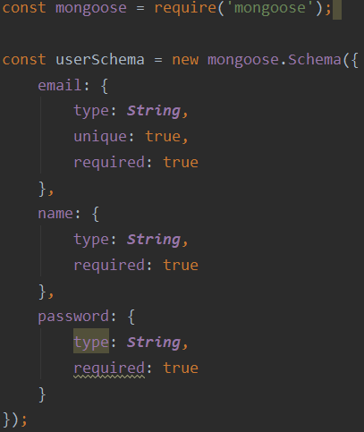
Example

Slide 21
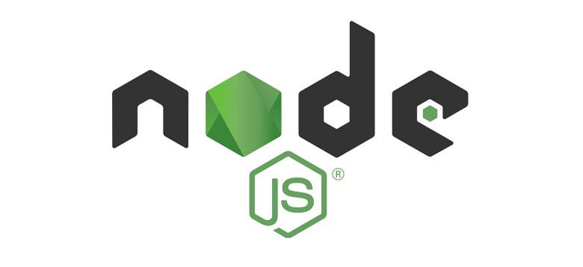
references
https://www.tutorialsteacher.com/nodejs/nodejs-modules
https://www.c-sharpcorner.com/article/nodejs-modules/
https://docs.npmjs.com/about-packages-and-modules

Slide 22


