Slide 1
AJAX FETCH
By Taras Dyda

Slide 2

AJAX, FETCH
AJAX purpose
Response on AJAX request
Upload file to the server using standard AJAX methods!
Fetch

Slide 3
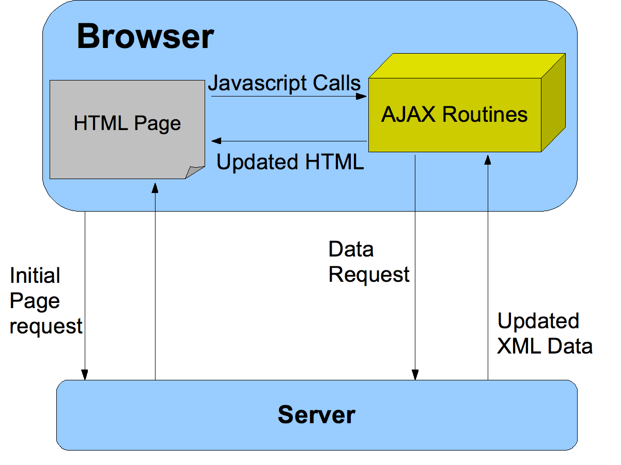
WHAT IS AJAX?
AJAX allows web pages to be updated asynchronously by exchanging data with a web server behind the scenes. This means that it is possible to update parts of a web page, without reloading the whole page.
AJAX just uses a combination of:
A browser built-in XMLHttpRequest object (to request data from a web server)
JavaScript and HTML DOM (to display or use the data)

Slide 4
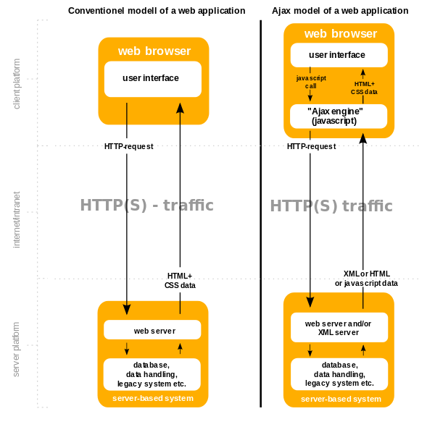
purpose
Read data from a web server - after the page has loaded
Update a web page without reloading the page
Send data to a web server - in the background

Slide 5
HTTP methods
Name | Description
GET | Uses to get data from server
POST | Uses to send data to server
PUT | Replaces all current representations of the target resource with the uploaded content
PATCH | Uses to update resource partially
DELETE | Removes all current representations of the target resource
HEAD | Same as GET, but transfers the status line and header section only
CONNECT | Establishes a tunnel to the server identified by a given URI
OPTIONS | Describes the communication options for the target resource
TRACE | Performs a message loop-back test along the path to the target resource.

Slide 6



HOW TO CERATE AJAX REQUEST?
1.
2.
3.
4.

Slide 7
XMLHttpRequest methods
Name | Description
abort() | Cancels the current request
getAllResponseHeaders() | Returns the complete set of HTTP headers as a string.
getResponseHeader( headerName ) | Returns the value of the specified HTTP header.
open(method, URL, async, userName, password ) | Initializes new request
send(open) | Sends the request
setRequestHeader( label, value ) | Adds a label/value pair to the HTTP header to be sent

Slide 8
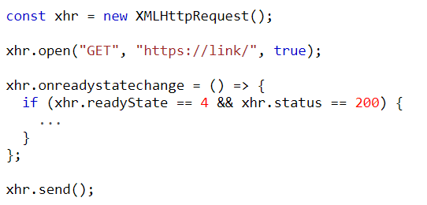
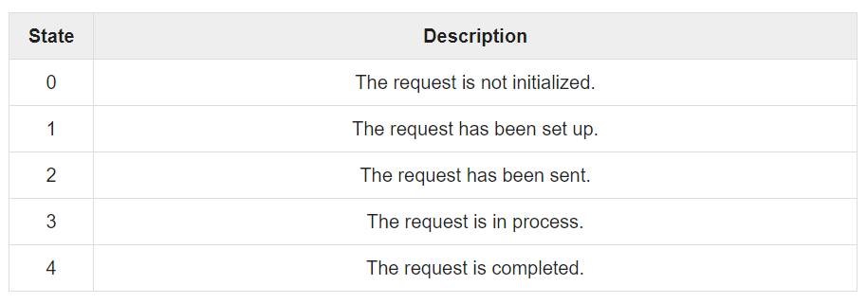
readyState and status

Slide 9
XMLHttpRequest properties
Name | Description
onreadystatechange | An event handler for an event that fires at every state change
readyState | Defines the current state of the XMLHttpRequest object
responseText | Returns the response as a string
responseXML | Returns the response as XML
status | Returns the status as a number
statusText | Returns the status as a string

Slide 10

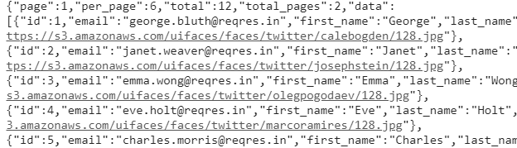
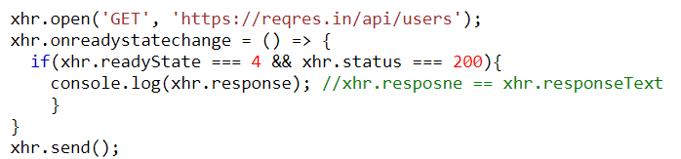
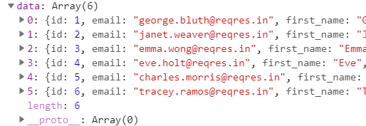
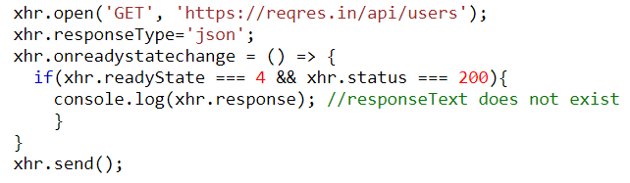
AJAX – server response

Slide 11
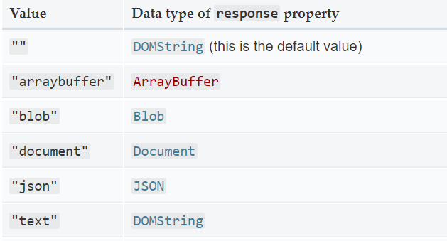
Types of server response

Slide 12
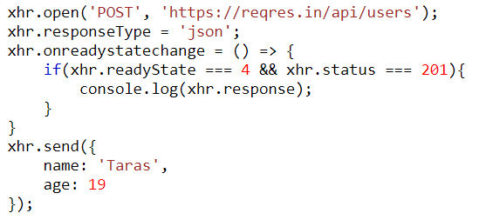
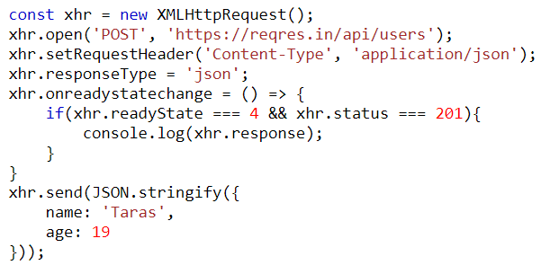

Send data to server

Slide 13

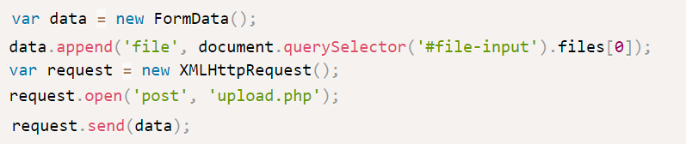
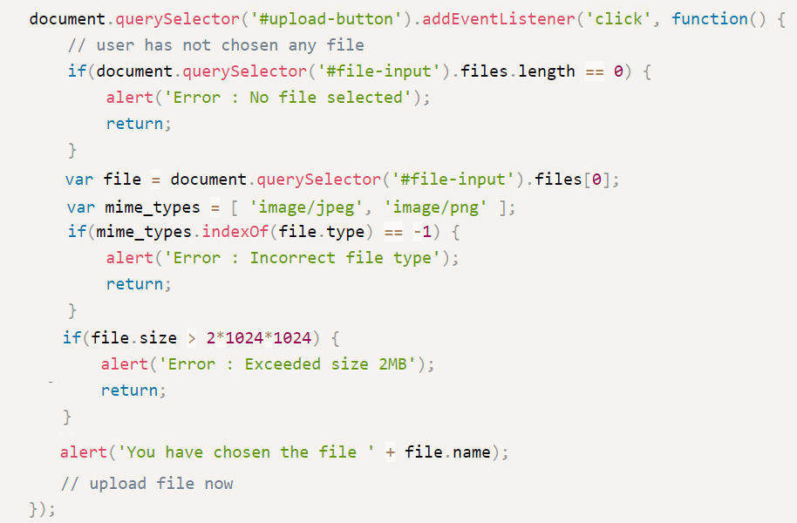
Upload file to the server using standard ajax methods!
Step 1 — Choose a Local File
Step 3 — Send an AJAX POST Request with File Attachment
Step 2 - Validate Chosen File for Type and Size

Slide 14


Fetch
fetch() allows you to make network requests similar to XMLHttpRequest (XHR). The main difference is that the Fetch API uses Promises, which enables a simpler and cleaner API, avoiding callback hell and having to remember the complex API of XMLHttpRequest.
It’s not supported by old browsers (can be polyfilled), but very well supported among the modern ones.
Without options, that is a simple GET request, downloading the contents of the url.

Slide 15
How it works?
Getting a response is usually a two-stage process
1. First, the promise, returned by fetch, resolves with an object of the built-in Response class as soon as the server responds with headers.
At this stage we can check HTTP status, to see whether it is successful or not, check headers, but don’t have the body yet.
2. The promise rejects if the fetch was unable to make HTTP-request, e.g. network problems, or there’s no such site. Abnormal HTTP-statuses, such as 404 or 500 do not cause an error.
We can see HTTP-status in response properties:
status – HTTP status code, e.g. 200.
Ok – boolean, true if HTTP status code is 200-299

Slide 16
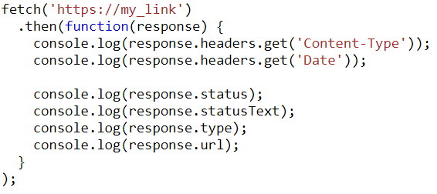
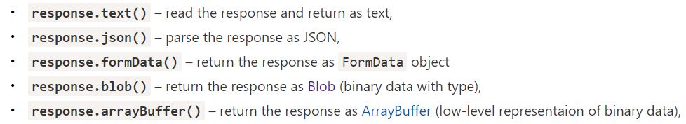
Server response

Slide 17
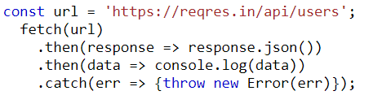
Data handling
Methods to handle fetch
.then()
.catch()
.finally()

Slide 18
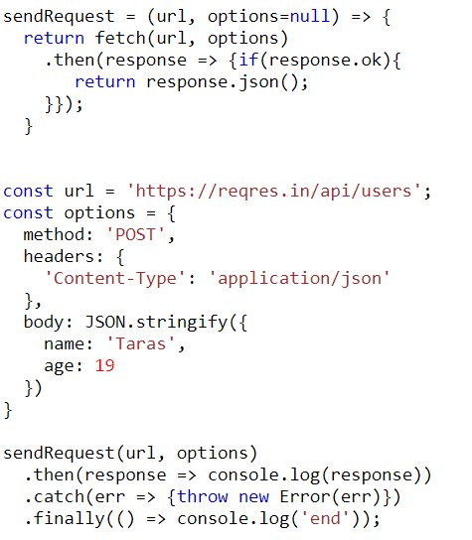
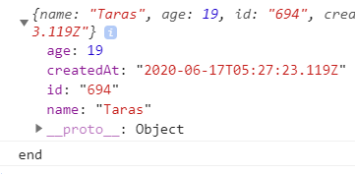
Send data to server

Slide 19

references
https://www.w3schools.com/xml/ajax_intro.asp
https://www.tutorialspoint.com/ajax/what_is_xmlhttprequest.htm
https://developers.google.com/web/updates/2015/03/introduction-to-fetch
https://javascript.info/fetch

Slide 20


