Slide 1
JQuery
By Taras Dyda

Slide 2

brief history
John Resig developed the initial version of jQuery in 2005 and released it in 2006 at an event called BarCampNYC
jQuery had two main value propositions. The first was to provide an ergonomic API for manipulating a webpage. In particular, it provided powerful methods for selecting elements.
The second selling point was that it abstracted away differences between browsers. Back then, it was hard to write code that would work robustly on all browsers.

Slide 3
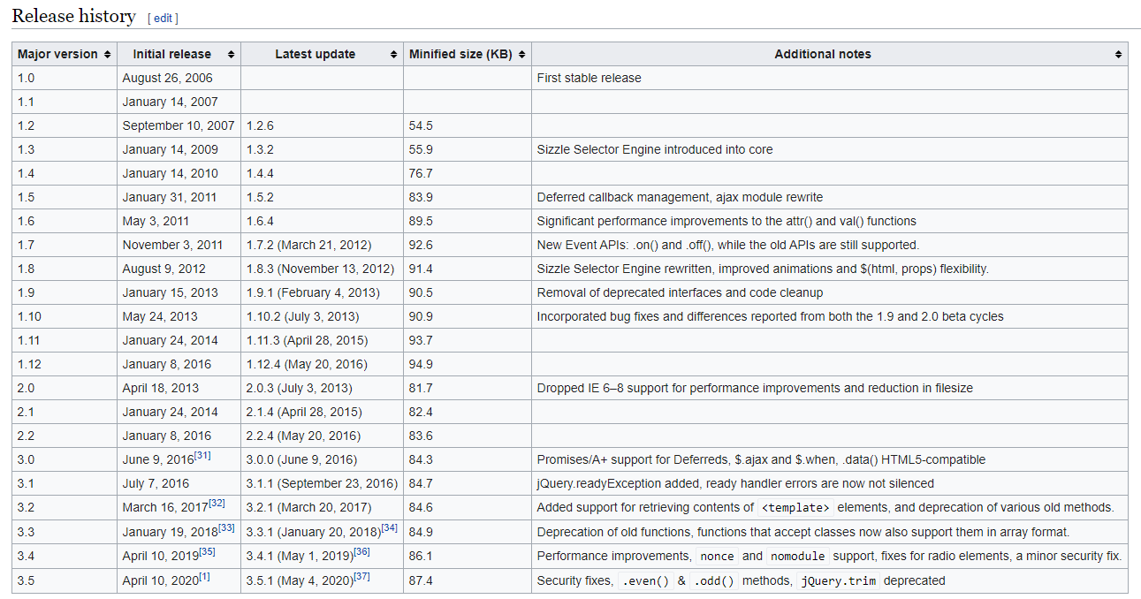
Release history

Slide 4
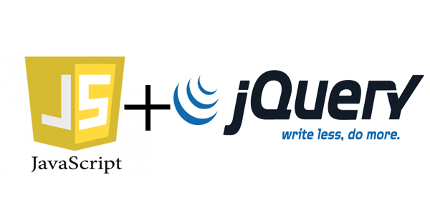
Why jQuery?
jQuery takes a lot of common tasks that require many lines of JavaScript code to accomplish, and wraps them into methods that you can call with a single line of code.
The jQuery library contains the following features:
HTML/DOM manipulation
CSS manipulation
HTML event methods
Effects and animations
AJAX
Utilities

Slide 5



Who use jquery?
Many of the biggest companies on the Web use jQuery, such as:
Google
Netflix
Microsoft
IBM

Slide 6
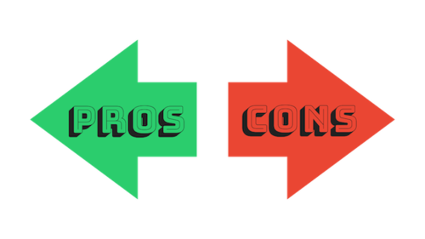
pros and cons
Pros:
cross-browser compatible with Chrome, Edge, Firefox, Internet Explorer, Safari, Android, and iOS
CSS3 compliant
short learning curve
faster programming
easy, impressive animations
open source with current maintenance
Cons:
slows the operation of some tasks
new alternatives

Slide 7
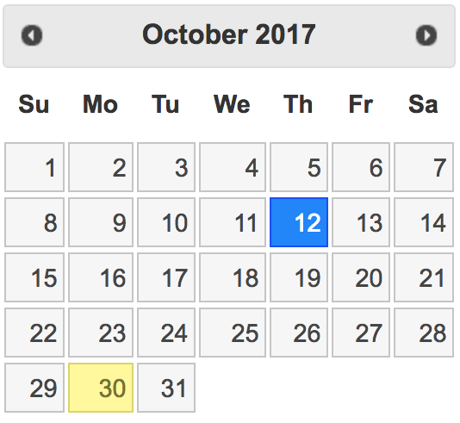

jQuery ui
jQuery UI is a curated set of user interface interactions, effects, widgets, and themes built on top of the jQuery JavaScript Library. Whether you're building highly interactive web applications or you just need to add a date picker to a form control, jQuery UI is the perfect choice.

Slide 8
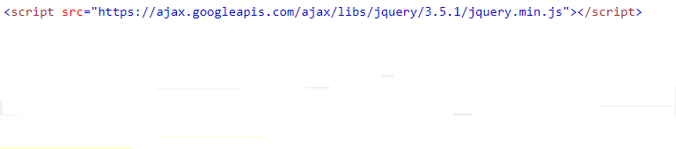


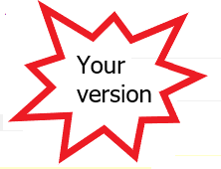
Get Started
There are several ways to start using jQuery on your web site. You can:
Download the jQuery library from jQuery.com
Include jQuery from a CDN, like Google

Slide 9
Downloading jQuery
There are two versions of jQuery available for downloading:
Production version - this is for your live website because it has been minified and compressed
Development version - this is for testing and development (uncompressed and readable code)
Both versions can be downloaded from jQuery.com.

Slide 10



SELECTORS
jQuery selectors are used to "find" (or select) HTML elements based on their name, id, classes, types, attributes, values of attributes and much more. It's based on the existing CSS Selectors.

Slide 11



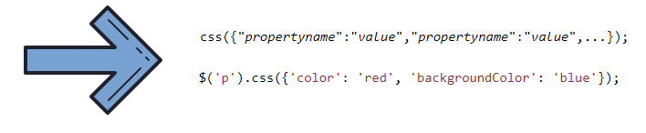

CSS

Slide 12
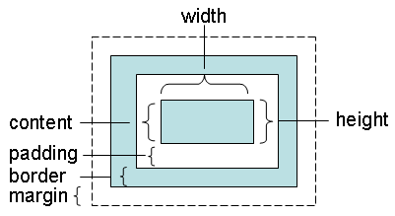

Width/height

Slide 13


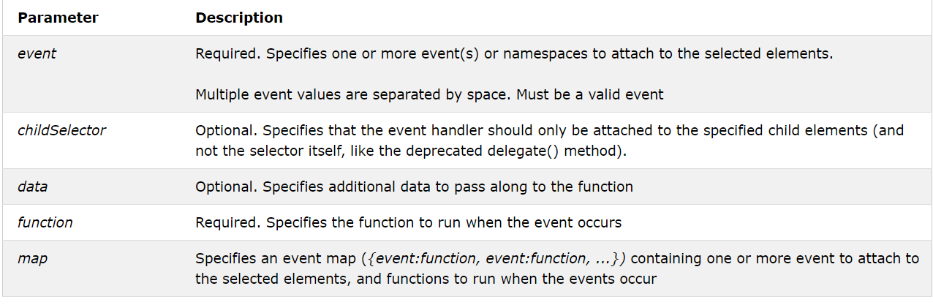
events
1.
2.

Slide 14
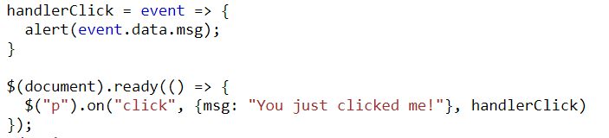
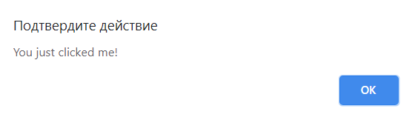
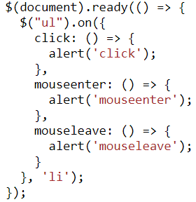
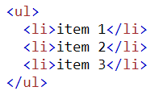
Events - example
1.
2.

Slide 15







HTML/DOM manipulation

Slide 16
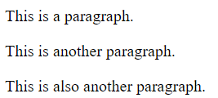
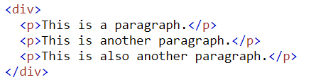


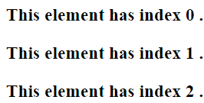
replaceWith()

Slide 17


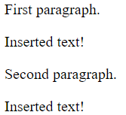
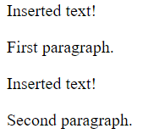
after()/before()

Slide 18

Attributes
1. Add or remove class:
2. Get or set value of attribute:

Slide 19
Effects and animations
.animate() | Perform a custom animation of a set of CSS properties.
.delay() | Set a timer to delay execution of subsequent items in the queue.
.fadeIn() | Display the matched elements by fading them to opaque.
.fadeout() | Hide the matched elements by fading them to transparent.
.finish() | Stop the currently-running animation, remove all queued animations, and complete all animations for the matched elements.
.hide() | Hide the matched elements.
.show() | Show the matched elements
.slideDown() | Display the matched elements with a sliding motion
.slideUp() | Hide the matched elements with a sliding motion.

Slide 20
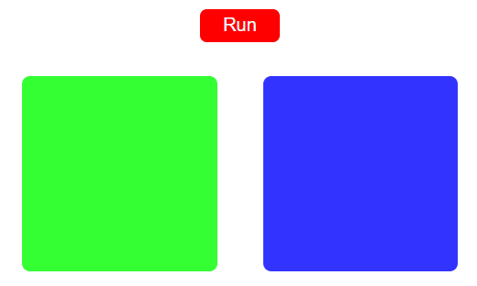
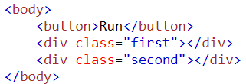

Animation – example #1

Slide 21
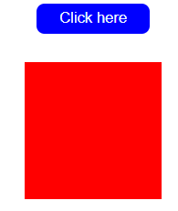

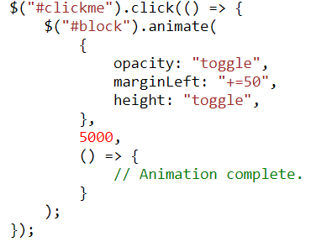
Animation – example #2

Slide 22
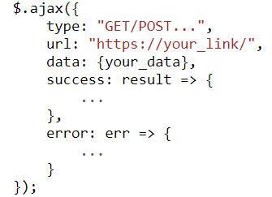
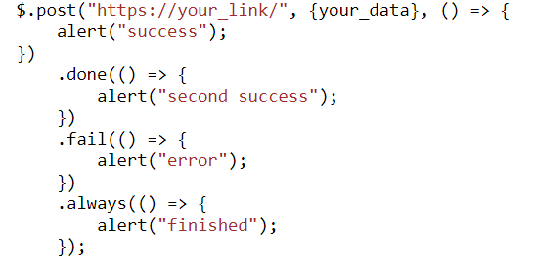
ajax
Ajax allows:
Read data from a web server - after the page has loaded
Update a web page without reloading the page
Send data to a web server - in the background

Slide 23
references
1) https://api.jquery.com/
2) https://code.jquery.com/jquery-3.5.1.js
3) https://medium.com/sololearn/write-less-and-do-more-with-jquery-82fcae9c1955
4) https://www.w3schools.com/jquery/jquery_ref_ajax.asp

Slide 24


