Slide 1
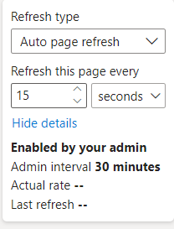
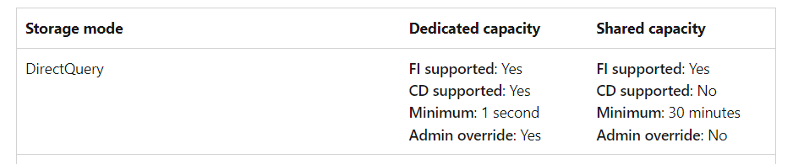
Pro subscription - Shared capacity by default 30 min
Premium minimal 1 sec + Change detection option
https://learn.microsoft.com/en-us/power-bi/create-reports/desktop-automatic-page-refresh
https://data-mozart.com/auto-page-refresh-in-power-bi-everything-you-need-to-know/

