Slide 1
MATERIAL MANAGEMENT
ENGLISH USER GUIDE
Material Management
User Guide
Notes:
[Sources]
- Local Material Management application and project source code; accessed 2026-08-03.

Slide 2
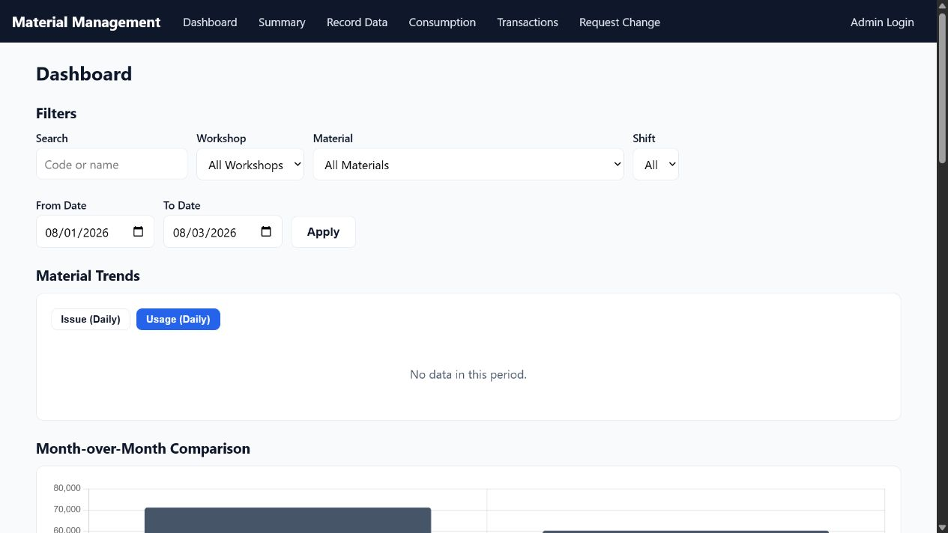
The top navigation covers every daily task
Choose the page that matches your task
Dashboard – monitor trends
Summary – review stock and usage
Record Data – enter daily values
Consumption – calculate material per output
Transactions – review history
Request Change – report an error
Application home
Use the same navigation bar from any screen.
2
Notes:
[Sources]
- Screenshot: local app / (Dashboard), captured 2026-08-03.

Slide 3
Use Dashboard filters before reading a trend
Dashboard workflow
1
Search by material code or name.
2
Limit results by workshop, material, shift, and date range.
3
Select Issue or Usage, then review month-over-month and cost sections.
Dashboard screenshot
3
Notes:
[Sources]
- Screenshot: local app / (Dashboard), captured 2026-08-03.
- Behavior verified in server.js dashboard routes.

Slide 4
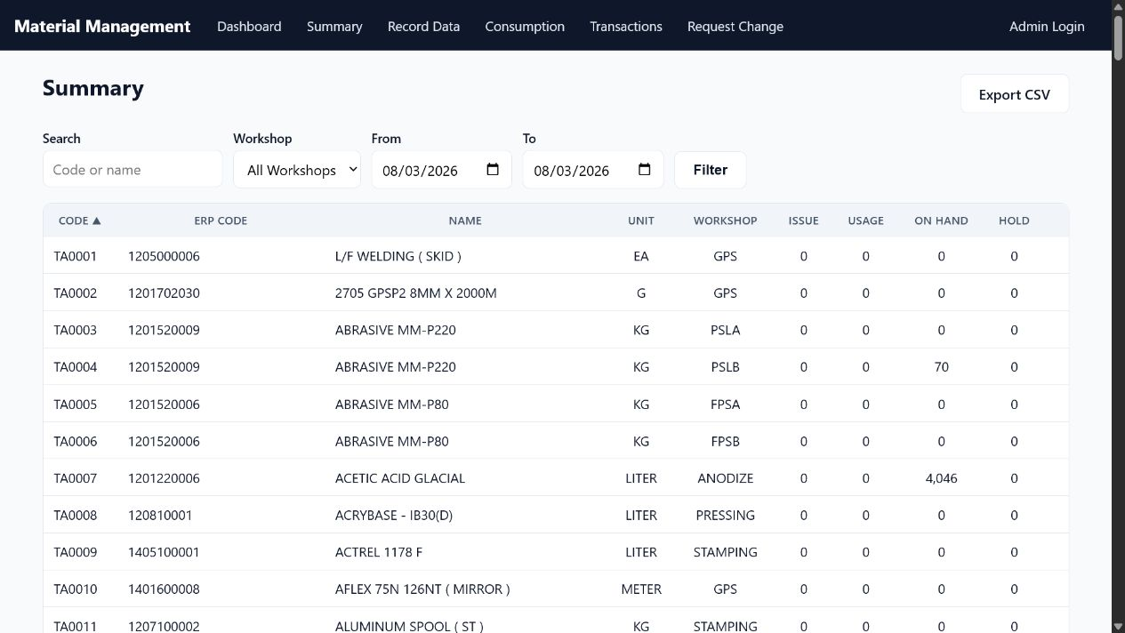
Summary turns stock records into a searchable list
How to use it
1
Search by code or name.
2
Select a workshop and date range.
3
Compare Issue, Usage, On Hand, and Hold.
4
Use Export CSV when offline analysis is needed.
Summary screen
Review material status without editing records.
4
Notes:
[Sources]
- Screenshot: local app /materials (Summary), captured 2026-08-03.

Slide 5
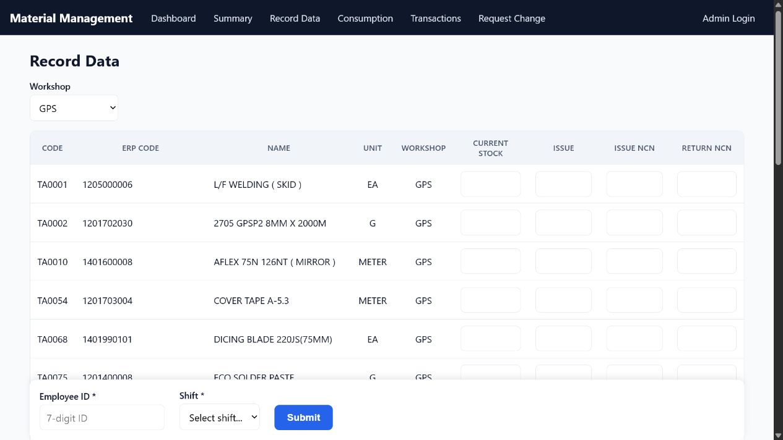
Record only the materials that changed today
Before selecting Submit
1
Select the correct workshop first.
2
Enter values only on relevant material rows; leave unused rows blank.
3
Confirm the 7-digit Employee ID and shift A, B, or C.
Record Data screenshot
5
Notes:
[Sources]
- Screenshot: local app /issue?workshop=GPS (Record Data), captured 2026-08-03.
- Input rules verified in server.js issue route.

Slide 6
Complete one daily entry in three checks
CHECK 1
CHECK 2
CHECK 3
Identify
Confirm workshop, material code, ERP code, name, and unit.
Enter
Record stock, issue, and NCN values. Use zero only when zero is the intended value.
Validate
Recheck Employee ID and shift, then submit once and read any warning.
6
Notes:
[Sources]
- Workflow derived from local app /issue and server-side validation in server.js.

Slide 7
Each Record Data field has a different meaning
Enter the physical value shown for the selected material and unit.
Do not copy a number from another row. Blank means no value was recorded; zero means the value is actually zero.
Stock and Issue
NCN movements
Current Stock: physical on-hand quantity.
Issue: quantity issued in the period.
Match the displayed unit before typing.
Issue NCN: quantity moved to NCN.
Return NCN: quantity returned from NCN.
Never swap the two NCN columns.
7
Notes:
[Sources]
- Field names and usage derived from local app /issue and issue_entries schema in src/db.js.

Slide 8
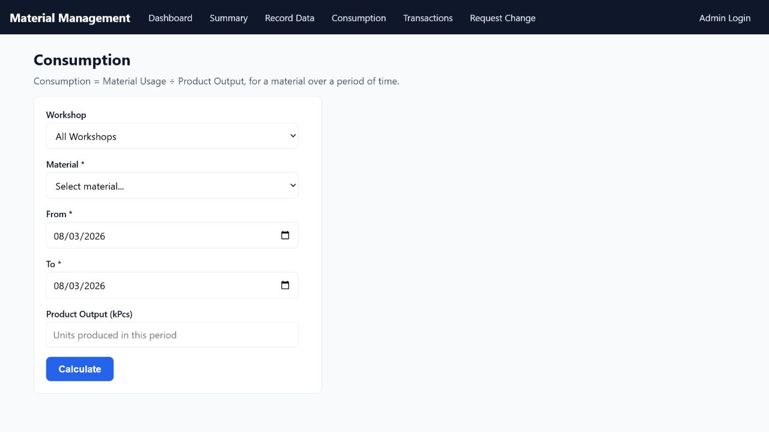
Consumption connects material usage to product output
Calculation steps
1
Select a workshop and material.
2
Set the From and To dates.
3
Enter Product Output in kPcs when available.
4
Select Calculate and review Usage and Consumption.
Consumption = Material Usage ÷ Product Output
Product Output must be greater than zero.
8
Notes:
[Sources]
- Screenshot: local app /consumption, captured 2026-08-03.
- Formula and validation verified in server.js consumption route.

Slide 9
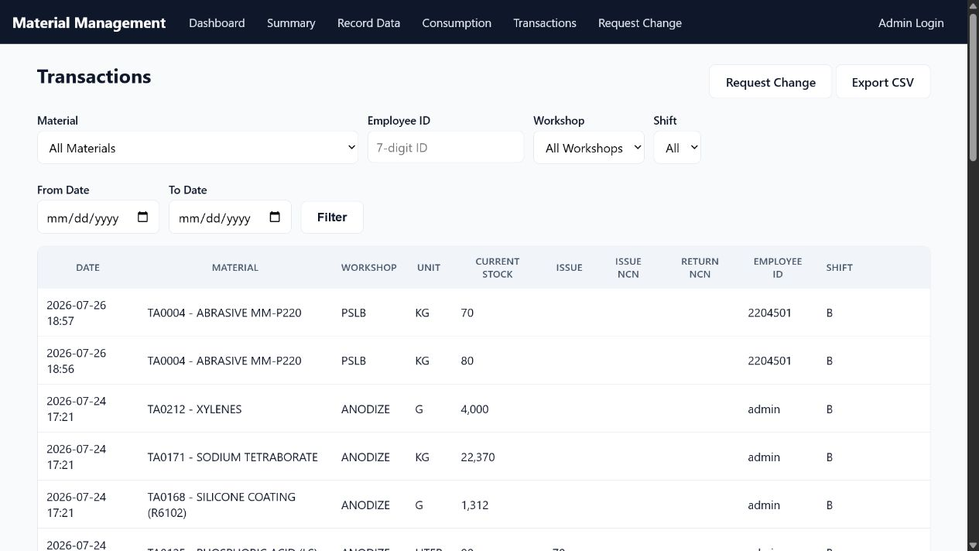
Transactions is the audit trail for every entry
Find the exact record
1
Filter by material, Employee ID, workshop, shift, and date.
2
Check stock, issue, NCN values, employee, and shift together.
3
Use Export CSV for an approved report; use Request Change when a record is wrong.
Transactions screenshot
9
Notes:
[Sources]
- Screenshot: local app /transactions, captured 2026-08-03.

Slide 10
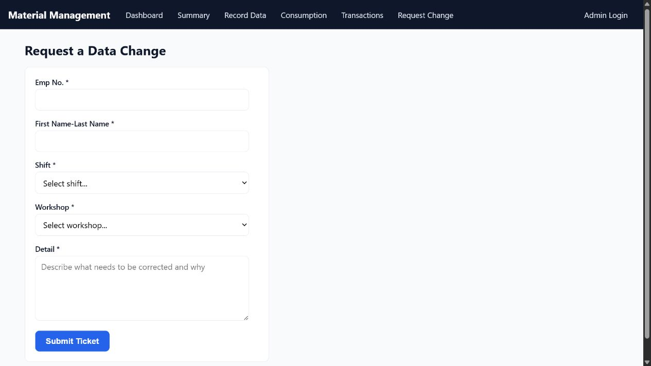
Report an incorrect entry instead of entering it again
Include enough detail
1
Enter employee number and full name.
2
Select the correct shift and workshop.
3
State the date, material code, wrong value, correct value, and reason.
4
Submit one ticket and wait for review.
Request a Data Change — A correction ticket keeps the issue traceable for an administrator.
10
Notes:
[Sources]
- Screenshot: local app /tickets/new, captured 2026-08-03.
- Ticket fields verified in server.js ticket route.

Slide 11
Five checks prevent most entry errors
Pause for ten seconds before selecting Submit. A quick visual check is faster than requesting a correction later.
Correct workshop
If a warning appears after saving, read it immediately and compare the current stock and issue values with the source document.
Do not press Submit twice while the page is processing.
Correct material and unit
Correct quantities
Correct Employee ID and shift
Submit once and read the result
11
Notes:
[Sources]
- Checklist derived from validation behavior in local app /issue and server.js.

Slide 12
QUICK REFERENCE
Identify. Enter.
Verify.
Record the correct material.
Submit only once.
Request a change when needed.
Notes:
[Sources]
- Summary of the local Material Management workflow.

