Slide 1
FINAL PROJECT
Can we predict , within 10 years, whether or not a person sees the risk to get coronary heart disease?
by
Antonio Zappia, Flavia Penta, Gabriel Radu Taranciuc

Slide 2
Introduction
World Health Organization has estimated 12 million deaths occur worldwide, every year due to Heart diseases; in fact, Cardiovascular diseases are the number 1 cause of death globally!
The early predictions of cardiovascular diseases can make lifestyle changes in high risk patients, and it can reduce the complications.
This project intend to prove the correlation between current behaviours of a person, and his future risk of heart disease, using several model such as Logistic Regression, K-Nearest Neighbors, Support Vector Machine, etc…..

Slide 3
Summary
1. Initialization and Presentation of the dataset
2. Data Exploration
3. Modify and work on the dataset
4. Prediction with Logistic Regression
5. Prediction with K-Nearest Neighbors
6. Prediction with Support Vector Machine
7. Prediction with Neural Networks
8. Prediction with Decision Trees
9. Prediction with Random Forests

Slide 4
Initialization and Presentation of the dataset
The dataset consists of an ongoing cardiovascular study on residents of the town of Framingham, Massachusetts.
We have a dataset consisting of 3749 rows and 16 columns.
The shown attributes are divided in:
Demographic attributes
Behavioral attributes
Medical attributes (history)
Medical attributes (current)
Predict variable (desired target)

Slide 5
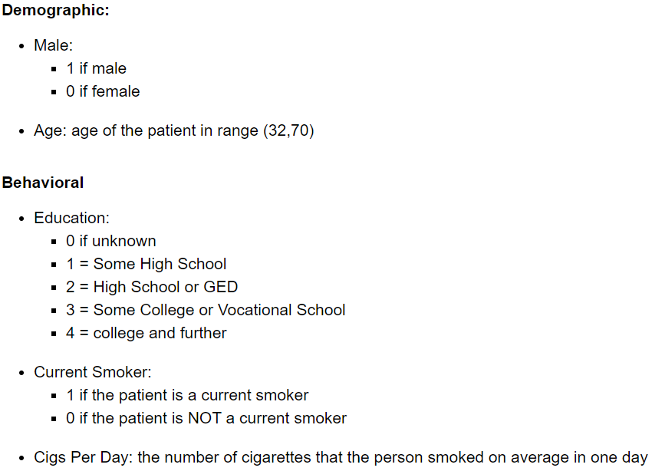
Initialization and Presentation of the dataset

Slide 6
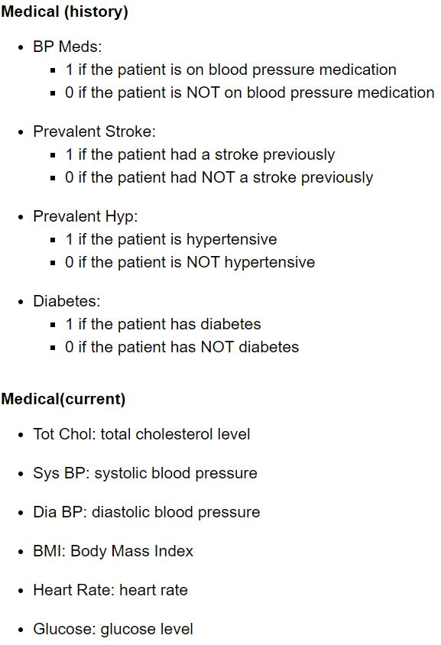
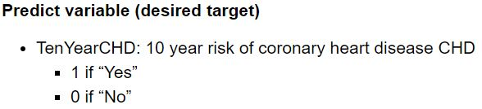
Initialization and Presentation of the dataset

Slide 7

Data Exploration
We can quite demonstrate that , for some of the variables, our dataset is enough balanced... but for other variables the dataset is NOT balanced
1st example: SMOKERS vs NON-smokers
2nd example: patients WITH diabetes vs withOUT diabetes
3rd example: patients WITH or withOUT risk of coronary heart disease CHD within 10 years

Slide 8
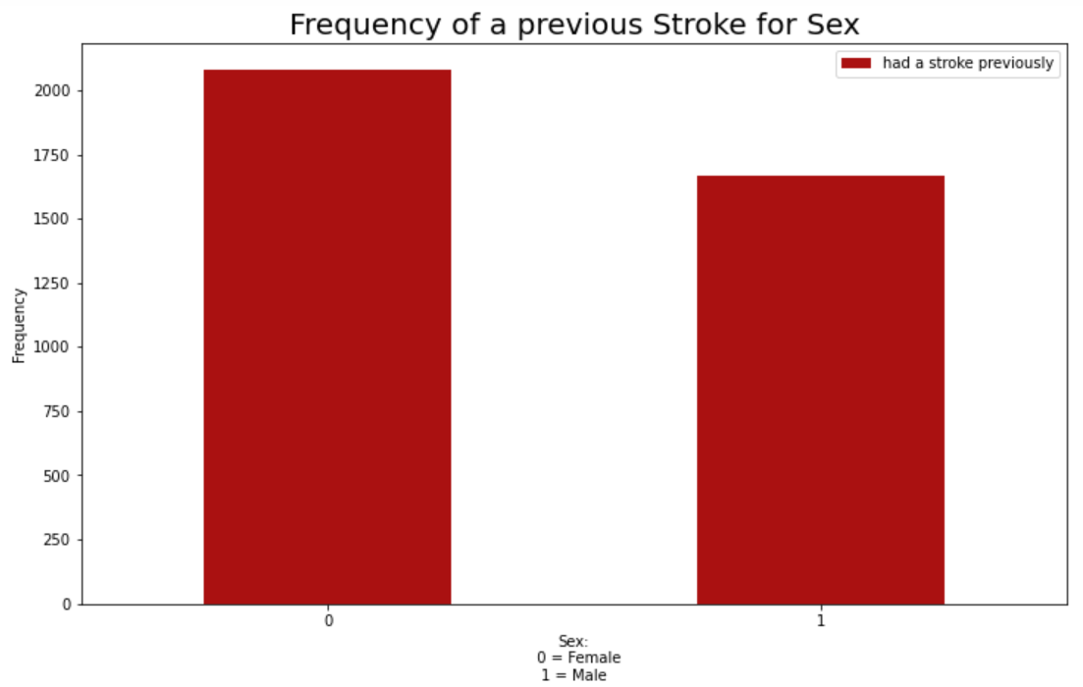
Data Exploration
4th example: frequency of a previous Stroke differentiated for Sex

Slide 9
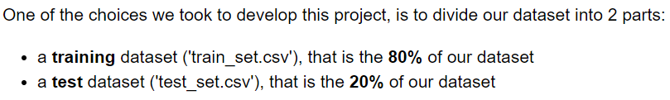
Modify and work on the dataset
Solve the inequality
In order to have equality between 0 and 1 belonging to the 'TenYearCHD' column, we delete some row representing patients whose risk is =0 (that is, patients witOUT risk of coronary heart disease CHD within 10 years), obtaining:
Normalization in range (0,1)
and normalize those values which are in a too large range (we need that all the values are in the range (0,1))

Slide 10
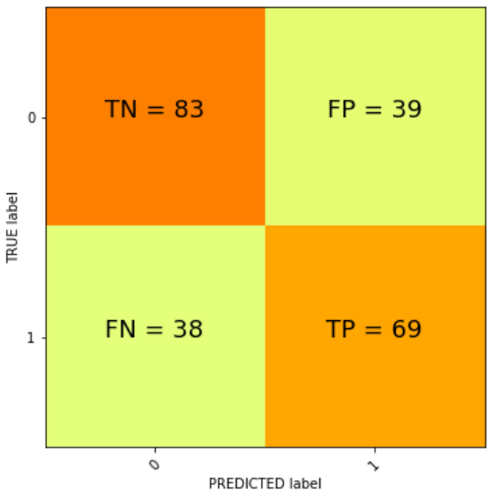
Prediction with Logistic Regression
Confusion Matrix
69 true True Positive predictions (that is, the prediction says that a patient RUNS the risk, and he really runs the risk!)
83 true True Negative predictions (that is, the prediction says that a patient DOESN'T run the risk, and he really DOESN'T run the risk!)
39 false False Positive predictions (that is, the prediction says that a patient RUNS the risk, but he doesn't really run the risk!)
38 false False Negative predictions (that is, the prediction says that a patient DOESN'T run the risk, but he really run the risk!)

Slide 11
Prediction with Logistic Regression
Precision
The percentage of the accuracy of our positive predictions, represented by the Precision,
is: 63.89%
Recall
The ratio of positive instances that are correctly detected by the classifier (true positive rate), represented by the Recall, is: 64.49%
F1-score
The F1-score, represented by the harmonic mean of precision and recall which, differently from the regular mean (that gives equal weight to all values), gives more weight to low values - favoring classifiers that have similar precision and recall - is: 64.19%

Slide 12
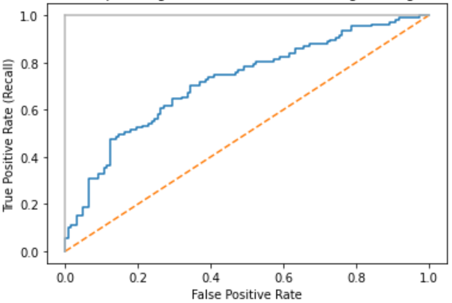
Prediction with Logistic Regression
Receiver Operating Characteristic (ROC) and Area Under the ROC Curve (AUC)
The Area Under the ROC curve (AUC) is: 0.7194
Accuracy
The overall predicted accuracy of the model is: 66.38%

Slide 13
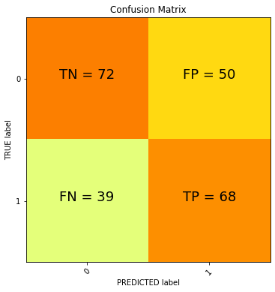
Prediction with K-Nearest Neighbour
Confusion Matrix
In this confusion matrix we have:
68 True Positive Predictions
72 True Negative Predictions
50 False Positive Predictions
39 False Negative Predictions

Slide 14
Prediction with K-Nearest Neighbour
Precision
The percentage of the accuracy of our positive predictions, represented by the Precision,
is: 57.63%
Recall
The ratio of positive instances that are correctly detected by the classifier (true positive rate), represented by the Recall, is: 63.55%
F1-score
The F1-score, represented by the harmonic mean of precision and recall which, differently from the regular mean (that gives equal weight to all values), gives more weight to low values - favoring classifiers that have similar precision and recall - is: 60.44%

Slide 15
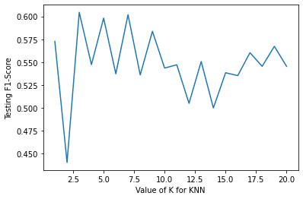
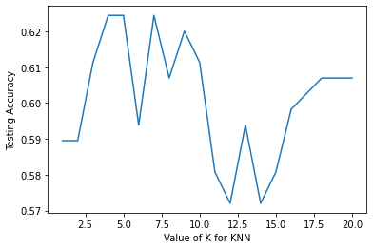
Prediction with K-Nearest Neighbour
Analyses F1 Score and Accuracy respect Number of Neighbour

Slide 16
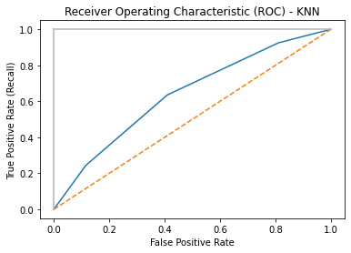
Prediction with K-Nearest Neighbour
Receiver Operating Characteristic (ROC) and Area Under the ROC Curve (AUC)
The Area Under the ROC curve (AUC) is: 0.6384
Accuracy
The overall predicted accuracy of the model is: 61.14%

Slide 17
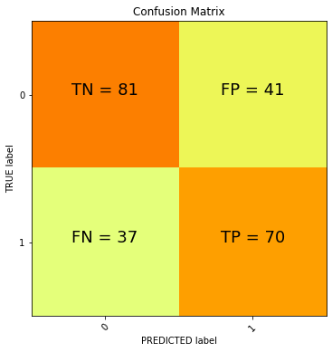
Prediction with Support Vector Machine
Confusion Matrix
In this confusion matrix we have:
70 True Positive Predictions
81 True Negative Predictions
41 False Positive Predictions
37 False Negative Predictions

Slide 18
Prediction with Support Vector Machine
Precision
The percentage of the accuracy of our positive predictions, represented by the Precision,
is: 63.06%
Recall
The ratio of positive instances that are correctly detected by the classifier (true positive rate), represented by the Recall, is: 65.42%
F1-score
The F1-score, represented by the harmonic mean of precision and recall which, differently from the regular mean (that gives equal weight to all values), gives more weight to low values - favoring classifiers that have similar precision and recall - is: 64.22%

Slide 19
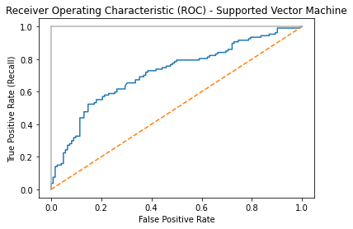
Prediction with Support Vector Machine
Receiver Operating Characteristic (ROC) and Area Under the ROC Curve (AUC)
The Area Under the ROC curve (AUC) is: 0.7164
Accuracy
The overall predicted accuracy of the model is: 65.94%

Slide 20
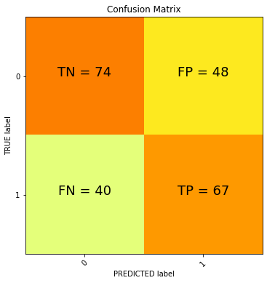
Prediction with Neural Networks
In this confusion matrix we have:
74 True Positive Predictions
67 True Negative Predictions
48 False Positive Predictions
40 False Negative Predictions

Slide 21
Prediction with Neural Networks
Precision
The percentage of the accuracy of our positive predictions, represented by the Precision,
is: 58.26%
Recall
The ratio of positive instances that are correctly detected by the classifier (true positive rate), represented by the Recall, is: 62.62%
F1-score
The F1-score, represented by the harmonic mean of precision and recall which, differently from the regular mean (that gives equal weight to all values), gives more weight to low values - favoring classifiers that have similar precision and recall - is: 60.36%

Slide 22
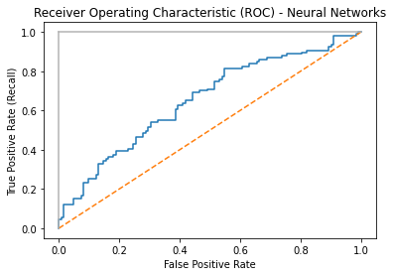
Prediction with Neural Networks
Receiver Operating Characteristic (ROC) and Area Under the ROC Curve (AUC)
The Area Under the ROC curve (AUC) is: 0.6522
Accuracy
The overall predicted accuracy of the model is: 61.57%

Slide 23
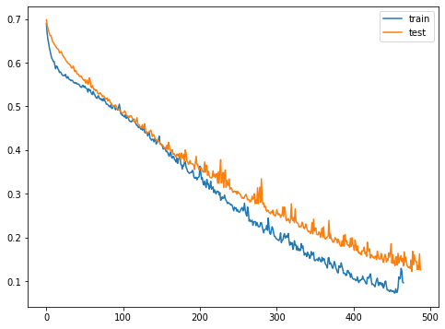
Prediction with Neural Networks
Loss curve (Loss value for Number of iterations)

Slide 24
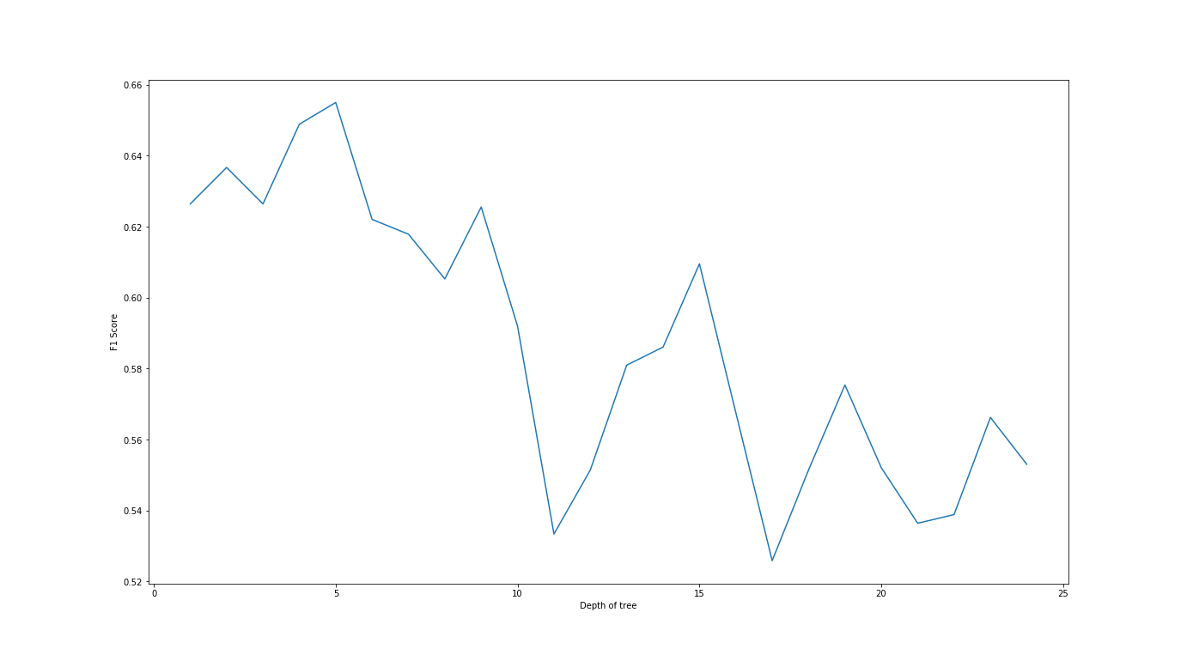
Depth Selection for Decision Tree

Slide 25
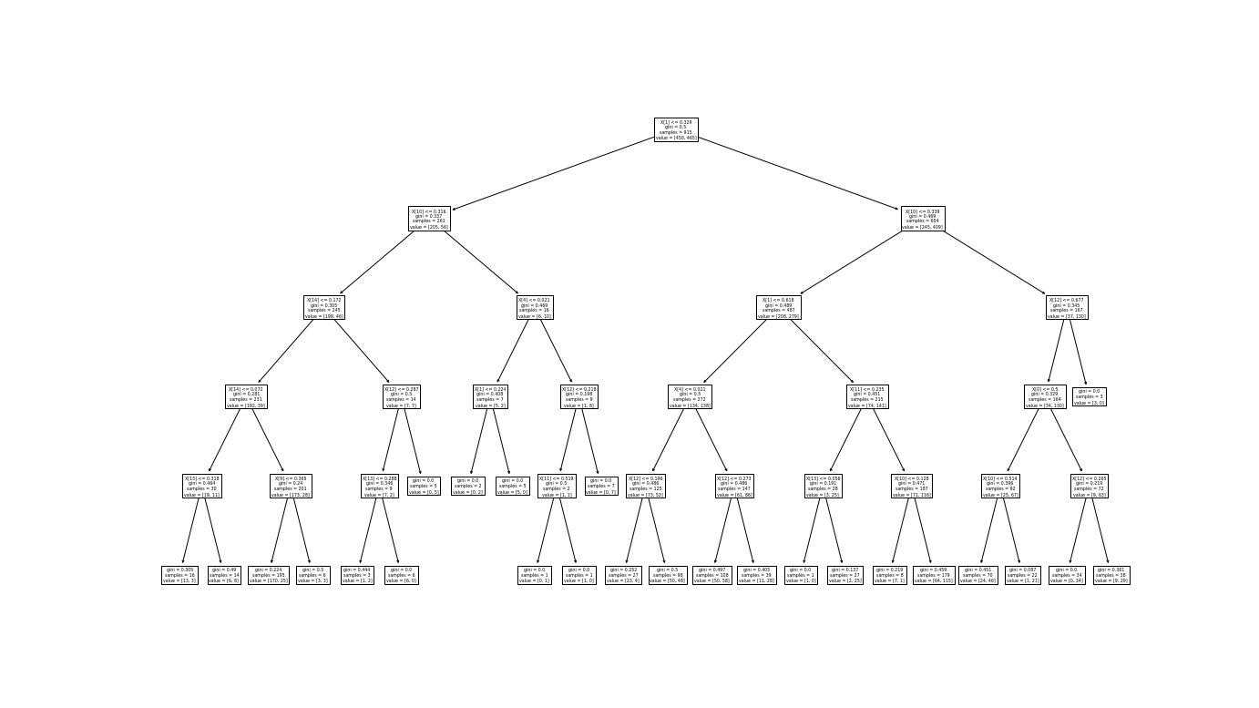
The Decision Tree

Slide 26
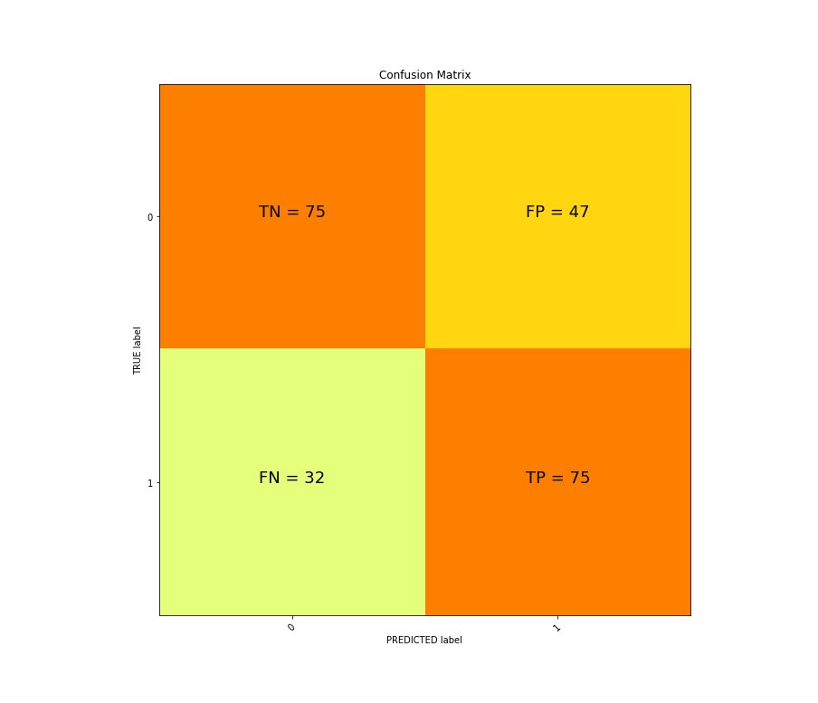
Prediction with Decision Trees
Confusion Matrix
The average confusion matrix for the best depth decision tree (depth 5) are as follows:
75 were correctly classified positive
75 were correctly classified negative
An average of 47 were incorrectly classified as positive
An average of 32 were incorrectly classified as negative

Slide 27
Prediction with Decision Trees
Precision:
The percentage of the accuracy of our positive predictions, represented by the Precision, is: 60.98%
Recall:
The ratio of positive instances that are correctly detected by the classifier (true positive rate), represented by the Recall, is: 70.09%
F1-Score:
The F1-score, represented by the harmonic mean of precision and recall which, differently from the regular mean (that gives equal weight to all values), gives more weight to low values - favoring classifiers that have similar precision and recall - is: 65.22%

Slide 28
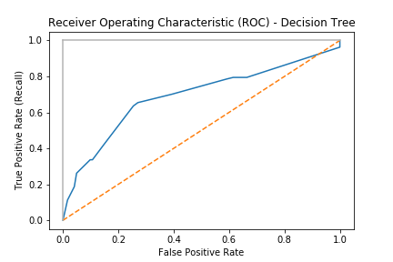
Prediction with Decision Trees
ROC, AUC and Accuracy
The curve to the right represents the ROC of our model.
The Area Under Curve is: 0.689
Accuracy:
he overall predicted accuracy of the model is: 65.07%

Slide 29

Prediction with Random Forest Classifiers
Confusion Matrix
The average confusion matrix for the trained Classifier has values
75 were correctly classified positive
74 were correctly classified negative
48 were incorrectly classified as positive
32 were incorrectly classified as negative

Slide 30
Prediction with Random Forest Classifiers
Precision:
The percentage of the accuracy of our positive predictions, represented by the Precision, is: 60.50%
Recall:
The ratio of positive instances that are correctly detected by the classifier (true positive rate), represented by the Recall, is: 67.29%
F1-Score:
The F1-score, represented by the harmonic mean of precision and recall which, differently from the regular mean (that gives equal weight to all values), gives more weight to low values - favoring classifiers that have similar precision and recall - is: 63.72%

Slide 31
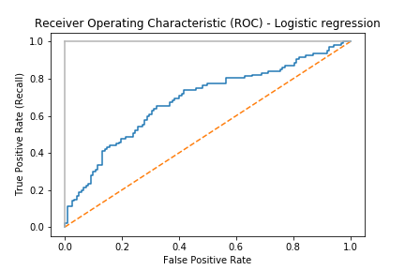
Prediction with Random Forest Classifiers
ROC, AUC and Accuracy
The curve to the right represents the ROC of our model.
The Area Under Curve is: 0.6844
Accuracy:
The overall predicted accuracy of the model is: 64.19%

Slide 32
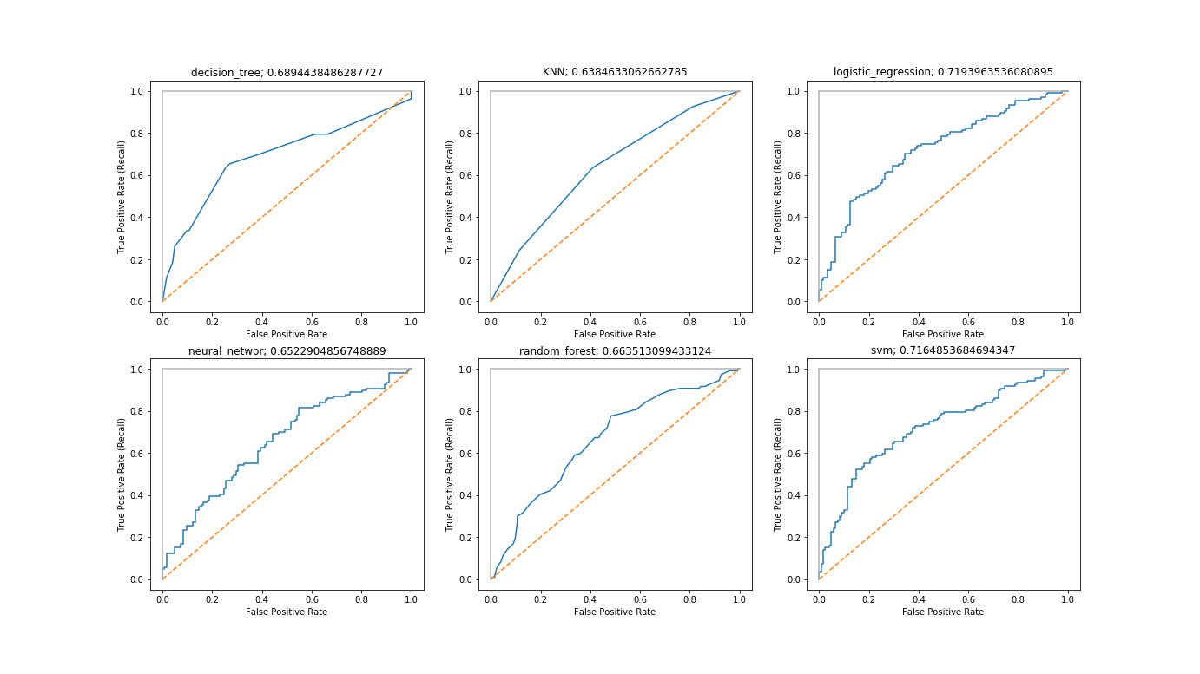
Model ROC Comparison

Slide 33
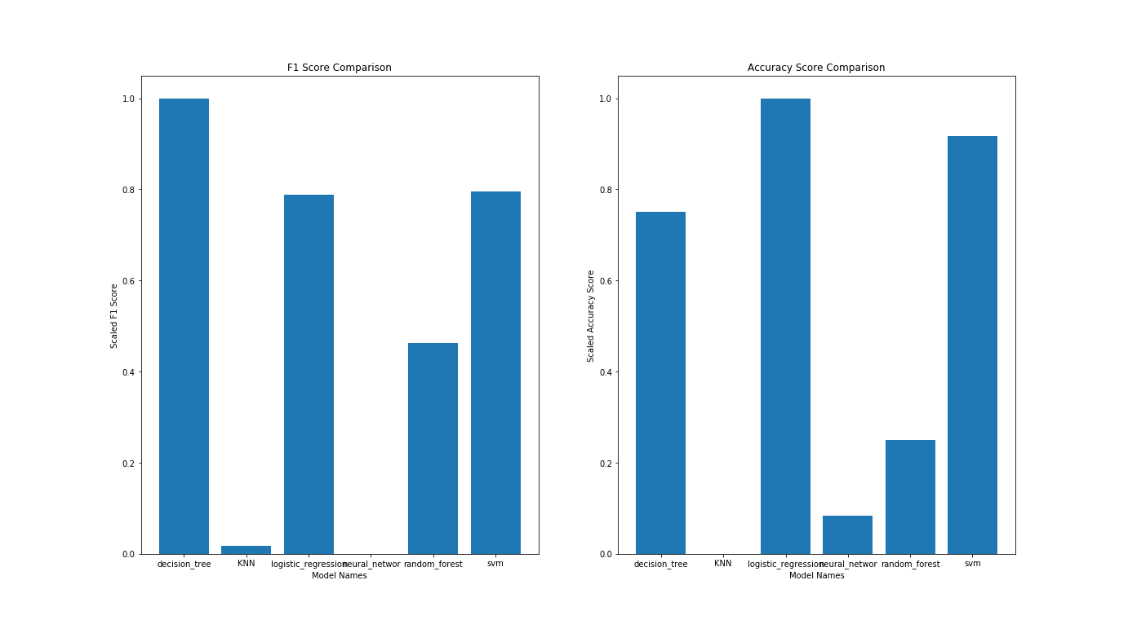
F1 and Accuracy Comparisons

Slide 34
Thank you all for your attention
Any questions are kindly welcome!

Slide 35
References and Bibliography
Article from World Health Organization web-site:
https://www.who.int/en/news-room/fact-sheets/detail/cardiovascular-diseases-(cvds)
DataSet resources:
https://www.kaggle.com/dileep070/heart-disease-prediction-using-logistic-regression

