Slide 1
FINAL PROJECT
Can we predict , within 10 years, whether or not a person sees the risk to get coronary heart disease?
by
Antonio Zappia, Flavia Penta, Gabriel Radu Taranciuc

Slide 2
Introduction
World Health Organization has estimated 12 million deaths occur worldwide, every year due to Heart diseases; in fact, Cardiovascular diseases are the number 1 cause of death globally!
The early predictions of cardiovascular diseases can make lifestyle changes in high risk patients, and it can reduce the complications.
This project intend to prove the correlation between current behaviours of a person, and his future risk of heart disease, using --models--

Slide 3
Summary
1. Initialization
2. Show our dataset
3. Data Exploration
4. Modify and work on the dataset

Slide 4
Initialization and Presentation of the dataset
The dataset consist of an ongoing cardiovascular study on residents of the town of Framingham, Massachusetts.
We have a dataset consisting of 3749 rows and 16 columns.
The shown attributes are divided in:
Demographic attributes
Behavioral attributes
Medical attributes (history)
Medical attributes (current)
Predict variable (desired target)

Slide 5
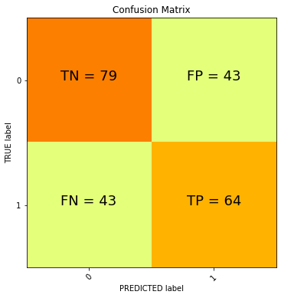
Prediction with K-Nearest Neighbour
Measures
Confusion Matrix:
Precision: 59.81%
Recall: 59.81%
F1-Score: 59.81%
Why this?
$$P=TP/(TP+FP)$$
$$R=TP/(TP+FN)$$

Slide 6
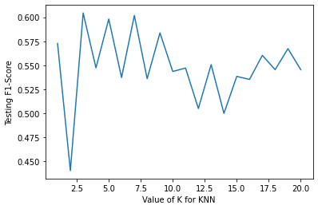
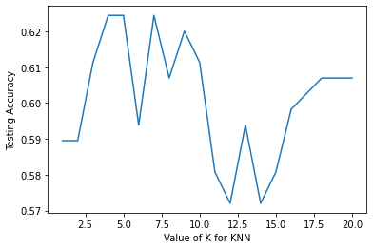
Prediction with K-Nearest Neighbour
Analyses F1 Score and Accuracy

Slide 7
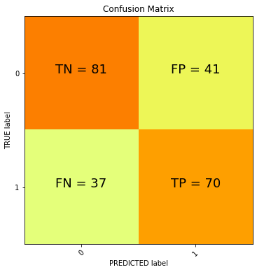
Prediction with Supported Vector Machine
Confusion Matrix:
Precision: 63.06%
Recall: 65.42%
F1-Score: 64.22%
Accuracy: 66%
Area Under ROC Curve: 0.71

Slide 8
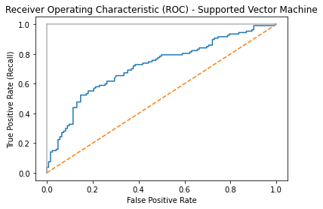
Prediction with Supported Vector Machine
Plot ROC Curve:

Slide 9
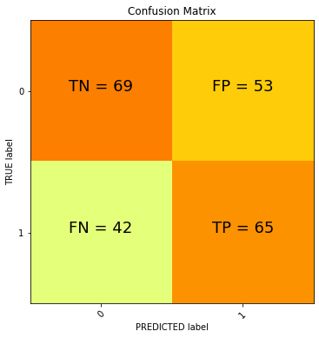
Prediction with Neural Networks
Confusion Matrix:
Precision: 55.1%
Recall: 60.75%
F1-Score: 57.08%
Accuracy: 58.52%
Area Under ROC Curve: 0.64

Slide 10
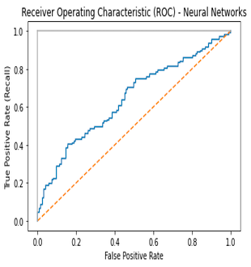
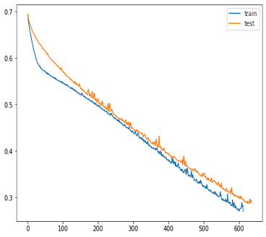
Prediction with Neural Networks
Plot ROC Curve:
LOSS Curve:
Scrivi per inserire una didascalia.

