Slide 1

Elo Kaggle Challenge
- Final Results Group 6 -
Tarazali Ryskul 742820 s_ryskul18@stud.hwr-berlin.de
Sara Sommerfeld 353391 s_sommerfeld18@stud.hwr-berlin.de
Polina Voroshylova 743340 s_voroshylova18@stud.hwr-berlin.de

Slide 2






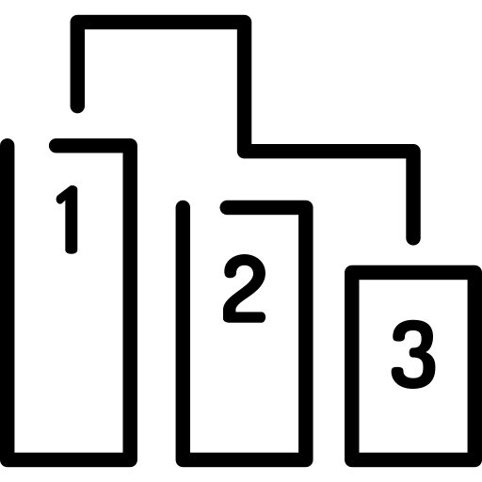

Our approach to solve the Elo Challenge
1.
2.
3.
4.
5.
6.
7.
8.
Project Understanding
Data Loading
EDA
Data Preprocessing
Data Cleaning
Modeling
Feature Importance
Model Submission
Notes:
1.Introduction 1.1 Understanding the Challenge of the Competition 1.2 Understanding the Meaning of the Data 2. Data Loading 3. Exploratory Data Analysis of Datasets 3.1 Exploration of Train and Test Data 3.2 Exploration of other Data Sources 3.2.1 Merchant.csv 3.2.2 History_transactions.csv 3.2.3 Feature Analysis 4. Data Preprocessing 5. Data Cleaning 6. Models 6.1 Decision Tree Regressor 6.2 Random Forest 7. Model Submission 8. Conclusion

Slide 3
1. Project Understanding

Slide 4


Project Understanding: Data Overview and Challenge
train.csv
historical_transactions.csv
test.csv
merchants.csv
sample_submission.csv
new_merchant_transactions.csv
customer loyalty
Target
Notes:
train.csv - the training set
test.csv - the test set
sample_submission.csv - a sample submission file in the correct format - contains all card_ids you are expected to predict for.
historical_transactions.csv - up to 3 months' worth of historical transactions for each card_id
merchants.csv - additional information about all merchants / merchant_ids in the dataset.
new_merchant_transactions.csv - two months' worth of data for each card_id containing ALL purchases that card_id made at merchant_ids that were not visited in the historical data
Target: customer loyalty

Slide 5
2. Data Loading

Slide 6
Data Loading and Size Reduction
def reduce_mem_usage(df, verbose=True): numerics = ['int16', 'int32', 'int64', 'float16', 'float32', 'float64'] start_mem = df.memory_usage().sum() / 1024**2 for col in df.columns: col_type = df[col].dtypes if col_type in numerics: c_min = df[col].min() c_max = df[col].max() if str(col_type)[:3] == 'int': if c_min > np.iinfo(np.int8).min and c_max < np.iinfo(np.int8).max: df[col] = df[col].astype(np.int8)
...
Mem. usage decreased to 4.04 Mb (56.2% reduction) Mem. usage decreased to 2.24 Mb (52.5% reduction) Mem. usage decreased to 1749.11 Mb (43.7% reduction) Mem. usage decreased to 114.20 Mb (45.5% reduction) Mem. usage decreased to 30.32 Mb (46.0% reduction)

Slide 7
3. Exploratory Data Analysis (EDA)
Notes:
POLINA - WHOLE CHAPTER

Slide 8
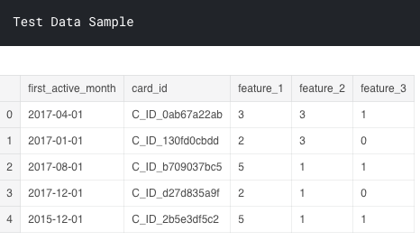
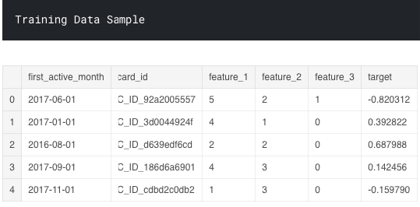
EDA: Train and Test Data
Target Variable

Slide 9
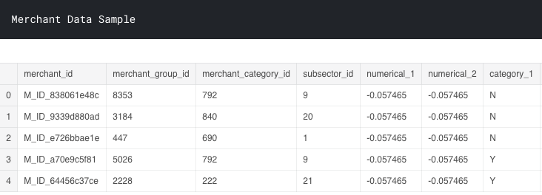
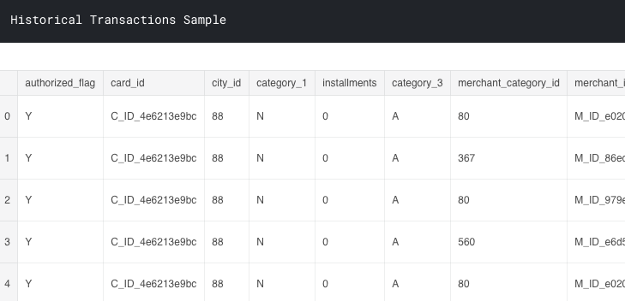
EDA: Merchant and Historical Transaction Data

Slide 10
Missing Values Check: Train Data
Train Data Your data contains 6 columns and has 0 columns with missing values
print('Train Data');display(missing_values(df_train))
print('Test Data');display(missing_values(df_test)) print('New Merchants');display(missing_values( df_new_merchant_trans)) print('Historical Transactions');display(missing_values( df_hist_trans)) print('Merchants');display(missing_values(df_merchants))

Slide 11
Missing Values: Overview of Analysis
Train Data
Test Data
New Merchants
Historical Transactions
Merchants
Train Data Your data contains 6 columns and has 0 columns with missing values
Test Data Your data contains 5 columns and has 1 column with missing values
New Merchants Your data contains 14 columns and has 3 columns with missing values
Historical Transactions Your data contains 14 columns and has 3 columns with missing values
Merchants Your data contains 22 columns and has 4 columns with missing values

Slide 12
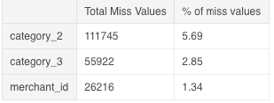
Missing Values: New Merchants Example
Train Data
Test Data
New Merchants
Historical Transactions
Merchants
Train Data Your data contains 6 columns and has 0 columns with missing values
Test Data Your data contains 5 columns and has 1 column with missing values
New Merchants Your data contains 14 columns and has 3 columns with missing values
Historical Transactions Your data contains 14 columns and has 3 columns with missing values
Merchants Your data contains 22 columns and has 4 columns with missing values

Slide 13
EDA: Feature Analysis
... sns.distplot( df_train.feature_1,ax=axes[0], kde = False, color = 'green', bins=10).set_title("Train Data") sns.distplot( df_test.feature_1,ax=axes[1], kde = False, color = 'red', bins=10).set_title("Test Data") axes[0].set(ylabel='Card Counts')
...
plt.show()
Notes:
here is piece of code as an example for each following diagram

Slide 14
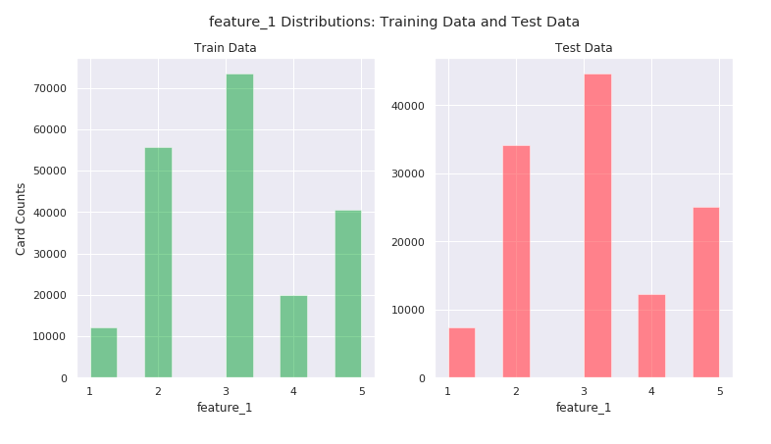
EDA: Feature Analysis

Slide 15
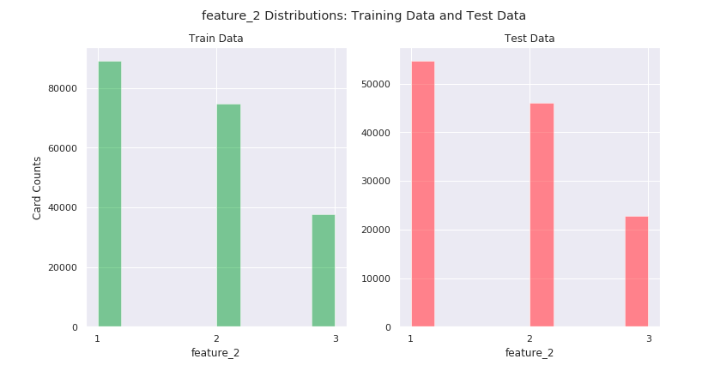
EDA: Feature Analysis

Slide 16
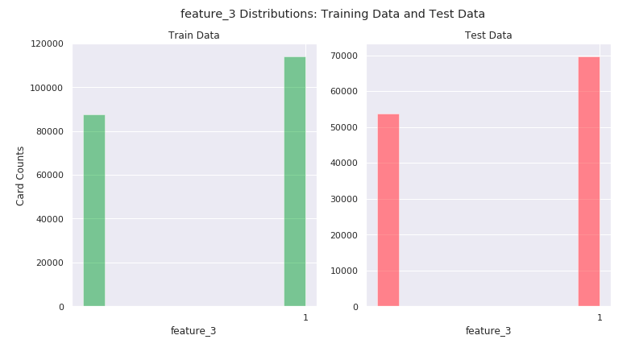
EDA: Feature Analysis

Slide 17
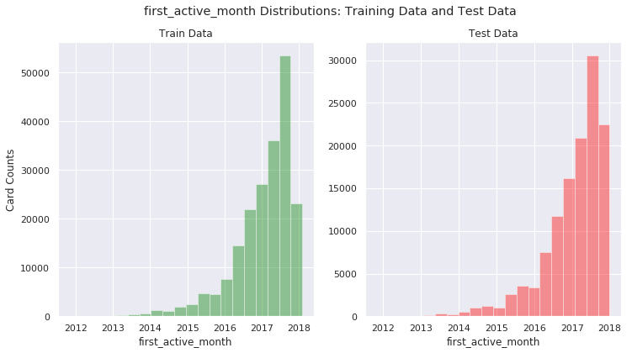
EDA: Feature Analysis

Slide 18
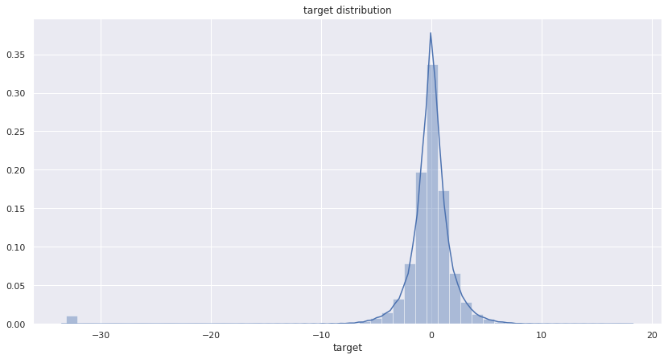
EDA: Distribution of Target Variable

Slide 19
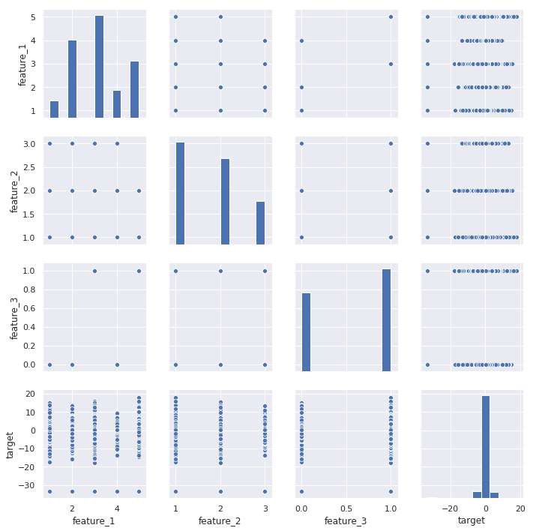
EDA: Correlation of Features and Target Variable

Slide 20
EDA: Correlation of Features and Target Variable

Slide 21
Column Analysis: purchase_amount
df_hist_trans.purchase_amount.describe()
count 2.911236e+07 mean 6.134567e-02 std 1.123521e+03 min -7.469078e-01 25% -7.203559e-01 50% -6.883495e-01 75% -6.032543e-01 max 6.010604e+06

Slide 22
Column Analysis: purchase_amount
df_hist_trans.purchase_amount.describe()
count 2.911236e+07 mean 6.134567e-02 std 1.123521e+03 min -7.469078e-01 25% -7.203559e-01 50% -6.883495e-01 75% -6.032543e-01 max 6.010604e+06

Slide 23
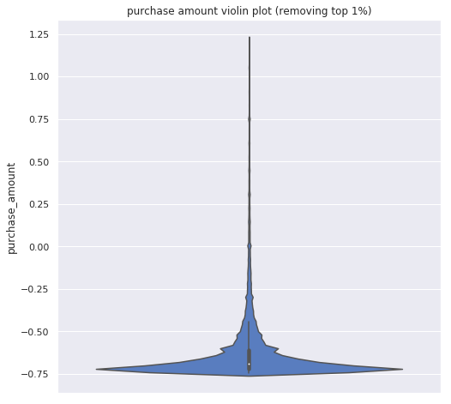
Column Analysis: purchase_amount
np.percentile(df_hist_trans
["purchase_amount"].values,q=99)
1.2208409547805337

Slide 24
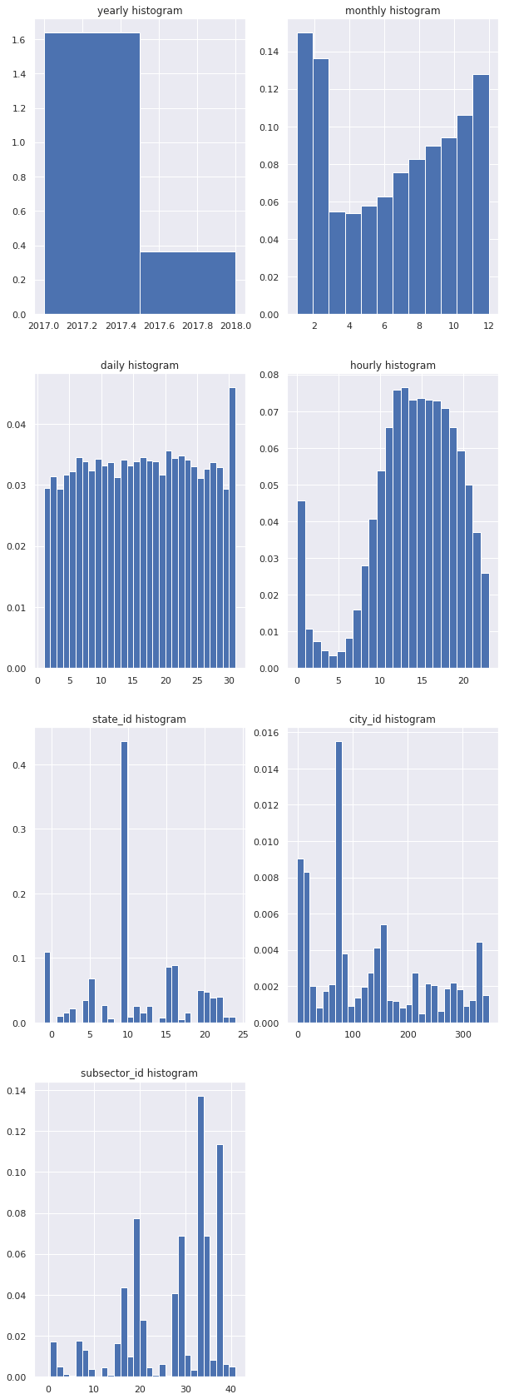
Feature Analysis: Yearly and Monthly Histogram

Slide 25
Feature Analysis: Daily and Hourly Histogram

Slide 26
Feature Analysis: state_id and city_id Histogram

Slide 27
Feature Analysis: subsector_id Histogram

Slide 28
4. Data Preprocessing

Slide 29
Data Preprocessing
def aggregate_historical_transactions(history): ... agg_func = { 'authorized_flag': ['sum', 'mean'], 'merchant_id': ['nunique'], 'city_id': ['nunique'], 'state_id': ['nunique'], 'purchase_amount': ['sum', 'median', 'max', 'min', 'std'], 'installments': ['sum', 'median', 'max', 'min', 'std'], 'purchase_date': [np.ptp], ...
}
Notes:
new merch + hist, verschmelzen miteinander, weil sie ähnlich sind. Fügen Sie neue Spalten zur Modellverbesserung hinzu

Slide 30
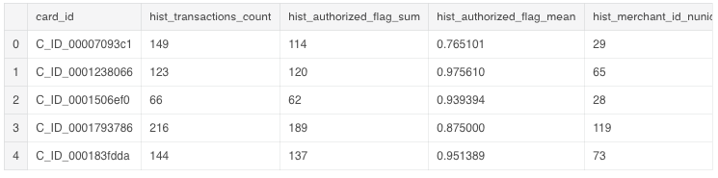
Data Preprocessing
def aggregate_historical_transactions(history): ... agg_func = { 'authorized_flag': ['sum', 'mean'], 'merchant_id': ['nunique'], 'city_id': ['nunique'], 'state_id': ['nunique'], 'purchase_amount': ['sum', 'median', 'max', 'min', 'std'], 'installments': ['sum', 'median', 'max', 'min', 'std'], 'purchase_date': [np.ptp], ...
}

Slide 31
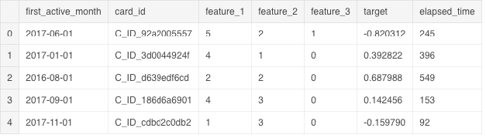
Data Preprocessing: elapsed_time Value Creation
from datetime import datetime df_train['elapsed_time'] = (datetime(2018, 2, 1) - df_train['first_active_month']).dt.days df_test['elapsed_time'] = (datetime(2018, 2, 1) - df_test['first_active_month']).dt.days

Slide 32
Data Preprocessing: Table Merging
df_train = pd.merge(df_train, new_history, on='card_id', how='left') df_test = pd.merge(df_test, new_history, on='card_id', how='left') df_train = pd.merge(df_train, new_merchants, on='card_id', how='left') df_test = pd.merge(df_test, new_merchants, on='card_id', how='left')
df_train.shape, df_test.shape
((201917, 50), (123623, 49))

Slide 33
5. Data Cleaning

Slide 34
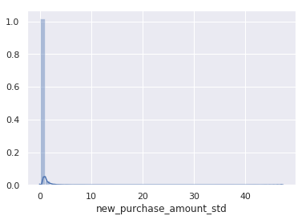
Data Cleaning
sns.distplot(df_train['new_purchase_amount_std'].dropna())
Notes:
on a new purchase amount std example

Slide 35
Data Cleaning
sns.distplot(df_train['new_purchase_amount_std'].dropna())
sns.distplot(df_train['new_purchase_amount_std'].fillna(df_train['new_purchase_amount_std'].mean()))
Your data contains 48 columns and has 0 columns with missing values
Notes:
on a new purchase amount std example

Slide 36
6. Modeling

Slide 37
Linear Models: Why we used Linear, Ridge and Lasso Regression
Linear Regression
Ridge Regression
Lasso Regression
Linear regression is the simplest form to be used for supervised learning particularly useful in order to predict quantitative responses.
Ridge regression shrinks the coefficients and it helps to reduce the model complexity and multi-collinearity.
Lasso regression not only helps in reducing overfitting but it can help us in the feature selection.
Notes:
Reasons of why use ridge and lass:
For example, if your number of observations n is greater than the number of predictors p, then the least squares estimates will have a low variance and it performs well. On the other hand, with p is greater than n (more predictors than observations), then variance is infinite and the method cannot be used!
Also, multiple liner regression tends to add variables that are not actually associated with the response. This adds unnecessary complexity to the model. It would be good if there was a way to automatically perform feature selection, such as to include only the most relevant variables.
OLS doesn’t consider which independent variable is more important than others. It simply finds the coefficients for a given data set. In short, there is only one set of betas to be found, resulting in the lowest ‘Residual Sum of Squares (RSS)’. The question then becomes “Is a model with the lowest RSS truly the best model?”.

Slide 38
Non-linear Models: Why we used Trees and Random Forest
Decision Tree
Random Forest
Can handle both numerical and categorical values.
Perform well on large datasets.
Are extremely fast.
Resistant to outliers, hence require little data preprocessing.
Applied to build a number of decision trees on bootstrapped training samples.
Random subsets of features considered when the nodes are splitted.
Source: ISLR Book
Notes:
Another difference is that „deep“ decision trees might suffer from overfitting. Random Forest prevents overfitting most of the time, by creating random subsets of the features and building smaller trees using these subsets. Afterwards, it combines the subtrees. Note that this doesn’t work every time and that it also makes the computation slower, depending on how many trees your random forest builds.
Random Forest is also considered as a very handy and easy to use algorithm, because it’s default hyperparameters often produce a good prediction result.
And of course Random Forest is a predictive modeling tool and not a descriptive tool. That means, if you are looking for a description of the relationships in your data, other approaches would be preferred.
Random Forest is a great algorithm to train early in the model development process, to see how it performs and it’s hard to build a “bad” Random Forest, because of its simplicity. This algorithm is also a great choice, if you need to develop a model in a short period of time. On top of that, it provides a pretty good indicator of the importance it assigns to your features.
Random Forests are also very hard to beat in terms of performance. Of course you can probably always find a model that can perform better, like a neural network, but these usually take much more time in the development. And on top of that, they can handle a lot of different feature types, like binary, categorical and numerical.

Slide 39
Modeling: How we applied the selected Models
Linear Regression
Ridge Regression
Lasso Regression
Decision Tree Regressor
Random Forest
Cross validation
Fitting model
Tuning params with GridSearchCV
Fitting model with best params
Tuning params with GridSearchCV
Fitting model with best params
Fitting model with our own parameter values
Tuning parameters with GridSearchCV
Fitting model with best params
Fitting model with own params values
Fitting model with best params tuned by Randomized SearchCV
Fitting model with best params tuned by Randomized SearchCV

Slide 40
Results of Modeling: Comparison of RMSE
Linear Regression
Ridge Regression
Lasso Regression
RMSE: 3.7718
RMSE: 3.7983
RMSE: 3.7987
Best RMSE
Decision Tree Regressor
Random Forest
RMSE: 3.7638
RMSE: 3.7419

Slide 41
7. Feature Importance

Slide 42
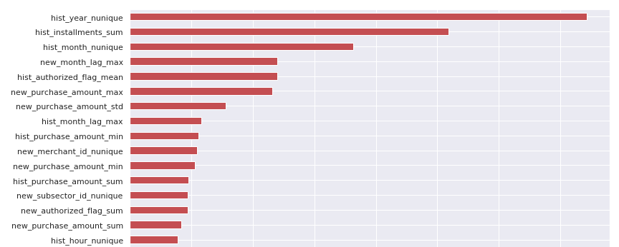
Feature Importance: Overview

Slide 43
8. Model Submission and Conclusion

Slide 44





Our main Challenges during the Project
Replacement of missing values
Some columns could not be replaced with the function of mean/median/min.
Main Challenges
New feature creation
First time to create new features to fit model with difficult identification of necessary features.
Application of best models
Opportunity to apply knowledge from class while choosing the best models for the challenge.
Reduction of memory
Large dataset had to be reduced in size in order to not “crash” the server constantly.

Slide 45
Result and Conclusion
Best Model
RANDOM FOREST
Result
RMSE: 3.759
Leaderboard
→ 2116 out of 3141 participants (status 28th January 2019)

Slide 46
THANK YOU

