Slide 1
Beshbarmaq about kazakh cuisine
prepared by
aibolat batyrov & tarazi azretaly

Slide 2
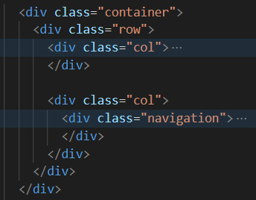
technologies used
Bootstrap Grid System

Slide 3
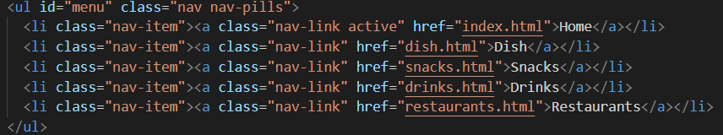
technologies used
Bootstrap Menu (Navigation)

Slide 4
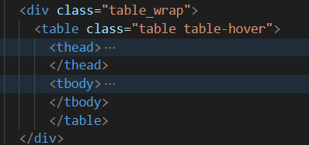
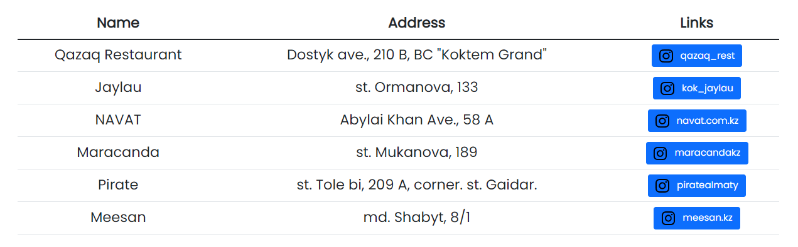
technologies used
Bootstrap Table Class

Slide 5

technologies used
Bootstrap Button Class

Slide 6
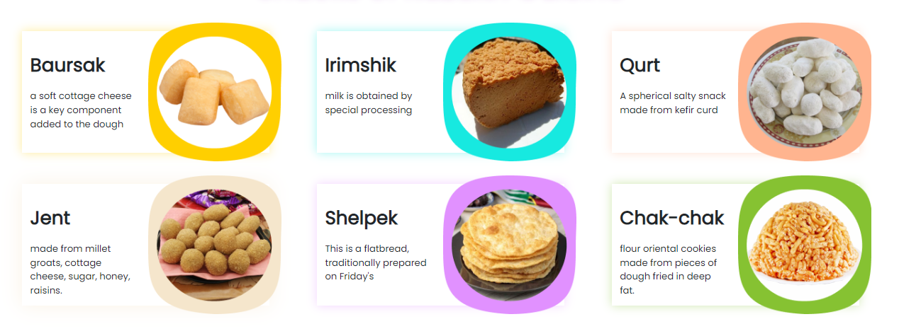
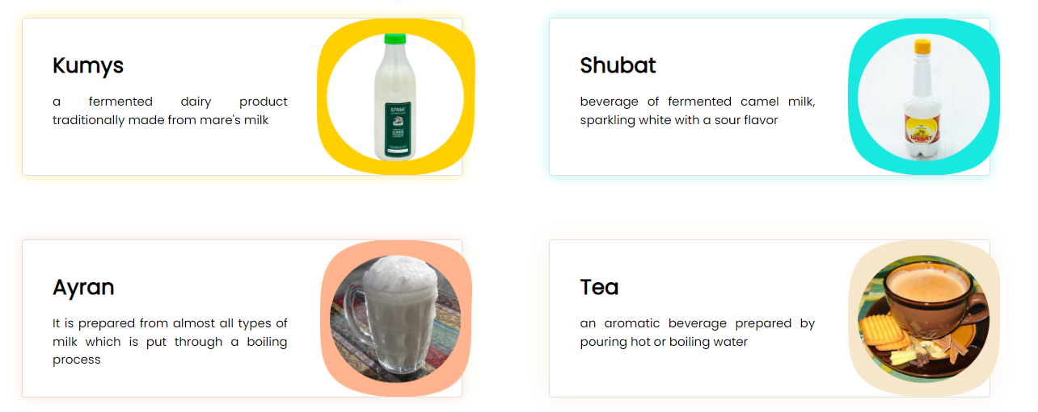
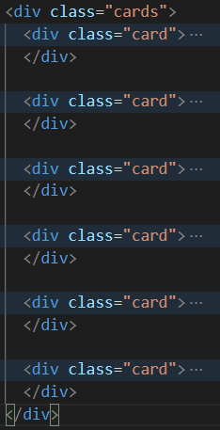
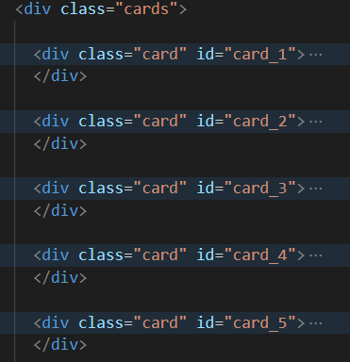
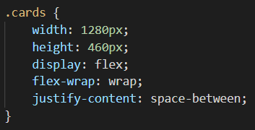
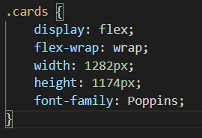
technologies used
Flexboxes

Slide 7
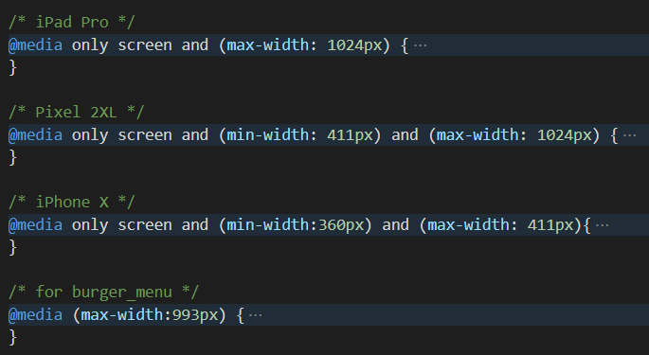
technologies used
@media Query
Using @media Query the site is adapted for tablet and smartphone.
For Apple iPad Pro [ 1024x1366 ]
For Apple iPhone X [ 375x812 ]
For Google Pixel XL [ 411x823 ]

Slide 8
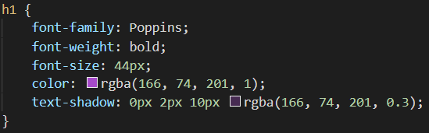
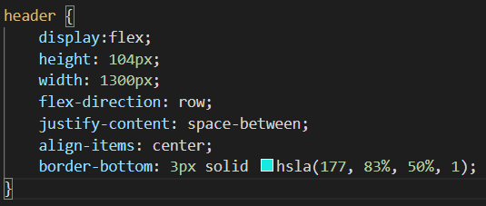

technologies used
Color properties
rgba
hsla
hex

Slide 9
Github repo
https://github.com/Ai-Batyrov/midterm_project.git - Aibolat Batyrov’s repository
https://github.com/Tarazi77/midtermProject.git - Tarazi Azretaly’s repository

