Slide 1

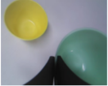
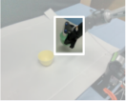
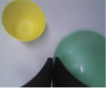
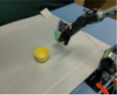
Recon. Part
Action Part
Predicted Noise
Condition
ε
=
𝒟
(z
;
h
, t)
h
h
t
R
R
A
translation
Diffusion
Denoiser
Large Language Model
LLM
rotation
𝒟
gripper
z
h
h
× n
t
I
S
Noise ε
Projector
𝒫
Textual
Tokenizer
𝒯
System Token
z
0
Image Token
Instr. Token
Visual Tokenizer
ℱ
Vision Encoder
ℰ
Recon. Token
Action Token
Scene Token
Noisy Token
"put the green bowl
on the yellow bowl."
Trainable
Frozen
Notes:
素材ID：AI-077
论文：ReconVLA: Reconstructive Vision-Language-Action Model as Effective Robot Perceiver
会议：AAAI 2026
奖项：Outstanding Paper
图号：Figure 3，PDF第3页
类型：系统架构
借鉴点：并列视觉重建支路和动作支路，用噪声token、条件token及原始场景串起监督关系。
论文URL：https://arxiv.org/abs/2508.10333
官方获奖URL：https://aaai.org/about-aaai/aaai-awards/aaai-conference-paper-awards-and-recognition/
原始论文与绘图来源：见本页论文链接及仓库 catalog/papers.md。

