Slide 1
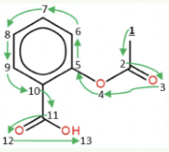
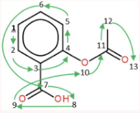





(b) ProfileVAE Training
Latent space of
gene expression profile
High
Encoder
Decoder
Low- and high-expressed
gene expression profile
Low
Reconstructed gene expression profile
Molecular-induced
Extracted gene features as conditions
(a) Effect of molecules
(c) MolVAE Training
Latent space of SMILES
representations
Canonical representation
Variant representation
Reconstructed molecule
Variant SMILES
GRU
Encoder
GRU
Decoder
Teacher forcing
CC(=O)Oc1ccccc1C(=O)O
c1cc(c(cc1)C(O)=O)OC(C)=O
c1cc(c(cc1)C(O)=O)OC(C)=O
Effect of the molecule
(d) Hit-like generation
Candidate hit-like molecule generation
Training phase:
Test phase:
Candidate
molecules
Variant SMILES:
Regular gene expression profile
Other operations:
Notes:
素材ID：AI-078
论文：GxVAEs: Two Joint VAEs Generate Hit Molecules from Gene Expression Profiles
会议：AAAI 2024
奖项：Outstanding Paper
图号：Figure 1，PDF第3页
类型：系统架构
借鉴点：通过基因表达VAE和条件分子VAE连接生物表型与结构生成，分层标记训练与推理阶段。
论文URL：https://ojs.aaai.org/index.php/AAAI/article/view/29248
官方获奖URL：https://aaai.org/about-aaai/aaai-awards/aaai-conference-paper-awards-and-recognition/
原始论文与绘图来源：见本页论文链接及仓库 catalog/papers.md。

